Slide 1
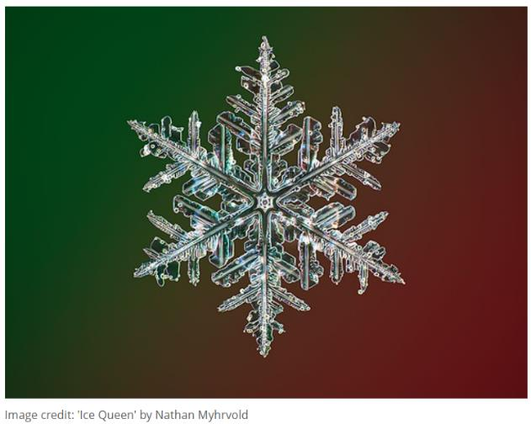
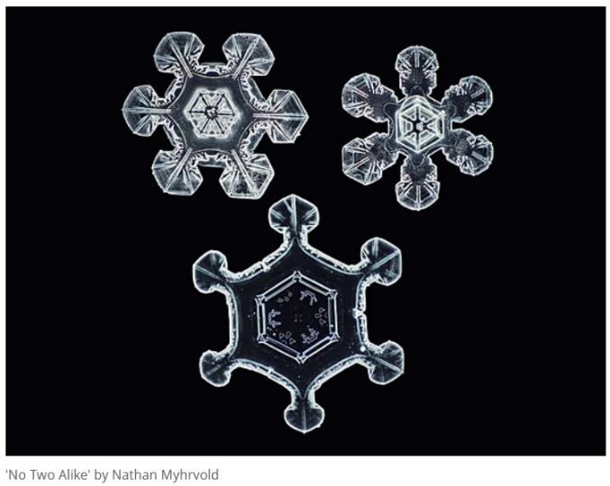
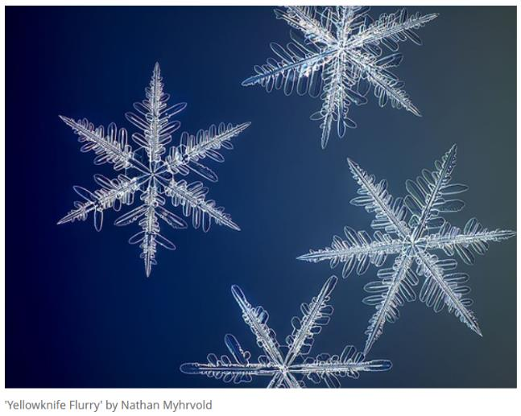
Day 1: Spot patterns and predict or extend sequences.
Expressive art Pattern
Snowflakes do not grow randomly, they grow according to a pattern or rule.
Notes:
Images from https://www.dpreview.com/news/2899775234/photographer-captures-the-highest-resolution-snowflake-photos-in-the-world

Slide 2
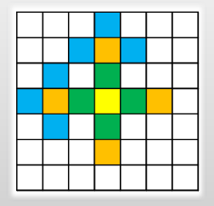
Day 1: Spot patterns and predict or extend sequences.
Expressive art Pattern
Today we are going to create our own snowflakes.
First, we colour one square in the middle.
Then we colour 4 squares in green which touch our yellow square by JUST one side.
Then we colour another 4 squares in orange which touch each of our green squares by just one side.
Then we will be able to colour three blue squares around each orange square.
Remember, we ONLY colour new squares which touch a coloured square along one side!

Slide 3
Day 1: Spot patterns and predict or extend sequences.
Expressive art Pattern
Remember, we ONLY colour new squares which touch a coloured square along one side!
Check the number of squares you colour in.
1st colour | 1 square
2nd colour | 4 squares
3rd colour | 4 squares
4th colour | 12 squares
5th colour | 4 squares
6th colour | 12 squares
7th colour | 12 squares
8th colour | 36 squares
9th colour | 4 squares

Slide 4
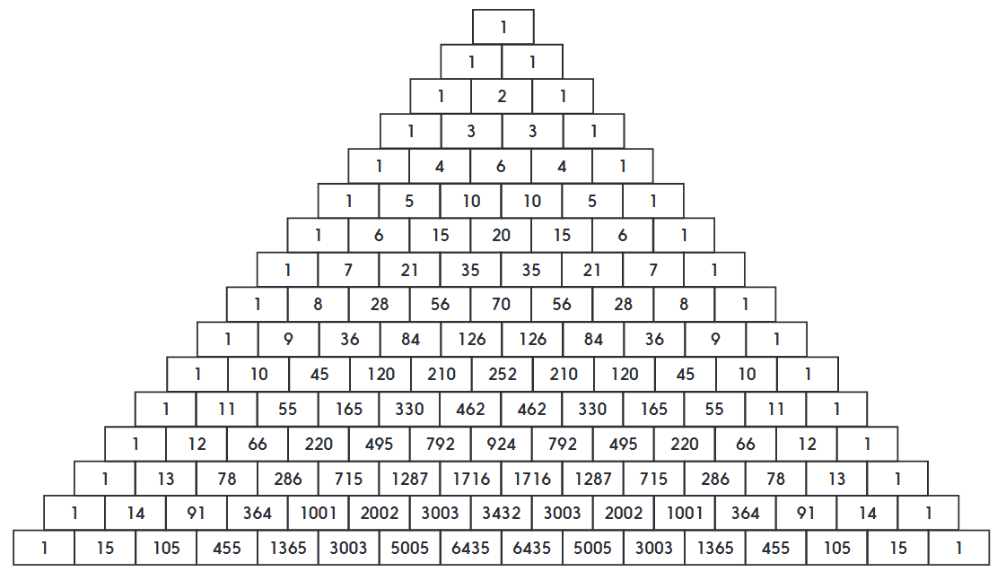
Day 1: Spot patterns and predict or extend sequences.
Expressive art Pattern
Watch what happens when we colour in the odd numbers.
Can you see any triangles?
Notes:
Briefly explain how Pascal's triangle is created – each number is the sum of the two above.

Slide 5
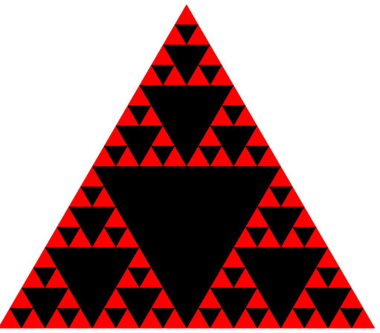
Day 1: Spot patterns and predict or extend sequences.
Expressive art Pattern
Watch this animation and see if you can work out the rule.
Can you see any similarities with the previous patterns of odd and even numbers?
Notes:
Click on the triangle to go to https://en.wikipedia.org/wiki/Sierpinski_triangle#/media/File:Animated_construction_of_Sierpinski_Triangle.gif

Slide 6
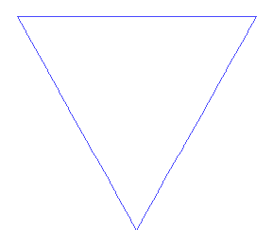
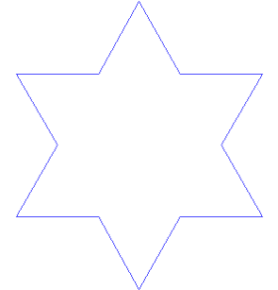
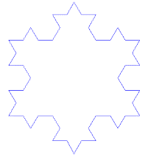
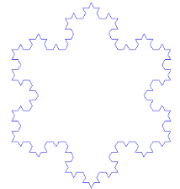
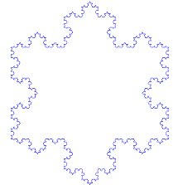
Day 1: Spot patterns and predict or extend sequences.
Expressive art Pattern
Can you work out the rule for creating this pattern?
You can see an animation of this pattern, clicking HERE
Notes:
If this grabs children’s interest, enter ‘fractals in nature’ into a search engine and see what other fractals you can find…

