Slide 1
Fractions and Decimals Decimals and Money
Day 1
Y3: Mark amounts of money on a line; round to the nearest £1.
Y4: Mark 1-place decimals on a number line; round to the nearest whole number.

Slide 2
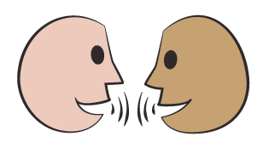
Day 1 Y3: Mark amounts of money on a line; round to the nearest £1.
Y4: Mark 1-place decimals on a number line; round to the nearest whole number.
0
1
2
3
4
5
6
7
8
9
10
2.5
3.9
5.6
7.3
8.1
Let’s check…
7.3 or 7 and 3 tenths
Which number would go here on this line? Remember… each whole number can be split into tenths.
Talk to your neighbour. Where would 5.6, 2.5, 3.9 and 8.1 go on this line?
Notes:
Teaching with Y3 and Y4
NB focus questions on Y4 but ask Y3 children to pay good attention because they will be using the same ideas later.

Slide 3
Day 1 Y3: Mark amounts of money on a line; round to the nearest £1.
Y4: Mark 1-place decimals on a number line; round to the nearest whole number.
0
1
2
3
4
5
6
7
8
9
10
2.5
3.9
5.6
7.3
8.1
Agree with your neighbour what whole number the other numbers round to. Which ones round up and which round down?
It rounds down to 7!
Which whole number is 7.3 closest to? Which whole number does it round to?
2.5 is halfway between 2 and 3 so it rounds up!

Slide 4
Day 1 Y3: Mark amounts of money on a line; round to the nearest £1.
Y4: Mark 1-place decimals on a number line; round to the nearest whole number.
0
1
2
3
4
5
6
7
8
9
10
0.7
4.5
6.3
9.8
Talk to your neighbour. Where would 9.8, 4.5, 0.7 and 6.3 go on the line?
Let’s check…
Agree with your neighbour what whole number each of these round to. Which ones round up and which round down?
Notes:
Repeat with a new set of numbers, still with one decimal place; this time use a sketched landmarked number line from 0 to 10.
Y4 children can now go on to do differentiated GROUP ACTIVITIES. You can find Hamilton’s group activities in this unit’s TEACHING AND GROUP ACTIVITIES download.
Y4 WT: Mark decimal numbers on a landmarked line, and circle nearest whole number.
Y4 ARE: Mark numbers with one decimal place on empty 0–10 number lines. Write numbers with one decimal place that round up and down to a given whole.
Y4 GD: Mark decimal numbers on a landmarked line, and circle nearest whole number.

Slide 5
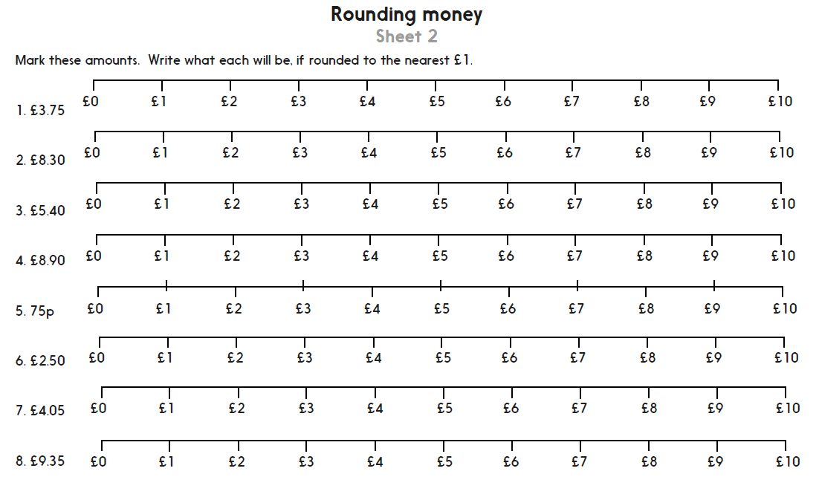
Challenge
Notes:
The Practice Sheet on this slide is suitable for most Y3 children.
Differentiated PRACTICE WORKSHEETS are available on Hamilton’s website in this unit’s PROCEDURAL FLUENCY box.
WT: Rounding money. Sheet 1.
ARE/GD: Rounding money. Sheet 2.

Slide 6
Day 1 Y4: Mark 1-place decimals on a number line; round to the nearest whole number.
£1.20
£2.80
£4.90
£1.50
£3.25
Discuss in pairs what each of the amounts would be if rounded to the nearest pound.
Where would £1.50 go on the line?
What about £2.80? Would it be closer to £2 or £3?
What are the rules for rounding whole numbers and decimals?
What about £3.25? Would it be closer to £3 or £4?
And £4.90? Would it be closer to £4 or £5?
How do we decide if an amount should be rounded up or down?
What would happen to £1.50?
Where would £1.20 go? Would it be closer to £1 or £2?
Notes:
Further teaching for Year 3
Show the ‘0-£5 landmarked line’ (see resources)
Y3 children can now go on to do differentiated GROUP ACTIVITIES. You can find Hamilton’s group activities in this unit’s TEACHING AND GROUP ACTIVITIES download.
Y4 WT: Create amounts of money; round to the nearest pound.
Y4 ARE/GD: Create amounts of money; round to the nearest pound.

Slide 7
Notes:
The Practice Sheet on this slide is suitable for most Y4 children.
Differentiated PRACTICE WORKSHEETS are available on Hamilton’s website in this unit’s PROCEDURAL FLUENCY box.
WT/ARE/GD: Rounding numbers with one decimal place. Sheet 3.
WT complete Parts A and B.
ARE/GD complete Parts B and C.

