Slide 1
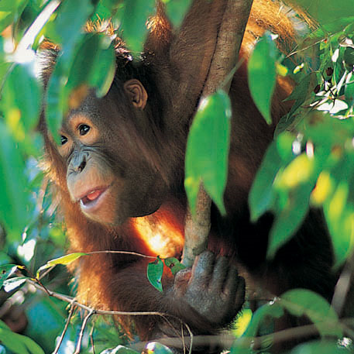
The Orangutan Quiz!!!!!

Slide 2
There is only one species of Orangutan.
TRUE
FALSE
FALSE
There are three!
Bornean
Sumatran
Tapanulian
What is the scientific classification for each species?

Slide 3
Orangutans in the wild are only found in Asia.
TRUE
TRUE
Orangutans are found only in the rain forests of the Southeast Asian islands of Borneo and Sumatra.
FALSE
How have orangutans adapted to live in this habitat?

Slide 4
Orangutans sleep on the ground.
TRUE
FALSE
FALSE
Orangutans build nests high in the trees at night and sometimes even make a roof of twigs!
Why do orangutans sleep where they do?

Slide 5
An orangutan’s arm span is about 2 metres long.
TRUE
FALSE
TRUE
Orangutan arms are one and a half times longer than their legs.
How do orangutans move through the rainforest?

Slide 6
Orangutans are an endangered species.
TRUE
FALSE
FALSE All three species of orangutan are now on the critically endangered list.
How many orangutans are currently living in the wild?

Slide 7
Orangutans are not herbivores.
TRUE
TRUE
Although an orangutan eats mainly fruit, this is not all they eat.
FALSE
What does an orangutan’s diet consist of?

Slide 8
Orangutans travel in large family groups.
TRUE
FALSE
FALSE Orangutans tend to live solitary existences.
When would orangutans come together?

Slide 9
The orangutans’ habitat is disappearing.
TRUE
TRUE
Orangutans have lost over 80% of their habitat in the last 20 years.
FALSE
What is happening to the orangutans’ habitat?

Slide 10
Male and female orangutans look the same.
TRUE
FALSE
FALSE There are significant differences in size and shape between males and females
What do male and female orangutans look like?

Slide 11
WWF are helping to protect Orangutans.
TRUE
TRUE
WWF is one of many conservation organisations who are helping to protect orangutans.
FALSE
What can be done to help protect orangutans?

