Slide 1
What does the mean mean?
The average!

Slide 2
Understand and calculate a mean.
What does the word ‘average’ mean to you?
We say that someone is of average height if they are neither particularly tall nor short. If we measured the height of everyone in our class, added the measurements and divided the total measurement by the number of people in our class, we would find the mean height for our class. That would be different to the mean height of the children in reception!
The mean is one type of average.
Today’s ‘Top Tip for Tests’ is for finding a mean: Think whether your answer looks ‘average’, roughly in the middle of the range of numbers.
A sprinter ran 100m in times of 12s, 15s, 13s, and 16s; then calculated her mean time to be 18s. Does this sound right?
Add the four times together and divide by 4 to find her mean time.
Does your answer look right?
Notes:
Record today’s ‘Top Tip for Tests’ for display in the classroom.

Slide 4
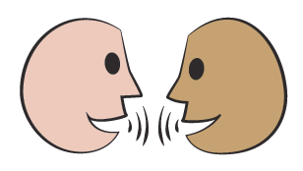
Understand and calculate a mean.
10
12
What is the mean?
What is the mean?
7 10
13
Your challenge is to work in pairs to write three other numbers with a mean of 10.
How did you do this?
Notes:
Take feedback on how they did this, e.g. making sure the three numbers added up to 30, or thinking of two numbers an equal distance away from 10.
Children can now go on to do differentiated GROUP ACTIVITIES. You can find Hamilton’s group activities in this unit’s TEACHING AND GROUP ACTIVITIES download.
WT: Calculate the mean of a data set.
ARE/GD: Manipulate data to create given mean values.

