Slide 1
The Mad Professor
is trying to split
atoms for another of his schemes.
It’s got to be accurate, or it’ll
go badly WRONG!!!

Slide 2
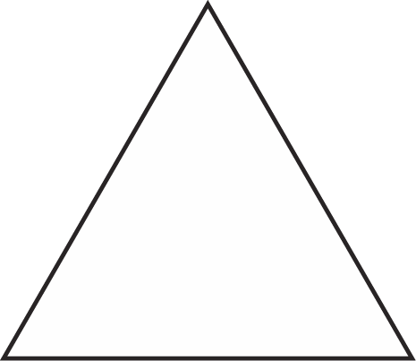
First we need to split the triangle atom in half - Can you draw how we do that?
Shade in the fraction ...

Slide 3
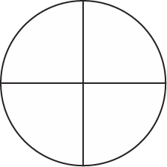
Now, we need to split the circle atom into 3/4 – Can you draw how we do that?
Shade in the fraction ...

Slide 4
Now, we need to split the rectangle atom into 1/4 – Can you draw how we do that?
Shade in the fraction ...

Slide 5
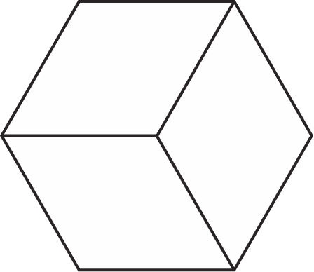
Tricky ... we need to split the hexagon atom into 2/3 – Can you draw how we do that?
Shade in the fraction ...

Slide 6
This one is already split! What fraction is already shaded in here?
¼

Slide 7
This one is already split! What fraction is already shaded in here?
½

Slide 8
Did we prevent the Mad Professor from creating a disaster ...
Perhaps not !!!

