Slide 1
The Mad Professor
is working with his potions again!
Can you help him mix the right fractions again?

Slide 2
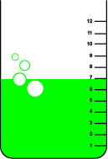
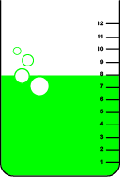
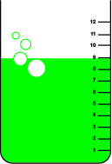
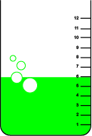
The Prof needs 2/3 of a
beaker of Green Gloop.
Which one is it?
✓
1
2
3
4

Slide 3
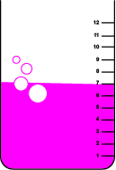
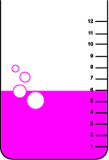
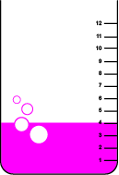
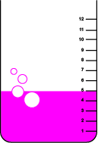
Now, Prof needs 1/3 of a
beaker of Magenta Madness.
Which one is it?
1
2
✓
3
4

Slide 4
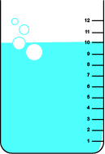
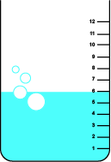
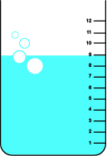
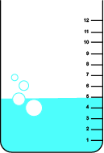
Now, Prof needs 5/6 of a
beaker of Blue Juice.
Which one is it?
✓
1
2
3
4

Slide 5
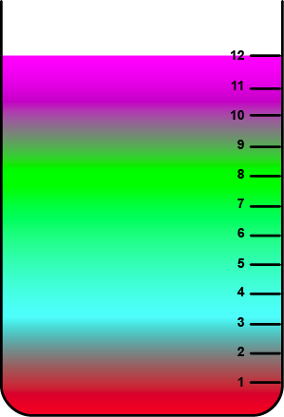
And now for a difficult one!
Draw a line on the beaker where these amounts should go ... 1/6 Ruby Red, 1/3 Blue Juice
1/4 Green Gloop and
3/12 Magenta Madness

