Slide 1
Can you help the
Mad Professor
mix his potions?
You must get the
fractions right,
or things might go
badly WRONG!!!

Slide 2
1. First pour in 3/4 of Green Gloop – how much is that?
2. Now 1/4 of blue juice – how much is that?
3. Now half magenta madness – how much is that?
4. Yummy yellow to 8 – what fraction is that?
2/3

Slide 3
That was a special
Speedy Snail potion.
Let’s see how well
it worked, with the
Great Snail Race!

Slide 4
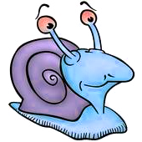
The first snail made it 3/4 of the way
The second snail made it 8/10 of the way
The third snail made it half way
The fourth snail made it 1/5 of the way
The fifth snail made it 9/10 of the way

