Slide 1
People of the Rainforest
LKS2 Topic: The Rainforests Block C: Life In The Rainforest Session 1
To be able to understand and explain why people live in a rainforest.
To compare and contrast how their daily routine is different from ours, based on their environment.
© Original resource copyright Hamilton Trust, who give permission for it to be adapted as wished by individual users.
We refer you to our warning, at the foot of the block overview, about links to other websites.

Slide 2
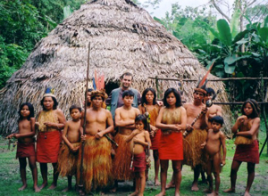
Who do you think lives in the Rainforest?
Native people have lived in the rainforests for thousands of years.
In Brazil about 2,500 Kayapo natives live in an area about the size of Wales.
They garden, hunt, fish
and gather wild foods.
They use over 600
species of plants for food,
medicine, dyes, soaps and
insect repellent.

Slide 3
Do you think the tribes are Affected by the modern western world?
Having been largely untouched for years, tribes flourished and grew as did their environment.
HOWEVER…
The tribes are now moving deeper and deeper into the forest as outsiders come in. They are trying to set up a PROTECTED AREA so that the groups do not have to keep trying to run away.

Slide 4
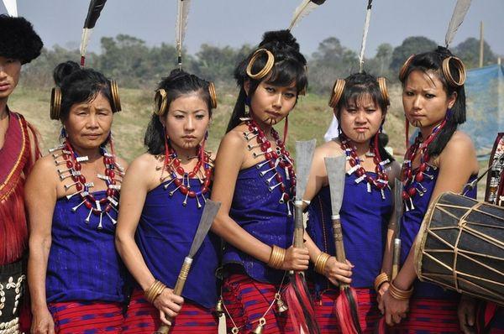
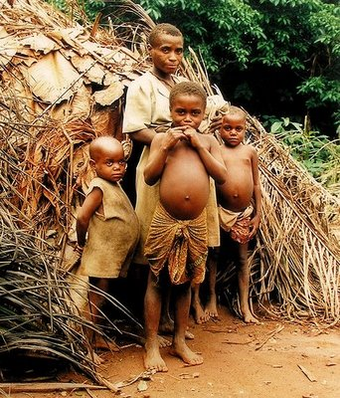
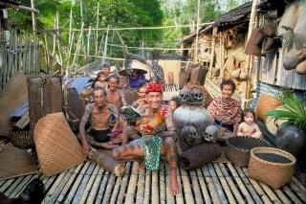
Do you think the tribal people live in villages and go to school?

Slide 5
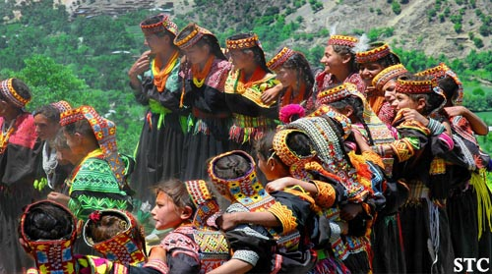
School...
Tribal children go to school often in the central hut for two hours a day to learn how to speak their own and other languages.
They have to find their own lunch every day, from the rainforest.
After school they go swimming or climb before having to go and help with the chores e.g. collecting wood and water.

Slide 6
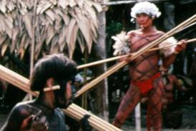
Why do the tribes respect the Rainforest so much?
Tribes respect every aspect of the Rainforest, only catching and using what they need for that day so as not to be wasteful.
They believe in the spirit of the world. They believe that if you are kind to the world the world will be kind to you.

Slide 7
People of the Rainforest
To compare and contrast how their daily routine is different from ours, based on their environment.

