Slide 1
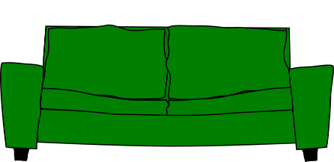
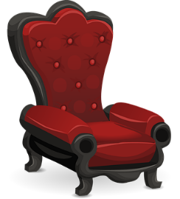
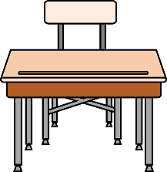
Formal and Informal writing
Register, Audience, Context and Vocabulary

Slide 2
Register
Register is created by the way that language and grammar are used.
Hey! What’s up?
Good morning. How are you today?
I wish to purchase some refreshment.
I want to buy a drink.
Register can be formal or informal.

Slide 3
Audience and Context
The register depends on situation and audience.
The same person will use different registers in different contexts.
At home with family
In school with head teacher
In the palace with the monarch
You’re going to wear that, are you?
When will we be allowed on the field?
I wonder, might I be permitted to stroke the corgi?
Informal
More Formal
Very Formal

Slide 4
Register
Formal language is often used for:
Situation | Audience
Official or formal situations | People you don’t know
Generalised or impersonal writing | People in official/important roles
Written communication more than spoken | People as a group
We would like to request your presence at next week’s award ceremony.
The ice was placed in a container and observed over the course of one hour.
Please alight at the next station.

Slide 5
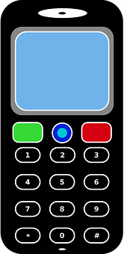
Register
Informal language is often used for:
Situation | Audience
Everyday conversation | Family, friends and people you know well
Social media and texts | People similar to you
Most spoken communication | People you meet in day-to-day life
RU COMING 2NITE?
I’m doing breakfast. You like jam on your toast, don’t you?
Hi. Two chips, a burger and a hotdog. No sauce, thanks.
We’re having milkshakes. Want one?

Slide 6
Formal and Informal Vocabulary
Formal and informal registers tend to use different vocabulary.
Could you assist me?
Can you help me?
It is time to depart.
It is time to go.
You need to purchase a ticket.
You need to buy a ticket.
I hate to inconvenience you.
I hate to bother you.
Informal
Formal
With formal vocabulary, words are often longer.

Slide 7
Formal and Informal Vocabulary
put
place
cease
stop
ask
enquire
inform
tell
need
require
obtain
get
Formal
Informal
Can you sort these synonyms into formal and informal vocabulary?

Slide 8
Formal and Informal Vocabulary
ANSWERS
put
place
cease
stop
ask
enquire
inform
tell
need
require
obtain
get
Can you sort these synonyms into formal and informal vocabulary?
Can you think of any other formal and informal pairs?
Formal
Informal

