Slide 1
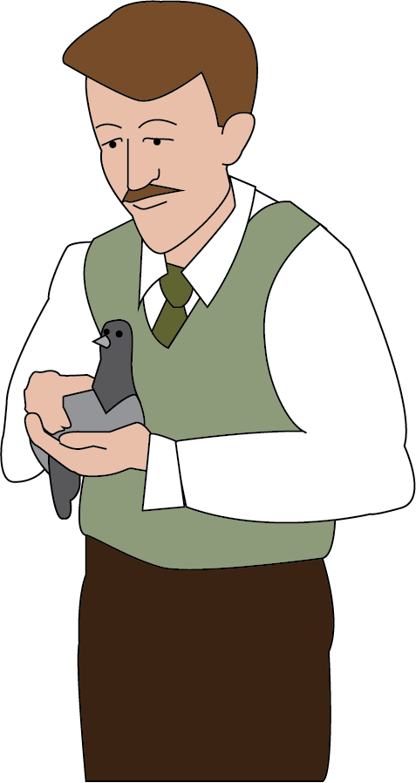
Punctuating Direct Speech King of Rome
You made my dreams come true.

Slide 2
Punctuating Speech
Speech bubbles can show us what someone is saying.
You’ll come back.
The words spoken are called direct speech.
“You’ll come back,”
said Charlie.
Bubbles take up too much room so we use speech marks.
Speech marks work in pairs to hug the direct speech.
We report who is speaking using a reporting clause.
Speech marks are also called inverted commas.

Slide 3
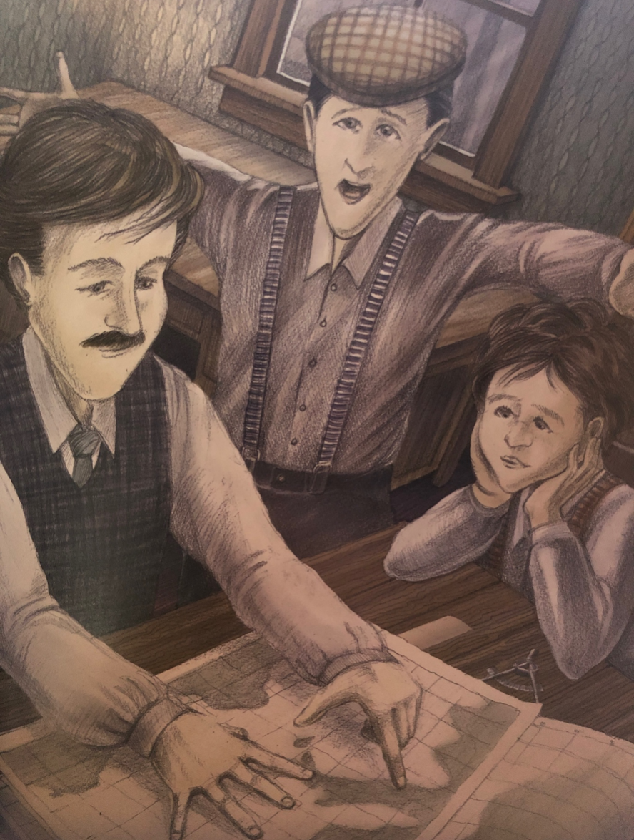
Punctuating Speech – capital letters open direct speech
Direct speech begins with a capital letter, even if it is in the middle of a sentence.
Tom questioned, “All the way from Rome?”
Charlie answered, “It’s a long way but he can do it.”
It is the beginning of the speaker’s sentence so a capital letter is used.

Slide 4
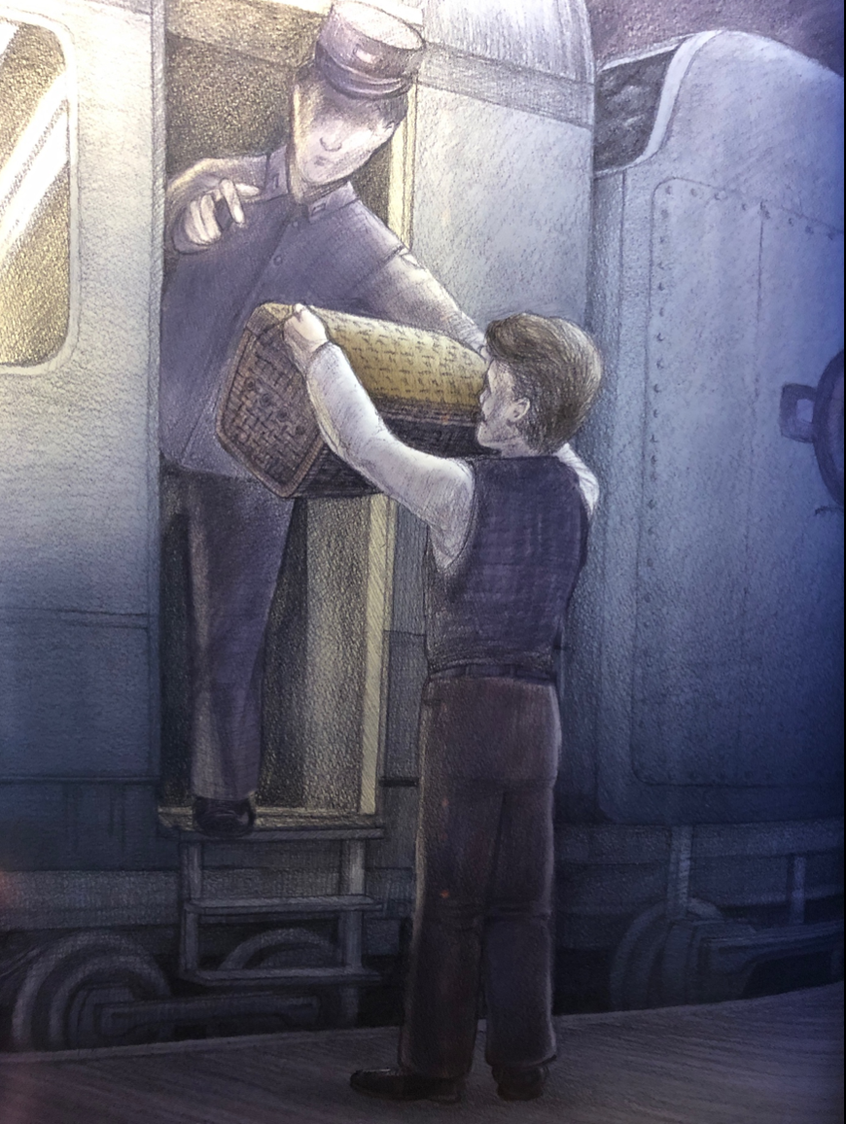
Punctuating Speech – a new line shows a change of speaker
“All the way to Rome?” asked the guard.
“That’s right,” answered Charlie.
“You know that’s a long way?” teased the guard.
Charlie laughed, “It’s an adventure!”
We show each change of speaker by starting a new line.
This makes it clear when the speaker changes.

Slide 5
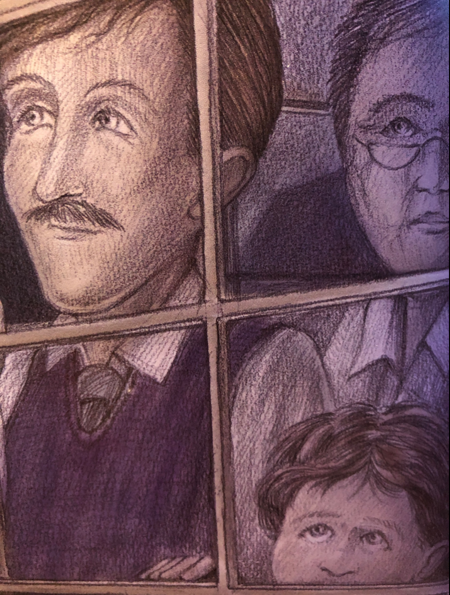
Punctuating Speech – commas separate clauses
Direct speech and reporting clauses are usually separated by a comma.
“There’s still no sign of him,” sighed the boy.
Charlie whispered, “Come back. Please make it.”
The comma is placed at the end of the first clause.
The speech marks follow the comma.

Slide 6
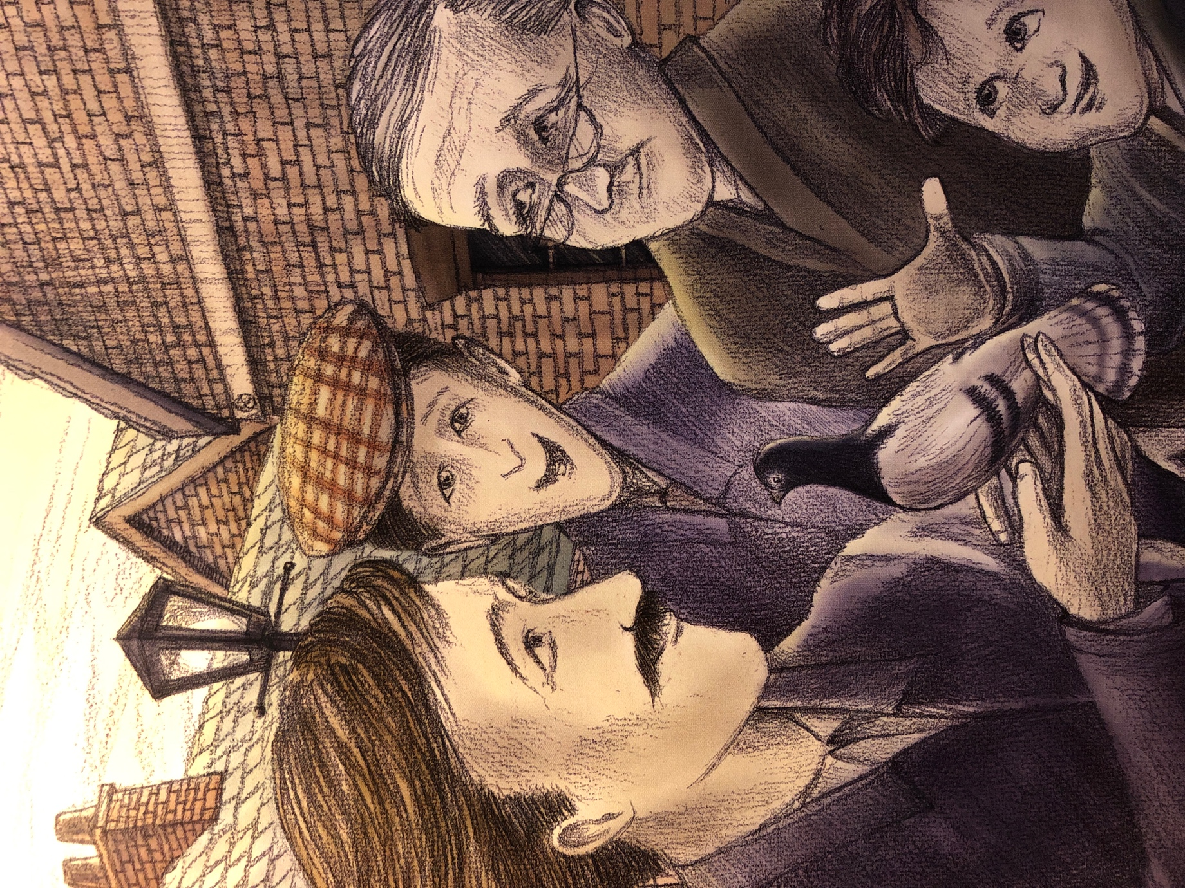
Punctuating Speech – exclamations and questions
If the speech ends in a ! or ? we do not need a comma after the speech.
“How did he do it?” everyone asked.
“Some kind of magic!” Charlie laughed.
The punctuation is placed inside the speech marks.
The punctuation belongs to the spoken words – they tell you how to say them.

Slide 7
What can you remember?
What are the rules for writing speech?
Hug the words spoken with speech marks
Start the spoken words with a capital letter
Separate the speech and reporting clause with a comma
Start a new line to show the speaker has changed

Slide 8
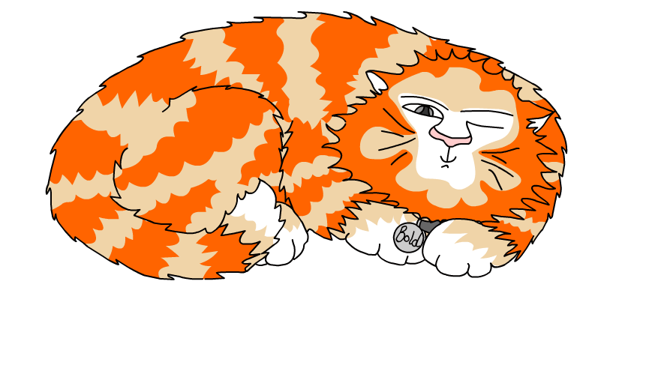
Explore more Hamilton Trust Learning Materials at https://wrht.org.uk/hamilton/ .

