Slide 2
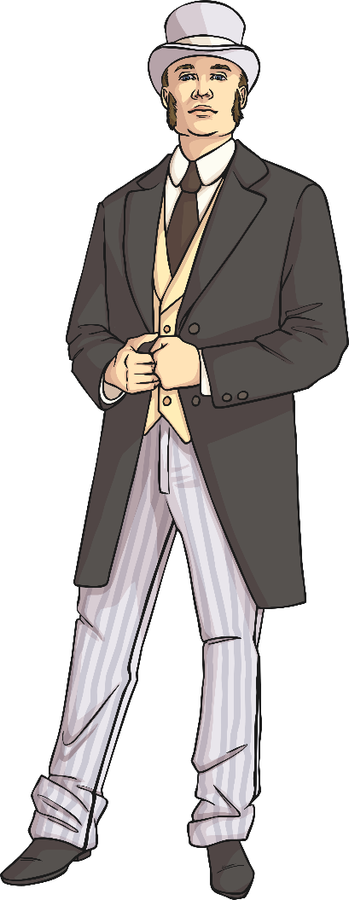
Dr Thomas Barnardo
Thomas Barnardo was born in Dublin in 1845.
He became a Doctor in 1876.
During his lifetime he was to become one of the most famous men in Victorian Britain due to his work with orphans.
The Victorians thought poverty was the result of laziness and an unwillingness to work. To them, it was something to be ashamed of.

Slide 3
Dr Thomas Barnardo
Thomas Barnardo fought against these ideas by accepting any child into his children's homes.
He was determined to give any child the best possible start in life, no matter where they had come from.
This meant that during most of his life he battled against these traditional Victorian beliefs.
Thomas Barnardo became aware of many homeless and destitute children in the cities of England.

Slide 4
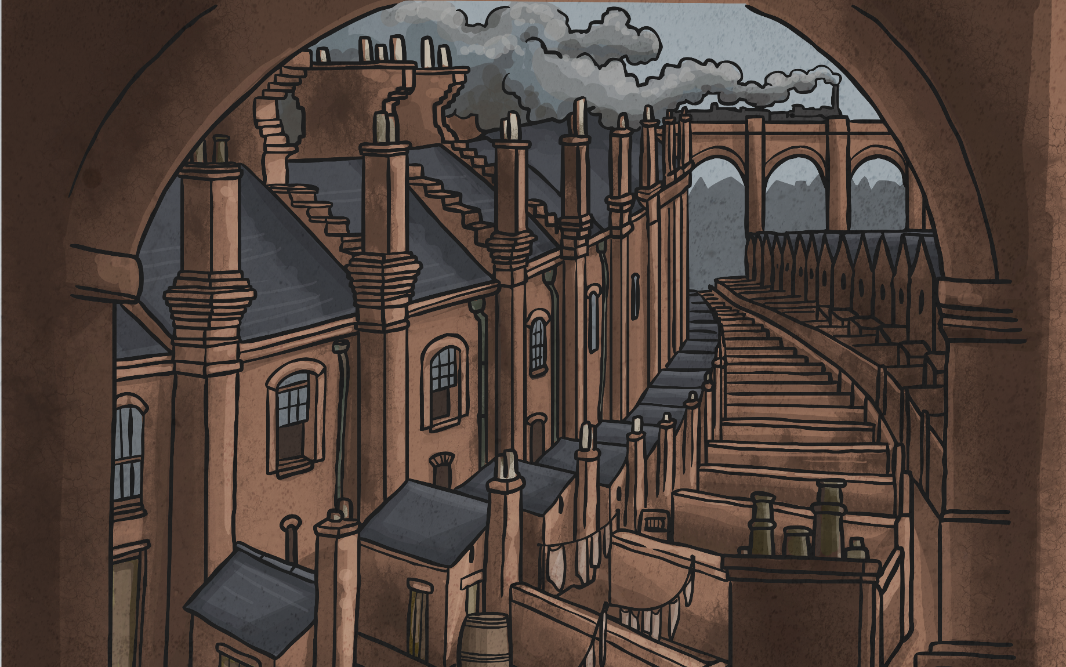
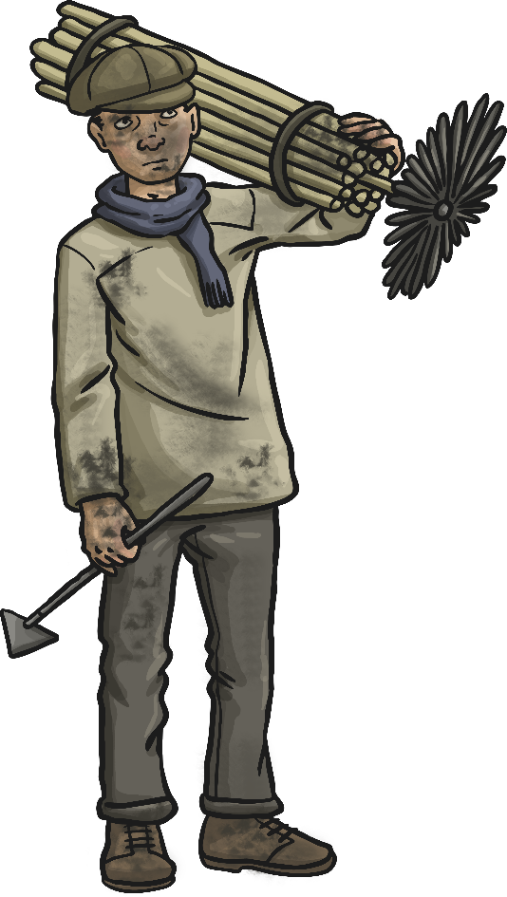
Dr Barnardo’s London
In 1866 Thomas Barnardo arrived in London to train as a doctor.
The population in London had increased rapidly due to the Industrial Revolution - particularly in the East End where the poorest people lived.
This led to terrible unemployment, overcrowding, poverty and disease.

Slide 5
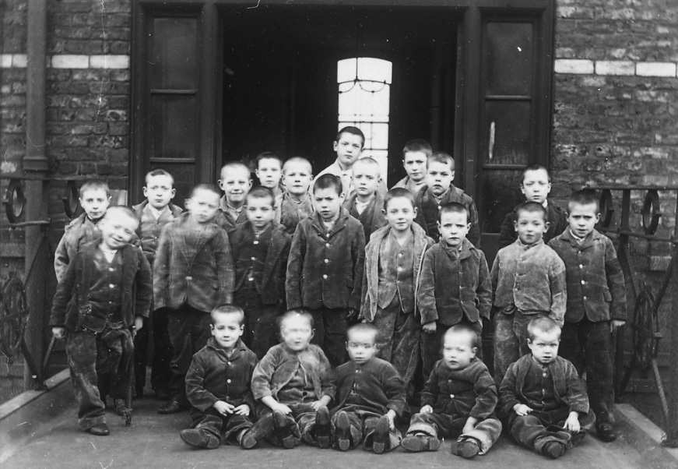
Dangers in Victorian London
Cholera was a deadly disease that was a daily threat in Victorian London.
Shortly after Thomas Barnardo arrived in London, cholera swept through the East End, killing more than 5500 people.
Thousands of children were forced to sleep on the streets and beg to survive.
Many had been injured terribly working in factories.
23 boys at Crumpsall Workhouse, circa 1895-1897
Photo courtesy of Manchester Archives@flickr.com - granted under creative commons licence - attribution

Slide 6
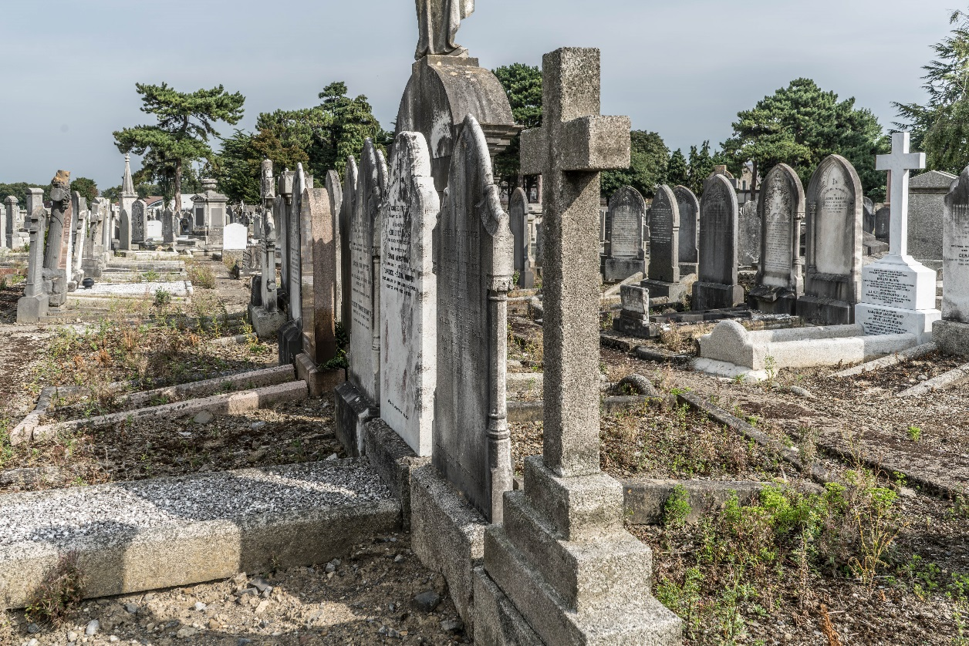
Dangers in Victorian London
The life of a Victorian child was hard work. Workhouses were dangerous and paid very little. The food was tasteless and was the same every day.
This, along with poor living conditions, meant disease and hunger lead to a higher death rate for children. In some cities, children under the age of five made up about half of all deaths.
Photo courtesy of William Murphy@flickr.com - granted under creative commons licence - attribution

Slide 7
Dr Barnardo’s First School
Education in Victorian England had to be paid for and many parents were too poor to afford this, so lots of children never learnt to read and write.
As a result of everything Thomas Barnardo had seen, he decided to open a school in the East End so children could get a basic education.
Thomas Barnardo started teaching London’s poor children in a donkey stable in 1866, before opening his own school.
Hope Place was opened in 1867 and termed a ‘ragged school’.

Slide 8
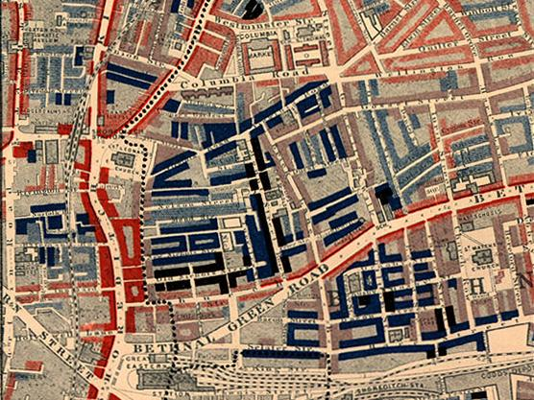
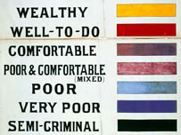
Dr Barnardo and the East End
Thomas Barnardo continued to take a great interest in destitute children.
One day a child called Jim Jarvis took him around the East End, showing him young children sleeping in gutters and on top of roofs.
The sight affected Barnardo so much that he decided to devote himself to helping these children.
Poverty map of Old Nichol slum, East End of London.
Photo courtesy of Wikimedia Commons - granted under creative commons licence - attribution

Slide 9
Stepney Causeway, London
This house in Stepney Causeway was to become the first of Thomas Barnardo’s homes for children.
It was opened in 1870 as a Home for Boys.
Barnardo would go out every night looking for homeless children.
One night an 11-year-old boy was turned away as the home was full.
Two days later he was found dead. From that day on, Barnado’s motto was ‘No Destitute Child Ever Refused Admission.’

Slide 10
Girls’ Village Home
When Thomas Barnardo married his wife, Syrie, in 1873, a supporter gave them a house to use as a children’s home. The Girls’ Village Home in Barkingside was opened in 1876.
It housed over 1500 girls at any one time.
This was different to the boys’ home as it was set in its own grounds; each cottage had its own front and back gardens and there was also a steam laundry on the grounds.
The girls who stayed at the Village Home received training as cooks and domestic service maids. This meant that every child could find employment once they had left the home.

Slide 11
Barnardo’s Today
The last Dr Barnardo’s home closed in 1981.
Today Barnardo’s helps over 110 000 vulnerable children and families through projects run at homes, schools and in local communities. Barnardo’s helps all sorts of children and young people, including those who have disabilities, or who have problems at school or with their families, or who don’t have any family of their own to support and look after them.
The main aim of Barnardo’s continues to be to support and encourage disadvantaged children to achieve success in their lives.

Slide 12
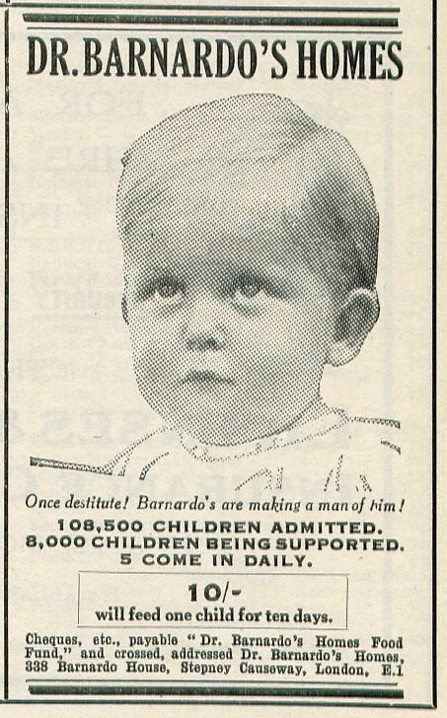
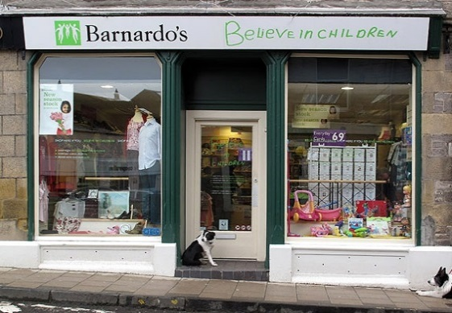
Barnardo’s Today
Did you know . . . ?
Barnardo’s works with more than 100 000 children, young people and families every year?
That’s more than you can pack into the Emirates Stadium, home of Arsenal FC.
Photos courtesy of Wikimedia Commons - granted under creative commons licence - attribution

