Slide 1
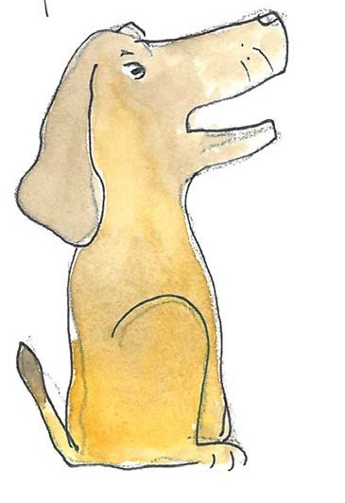
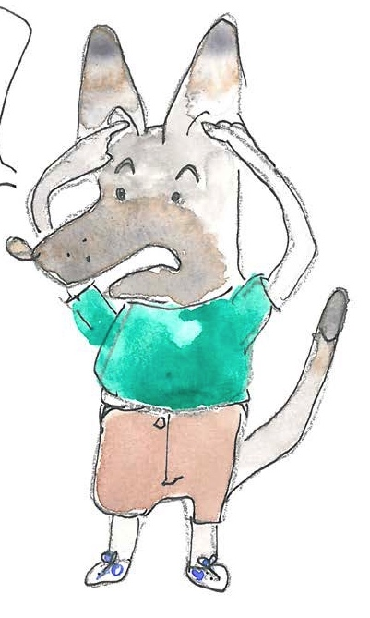
Using conjunctions and prepositions to add information about time, place and cause

Slide 2
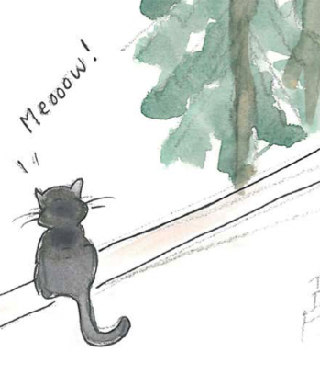
Verbs
Verbs indicate that someone or something is
doing, feeling or being.
He smells.
The cat miaows.
A cloud drifts.
I cheered!
Usually verbs have the name of a person or thing or a pronoun in front of them.

Slide 3
Clauses
Clauses are groups of words with an active verb and a subject.
The dog smelt something.
He looked all around.
Then he spotted the cat, sitting on the wall.
He barked loudly, ready to chase her.
The subject is ‘the doer’ of the verb; it can be a noun or pronoun.

Slide 4
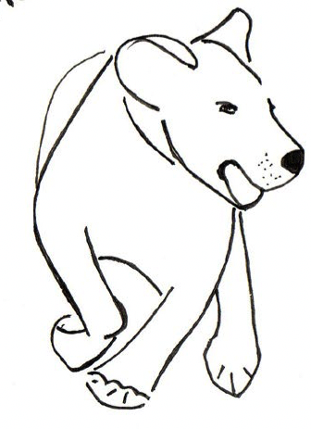
The dog smelt something.
Conjunctions
Conjunctions join clauses.
as
join clauses.
He looked around.
because
so
He spotted the cat.
I love chasing cats!
before
after
He barked loudly.
when
since
until
The dog looked around because he smelt something.
as
while
He barked loudly when he spotted the cat.
wherever
where
Wherever he spotted a cat, the dog chased it away.
Remember – a clause always has an active verb.

Slide 5
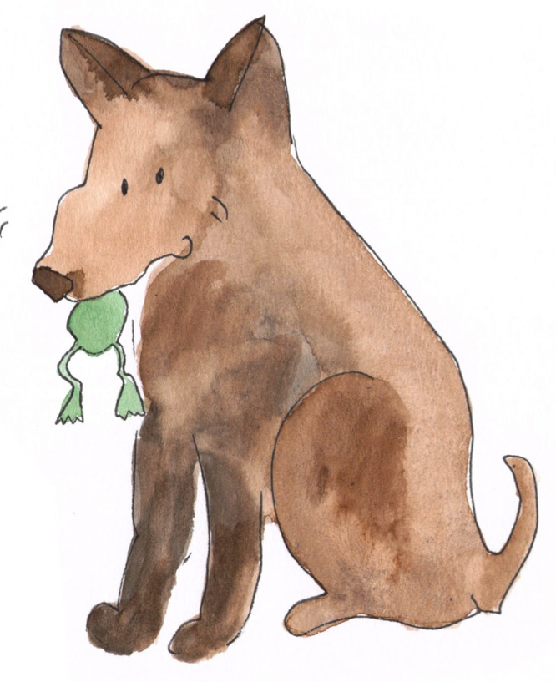
Phrases
A phrase is a group of words which adds meaning to a sentence.
under the tree
with a tasty titbit
in the night
because of the storm
There is no active verb in a phrase.
Revision

Slide 6
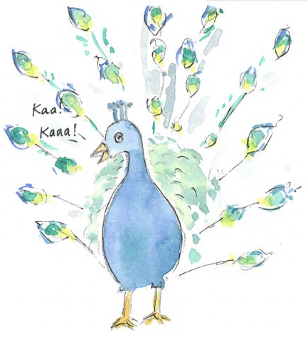
Prepositions
Prepositions show the relationship between words.
above
on
over
before
because of
from
due to
between
while
in
since
outside
inside
under
from
at
on
below
after
for
during
Can you see a pattern in the grouping of these prepositions?

Slide 7
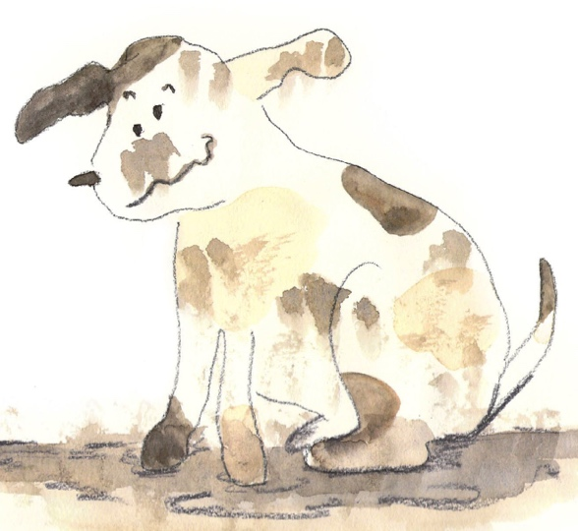
Prepositions
Prepositions link a phrase to a clause.
I think there is a puppy
in the wet mud puddle!
I lie down comfortably
with the soft, warm cat.
She often goes out
in the middle of the night.

Slide 8
Placing and punctuating phrases and clauses
Subordinate clauses can be added at the start, in the middle or at the end of a sentence.
When the cat purrs, I feel so very contented.
when
No comma is needed when the clause is at the end.
I feel, when the cat purrs, so very peaceful.
because
I feel so very honoured when the cat purrs.
that
Notice how we need commas in the first two.
if
Commas separate the clause from the rest of the sentence.

Slide 9
Placing and punctuating phrases and clauses
Phrases can be added at the start, in the middle or at the end of a sentence.
No comma is needed when the phrase is at the end.
Beside the door, the dog is whining to go out.
I hope, in the morning, not to find a mess on the floor!
The dog eats his dinner on the floor by the door.
Notice how we need commas in the first two.
Commas separate the phrase from the rest of the sentence.

Slide 10
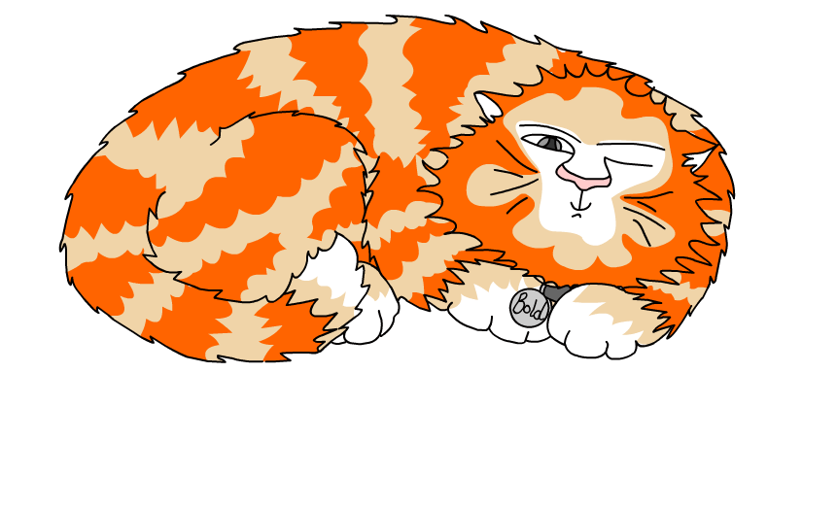
Explore more Hamilton Trust Learning Materials at https://wrht.org.uk/hamilton/ .

