Slide 1
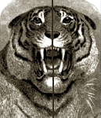
Line Symmetry
If a shape can be folded in half so that one half fits exactly on top of the other, then we say that the shape has got line symmetry.
One half of the shape is the mirror image of the other half.
The fold is called a line of symmetry or reflection.
Often things in the world around us have a line of symmetry, such as this tiger and this crab.
This shape has got a vertical line of symmetry.
Shapes can have a vertical, horizontal or diagonal line of symmetry.

Slide 2
This shows a line of symmetry. True or false?
TRUE
FALSE

Slide 3
TRUE
FALSE

Slide 4
TRUE
FALSE

Slide 5
TRUE
FALSE

Slide 6
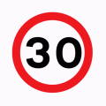
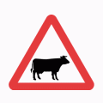
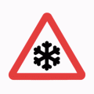
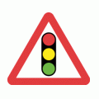
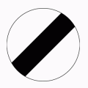
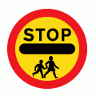
Lines of Symmetry all around us
Which of these road signs have got lines of symmetry?
Click to see the lines of symmetry.

Slide 7
Line Symmetry in the Alphabet
Which letters have got lines of symmetry?
Click to see the lines of symmetry.
A
B
C
D
E
F
G
H
I
J
K
L
M
N
O
P
Q
R
S
T
U
V
W
X
Y
Z

Slide 8
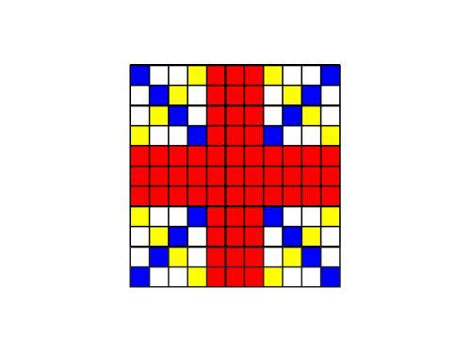
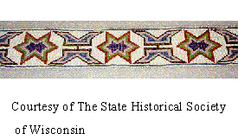
Patterns
Patterns in the world around us are symmetric. Can you see the line or lines of symmetry in these patterns?

Slide 9
Shape 1
Look at this shape.
Can you spot the vertical reflection of the shape on the next slide?

Slide 10
A
B
C
D
Notes:
Put your hand up if you think it’s A, B, C, D etc.

Slide 11
Congratulations! The correct answer is B!

Slide 12
Shape 2
Look at this shape.
Can you spot the horizontal reflection of the shape on the next slide?

Slide 13
A
B
C
D

Slide 14
Congratulations! The correct answer is D!

