Slide 1
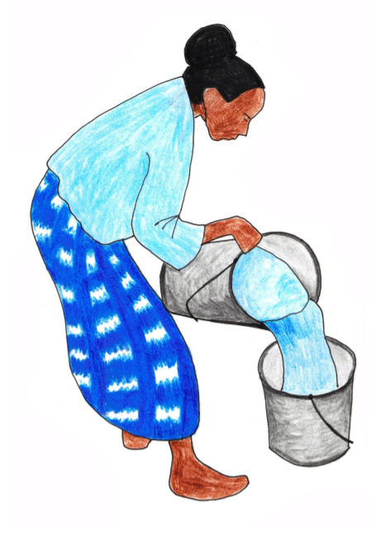
Prepositions
cause
time
before
after
at
until
since
in
during
because of
due to
from
for
A phrase is a group of words which adds meaning to a sentence. Prepositions can join these phrases to a sentence.
cause
and place.
Prepositions can express time,
Prepositions often join nouns or noun phrases to a sentence.
place
The dye is extracted from the leaves.
above
across
behind
inside
up
down
round
underneath
with
It changes colour during the process.
Indigo was popular for its intensity.

Slide 2
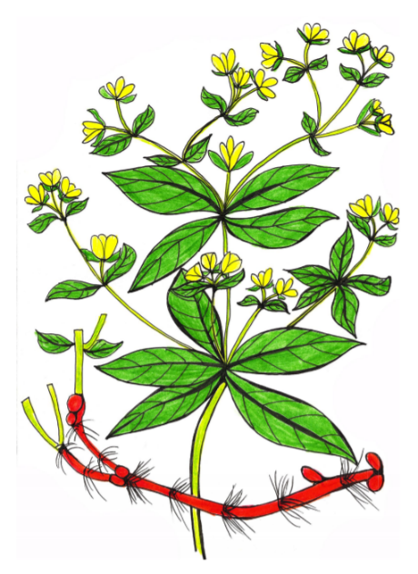
When?
Prepositions
Prepositions help us express time, place and cause.
time
, place
and cause.
Try adding your own prepositional phrase to express time.
Madder plants were used
for 4000 years.
Madder plants were used
in the dye-making process.
Prepositions
while, since,
before, during, after, at, on, during
Madder plants were used
until Medieval times.

Slide 3
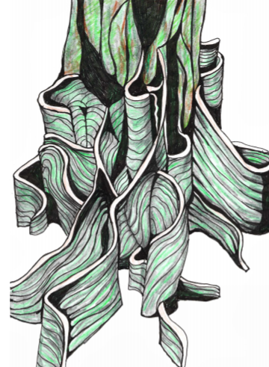
Where?
Prepositions
Prepositions help us express time, place and cause.
time,
place
and cause.
Try adding your own prepositional phrase to express place.
The dye is produced
from the roots.
The dye is produced
in a vat.
The dye is produced
below the ground.
Prepositions
above, below,
inside, outside, on, in, between

Slide 4
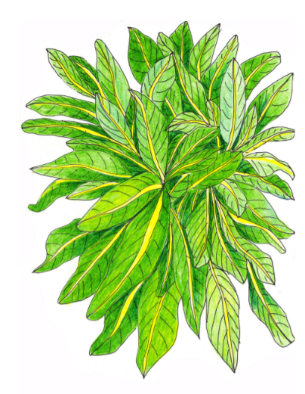
Why?
Prepositions
Prepositions help us express time, place and cause.
time,
place and
cause.
Try adding your own prepositional phrase to express cause.
Woad was used
for its deep blue dye.
Woad was used
due to its easy cultivation.
Woad was used
because of the range of shades it creates.
Prepositions
because of, due to,
from, for

Slide 5
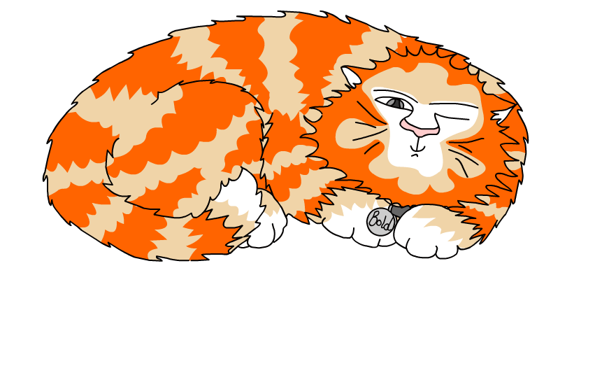
Explore more Hamilton Trust Learning Materials at https://wrht.org.uk/hamilton/ .

