Slide 1
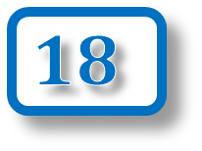
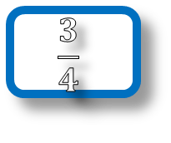

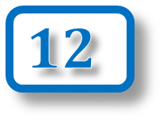
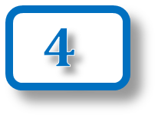
The number of the day is …
$$4$$
$$0.7$$
$$18$$
Add to it
Subtract from it
$$12$$
$$4$$
Multiply it by
Divide it by
Square it
Cube it
Square root it
List all of its factors
List its first 5 multiples
50%
$$\frac{3}{4}$$
Find of it
Find of it

