Slide 1
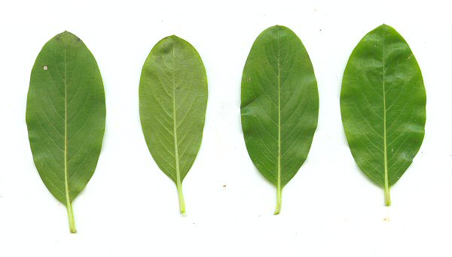
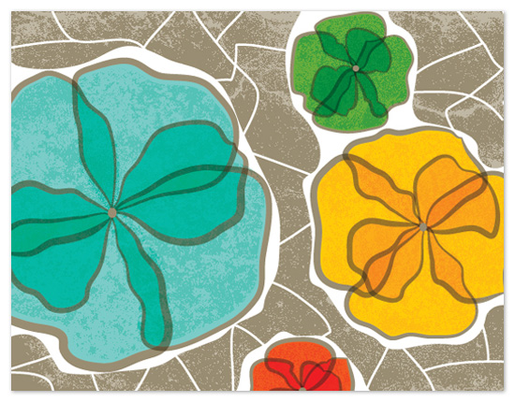
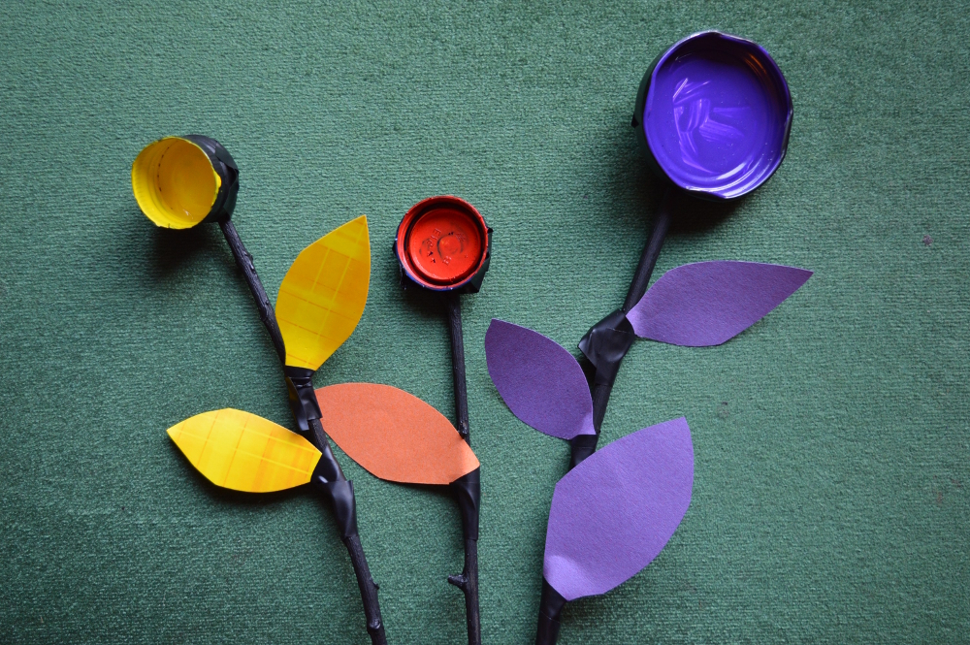
I can create different textures.

Slide 2
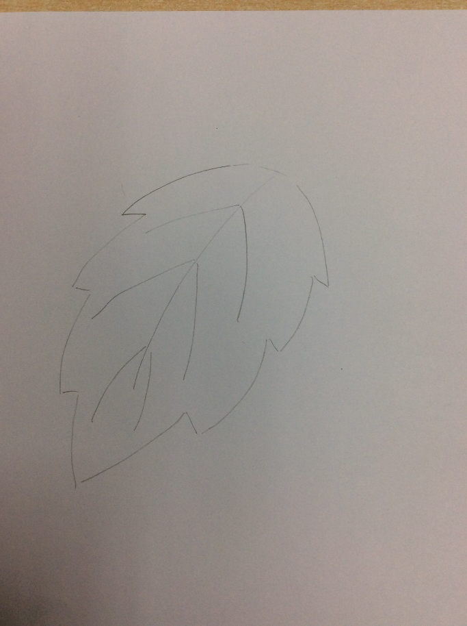
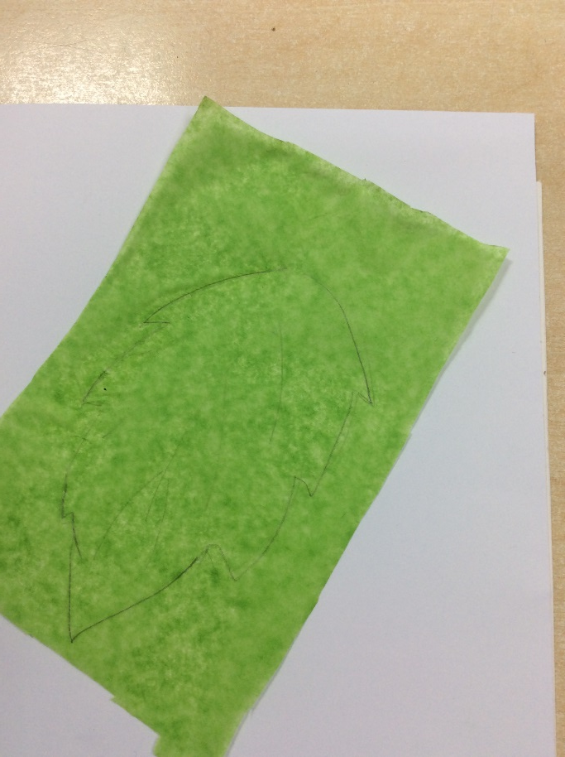
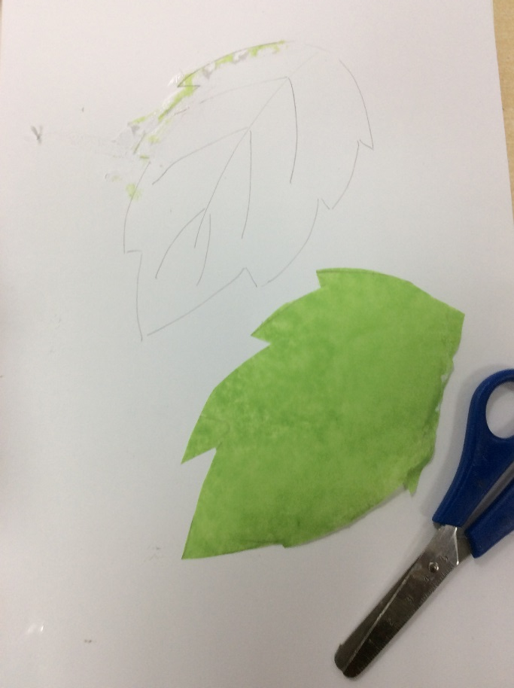
STEP 2
TRACE YOUR LEAF
REMEMBER TO LEAVE IT A BIT BIGGER THAN YOUR DRAWING
STEP 1
DRAW YOUR LEAF
STEP 3
CUT IT OUT

Slide 3
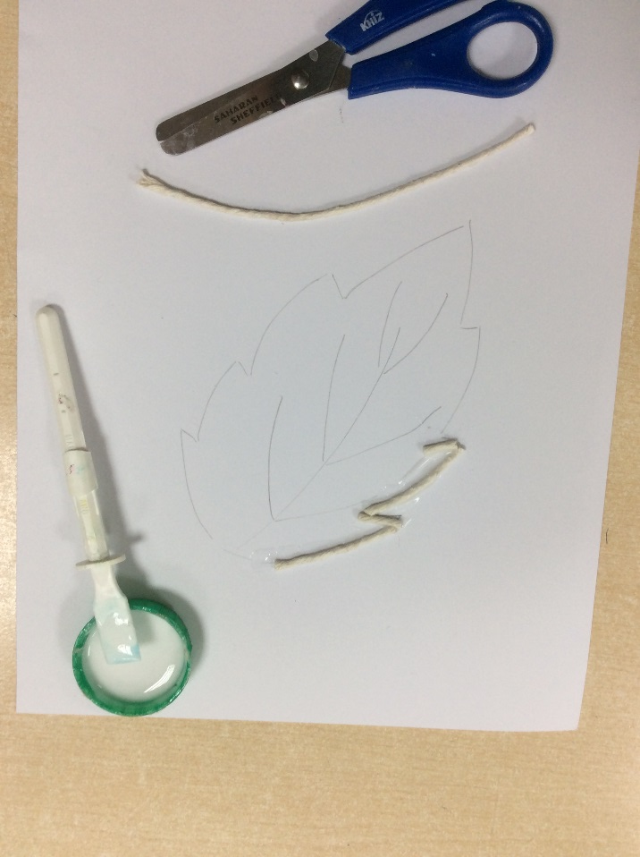
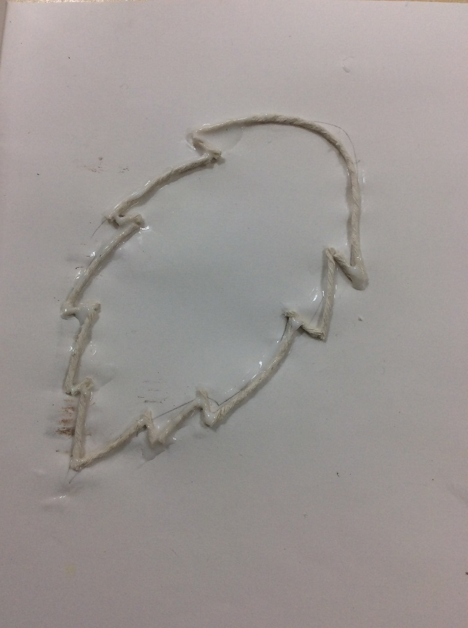
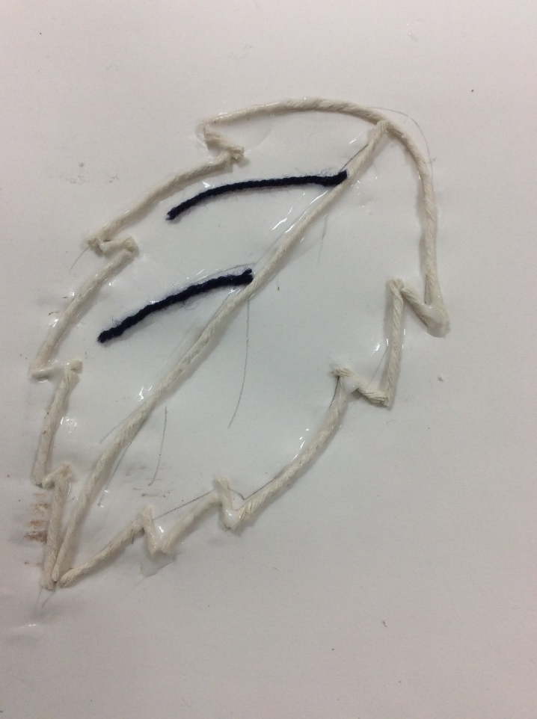
STEP 4
USE STRING AND GLUE TO MAKE THE EDGE
STEP 5
KEEP GOING UNTIL YOU HAVE BEEN ALL THE WAY AROUND
STEP 6
USE A DIFFERENT STRING TO MAKE THE VEINS

Slide 4
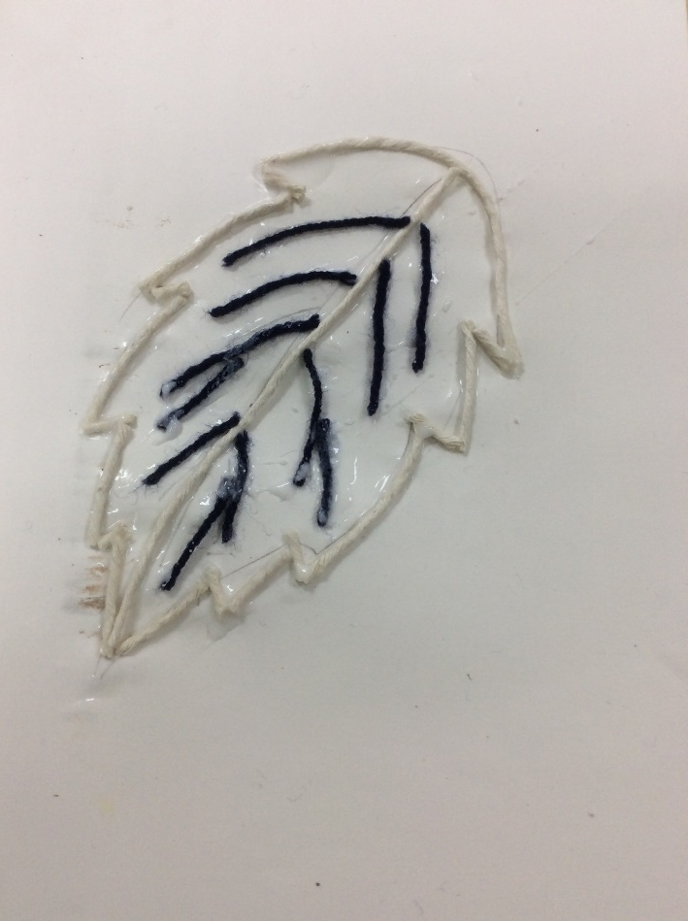
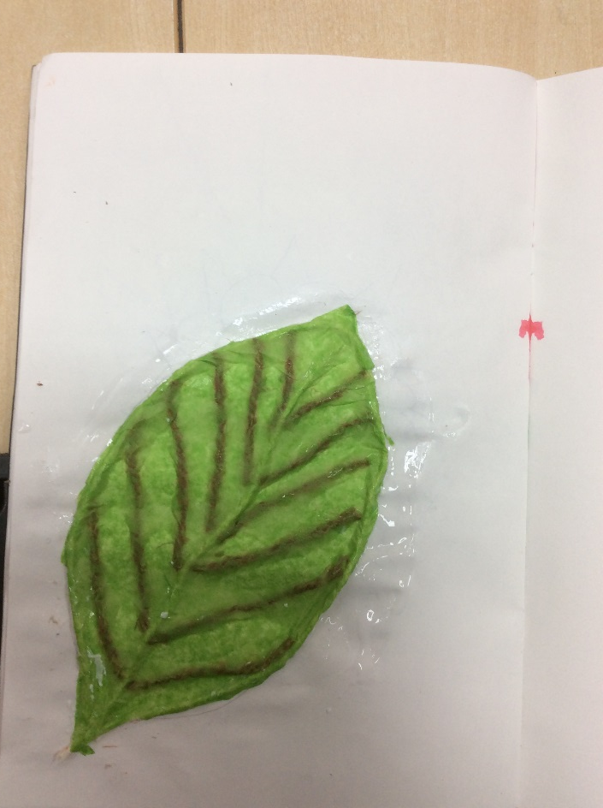
STEP 7
KEEP GOING UNTIL YOU HAVE FINISHED ALL THE VEINS
STEP 8
PUT YOUR TISSUE LEAF ON TOP. USE GLUE TO STICK IT ALL DOWN!

