Slide 1
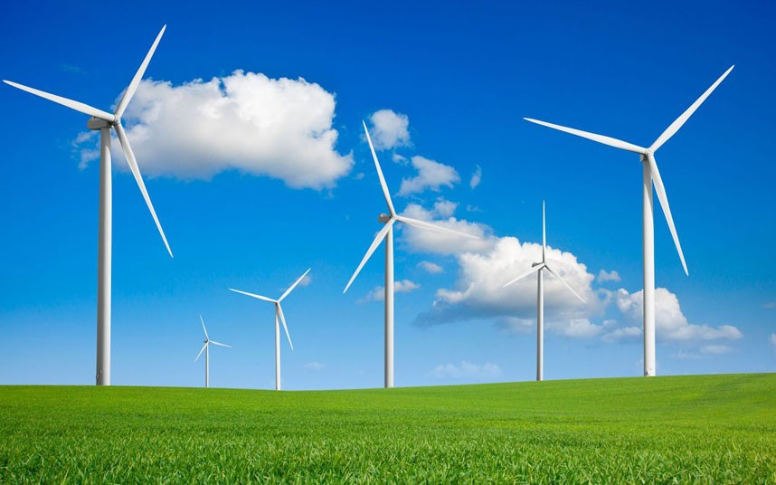
What can you remember about wind energy?

Slide 2
If we were to build a wind turbine at school, where would be the best place and why?

Slide 3
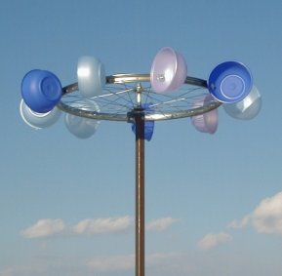
We are learning to build and anemometer and record and compare wind speeds

Slide 4
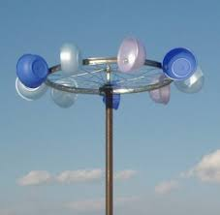
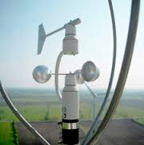
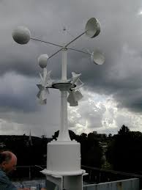
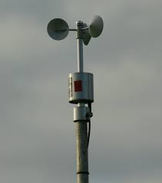
What is their job?
What is an anemometer?

Slide 5
An anemometer is used to measure how powerful the wind is in certain areas. They measure wind speed and explore weather patterns as well as ensuring wind farms are built in sufficient areas.

Slide 6
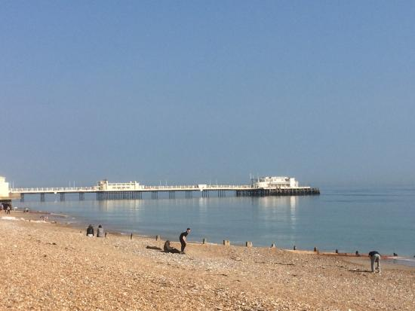
We are building An anemometer to compare wind speeds on WORTHING SEAFRONT.

Slide 7
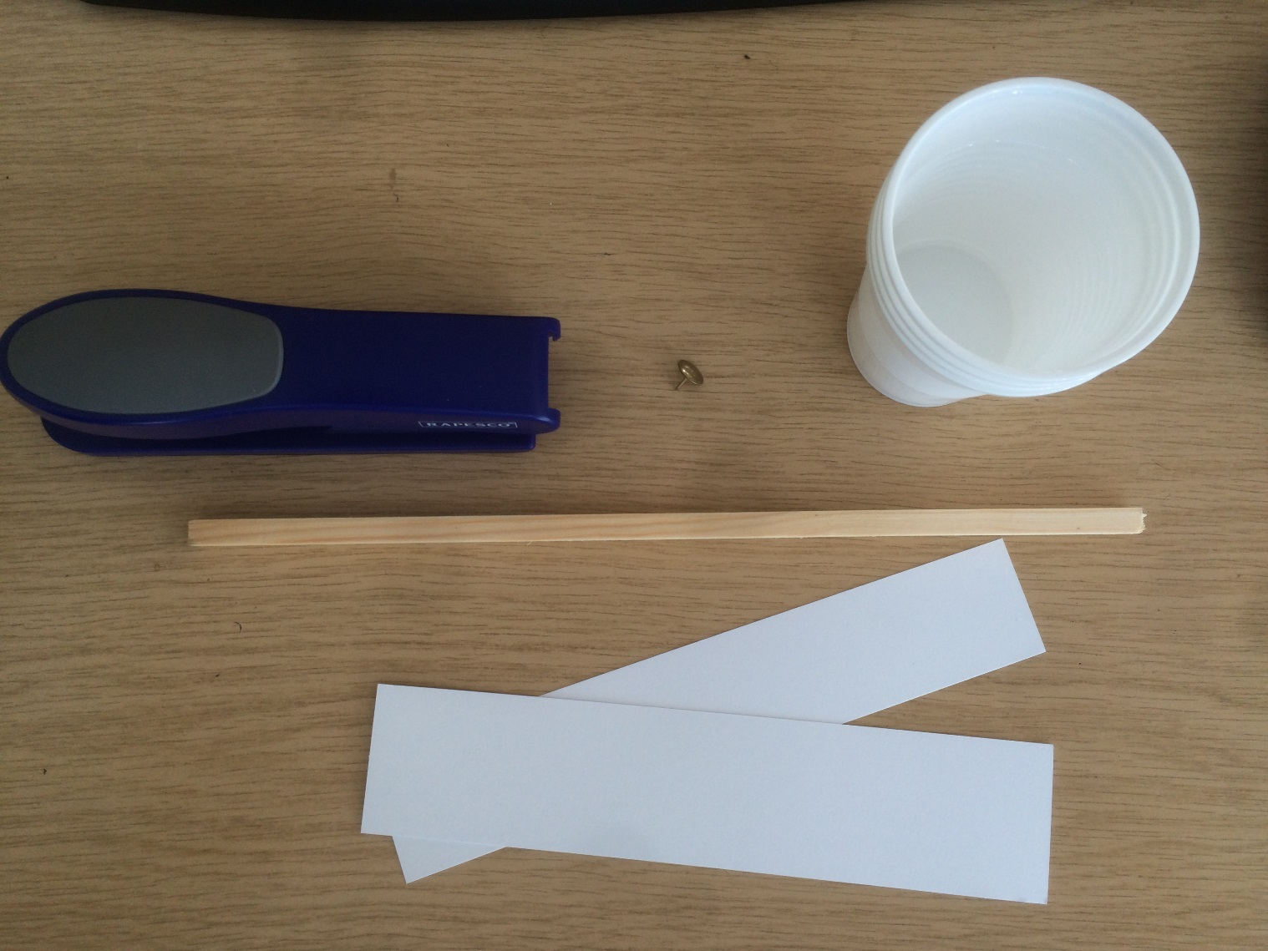
You Will Need…
A Stapler
A Board Pin
4 Plastic Cups
Some Dowell
2 Strips of Card
(double if its thin)
Scissors
Sharpie

Slide 8
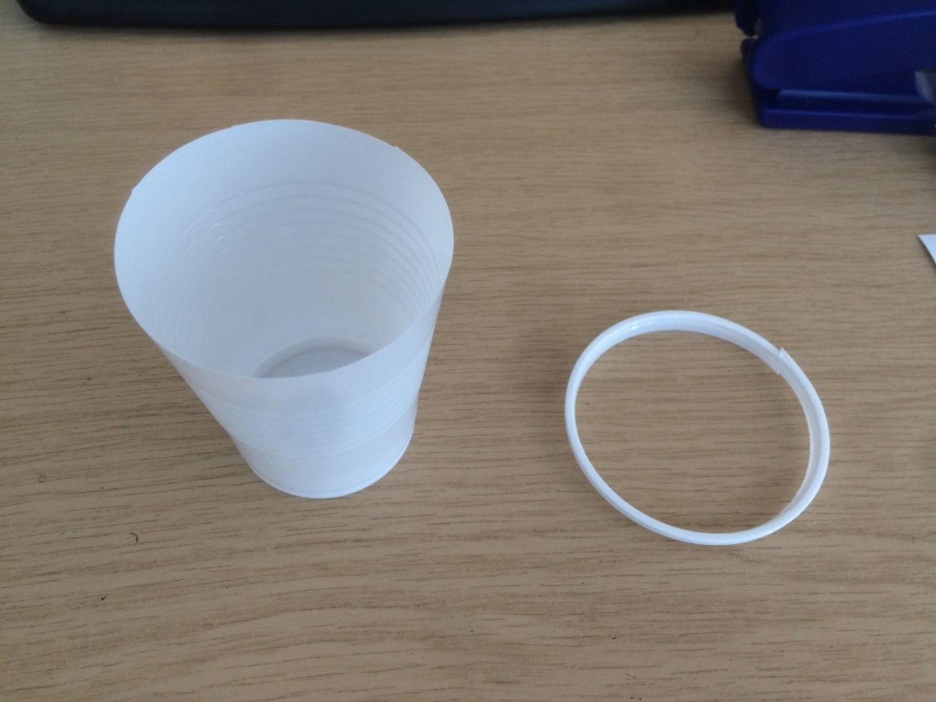
First…
Cut the top lip off of your 4 cups like so.

Slide 9
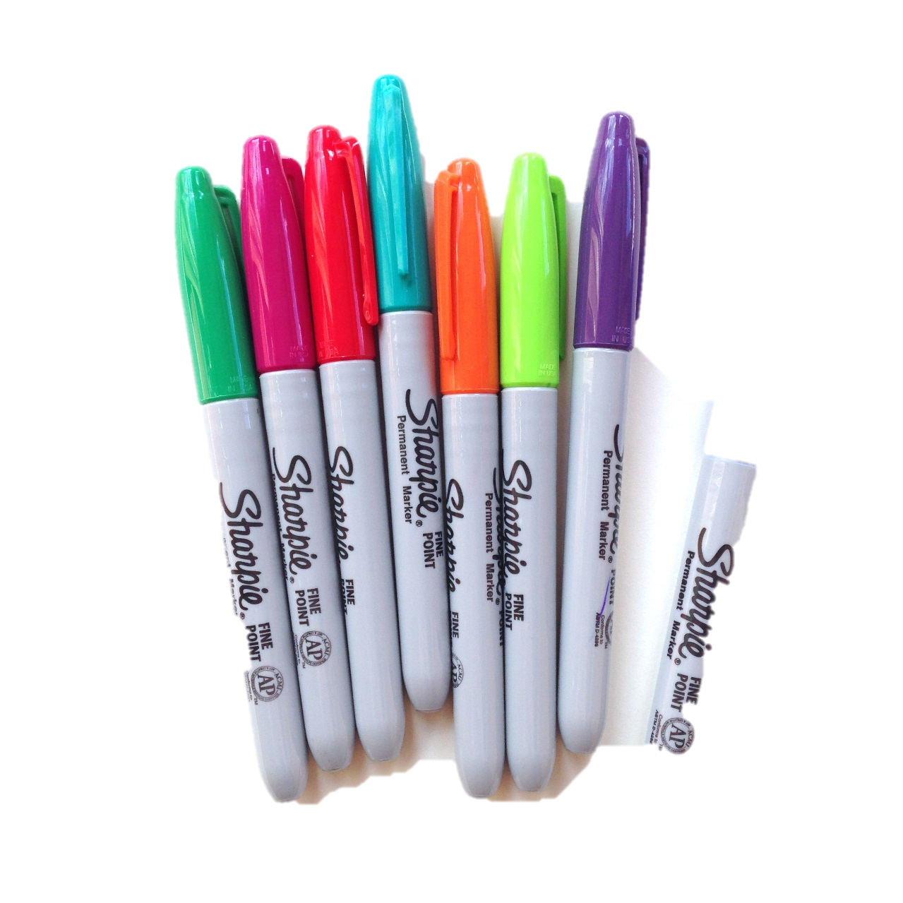
Second…
Make a coloured mark on one of your cups.
Why do you think
we mark one cup?

Slide 10
Then…
Staple your two pieces of card together like a cross. You may have to double card if it is too thin!

Slide 11
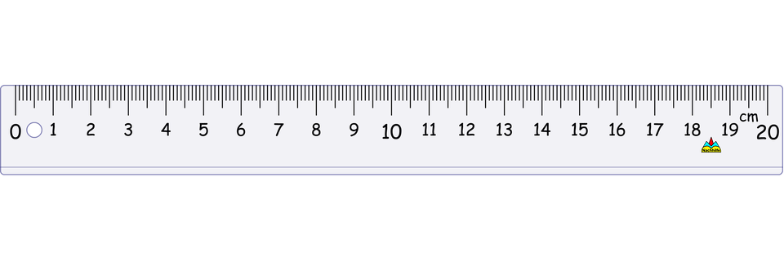
After…
Find and mark the exact CENTRE OF THE CARDBOARD STRIPS. You may wish to use a ruler.

Slide 12
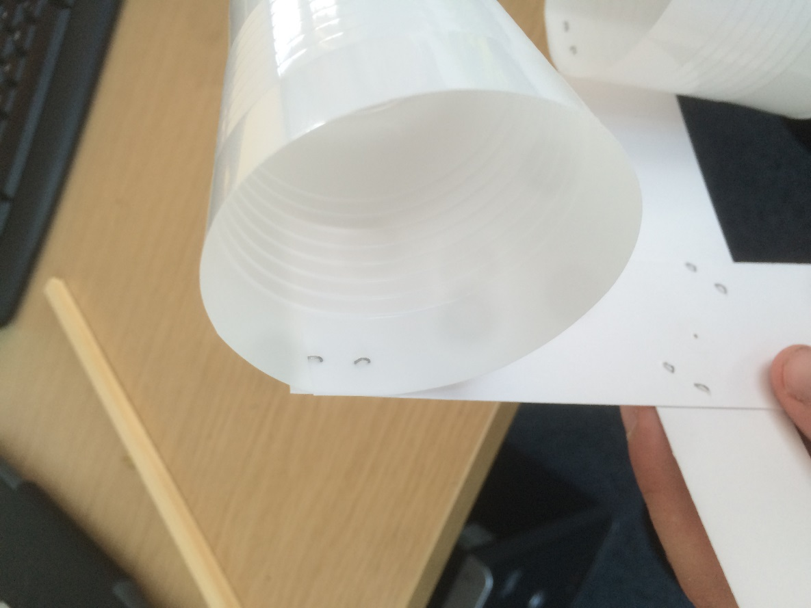
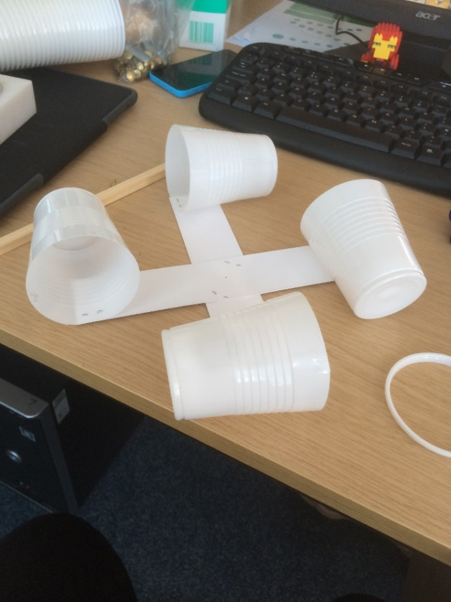
Next…
Staple your cups to each end of your card. They must all be facing the same direction.

Slide 13
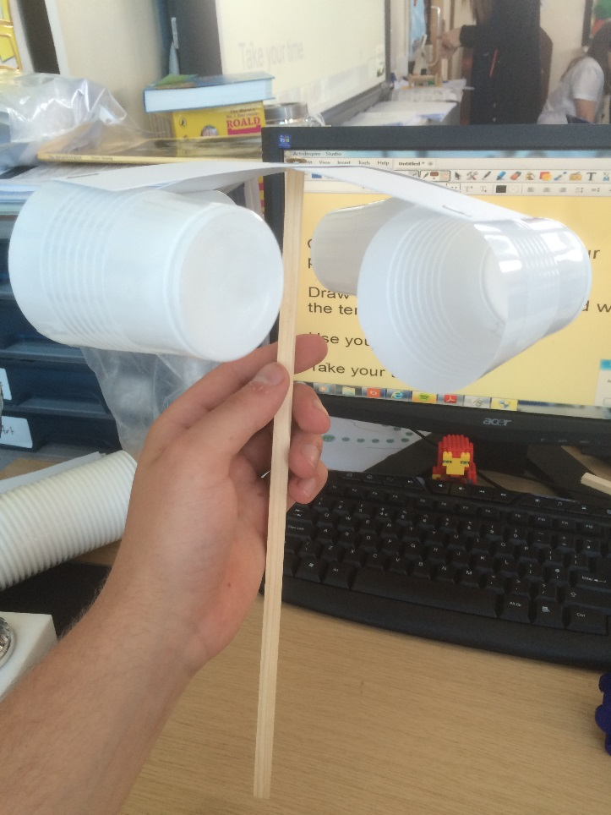
Finally…
Put your pin through the middle of your cross and attach this to the top of your dowel.. Do not push it down all the way
Or it won’t spin.

Slide 14
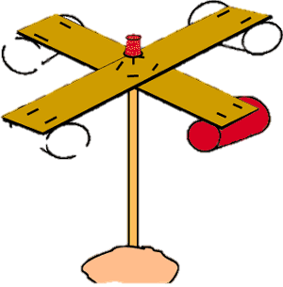
You should have successfully made an anemometer!

Slide 15
GO GO GO!
How many times does your anemometer spin in 1 minute?
What did you notice?

