Slide 1
BISCUITS

Slide 2
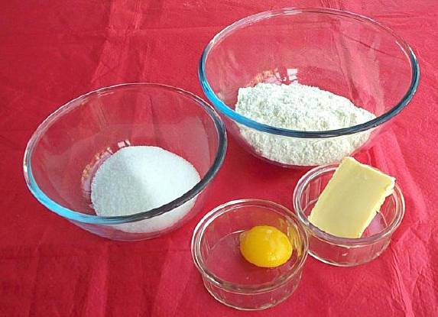
Ingredients:
50g margarine 75g granulated sugar 1 small egg yolk 100g plain flour

Slide 3
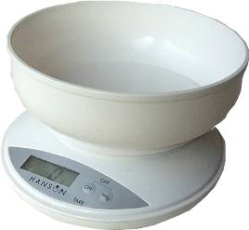
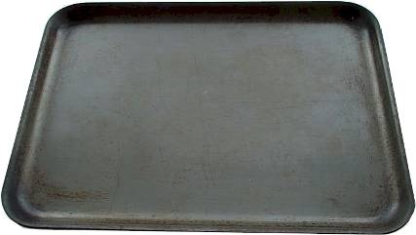
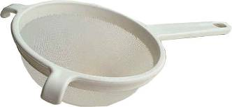
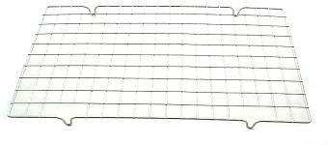
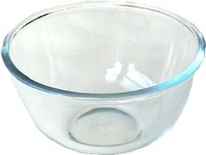
Equipment:
Mixing bowl, sieve, wooden spoon, baking tray, sieve, weighing scales, fork and cooling rack.

Slide 4
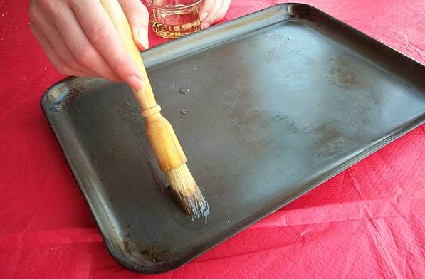
Method
1. Preheat oven to 180ºC, gas mark 4. Grease a baking tray.

Slide 5
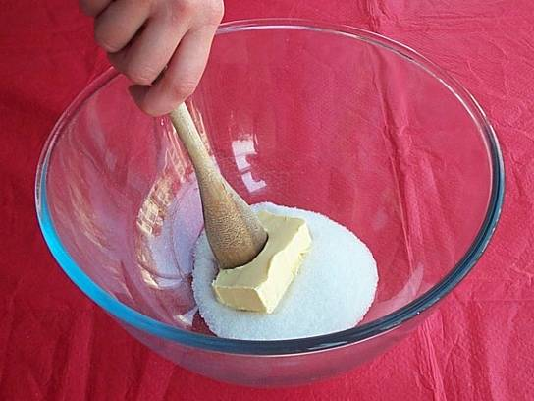
2. Beat the margarine and sugar in a bowl with a wooden spoon until creamy.

Slide 6
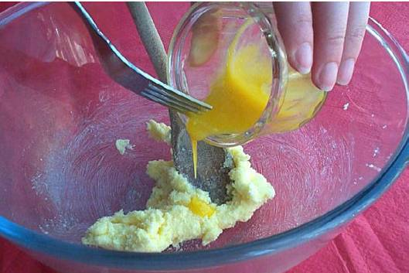
3. Add the egg, a little at a time.

Slide 7
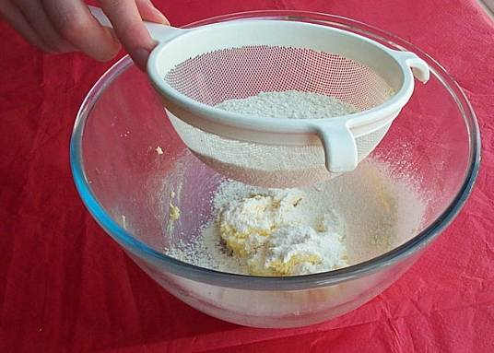
4. Sift the flour into the bowl.

Slide 8
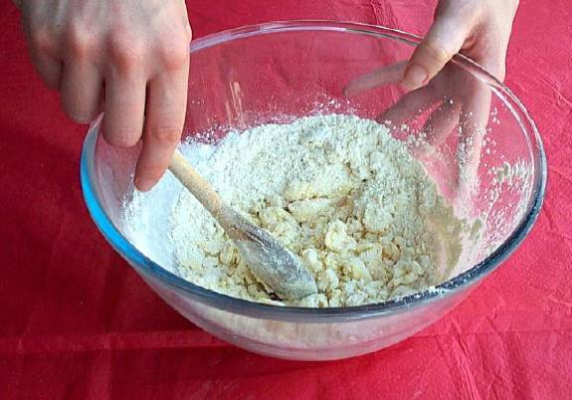
5. Mix well to a firm dough.

Slide 9
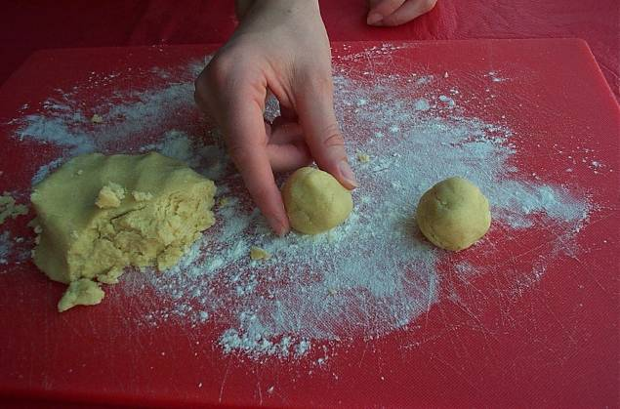
6. Shape into biscuits.

Slide 10
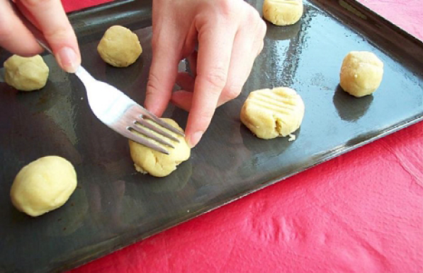
7. Place on the greased baking tray and bake for 10 minutes, until golden brown.

Slide 11
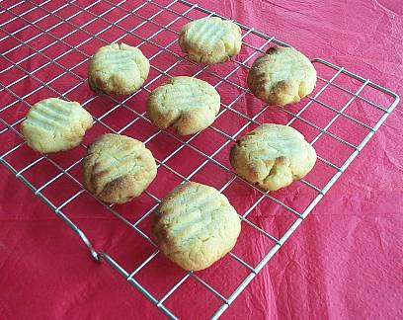
7. After baking, place on a cooking rack.
Handy Hints
Do not crowd the biscuits on the baking tray, as they may spread while in the oven.
Try adding optional ingredients after the flour, for example 25g dried apricots, 25g cherries or 25g choc-chips.

