Slide 2
Introducing Hans
Hello, my name is Hans. I would love to shake your hand, give you a high five or a fist bump but right now we can’t do that. Have a read of this handy guide I have put together to help you understand why life is different for us all at the moment.

Slide 3
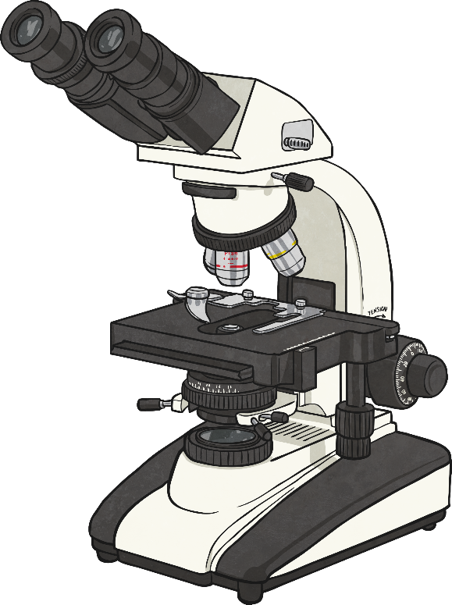
What Is COVID-19?
COVID-19 is the name of a disease which is causing a lot of problems around the world. The virus has spread because infected people moved all over the world, not knowing they had it.
COVID-19 is a part of a group of viruses that all have the same shape. This group of viruses are a type of virus known as coronavirus.
The virus itself is incredibly small and can only be seen with a very powerful microscope. However, it can get into the human body and if this happens, it can make the person who has it feel unwell.

Slide 4
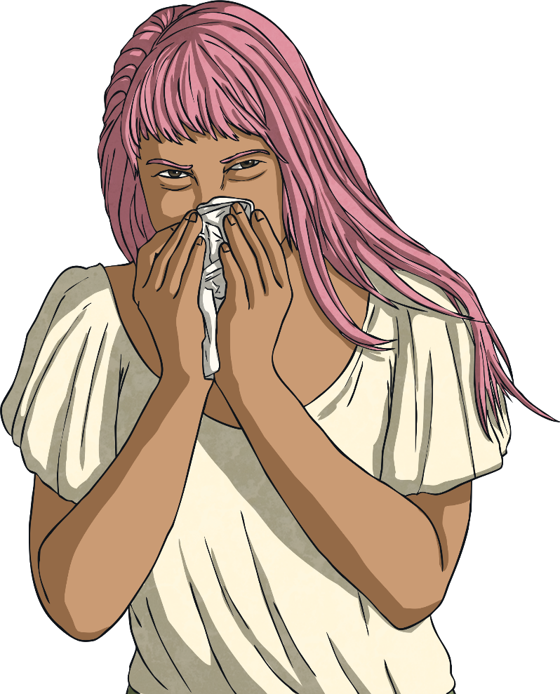
How Does the Virus Get into the Human Body?
When someone who has the virus coughs or sneezes, the virus can be forced out into the air and on to people and nearby surfaces.
The virus can live on human hands and enter the body if a person touches their face, puts their fingers in their mouth or eats something without washing their hands.
The virus can stay on different surfaces and can then be transferred to people when they touch those surfaces.

Slide 5
How Does the Virus Affect People?
Once the virus gets into the human body, it stays in the lungs. It may stay there for a few days or weeks without the person knowing they have it. However, it eventually makes people feel unwell. They might start with a cough and have a fever (high temperature).
The virus affects different people in different ways. Some people will get better on their own; others will need to go to hospital. Children do not appear to get very ill if they catch the virus but older people and those who are already ill can become very unwell.

Slide 6
What Have We Learnt about COVID-19?
COVID-19 is a form of coronavirus and it is so small that we can only see it with very powerful microscopes, not our eyes.
The virus can enter the human body and infect the lungs. It can give people a fever (high temperature) and/or a cough that does not go away.
The virus can enter the human body through the air and can live on surfaces and people’s hands.

Slide 7
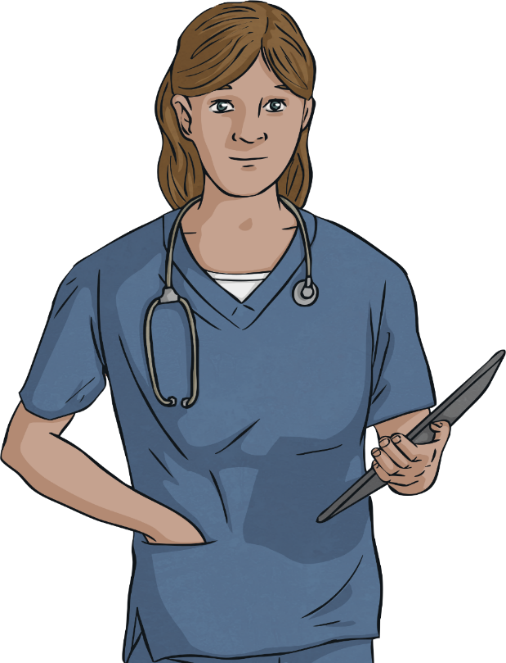
How Can We Stay Safe and Work Together to Beat COVID-19?
As people can have the virus in their body without feeling ill, it can be spread without people realising. Doctors, nurses and all hospital staff are working hard to look after the people who are feeling very unwell after catching the virus. It is important that not too many people become very unwell at the same time, so the people who need to go to hospital get a bed to sleep in and the treatment they need.
We need to all work together to stop it spreading and making people ill, especially older people and those who are already unwell with another condition.

Slide 8
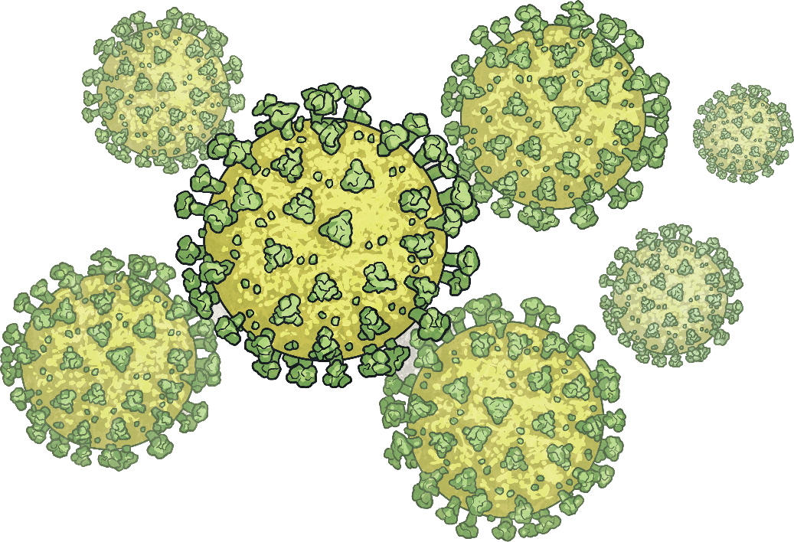
How Can We Stay Safe and Work Together to Beat COVID-19?
The way to stop it spreading is by limiting the amount of people we are near. This is the reason why schools have closed, why many parents and carers are working from home at the moment and why we have all been asked to stay at home if possible.

Slide 9
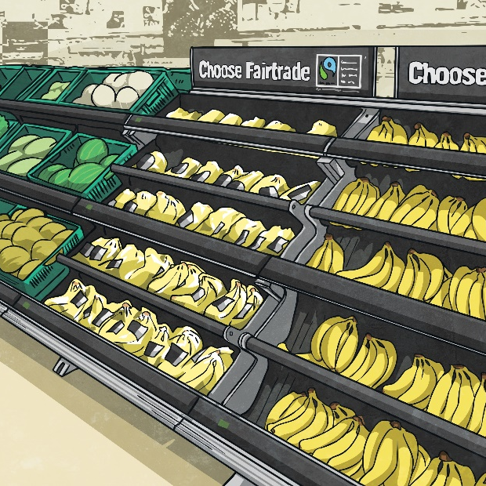
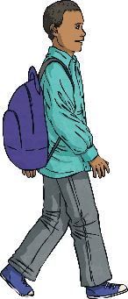
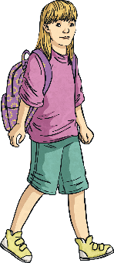
How Can We Stay Safe and Work Together to Beat COVID-19?
Only leave your home to buy food, get medicine and to exercise once a day.
Stay at home.
If you must go out, stay more than two metres away from people who you do not live with.

Slide 10
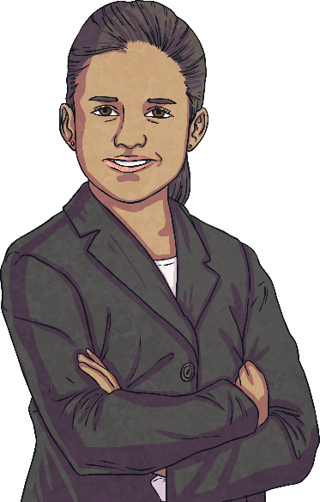
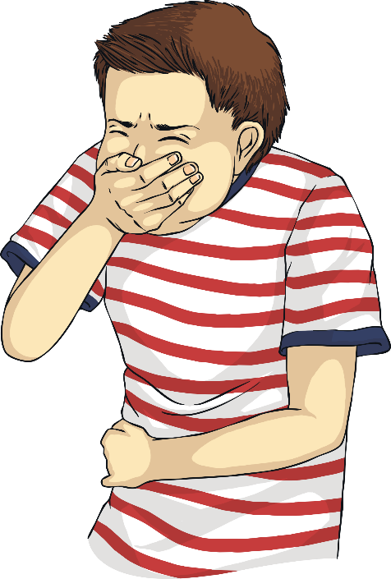
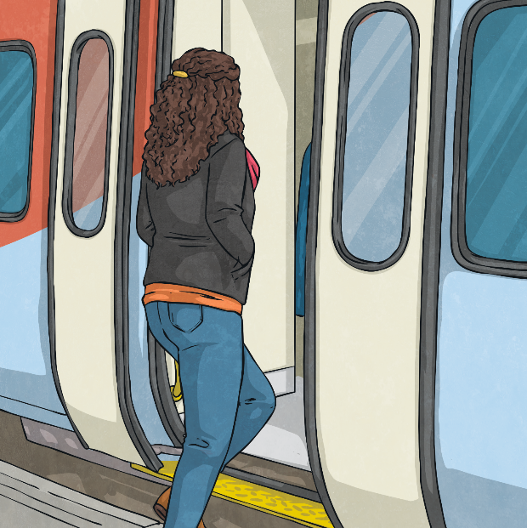
How Can We Stay Safe and Work Together to Beat COVID-19?
If someone is unwell with a high temperature or a new continuous cough, do not touch them or go near them.
Grown-ups should work from home if they can.
Do not use public transport unless it is essential that you do.

Slide 11
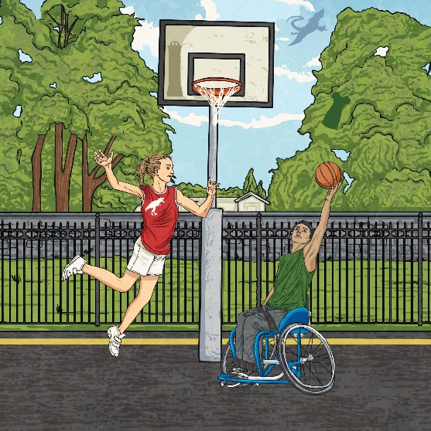
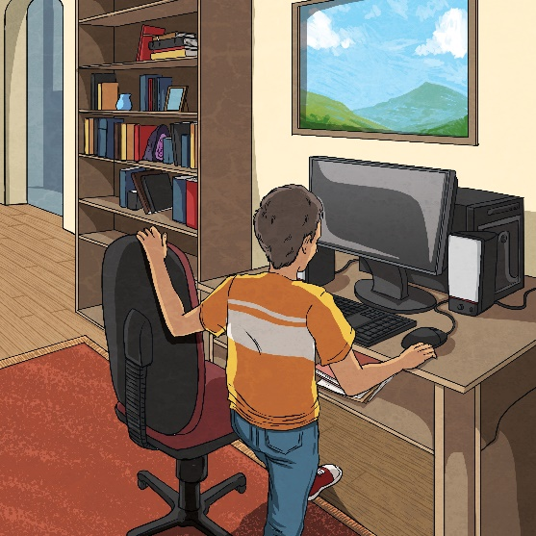
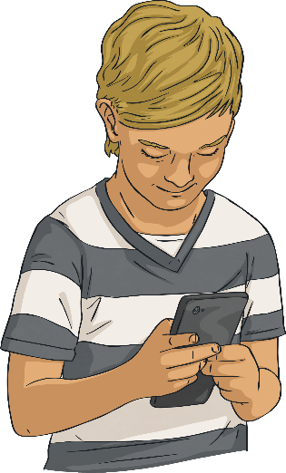
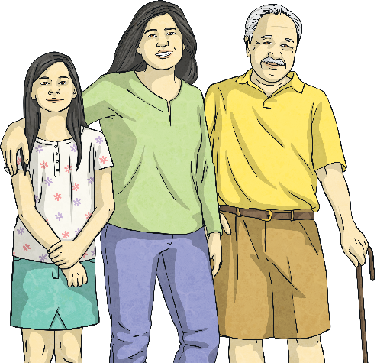
How Can We Stay Safe and Work Together to Beat COVID-19?
Do not get together with people who do not live with you in public spaces such as parks or on the street.
Keep in touch with family and friends by using phones and the Internet.
Do not meet up with friends or family who you do not live with.
Use the phone to contact people who help you stay safe and well, such as doctors.

Slide 12
How Will We Beat COVID-19?
By not being near too many people and not going to school or work if possible.
Doctors, nurses and all hospital staff are helping those who are very ill.
Follow the advice and stay at home.

Slide 13
How Can We Help?
The easiest way for the virus to get into the human body is on people’s hands, so it is important to wash our hands often for at least 20 seconds. We can also remind people we live with to wash their hands too, especially before eating.
Coughing and sneezing can spread the virus on to our hands and to other people around us. When we cough and sneeze, we must cover our mouth with a tissue or our elbow.

Slide 14
How Can We Help?
We must not cough or sneeze into our hands as we could spread the virus very easily to all the things we touch. If we use a tissue, we must throw it away immediately, then wash our hands.
If someone we live with becomes ill with a fever (high temperature) or a cough, we must all stay at home for 14 days (two weeks). We must not go too close to anyone who is ill (at least two metres away) and not share anything that touches our face, like forks or cups.

Slide 15
How Can We All Help?
Wash our hands often and remind everyone to do the same.
Keep a safe distance away from other people.
Cough and sneeze into our elbow and if anyone we live with is ill, do not share things with them that touch our faces.

Slide 16
Hands Up
Who is ready to work together to beat COVID-19?! Remember, if you have any worries or questions about COVID-19, talking to an adult you trust is a great place to start.

