Slide 1
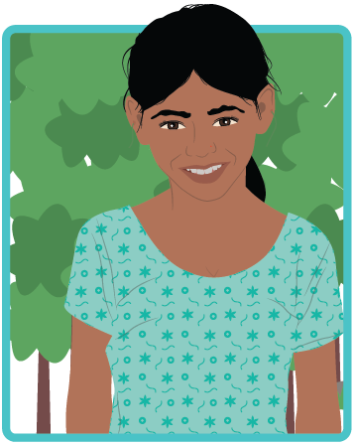
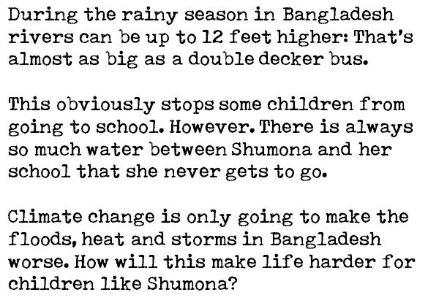

Slide 3
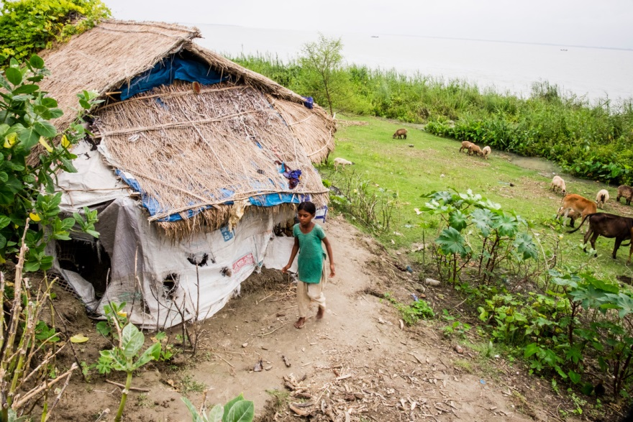
Notes:
Photographer's Credit
Mahmud /MAP/ActionAid

Slide 4
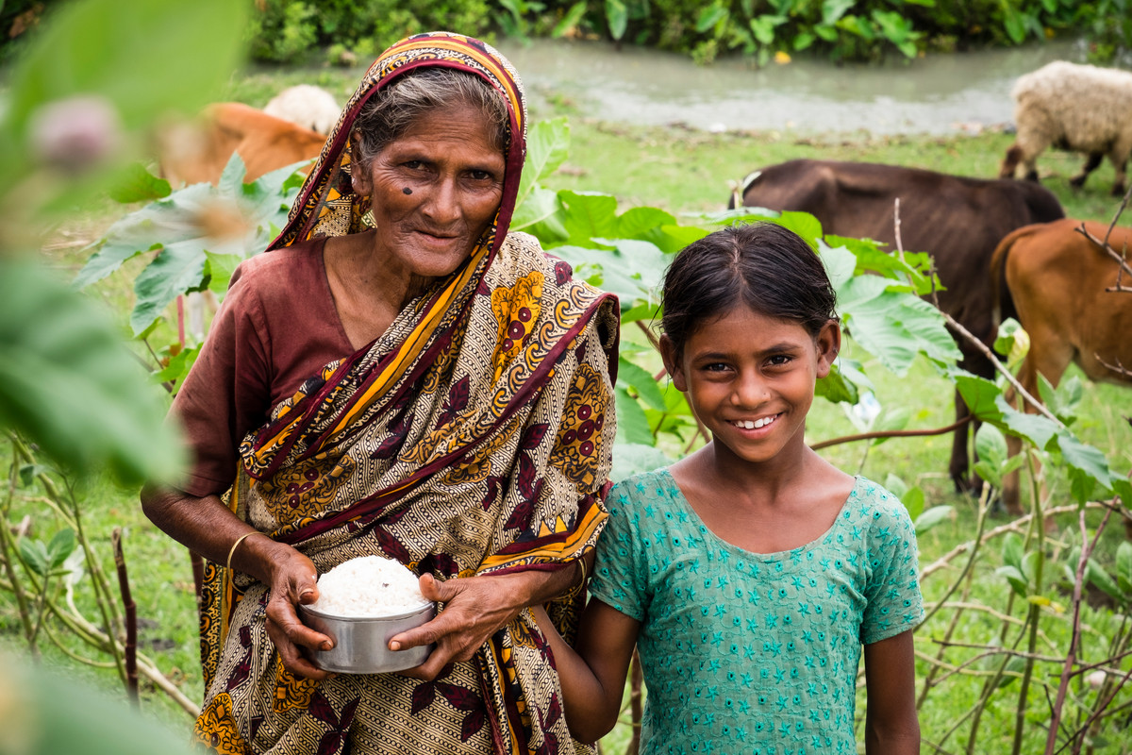
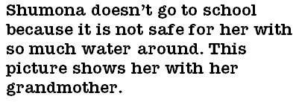
Notes:
Shumona with her Grandmother
Photographer's Credit
Mahmud /MAP/ActionAid

Slide 5
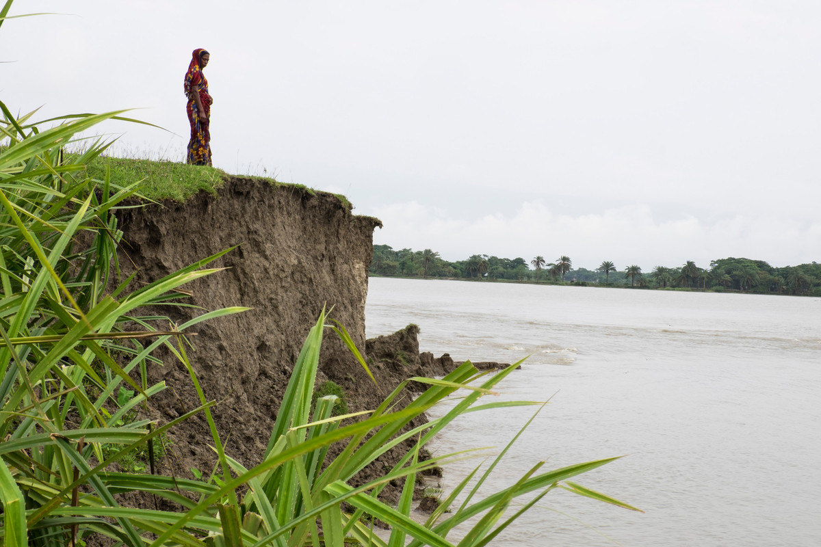
Notes:
Photographer's Credit
Mahmud /MAP/ActionAid

Slide 6
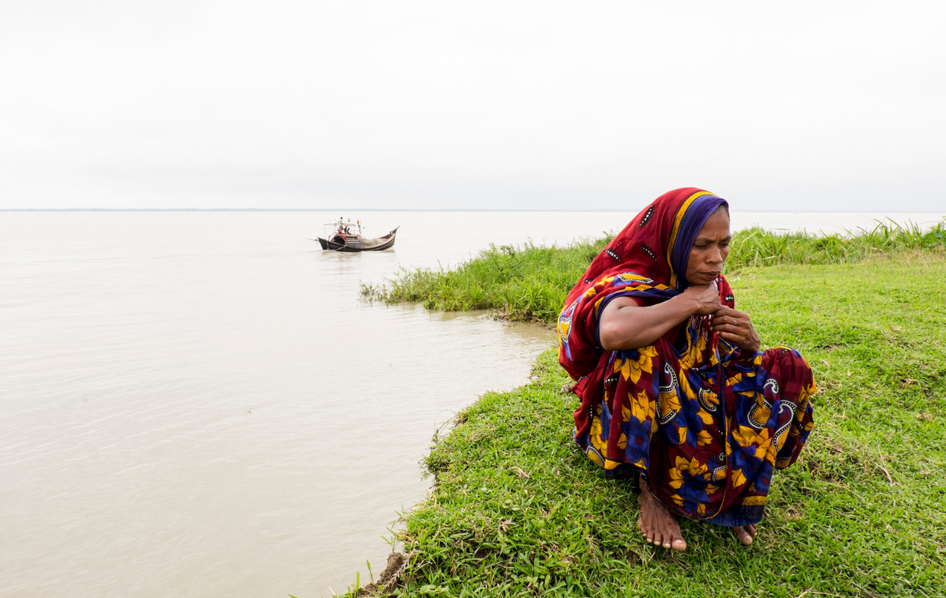
Notes:
Photographer's Credit
Mahmud /MAP/ActionAid

Slide 7
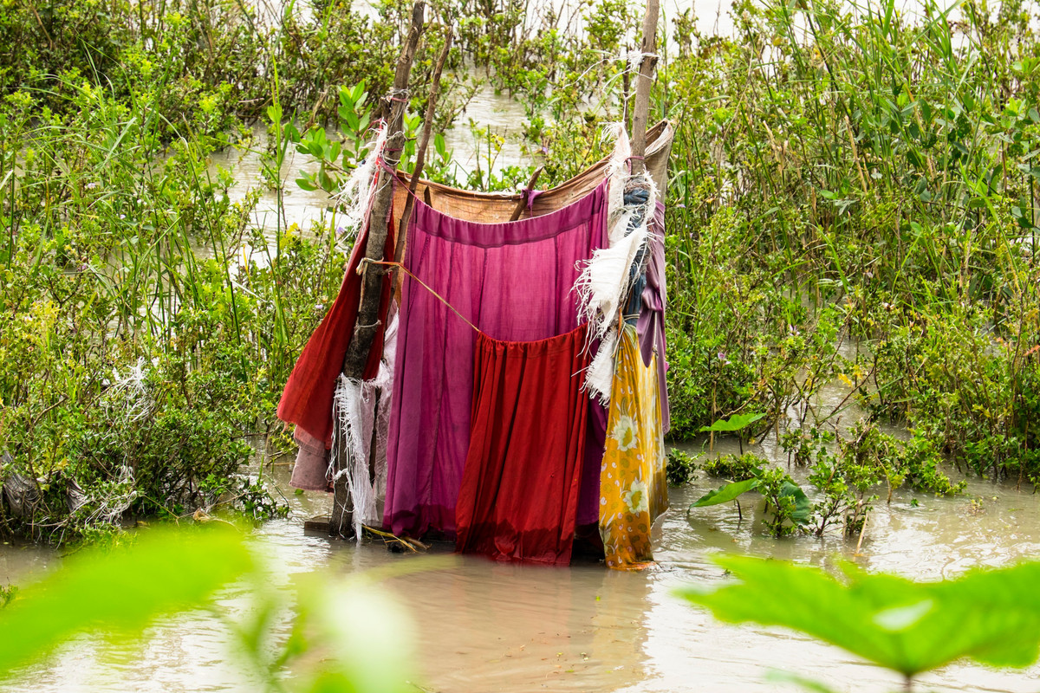
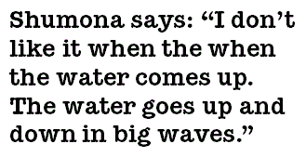
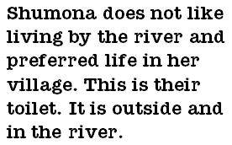
Notes:
Photographer's Credit
Mahmud /MAP/ActionAid

Slide 8
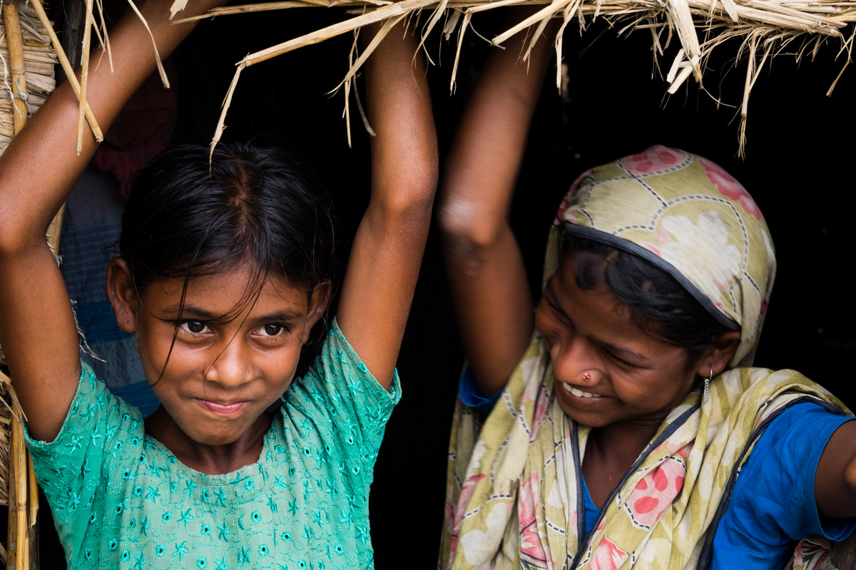
Notes:
Photographer's Credit
Mahmud /MAP/ActionAid

Slide 9
