Slide 1
Coronavirus: COVID-19

Slide 2
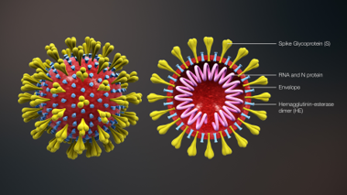
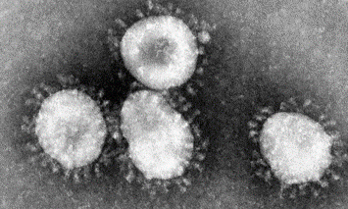
What Is a Coronavirus?
Coronavirus is the name of a family of viruses that are associated with the common cold. Most people will be infected with these viruses at some point in their lives.
Viruses live inside cells. They reproduce rapidly inside the cell, then burst out, causing damage to the cell. The new viruses then go on to infect further cells.
Coronaviruses get their name from the crown-like halo (corona) that is visible when the virus is viewed under an electron microscope.
“3d_medical_animation_corona_virus” by [Wikimedia.org] is licensed under CC BY 2.0
“corona viruses_004_lores” by [Wikimedia.org] is licensed under CC BY 2.0

Slide 3
What Is COVID-19?
COVID-19 is the name that has been given to the disease caused by a novel strain of coronavirus.
COVID-19
coronavirus – the family of viruses
disease
the year the virus was identified
SARS-CoV-2 (severe acute respiratory syndrome coronavirus 2) is the name that has been given to the virus. The virus was previously named 2019-nCoV.
This name was chosen because the virus is genetically related to the coronavirus responsible for the outbreak of SARS in 2003.
Viruses, and the diseases they cause, often have different names. For example, the HIV virus causes AIDS and the rubeola virus causes measles.

Slide 4
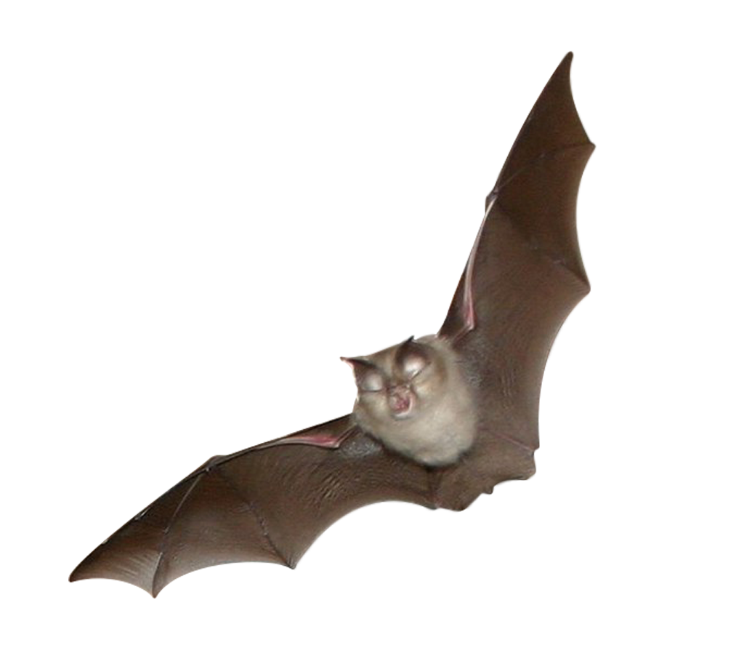
Where Did the Virus Come From?
Coronaviruses are common in many different species of animals, including camels, cattle, cats and bats. In rare cases, animal coronaviruses can infect people.
In 2003, SARS-CoV was first identified in Guangdong, China. It was transmitted to humans from bats and civet cats.
In 2012, MERS-CoV was first identified in Saudi Arabia. It has been found in camels from several countries.
It’s not just coronaviruses that can be transmitted from animals to humans.
HIV/AIDS originated in great apes.
Avian flu originated in birds.
Swine flu originated in pigs.
Ebola originated in bats.
“Lesser horseshoe bat (Rhinolophus hipposideros) bat flying towards you” by. Jessicajil [flickr.com] is licensed under CC BY 2.0

Slide 5
Where Did the Virus Come From?
When large populations of people live in close proximity to animals, the risk of a virus being transmitted from animals to humans increases.
Scientists have not yet identified the animal hosts of COVID-19.
However, genome sequencing shows that it has similarities to coronaviruses found in bats.
The genome is the entire genetic material of an organism.
The genome of coronaviruses is made from RNA, unlike the human genome which is made from DNA.
Genome sequencing is important because it helps us to understand which other viruses COVID-19 is similar to. This can help us to understand how the viruses arise and how we can predict or reduce the risk of future outbreaks of the disease.
nucleobases
base pair
helix of
sugar-phosphates
RNA
Ribonucleic
acid
DNA
Deoxyribonucleic
acid

Slide 6
Where Did the Virus Come From?
The first cases of COVID-19 in humans were identified in December 2019 in Wuhan, a city in the Hubei province of China. The first infections were linked to a live animal market.
The virus is now spreading from person-to-person. As of 23rd March 2020, there have been 332 930 confirmed cases worldwide and 14 510 deaths.
There are 190 countries and territories with reported, confirmed cases of COVID-19. In the UK, 5687 people have tested positive for the virus.
On 11th March, COVID-19 was characterised as a pandemic.
Hubei
Pandemic
A disease that has become widespread around the world, with an impact on society.
1 https://www.who.int/docs/default-source/coronaviruse/situation-reports/20200311-sitrep-51-covid-19.pdf?sfvrsn=1ba62e57_4

Slide 7
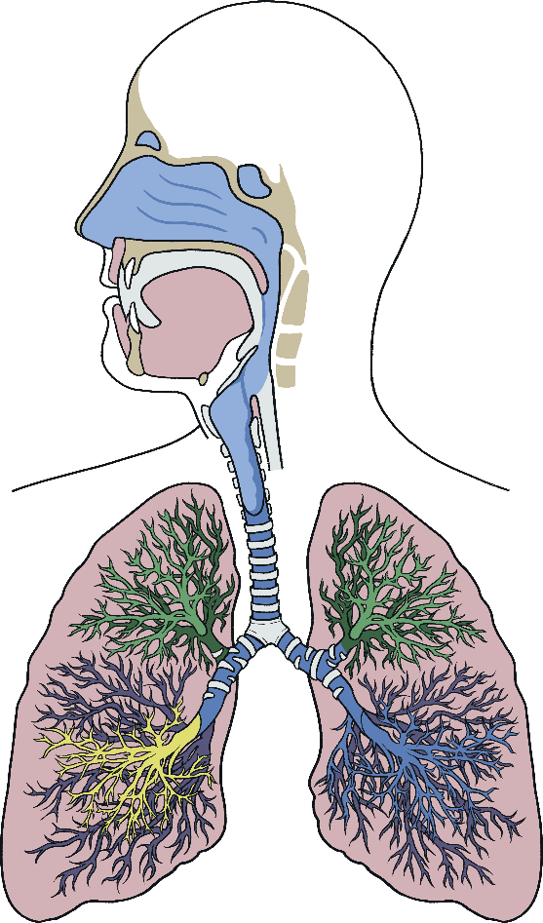
How Is the Virus Spread?
Coronaviruses affect the respiratory system, which contains the organs needed for breathing. Therefore, the viruses cause symptoms such as coughs, blocked noses and sore throats.
People with respiratory viruses are usually most contagious when they feel ill and have symptoms.
There have been reports of COVID-19 spreading before the patient has symptoms. The same is seen with the flu.
Some viruses are spread more easily than others. Scientists are not sure yet how infectious the virus causing COVID-19 is.
The Respiratory System

Slide 8
How Is the Virus Spread?
Viruses usually spread from person-to-person through droplets that are produced when an infected person sneezes or coughs. Flu is also spread in this way. For this reason, people with COVID-19 are being asked to isolate themselves at home.
“sneeze” by [Wikimedia.org] is licensed under CC BY 2.0
Another way that flu is spread is by touching a surface that has the flu virus (influenza) on it. It is possible that a person can get COVID-19 by touching a surface or object that has the virus on it and then touching their own mouth, nose or eyes.
The risk of becoming infected with the virus causing COVID-19 from products shipped from China is low.

Slide 9
How Do You Treat a Virus?
Because viruses live inside cells, it is difficult to develop drugs that kill them without also damaging the body’s tissues.
Antibiotics only kill bacteria, so they do not work on viruses.
A coronavirus infection can be treated in the same way you would treat a cold.
Get plenty of rest.
Drink lots of fluids.
Use painkillers to treat symptoms.
Coronaviruses can sometimes cause pneumonia. This is more likely to happen in infants under the age of two, the elderly or vulnerable patients. Smoking is also a risk factor for pneumonia.
In hospital, breathing support is given to patients who have breathing difficulties.

Slide 10
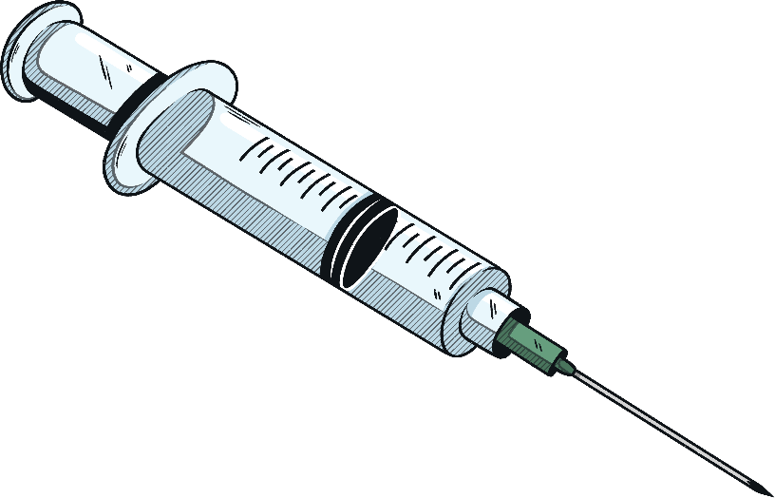
Do We Have a Vaccine?
The virus that causes COVID-19 is a new virus that hasn’t been seen in humans before, so scientists still have a lot to learn about it.
Therefore, there is not currently a vaccine available.
Now that the genome of the coronavirus has been sequenced, lots of teams are working hard to make a vaccine and research groups are hoping to have a viable vaccine produced within a few months.
After a vaccine has been produced it will have to be tested and this will take much longer.
All new drugs are tested for:
toxicity – to check they aren’t poisonous;
efficacy – to check they work;
dose – to find out how much is safe to give while still being effective.

Slide 11
How Can We Prevent Infection?
As an Individual:
You can prevent the spread of a coronavirus infection in the same way that you can avoid infection with the common cold.
Wash hands thoroughly with soap and water.
Avoid touching your eyes, nose and mouth with your hands, as this could allow viruses from surfaces you touch to enter the body.
Avoid close contact with people who are infected.
Stay home if you are ill.
Cough or sneeze into your elbow or a tissue and throw it in the bin.
Clean and disinfect frequently touched surfaces.

Slide 12
How Can We Prevent Infection?
Countries are responding in a variety of ways depending on their resources and how severe the outbreak is.
Travel Restrictions
Severely affected countries are limiting the movement of their citizens to try and prevent people who have become infected from spreading it to others.
Many countries have banned foreign nationals from entering if they have visited affected countries in the last 14 days. Others have imposed 14 day quarantine periods on passengers arriving from infected countries.
Closing Schools and Colleges
Fourteen countries have nationwide school closures, while another thirteen have closed some schools.
Cancelling Large Gatherings
Events which would result in large gatherings of people, such as concerts or sports events are being postponed or cancelled. Some sports events are being played in empty stadiums.

Slide 13
Should We Be Worried?
People of all ages can be affected by COVID-19. However, initial data suggests that children are less affected than adults. Current data suggests that 80% of infections are mild or asymptomatic.
The remaining 20% of cases are severe and require hospitalisation. This is higher than is observed with influenza infection. Older people and those with existing medical conditions are more vulnerable to becoming severely ill.
The current estimate of reproduction number for the virus causing COVID-19 is between 2.0 and 2.5, which tells us that every infected person goes on to infect between 2.0 and 2.5 new people.
This number is higher than seasonal flu which has a reproduction number of between 1 and 2, depending on the strain. However, influenza can spread faster than COVID-19 because it has a shorter incubation period and a longer period of pre-symptomatic transmission.
Measles has a reproduction number of 12 - 18 people.
We know that COVID-19 is spreading, but not as fast as some other viruses can.

Slide 14
Should We Be Worried?
The case-fatality ratio tells us the percentage of people who become infected that die.
Virus | Case-Fatality Ratio
MERS-Cov | 34%
SARS-Cov | 9.6%
SARS-Cov-2 (COVID-19) | 3 - 4%
Seasonal Influenza | 0.1%
It’s important to remember that the numbers for COVID-19 are only estimates and should be used with caution. There is likely to be a bias for severe cases while the information is still new. Mild cases will be under-reported because people won’t necessarily need to seek medical attention.

Slide 15
Should We Be Worried?
You may read lots of different views about the coronavirus in the news and on social media.
There is a lot of information accessible to you: some of it is accurate and some of it is not. This can make it hard to find reliable information that you can trust.
The World Health Organisation is working hard to share evidence-based information that you can access on its site and social media channels.
Most viruses can have severe health impacts on vulnerable people.
You can help to protect vulnerable people and yourselves by reducing the spread of infection.
If you are ill, stay at home.
Wash your hands.
Catch coughs or sneezes in tissues and then throw them away.

