Slide 1
Buddhism
Week 4

Slide 2
Remind your partner
What have we learnt about Buddhism so far?
The life of Buddha
The Eightfold path

Slide 3
Today
We are going to be learning about a celebration that is important to Buddhists.

Slide 4
Starter
What is your favourite celebration or time of the year and why it is your favourite?

Slide 5
LI: To be able to investigate the significance of Wesak and explore ways Buddhists celebrate it.
Success criteria:
I can explain what a festival is.
I can understand why Wesak is an important Buddhist festival.
I can explain how Buddhists celebrate Wesak.

Slide 6
TTYP
What is a celebration?
A celebration is a way of marking an important day or event.

Slide 7
Think about…
THREE events that people usually celebrate.

Slide 8
TTYP
Think of THREE words that describe the feelings usually associated with special times and celebrations.

Slide 9
TTYP
What is the difference between celebration and a festival?
A festival is a day or period of celebration, typically for religious reasons.

Slide 10
TTYP
Name at least 3 religious festivals (from any religion) that you can think of.

Slide 11
Today
We are going to be learning about a Buddhist festival which is known as Wesak.

Slide 12
Wesak
Wesak is the most important of the Buddhist festivals and is celebrated on the full moon in May.
It celebrates the Buddha's birthday, and, for some Buddhists, also marks his enlightenment and death.

Slide 13
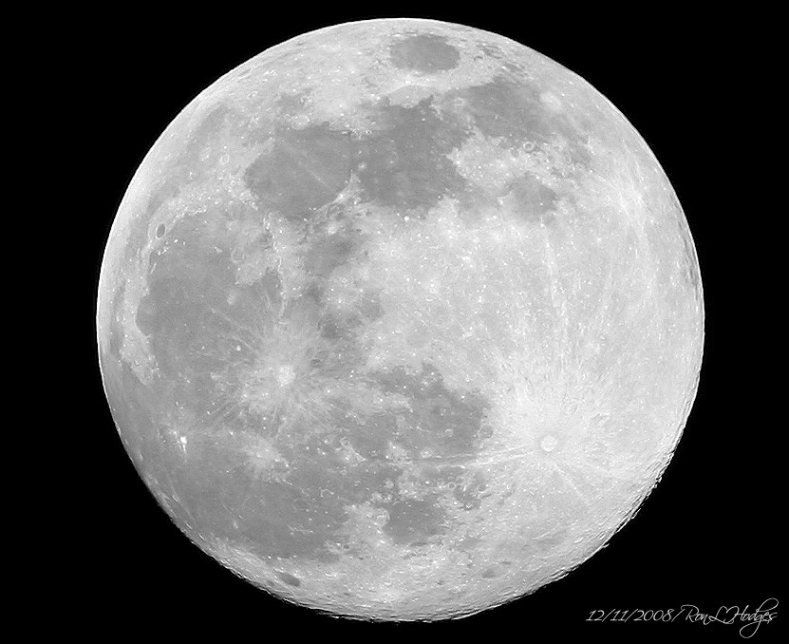
When is Wesak celebrated?
Wesak is celebrated on the full moon in May.

Slide 14

How do Buddhists celebrate Wesak?
Buddhists send each other greetings cards and decorate their homes and temples with lights.

Slide 15
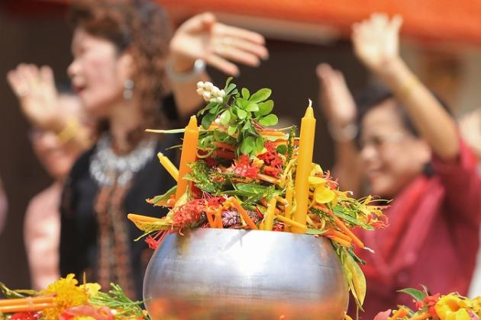
What else?
In many countries during the festival, Buddhists will visit their local temple for services and teaching.
Buddhists will give offerings to the monks of food, candles and flowers.

Slide 16
Chanting
Chanting and praying are an important part of Wesak.
https://www.youtube.com/watch?v=MOlZlXn0KT8
Close your eyes
Think about how the chanting makes you feel?

Slide 17
Practices
Water is poured over the shoulders of the Buddha as a reminder to purify the mind from greed, hatred and ignorance.

Slide 18
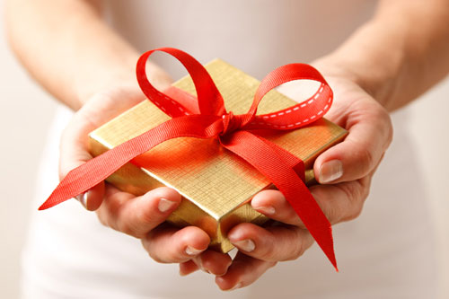
Gifts
Gifts are taken to an altar to be offered to the Buddha statues. This shows respect and gratitude to the Buddha for his life and teachings.

Slide 19
Watch this clip
https://www.youtube.com/watch?v=pLqbVQxiFY0
Can you use what you have learnt about the Wesak festival to identify what is happening?

