Slide 1
TTYP
Who is Buddha?

Slide 2
Buddha
Buddha was a human being who became enlightened, understanding life in the deepest way. He was born around 2,500 years ago and was the founder of Buddhism.

Slide 3
Today
We are going to be learning about the Eightfold Path which is one of the Buddha’s principal teachings and a very important aspect of Buddhists’ lives.

Slide 4
LI: To be able to understand the main beliefs of Buddhists
Success Criteria:
I can understand what the Eightfold path is.
I can understand that the Eightfold path is important to Buddhists
I can understand how the Eightfold path affects Buddhists’ everyday lives.

Slide 5
The Eightfold Path

Slide 6
Buddhists’ Believe…
Buddhists believe that to live a good life you must follow the Eightfold Path
The Eightfold Path has eight parts that must be followed in everyday life.
These are…

Slide 7
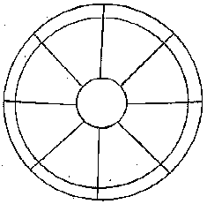
Eightfold Path
To practice concentration
To know the truth
Free one's mind from evil
To resist evil
To be in control of one's feelings and thoughts
To not say anything to hurt others
To work at a
job that does not injure others
To respect life, property, and morality

Slide 8
Warning
On the next slide is a still picture, however it looks like its shaking; your mind is being tricked!
Can you control your mind to stop the picture shaking?
If it hurts your eyes look away

Slide 10
Can you control your mind?
What do you see?
This picture can be either
a young lady or an old lady
Can you make your mind
see both?
Eightfold Path- To practice concentration and to be in control of your thoughts

Slide 11
Does this help?

Slide 12
