Slide 1
Teacher note:
We hope you find the information on our website and resources useful. This resource contains potentially sensitive information that may emotionally impact on students you use it with due to their experiences in their past. While there are many positive aspects of organ donation, the subject does cover death as this is when many organs are donated. Questions may be raised about the age of donors which can be any age in the same way that people of any age, including babies, can have a life saved by organ donation. It is your responsibility to consider whether it is appropriate to use this resource with your students. If you do use this resource, it is your responsibility to ensure that appropriate support is available for anyone affected.

Slide 3
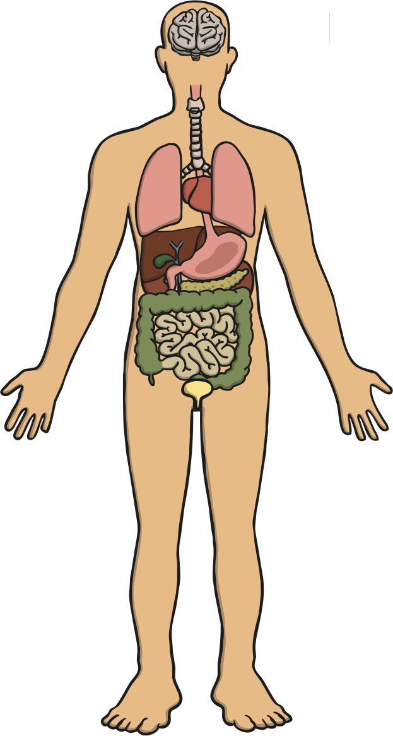
What Is an Organ?
An organ is a part of your body that does a job.
There are actually 79 organs and 11 organ systems in the human body but you have five vital organs which are the ones you need in order to live.
Brain
Lungs
Can you write a list of what you think are the vital organs in your body?
Then, reveal the answers…
Heart
Liver
Organs inside the body are called internal organs and those on the outside are called external organs.
Kidneys
Did you know?
The skin is the largest organ of the body.

Slide 4
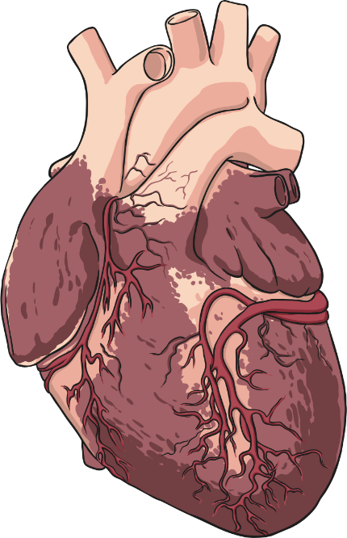
What Is Organ Donation?
Organ donation is when a someone (alive or dead) gives an organ from their body to another person to improve or save their life.
It’s called a donation as in most countries it’s illegal to receive money for organs.
There are three types of organ donation:
Living donation
Donation after brain death (DBD)
Donation after circulatory death (DCD)
Did you know?
More than 50 000 people are alive in the UK today because of organ donation.

Slide 5
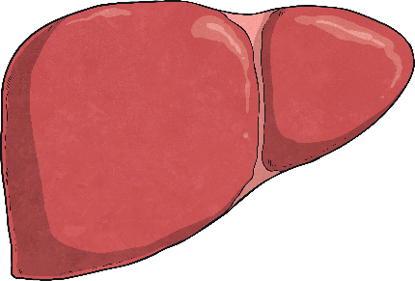
Living Donation
Although your vital organs are needed to keep you alive, you can survive without all of them. Due to this, you can actually choose to donate some of your organs while you are alive.
You have two kidneys but can survive using only one. Some people donate a kidney while they are alive.
You only have one liver but you can donate part of it while you are alive as you might not need all of it.
Did you know?
People waiting for a kidney transplant wait an average of two and a half years for an after-death donation.

Slide 6
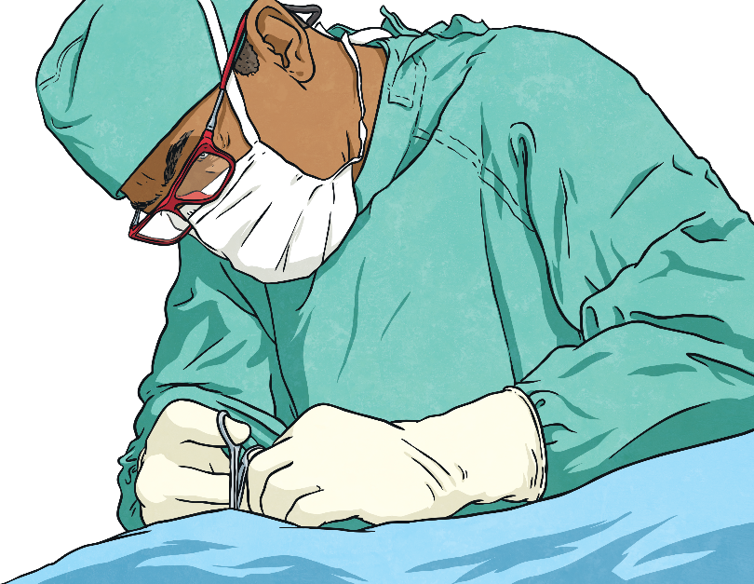
What Is a Transplant?
A transplant is basically taking something out of one place and putting it in another home. A bit like when we transplant flowers or bushes from one garden or plant pot to another.
A transplant can happen with human organs too. There is an operation done to take an organ out of one body and attach it in its new home – another person’s body. The person receiving the organ is known as the recipient.
Did you know?
The first organ to be transplanted successfully was a kidney in 1954 and the world’s first human heart transplant was done by Doctor Christiaan Barnard in 1967 in Cape Town, South Africa.

Slide 7
Getting the Right Organs
Unfortunately, not all possible organ donations can be transplanted or even considered.
People who have died away from a hospital can’t usually donate their organs.
Potential organs have to be tested for infection and disease as they may not be safe to transplant.
Potential organs are also tested to see if they are a match for the person who might receive them. Things like blood group and size of body really matter.
Did you know?
There are eight blood types. Do you know which type you are?

Slide 8
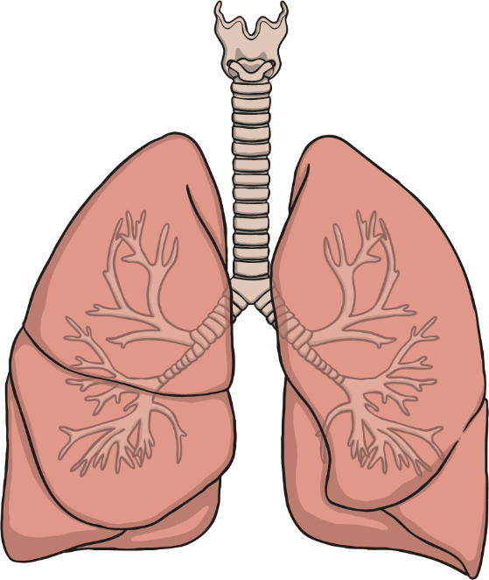
Critical Transplant Timings
There are lots of people involved in making sure an organ reaches the new body (the recipient) in time so that it is still working enough for the transplant to be a success
Lungs and hearts, for example, only have between 4–6 hours to get from one body to another while a liver is 14–16 hours and a kidney is 12–24 hours.
Did you know?
In the UK, there are around 200 heart transplants performed each year.

Slide 9
The Organ Donation Register
This is a national list with the details of everyone who has signed up to say that they would like to donate their organs after they have died.
This is a national list with the details of everyone who has signed up to say that they would like to donate their organs after they have died.
Anyone who signs up should also talk to their family about their wishes so that everyone knows.
Organ donation can be a difficult subject to talk about, can you think why?
Did you know?
All the major religions in the UK support organ donation within their beliefs but it is still down to the individual to make choices.

Slide 10
The Transplant Process – Every Second Counts
The family of the person who has died have agreed to organ donation or the person who has died is on the organ donation register and the family are happy with this decision.
Speed is vital so potential organs are tested and matched with a recipient while step 1 is still taking place and step 3 can also start happening.
As quickly as possible, a surgical team remove the organs, clean and cool them ready for transportation.
The transport team take the organ as quickly as possible to the hospital where the recipient is. The longer an organ takes to get to the recipient, the less chance it has of being successful.
The surgical team will be waiting with the recipient (already in the operating theatre) ready to perform the transplant.
Did you know?
There are over 6000 people in the UK currently waiting for a transplant and these people would have to go to hospital immediately if a donor was found.

