Slide 1
What is a paragraph?

Slide 2
A paragraph is a group of sentences which all link together about the same subject.
E.g. Silently, he crept through the dark, dingy cave. It smelt awful. So awful that he had to hold his nose! But he kept on going.
In this paragraph, the subject is all about walking through the cave.

Slide 3
So what now??? Let’s see what happens next.
Silently, he crept through the dark, dingy cave. It smelt awful. So awful that he had to hold his nose! But he kept on going.
Before long, he found the entrance and felt the hot sun on his face. It was a beautiful day and he thanked his lucky stars that he had escaped.
So why did the writer start a new line?

Slide 4
All about the cave.
Silently, he crept through the dark, dingy cave. It smelt awful. So awful that he had to hold his nose! But he kept on going.
Before long, he found the entrance and felt the hot sun on his face. It was a beautiful day and he thanked his lucky stars that he had escaped.
Changed time and location.

Slide 5
If something changes in the story or information page, then you must have a new paragraph.

Slide 6
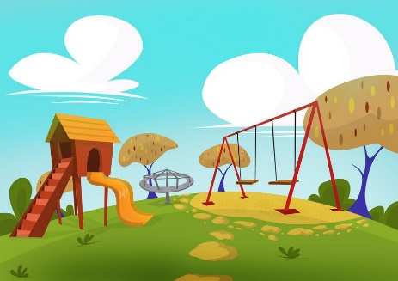
When should I start a new paragraph?
Change of time e.g. Later that day…..
Change of place e.g. At the park…
Change of person speaking e.g. “Help me!”

Slide 7
Task: Can I make a help poster about paragraphs?
Make sure you include what a paragraph is and the main reasons for starting a new paragraph.
Change of time
Change of place
Someone new starts speaking
What pictures would help you remember?

