Slide 1
Printing like a pro!
Year 5 Art

Slide 2
Transferring your design

Slide 3
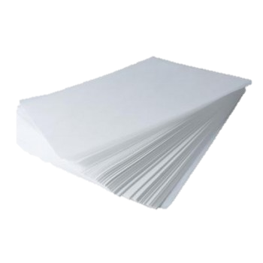
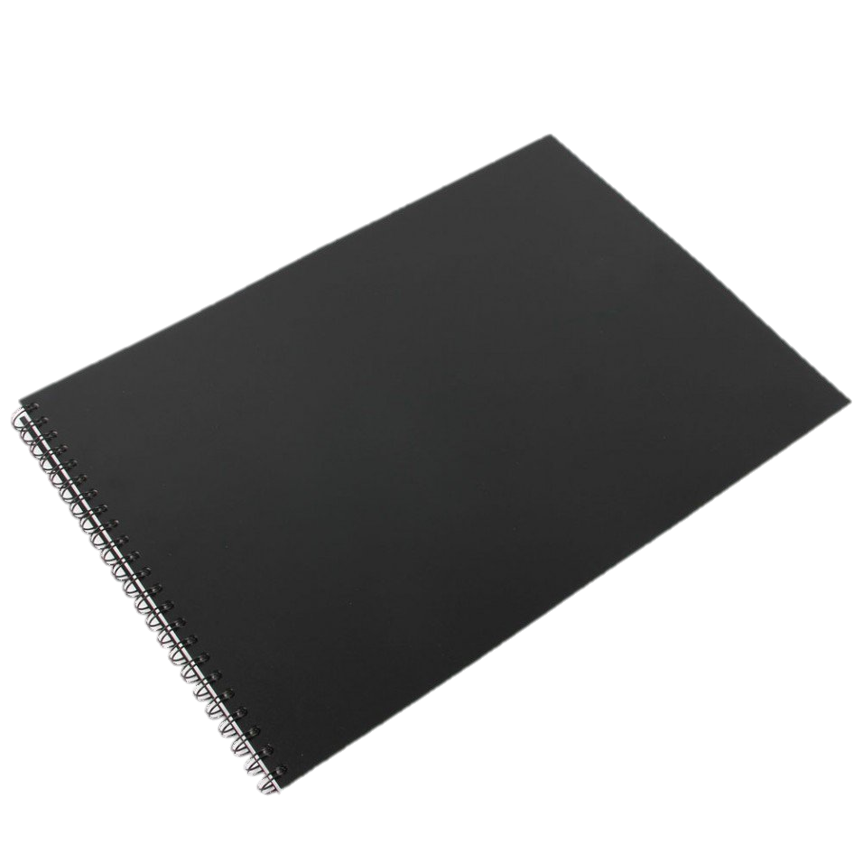
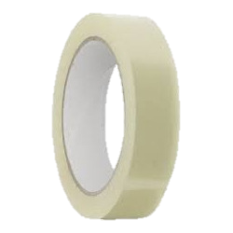

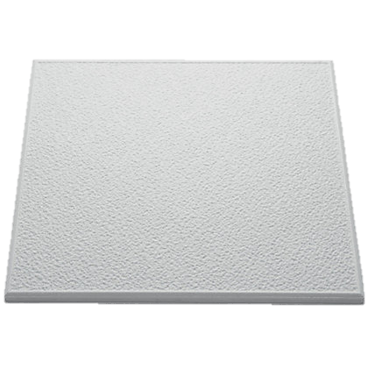
You will need:
10 x 10 tile
Tracing paper
Sketchbook
A sharp and blunt pencil
Sellotape
Whiteboard pen
Glue
Patience!

Slide 4
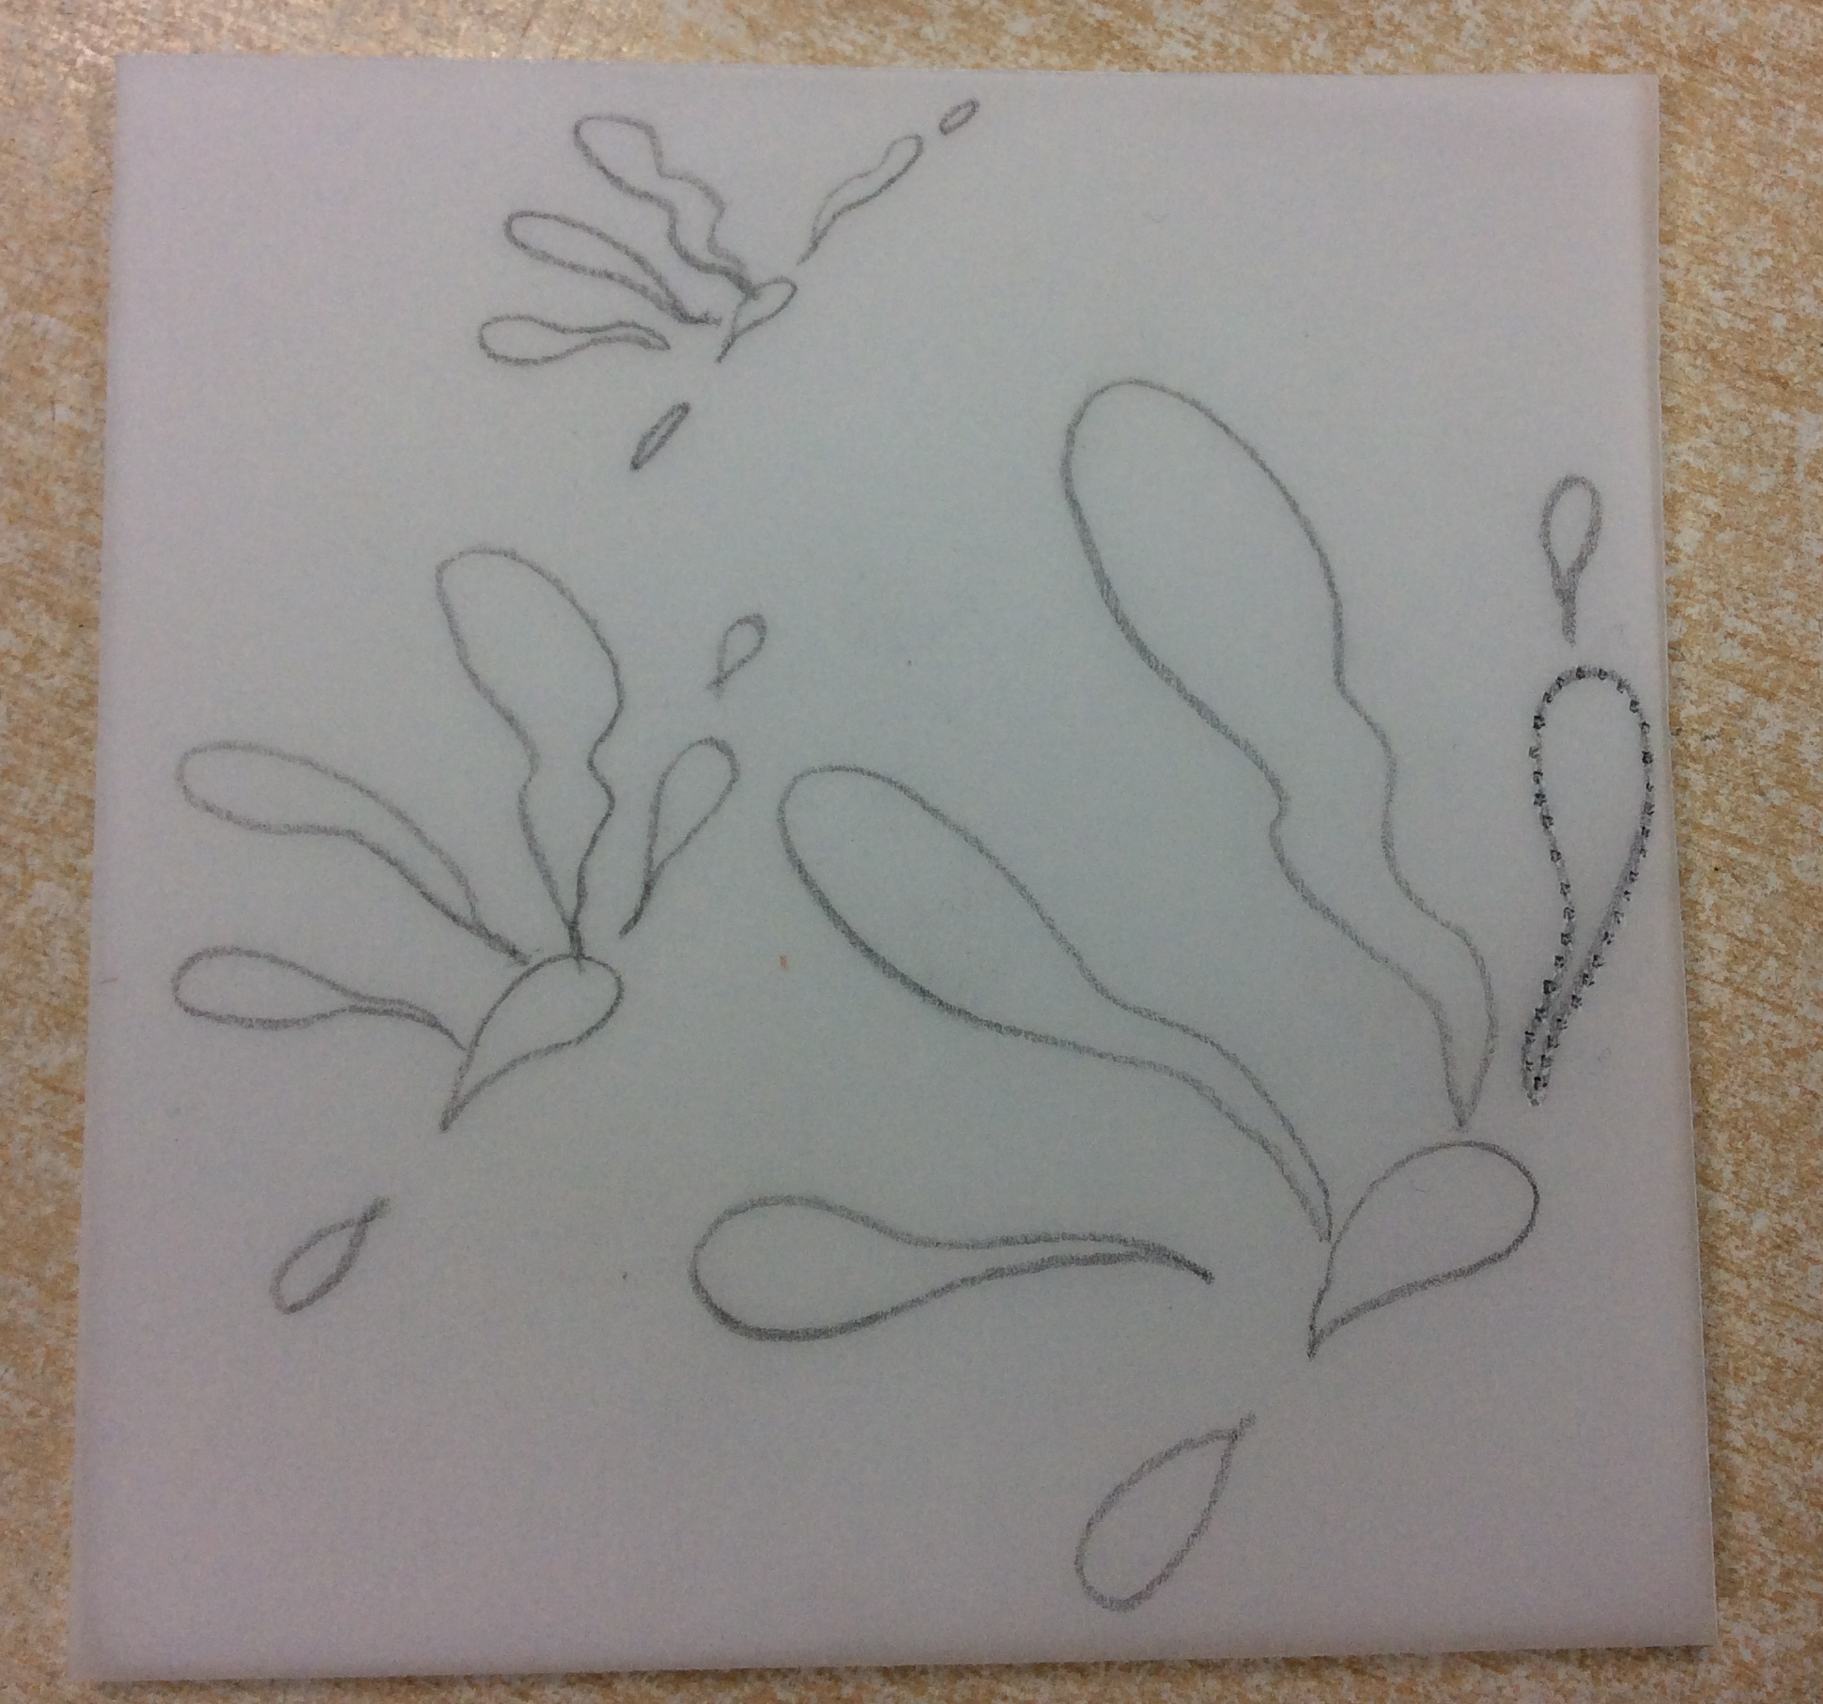
Step 1:
Carefully trace your final print design from your book onto tracing paper, using a sharp pencil.

Slide 5
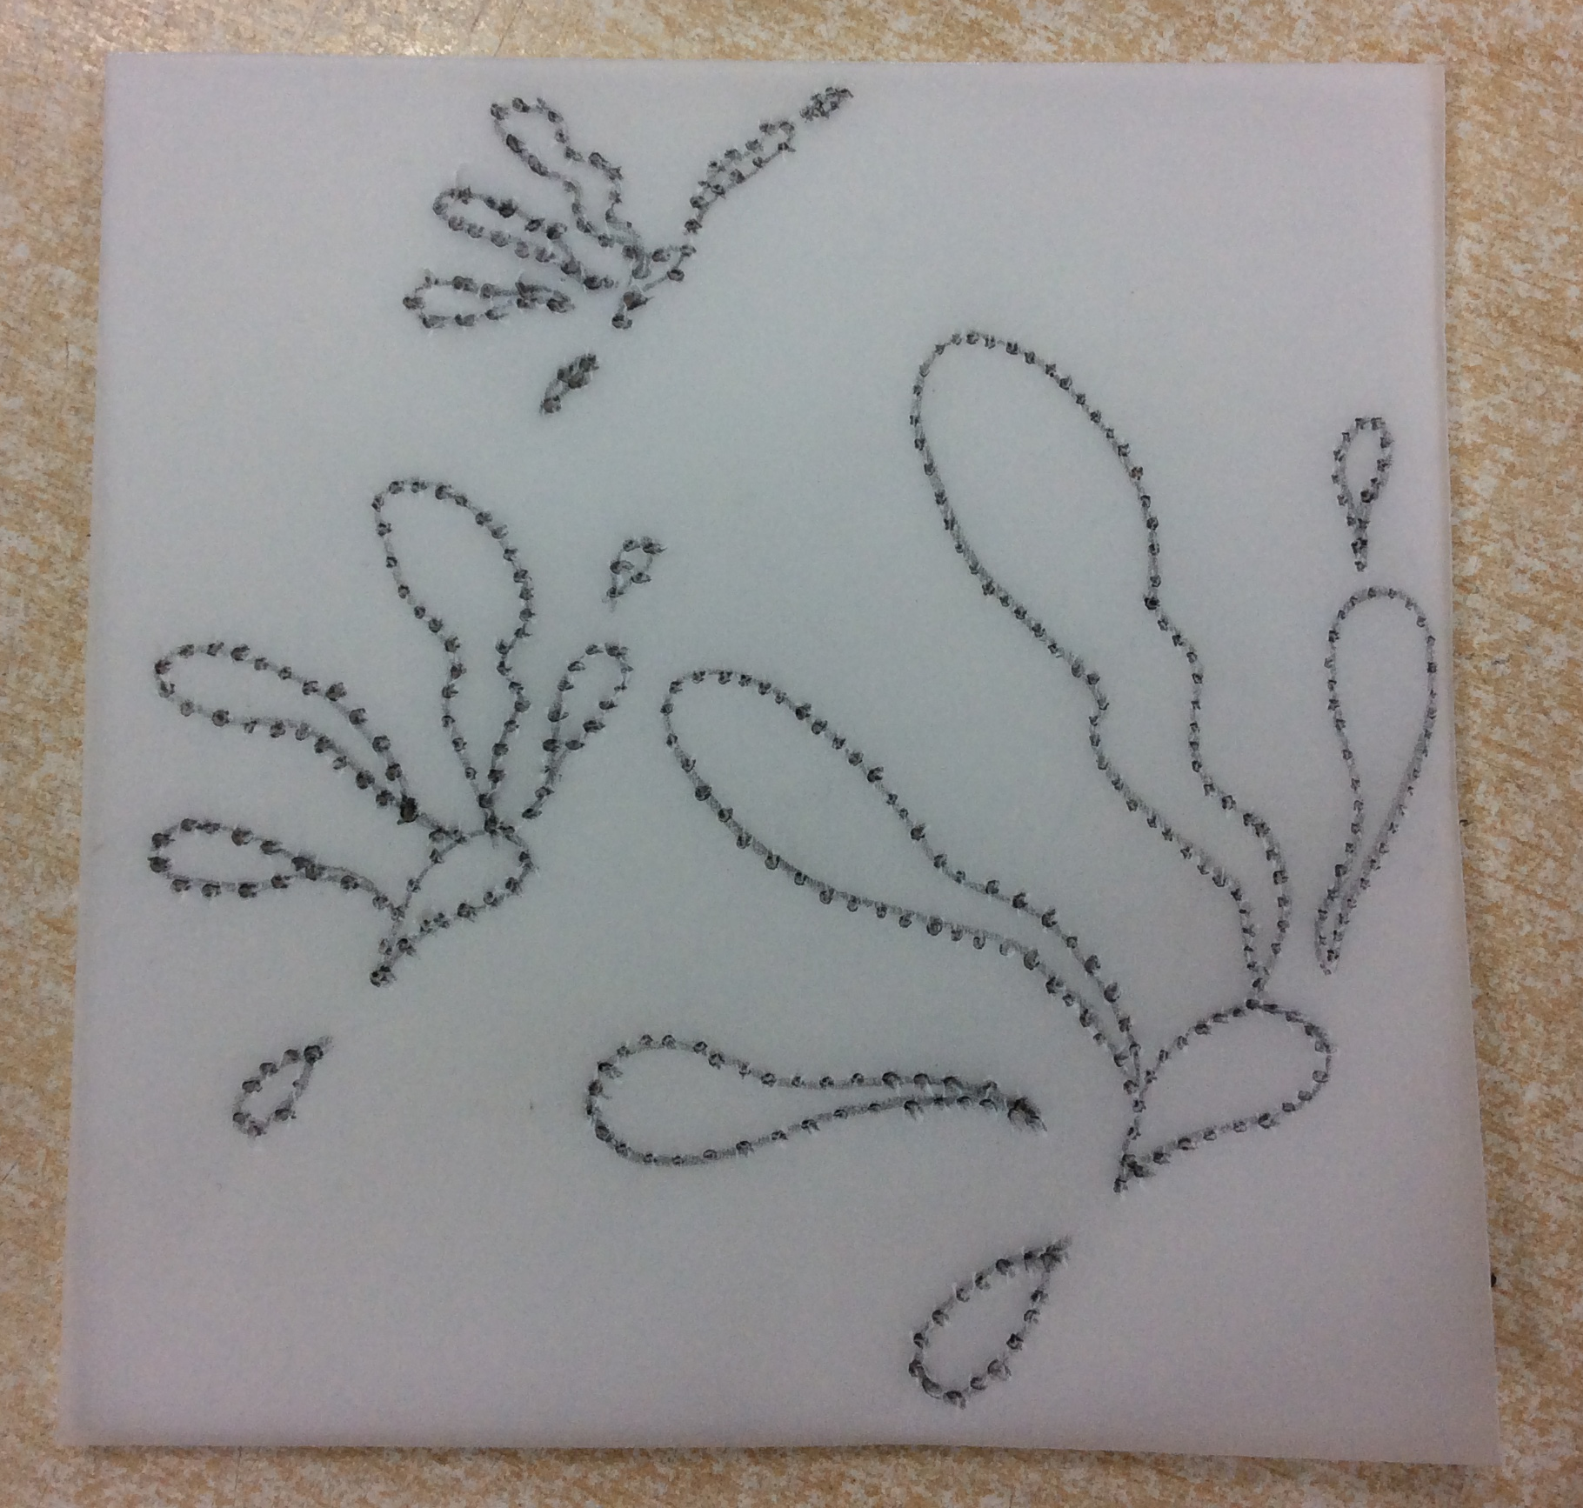
Remember- The part you are dotting through will be the bit that stays white!
Step 2:
Place your tracing paper on top of your tile and secure it with sellotape. Carefully, dot the design through using a sharp pencil. The dots should be close to one another.
Be careful not to dot through the tile too hard so it comes out the other side!

Slide 6
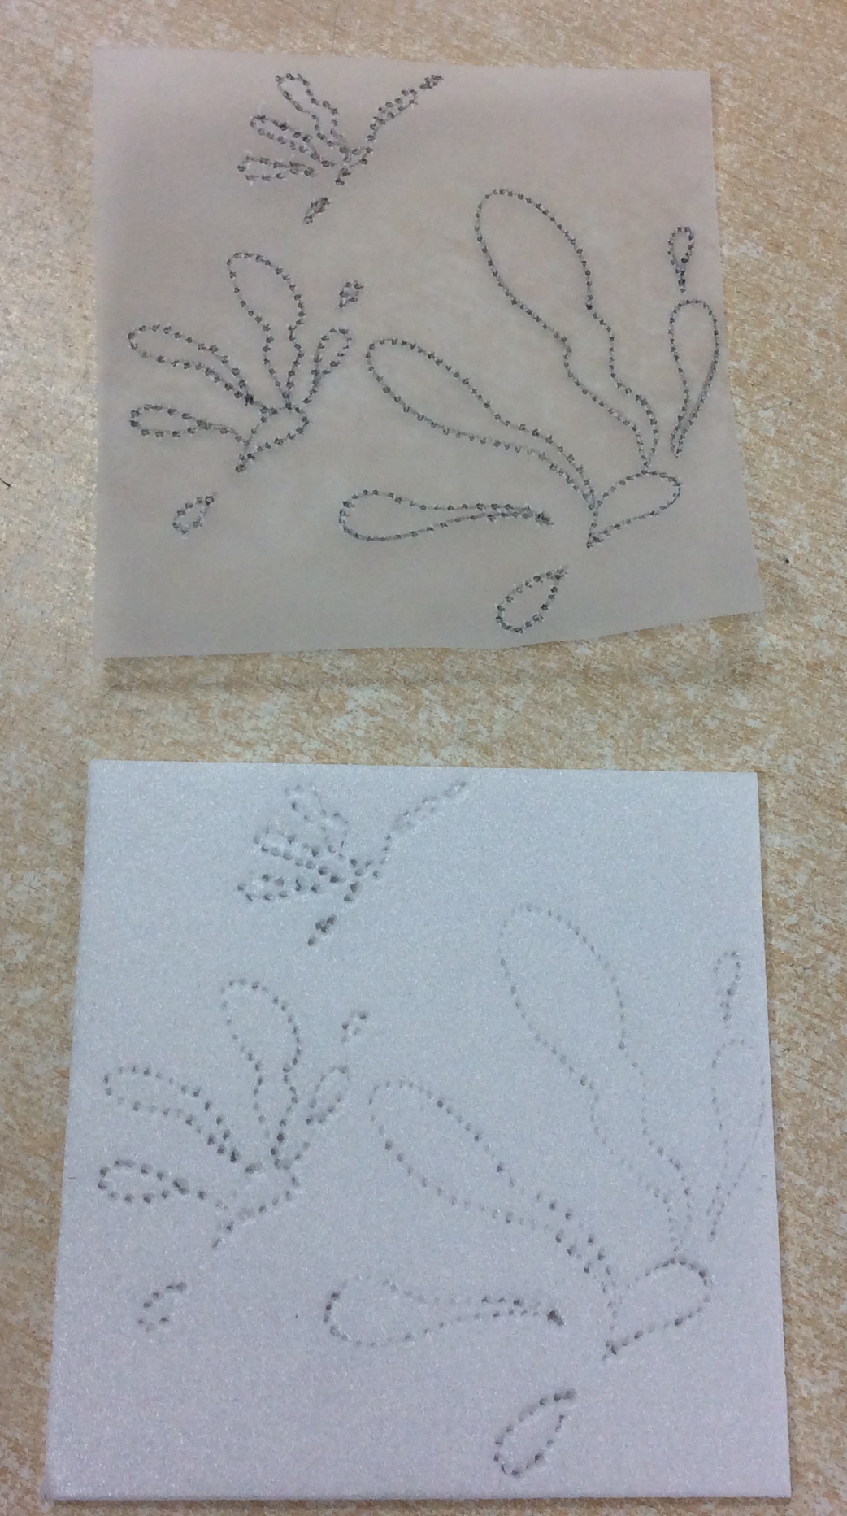
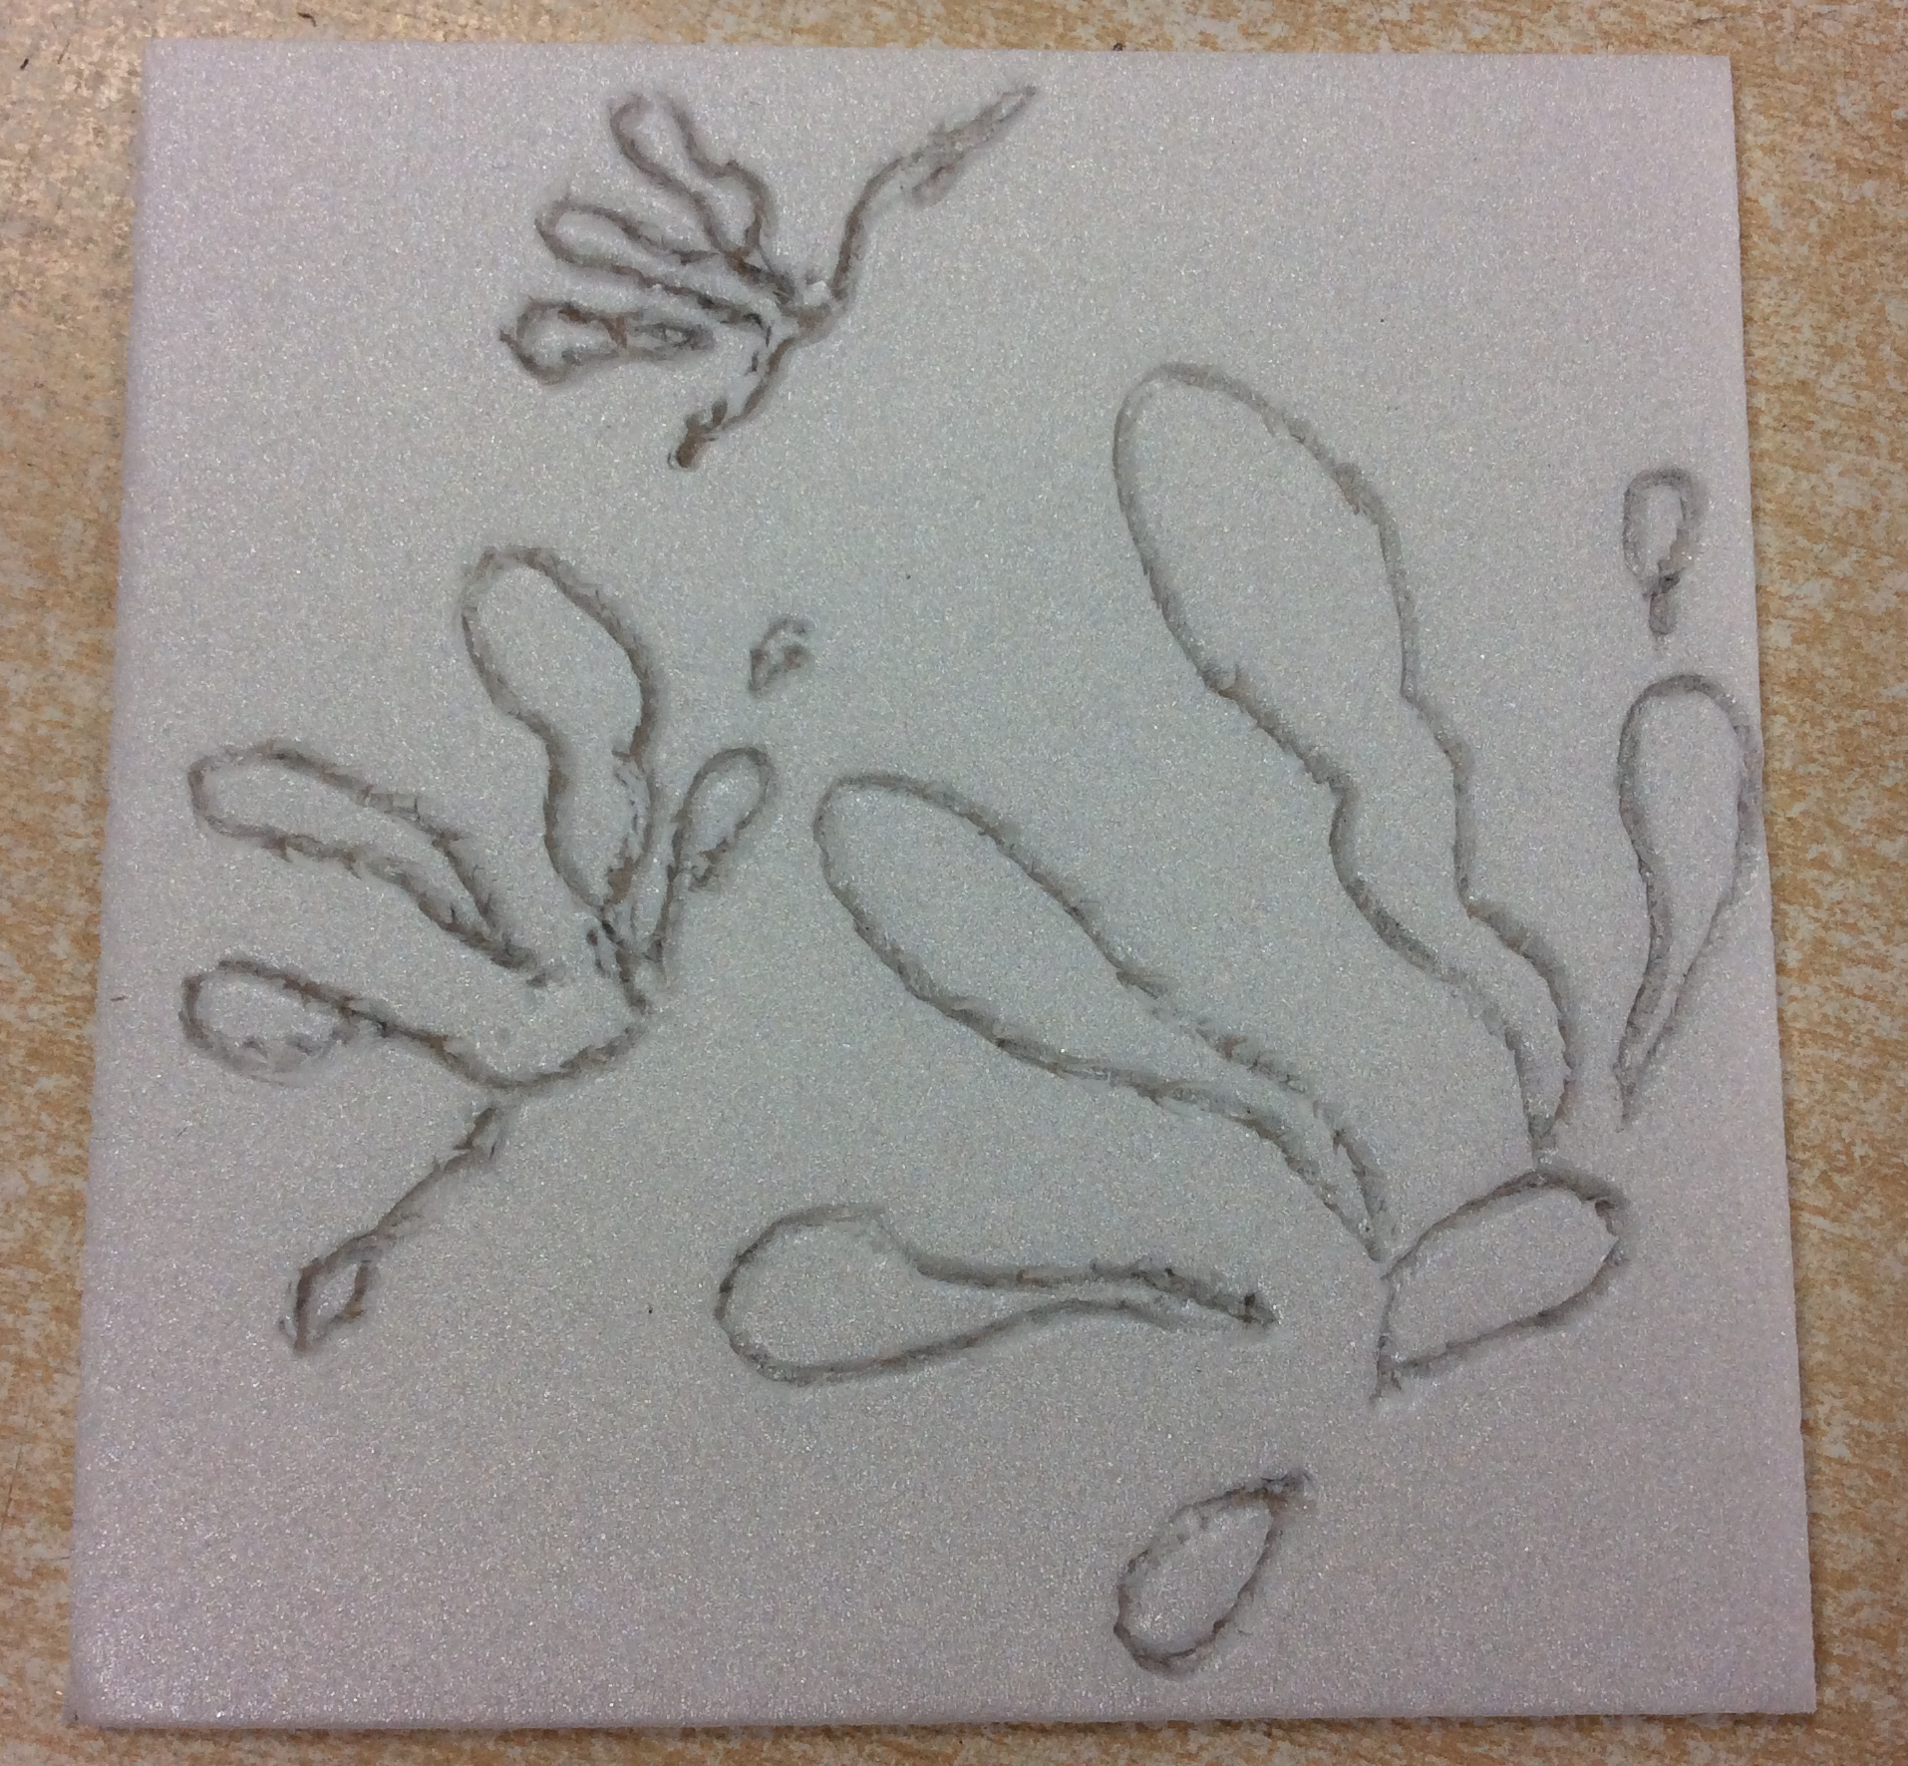
Step 3:
Remember- The part you are drawing will be the bit that stays white!
Once completed, carefully remove tracing paper and then join dots together on your tile (using a blunt pencil to create a definite line).

Slide 7
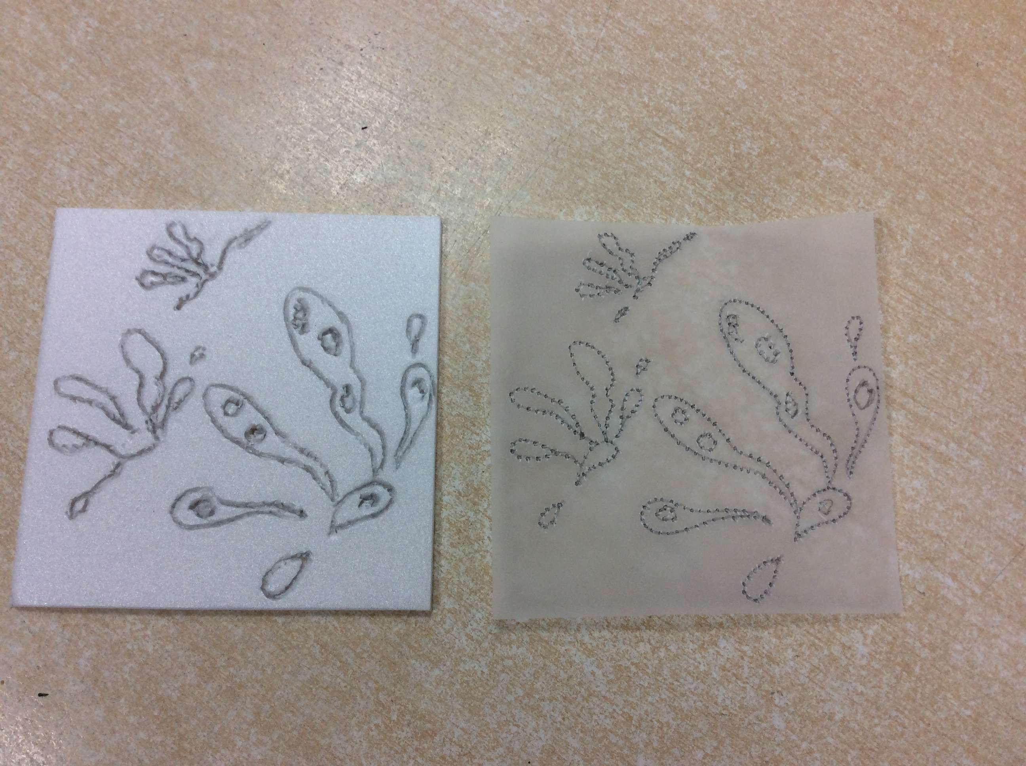
Step 4:
Go over this outline to create a clear, wide indentation, using a sharp pencil.
These bits will remain white once you print!

Slide 8
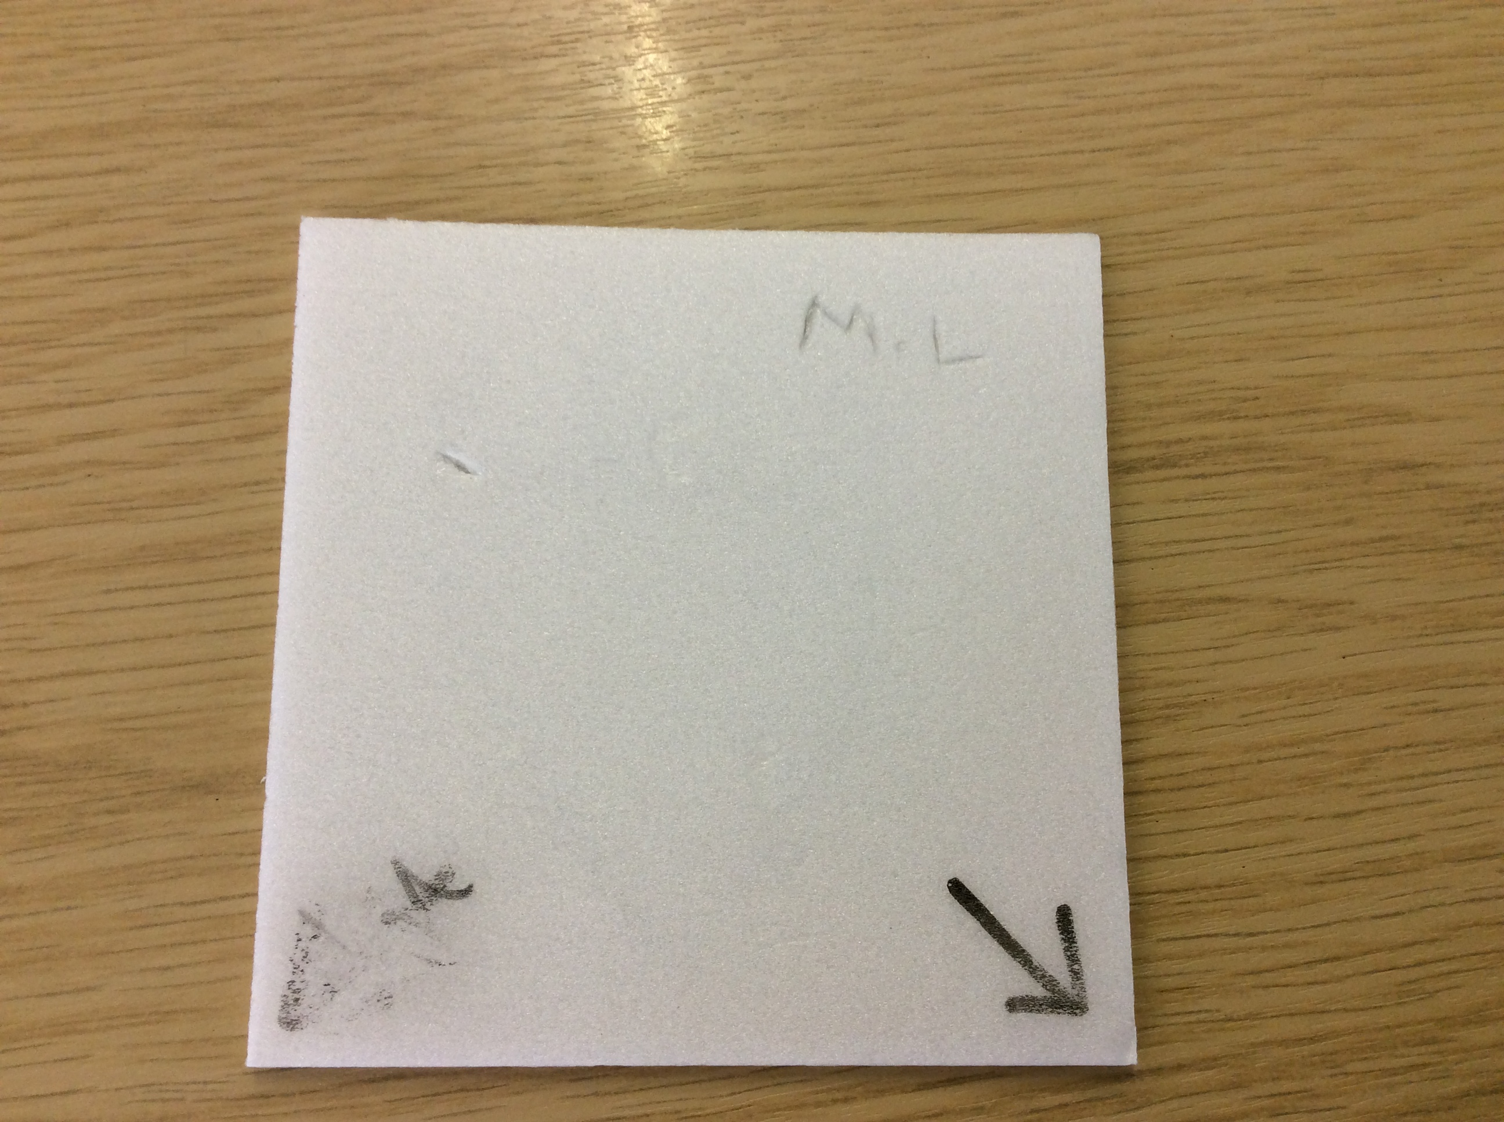
Step 5:
Write your initials and draw an arrow on the back of your tile (using a whiteboard pen), showing the corner from which your design will rotate (have it pointing to the middle corner).

Slide 9
This arrow will then turn 90 degrees each time you print.

Slide 10
Step 6:
Stick your design on a clean page

Slide 11
Top Tips for printing like a pro!
I can transfer my design to a press print tile
Be patient!
Take care
Don’t rush
Follow instructions

Slide 12
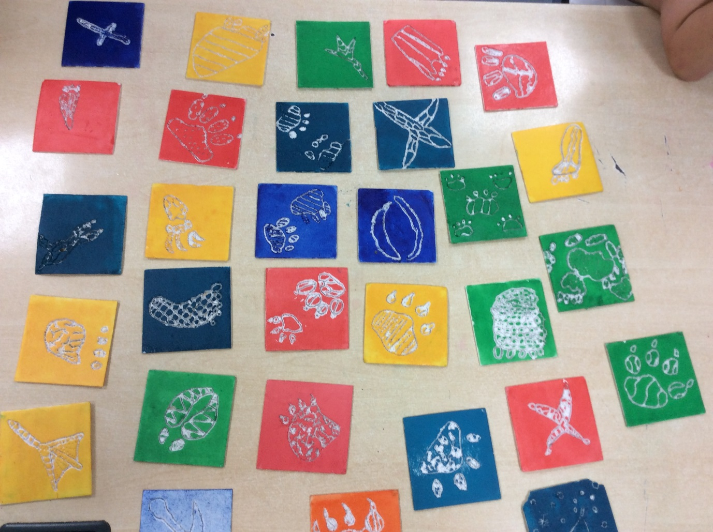
Printing
1st print

Slide 13
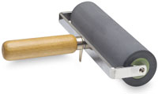
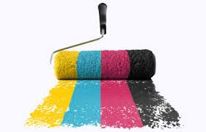

You will need:
Your tile
Your first chosen colour
2 rollers
Pallet
Newspaper
Plain paper

Slide 14
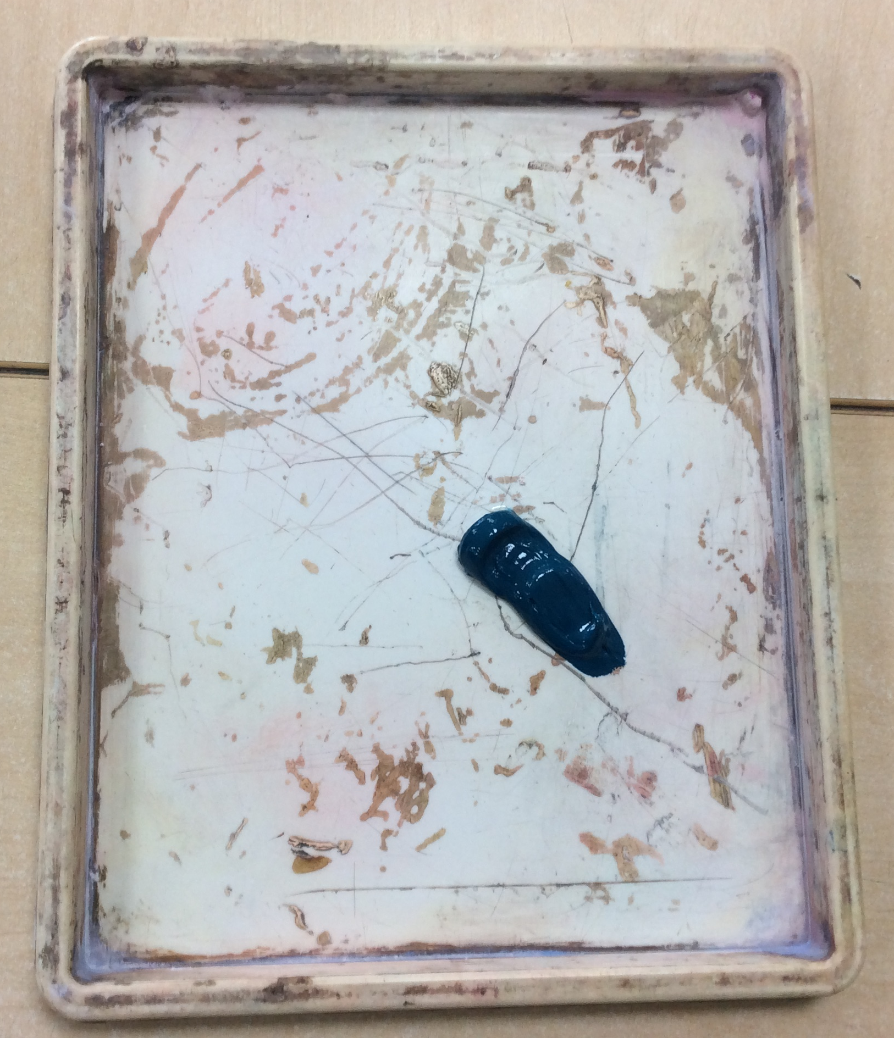
Step 7:
Squeeze a small amount of your chosen ink onto a pallet.

Slide 15
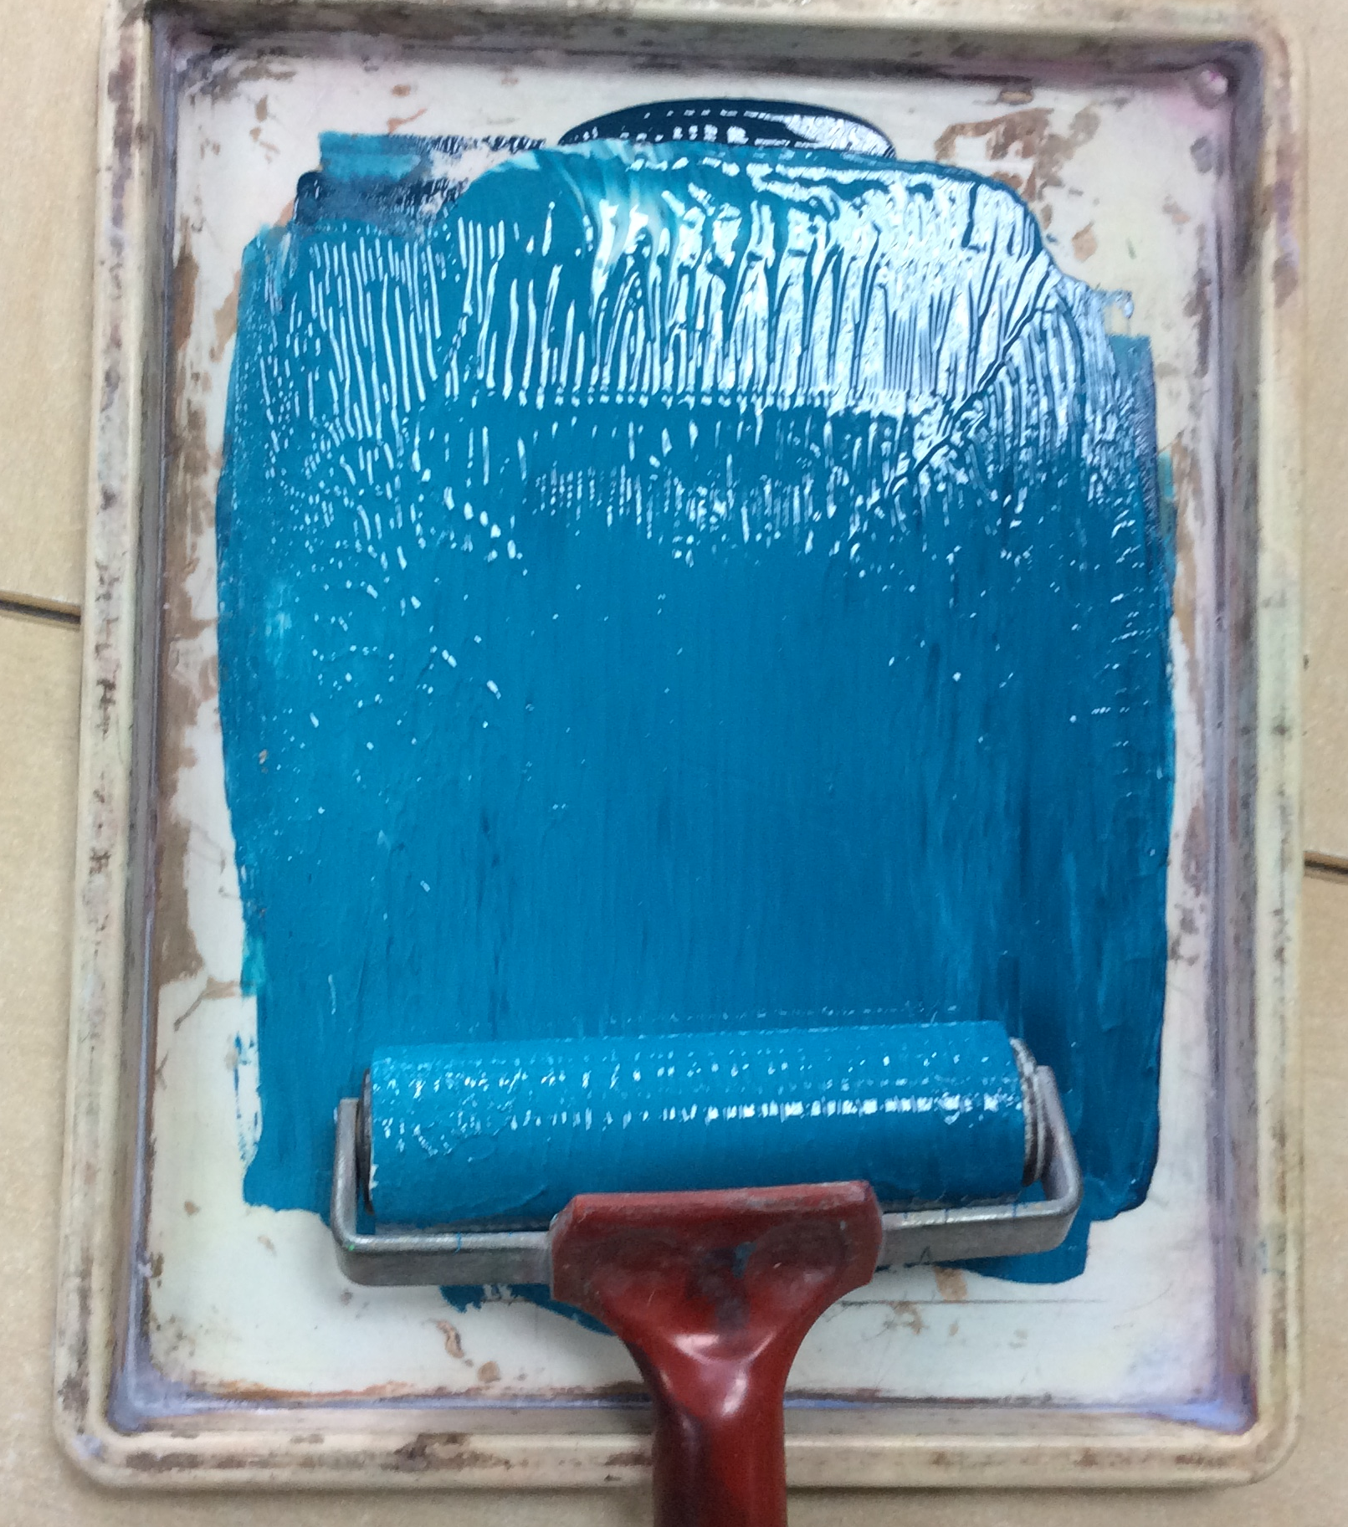
Step 8:
Use your first roller to evenly spread the ink all over the pallet. Make sure your tile is on a piece of newspaper.

Slide 16
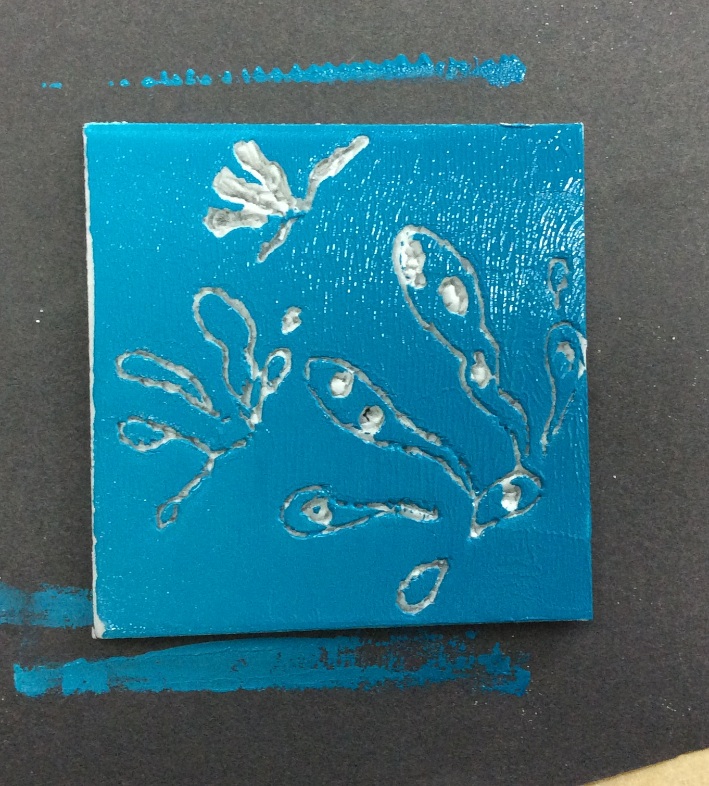
Step 9:
Then roller the ink onto the face of your tile.
Make sure you entire tile is covered!
(Now you can see which parts will stay white!)

Slide 17
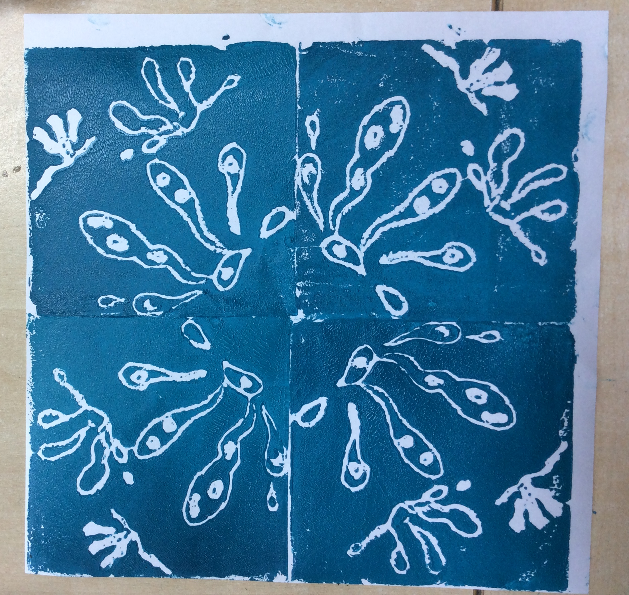
Step 10:
You must apply more ink after each individual print!
Be careful when peeling the paper away from your tile!
Print your designs by placing your tile face down and using the clean roller to add pressure evenly. Now rotate your design 90 degrees each time (using the arrow to help) like you’ve practised.
You will need to print your design 8 times on white paper- so two lots of this!

Slide 18
Printing
2nd print

Slide 19
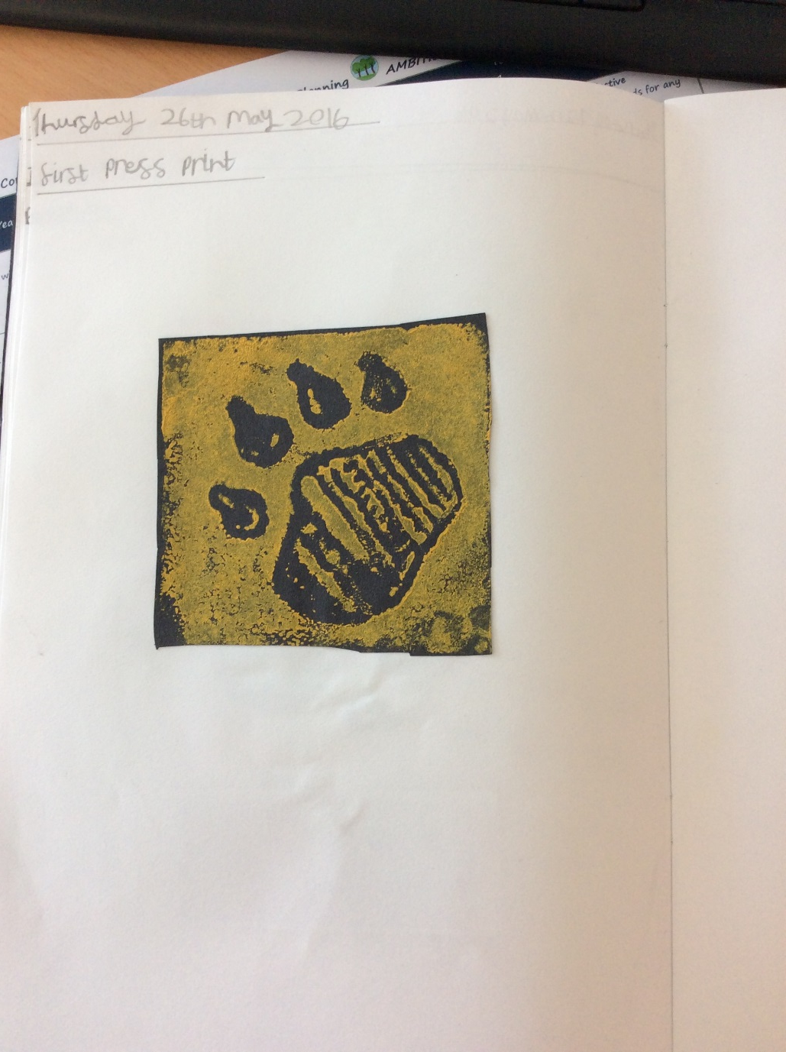
Cut out one of your prints and stick on the next clean page in your sketchbook. Make sure you leave a set of 4 together.
Step 11:

Slide 20
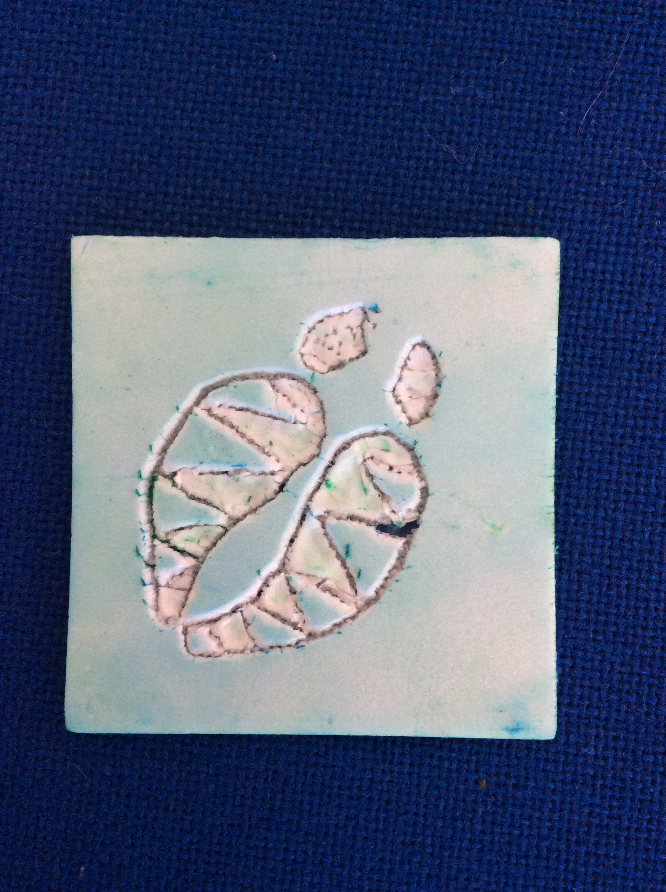
Etching
Step 12:
These are the bits o have etched away. They are the bits that will stay my first print colour.
You now need to etch away the parts of your design you want to stay your first print colour.

Slide 21
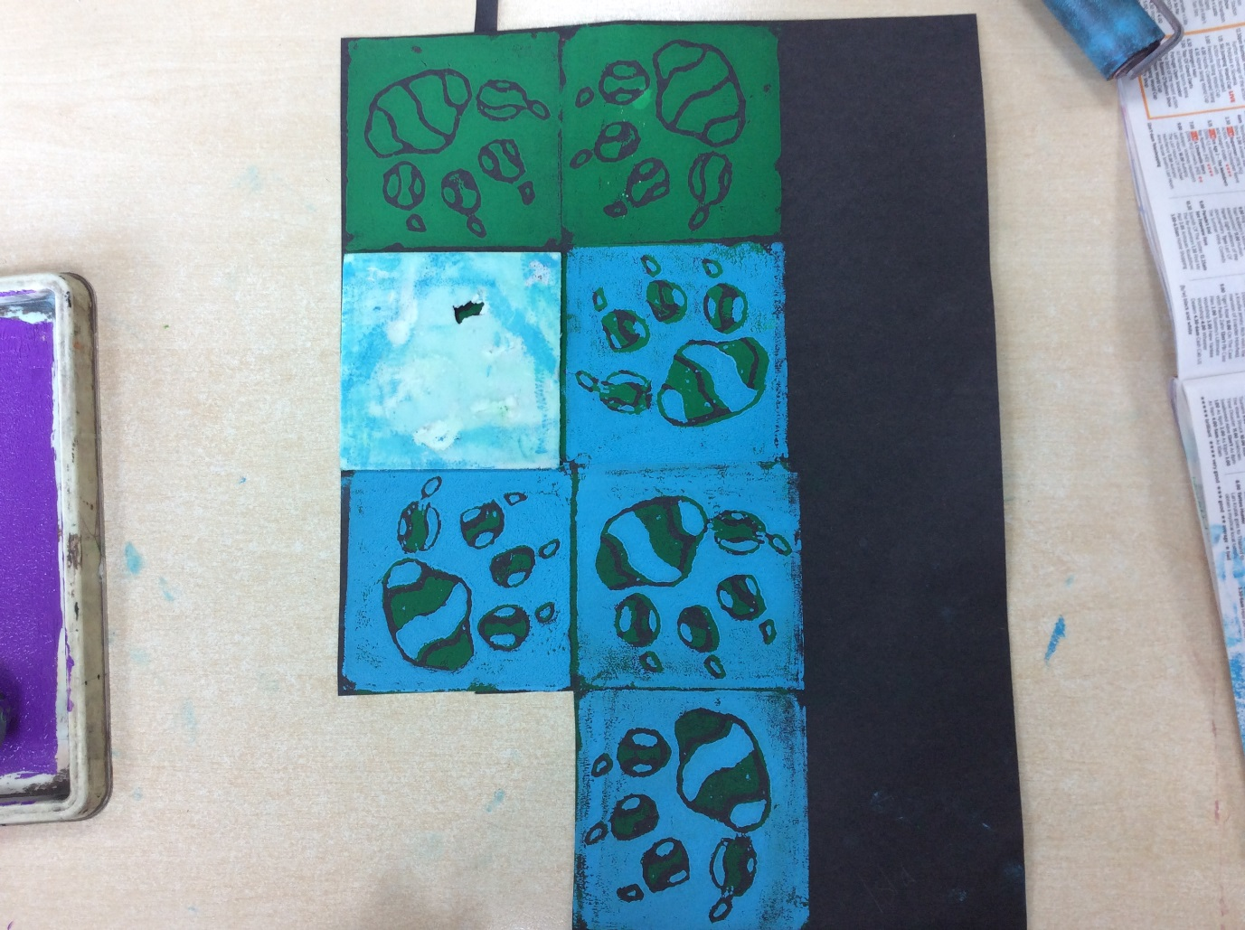
Repeat the same printing process but now using your second colour for your second print.
Step 13:
You will now only be printing 7 times. Make sure you rotate your design properly!

Slide 22
Printing
^{3rd} and final print!

Slide 23
Cut out one of your prints and stick on the next clean page in your sketchbook. Make sure you leave a set of 4 together.
Step 14:

Slide 24
Etching
Step 15:
You now need to etch away the parts of your design you want to stay your second print colour.
I want these bits to stay blue so I will etch them away!
This last print is your background colour!

Slide 25
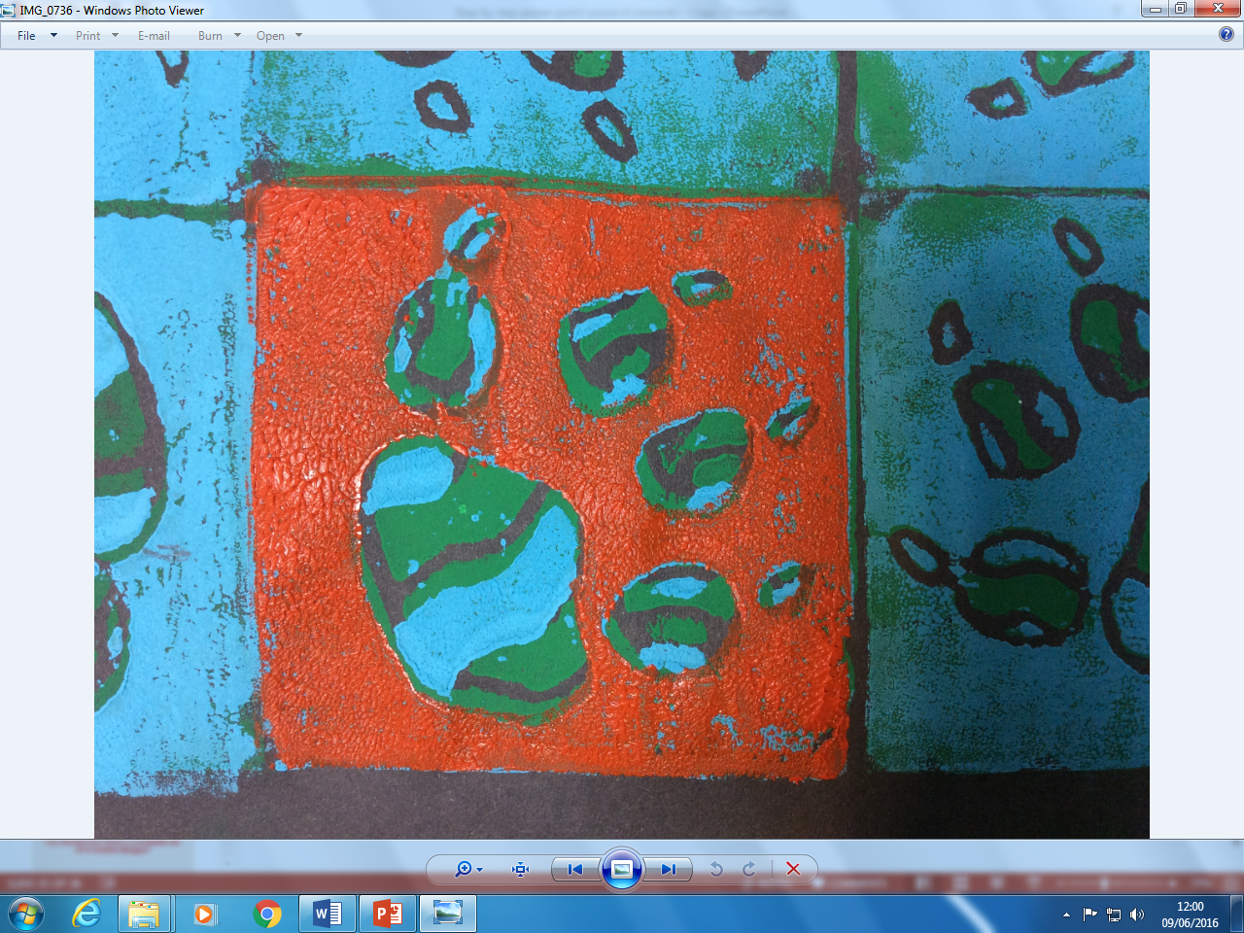
Step 16:
Repeat the same printing process but now using your second colour for your second print.
You will now only be printing 6 times. Make sure you rotate your design properly!

Slide 26
Final Lesson
Final Lesson

Slide 27
Cut out one of your prints and stick on the next clean page in your sketchbook. Make sure you leave a set of 4 together.
Step 17:

Slide 28
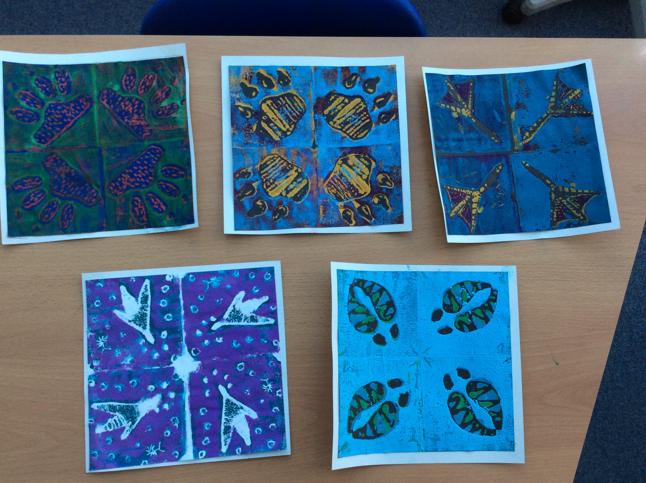
You should now have a complete set of 4 rotated designs!

Slide 29
Cut out and mount your final designs on card!
Check you out!

Slide 30
How did you do?
How well did I do? |  |  |  | Teacher Comment
Exploring & designing animal prints
Scoring and preparing a printing tile
Rotating my printing |  |  |  | Pupil Comment
Embellishing the final product

