Slide 1
Can I emulate the work of Simon Hart?
These are a collection of photos to inspire you to create your own painting in the style of Simon Hart!
Think about the colours and lines that you can include.

Slide 2
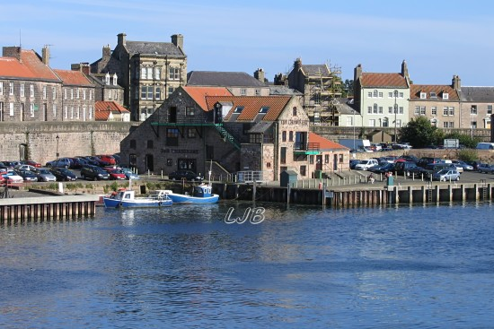
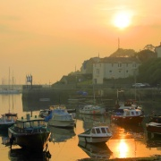
Can I use a photo as a starting point for my composition?

Slide 3
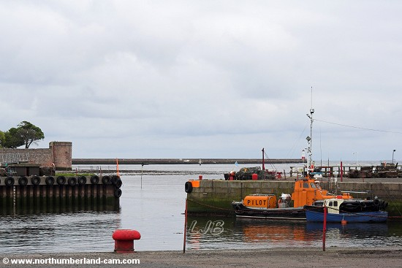
Can I use a photo as a starting point for my composition?

Slide 4
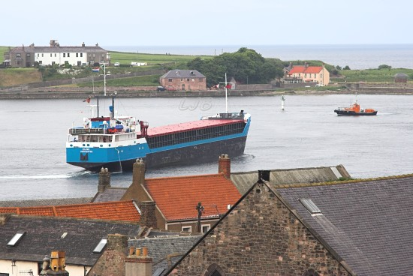
Can I use a photo as a starting point for my composition?

Slide 5
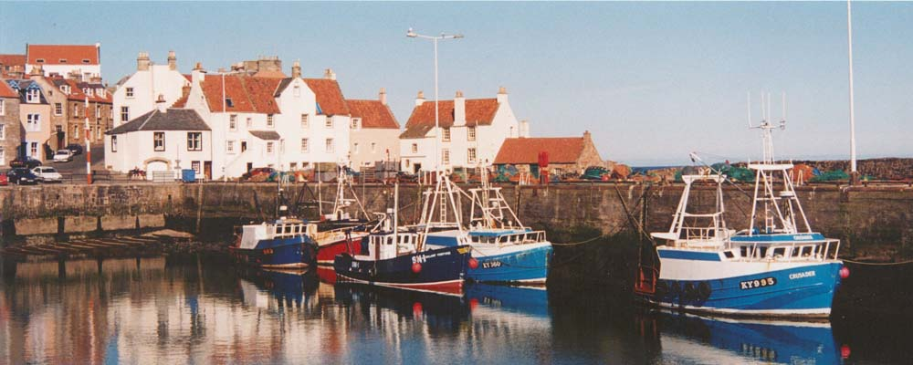
Can I use a photo as a starting point for my composition?

Slide 6
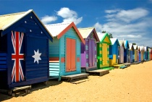
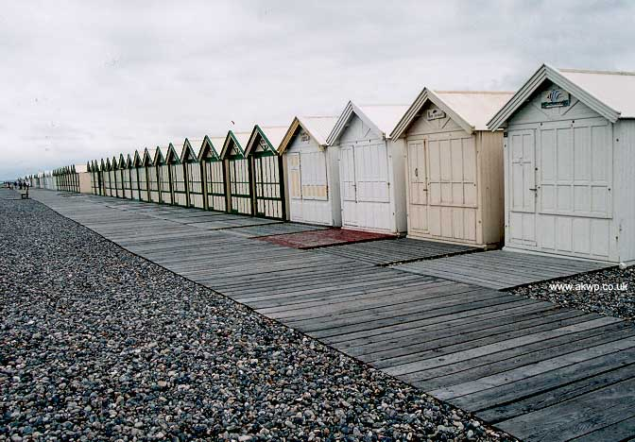
Can I use a photo as a starting point for my composition?

Slide 7
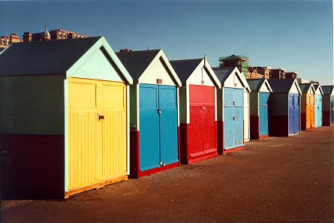
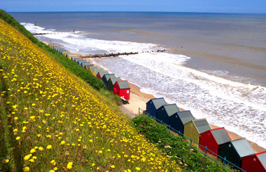
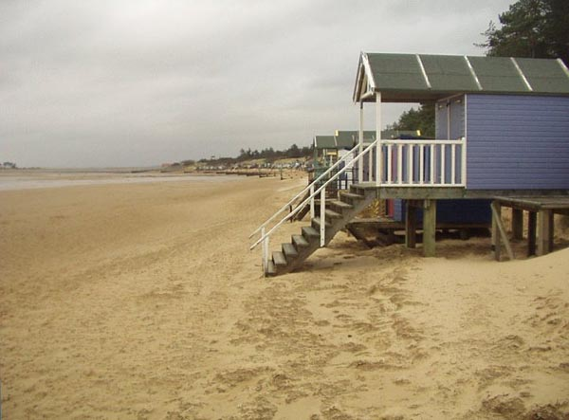

Slide 8
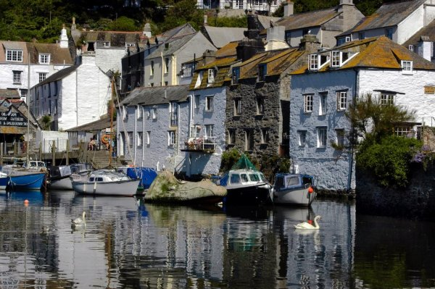
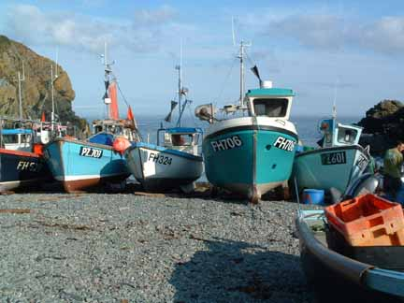
Can I use a photo as a starting point for my composition?

Slide 9
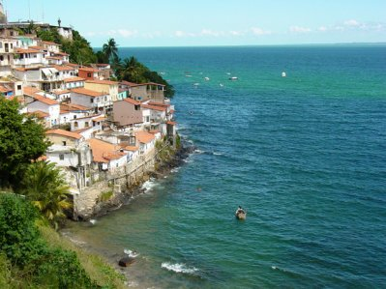
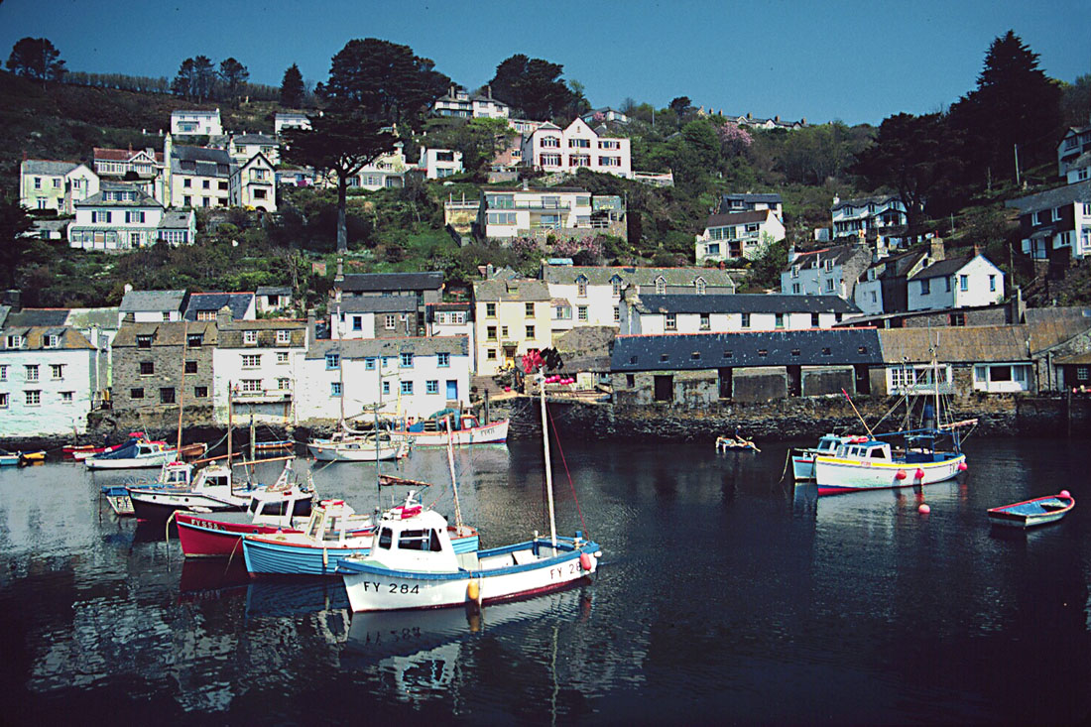

Slide 10
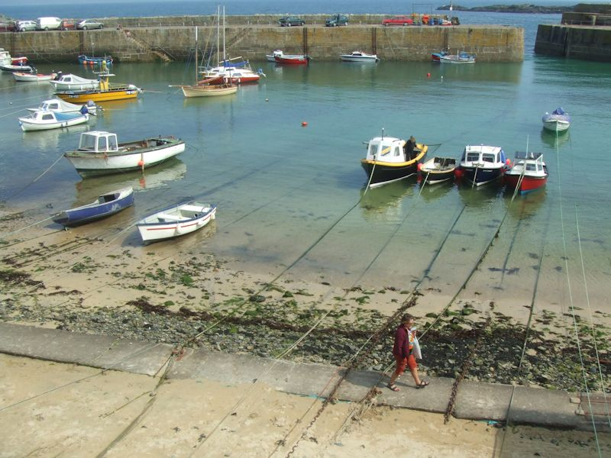
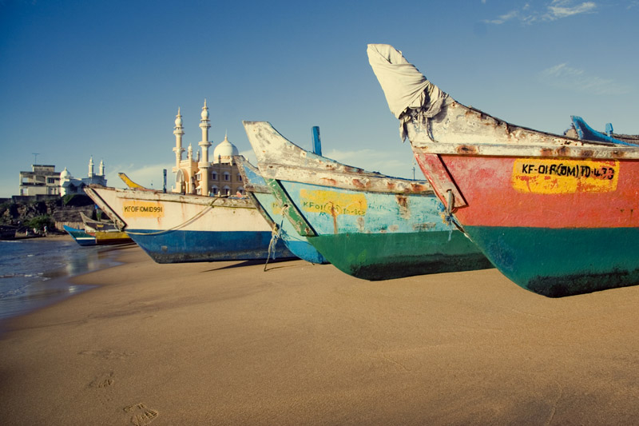
Can I use a photo as a starting point for my composition?

