Slide 1
Pitta Pizzas
Have a go at making these delicious lunchtime treats with the help of an adult at home!

Slide 2
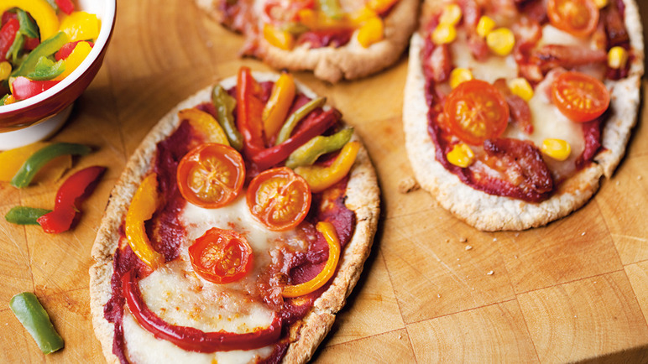
Pitta Pizzas
READY IN 22 minutes
COOKING TIME12 minutes
PREP TIME10 minutes
Ingredients :
Mixed peppers
6 wholemeal pitta breads
175g tomato purée
125g medium cheddar, grated
100g drained tinned sweetcorn
170g cherry tomatoes, quartered
Optional crispy bacon

Slide 3
Pitta Pizzas
Preheat the oven to 200°C/gas mark 6.
Slice the peppers and tomatoes and set aside.

Slide 4
Pitta Pizzas
Cut the pittas in half horizontally and put on a large baking tray, cut-side down.
Spread the tomato purée over the pitta halves, then top with the cheddar, sweetcorn, tomatoes and peppers. Add pre-cooked crispy bacon if you like.

Slide 5
Pitta Pizzas
Cook in the oven for 10-12 minutes, until the cheese is melted and bubbling.
Serve and enjoy!

