Slide 1
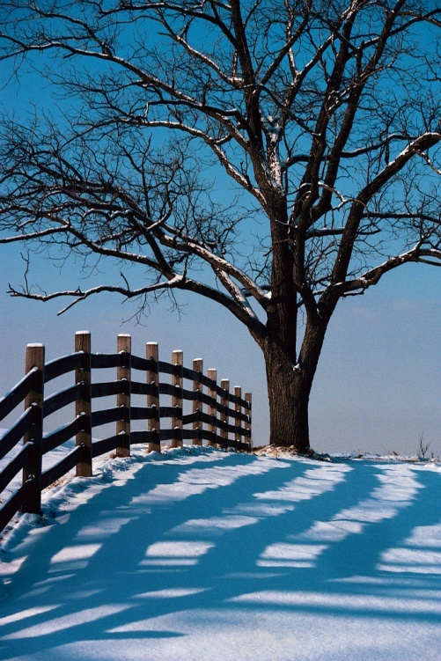
The snow was a white carpet covering the land.
This is called a metaphor

Slide 2
So what are metaphors?
A metaphor is an unusual way of describing something.
A metaphor says something is something else.
e.g. Tony is a tower of strength.
Louise is green with envy.
Wayne Rooney is a goal machine.
David was as good as gold.

Slide 3
Can you complete these metaphors?
The bats winked from the treasure chest.
A waterfall danced on the cave walls.
The cave were black velvet scarves.
Gold coins was a curtain of glittering, blue silk.
The torchlight is a gloomy prison for the climber.

Slide 4
Draw a metaphor!
Draw an amusing picture for each of these metaphors:
Her feet were blocks of ice.
He flew down the street.
Its raining cats and dogs.
Time files.
Can you think of your own metaphor to draw?

Slide 5
Similes or Metaphors?
Some of these sentence are similes, some are metaphors. Can you tell which are similes, which are metaphors?
As slippery as an eel.
Arnie was a man-mountain.
He was a lion in battle.
She is as pretty as a picture.
The striker was a goal machine.
The torch lit up the room as if the sun had risen early.
The moon was a misty shadow.
My friend has a face like a bag of spanners.

