Slide 1
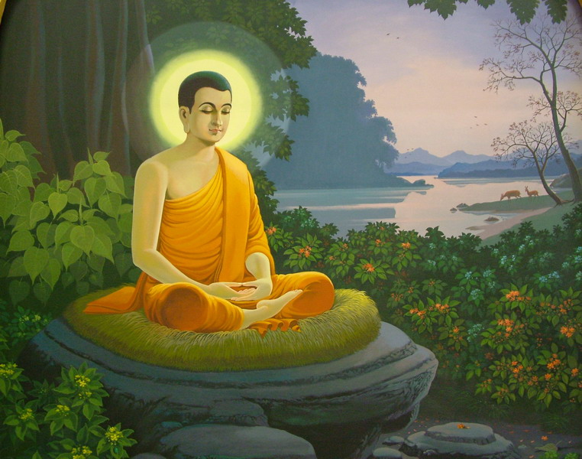
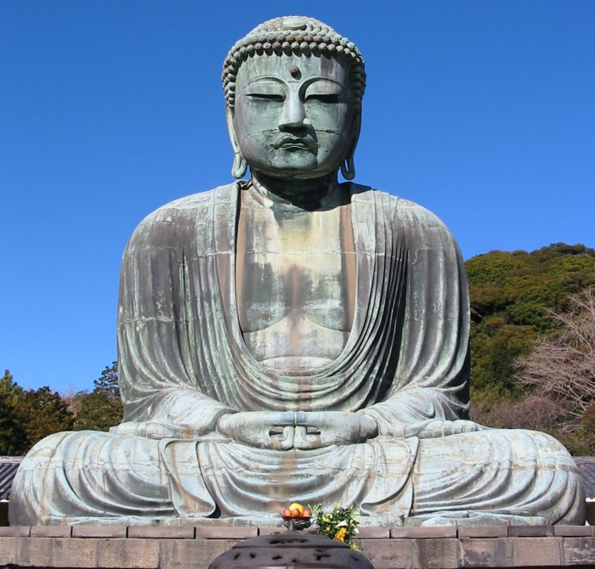
KS3 Religious Education
Spring Term

Slide 2
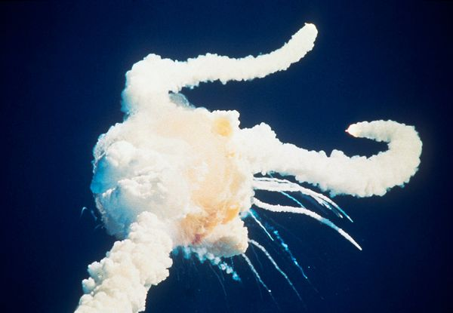
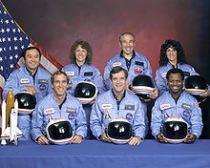
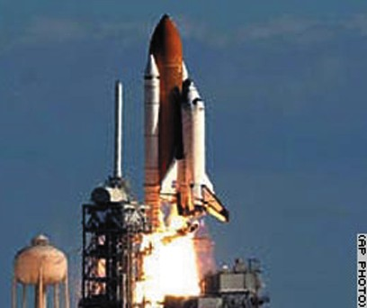
Notes:
You may need to customise this slide to match yourself. I started the lesson by explaining what my earliest memory was of something happening in the news that was shocking and made me realise that bad things do happen to nice people. For me, this is the first news story I can remember as a child and being very upset that a teacher had been killed and that all of her pupils were watching it live.

Slide 3
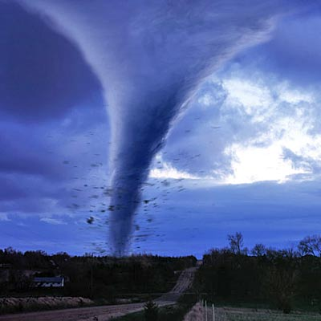
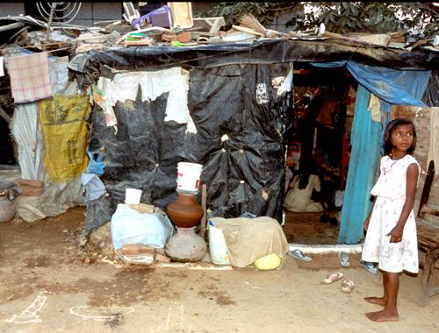
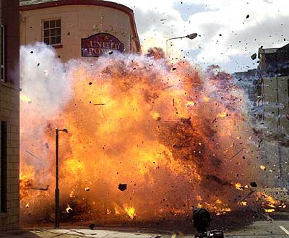
I would like you to think back in your mind to when you were a small child. Can you think of the first time that you became aware of the following things?
Natural Disasters
Extreme
Poverty
Man-Made Disasters
Can you remember any of the feelings that you had when you first saw these things?
Notes:
Pupils did this in rough. This will be linked back to later in the lesson when we talk about the Buddha seeing suffering for the first time.

Slide 4
How did the religion of Buddhism start? All
Who is The Buddha? Most
How did the Buddha’s early life affect him? Some
By the end of the lesson can you….
… describe the early life of the person who would become the Buddha?
… explain the pivotal moment in his life that lead to the formation of the Buddhist religion ?
… link the events of the Buddha’s life to events in your own?
Lesson 2

Slide 5
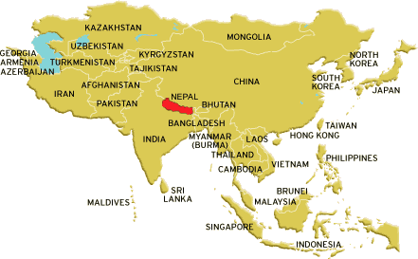
Buddhism started in the country of Nepal.

Slide 6
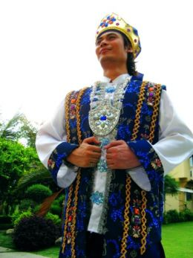
Siddhartha Gautama was the son of a king and queen who was born around 2500 years ago in Nepal.
He was to become the founder of one of the worlds great religions called Buddhism.
This is the story of his life and how the Buddhist religion started..
Notes:
To increase pupils participation in the lesson, I asked volunteers to read out each section as it appeared on the board. I then expanded on the story in between each of the slides where needed. There are 26 separate text boxes that will appear throughout the story.

Slide 7
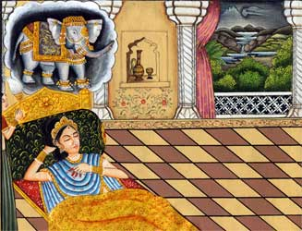
There were signs before and after the birth of the Prince that he would become a special person.
His mother, Queen Maya, has a special dream that foretold that her son was going to be a very special spiritual leader.

Slide 8
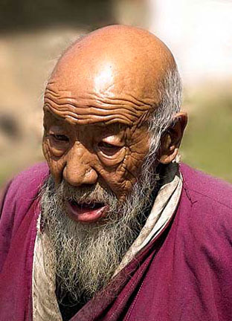
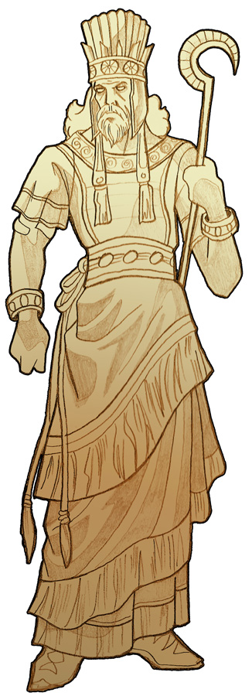
If this boy ever sees suffering, he will never become King. Instead, he will become a great spiritual leader.
My son WILL become the King. I decree that he will never be allowed to see a person suffer.

Slide 9
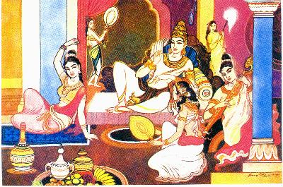
The life of the Prince was a one of great privilege. He was sheltered from any exposure to the outside world.
He was never allowed to leave the grounds of the palace.
Great care was taken that the young Prince should never see any example of suffering and hardship.
Notes:
Omnipotent – Is everywhere and has all limitless power.
Malevolent – Is evil and acts with malice is causing suffering and pain.

Slide 10
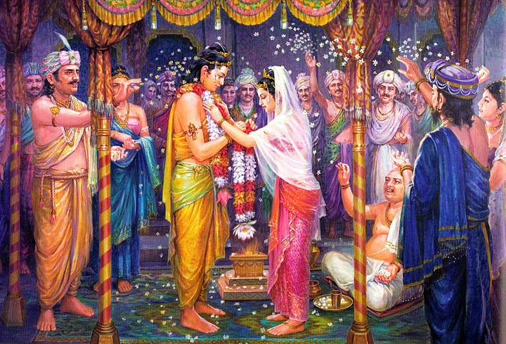
When Prince Siddhartha was 16 years old, he married a beautiful princess. Very soon they had a son together. He was very contented with his life. He obeyed his father and stayed within the city walls.

Slide 11
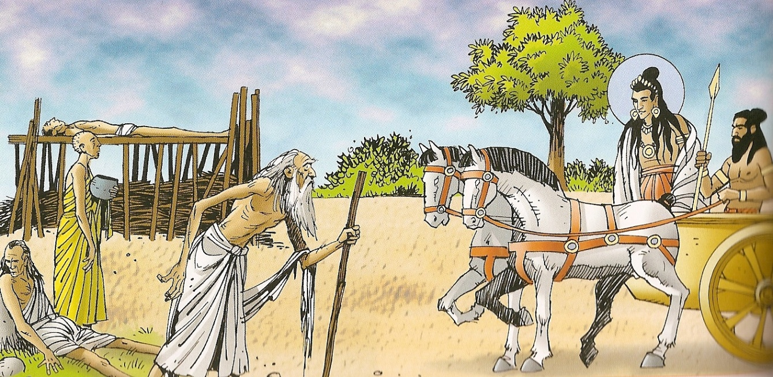
Prince Siddhartha grew frustrated over the years and when he was 29 years old, he sneaked out of the place for the first time ever.
An dead man
A holy man
He saw four things that he had never seen before and these changed his life forever.
A sick man
An old man

Slide 12
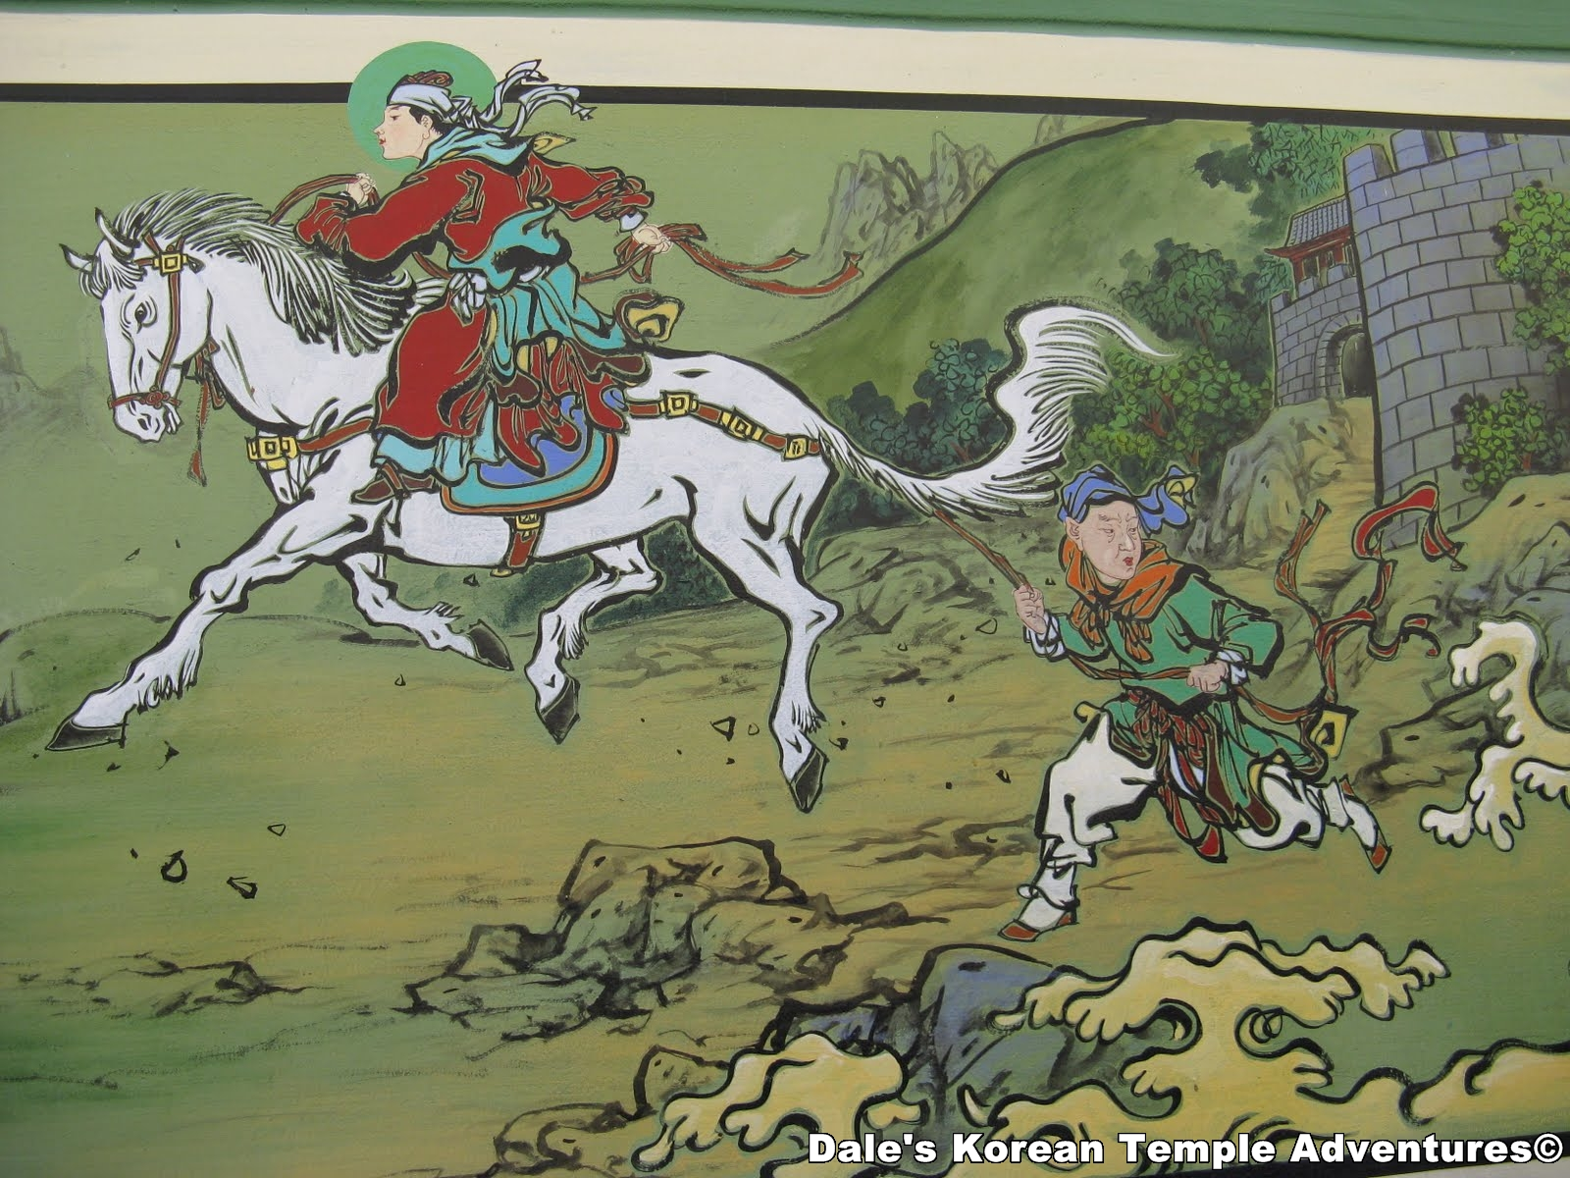
He took off his royal robes, put on simple clothes and shaved his head. He decided to become a holy man to try and find out the answer to the question.
The Prince was deeply affected by the things he saw. He felt that he needed to understand why there was so much suffering in the world.

Slide 13
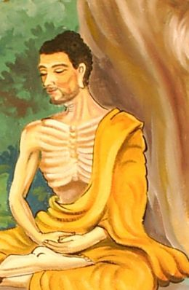
Siddhartha spent 6 years travelling around Northern India. He met a group of monks who thought that if you ate and drunk as little as possible and spent time thinking, you will understand the meaning of life.
He became very ill and still was no clearer that before. He decided that this was not the way to find the answer and left the group of monks.

Slide 14
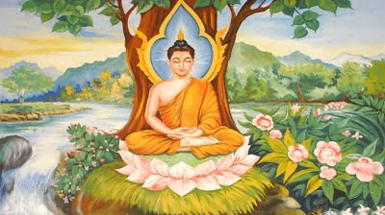
He came across a holy fig tree and sat underneath it to meditate. He stayed there for 46 days, paying no attention to what was happening around him.
As he sat meditating under the tree, he found that he understood the answer to his question. He became enlightened. He became the Buddha (the enlightened one).

Slide 15
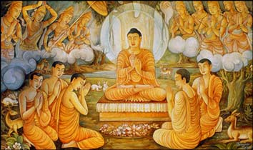
The Buddha went back to where the monks were and taught them what he had learnt.
They became the first disciples of the Buddha. He lived to be 80 years old and travelled around teaching and explaining to people his ideas.
Notes:
Pupils classwork / homework is to then follow this up by making a timeline story of his early life. There are a number of different worksheets that can be used, with varying degrees of complexity. The with all of the story already written in were confined one to those pupils in set three English.

