Slide 1
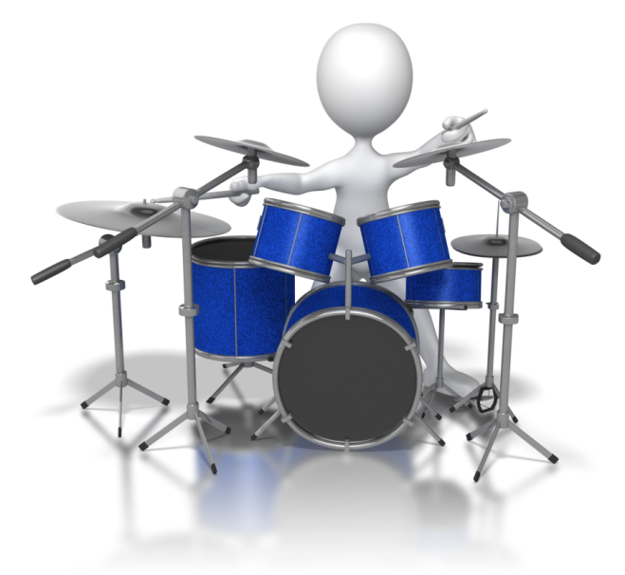
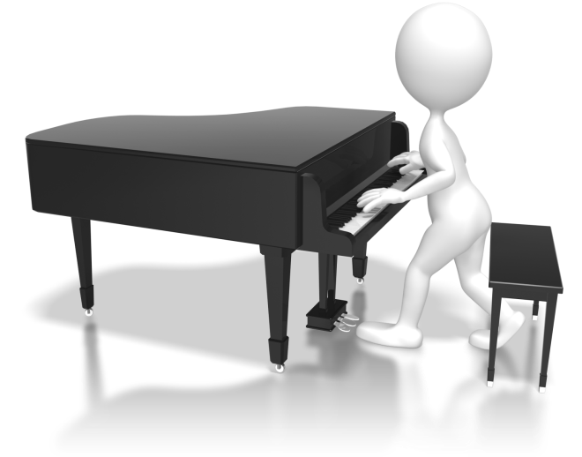
Do all objects reflect light the same?
Light And shadow

Slide 2
Steps to Success
1) To know what ´reflect´ means.
2) Predict how materials will behave when light is shone on them.
3) Investigate light reflection and record your results.

Slide 3
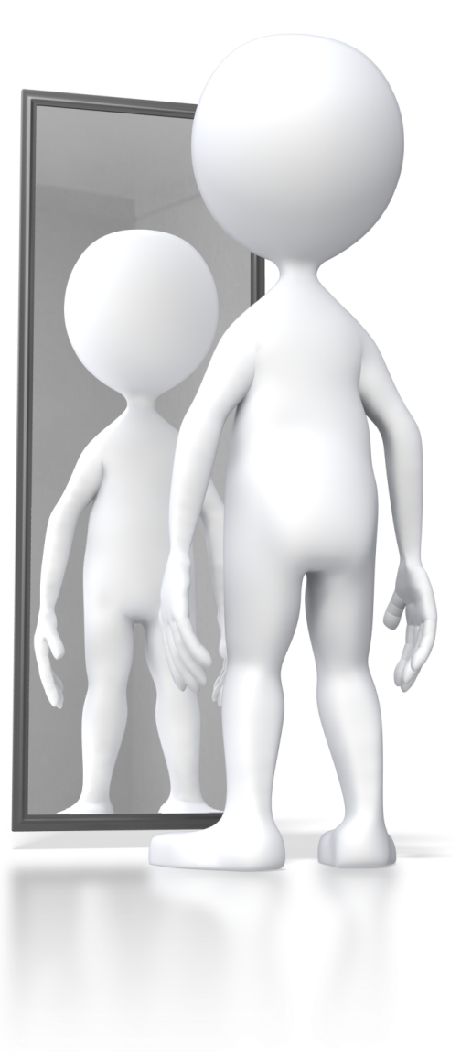
Funny Faces
Playing hide and seek on your own is really difficult!
Who can pull the best funny face in a mirror?
Yes, but how do we see ourselves in a mirror?
But what word describes what the mirror does to the light?
Light Source
Object
Eye

Slide 4
Your Task
Reflective
scale
Material | Prediction | Actual
Wood
Plastic
Metal
Paper
Glass
Water
Excellent
Good
Ok
Dull
No reflection

Slide 5
Click me to check out some helpful reflective materials
Are these statements true or false?
What did you find out from your results?
All paper reflects light the same amount.
All wooden objects are not very shiny.
All types of metal are really good at reflecting light.

