Slide 1
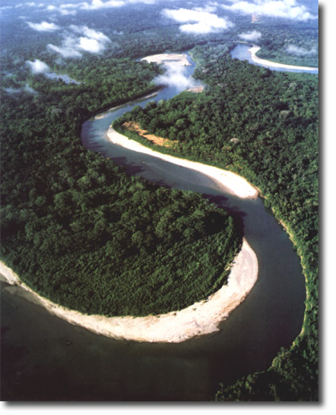
MEANDERS
Water often winds backwards and forwards like a snake. We call this meandering. The reason for a river to meander is quite complex. When a river bends, water on the outside of a bend flows faster than the water on the inside of the bend. The fast water often carves deep pools within the channel, whilst the slower water is much more shallow. The fast water is catapulted out of the bend and forms the outside curve of a new bend going in the opposite direction. The bigger and wider the river, and the finer the material in its bed and banks, the bigger the meander will be.

Slide 2
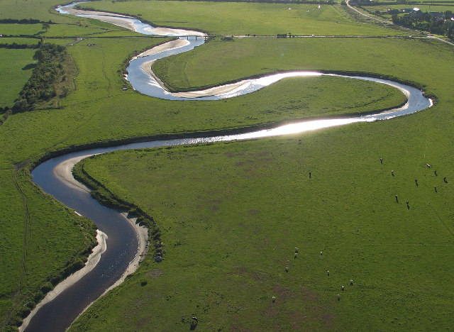

Slide 3
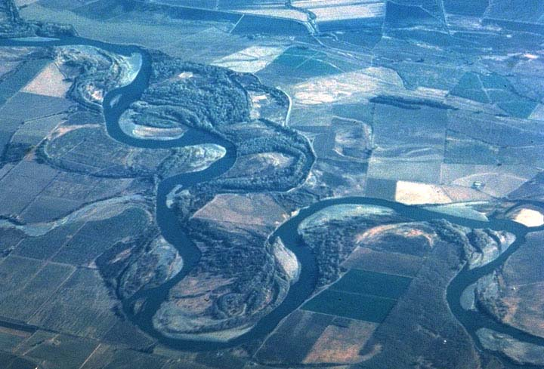

Slide 4
