Slide 1
Buddhism
Week 2

Slide 2
Remind your partner
What have we learnt about Buddhism so far?
The life of Buddha

Slide 3
Today
We are going to be learning about the four noble truths.

Slide 4
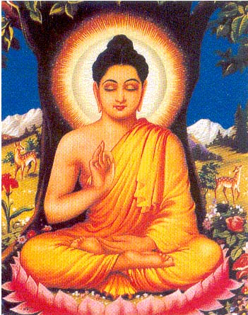
LI: To be able to understand the four noble truths and how they affect the lives of Buddhists.
Success criteria:
I can understand what the four noble truths are.
I can understand how the four noble truths can relate to our own lives.

Slide 5
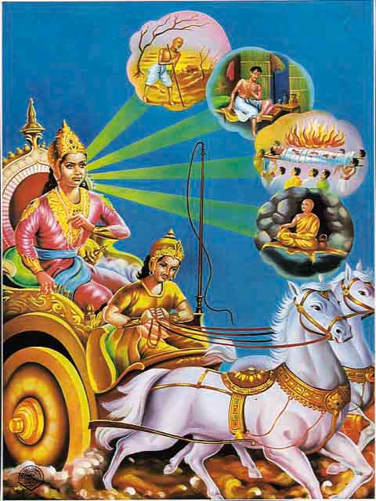
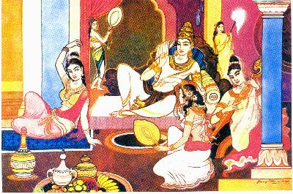
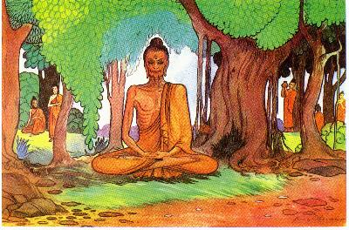
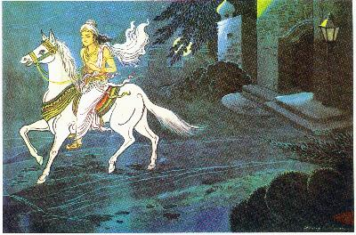
TTYP – Can you put the story of Siddhartha Gautama in order
He saw suffering for the first time
He lived a life of luxury in a palace
He went and mediated under a Bohdi tree for nine years
He left the palace to find out more about the world

Slide 6
Did you get it right?
He lived a life of luxury in a palace
He left the palace to find out more about the world
He saw suffering for the first time
He went and mediated under a Bohdi tree for nine years

Slide 7
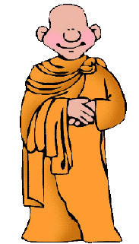
Using sign language how do you think Siddhartha Gautama felt when he first saw suffering?
Worried?
Happy?
Confused?
Ashamed?

Slide 8
The Four Noble Truths
When Siddhartha Gautama first saw suffering he felt confused, worried and ashamed because he had never seen them before
He went and meditated for nine years to try and understand why suffering happens
After nine years he became enlightened and became known as ‘Buddha’.
Buddha said there is suffering in the world because of the four noble truths……

Slide 9
The four noble truths
Suffering happens all the time because people always want more or something better than what we have.
Because we don’t have what we want we suffer and feel upset.
If we accept what we have and stop wanting more we will become happy.
This will stop suffering.

Slide 10
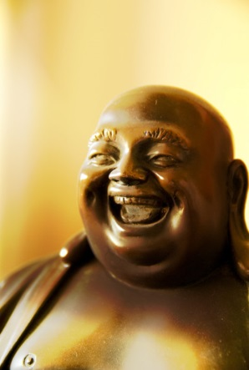
What would Buddha say about us?
Buddha would say that if we always want what other people have we will never be happy.
We should always be happy with what we have even if you got no prize!
You should always think about what other things you have and how lucky you are
If all people did this the world would be happy.

