Slide 1
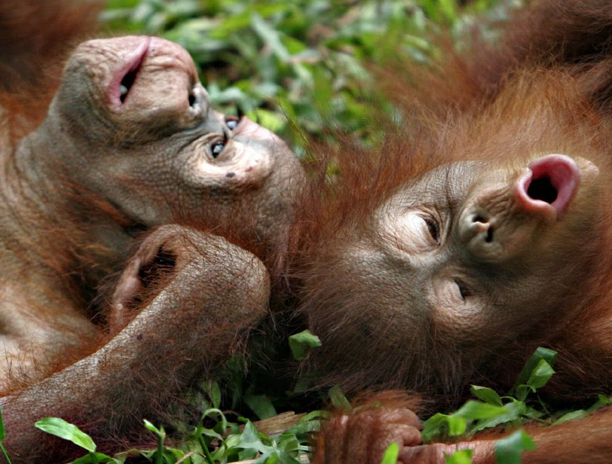
Orangutans

Slide 2
What do you know about orang-utans?

Slide 3
Where in the world do they live?

Slide 4
What is their habitat?

Slide 5
What do they eat?

Slide 6
How long do they live?

Slide 7
Your challenge today is to find out the answers to some of these questions! GOOD LUCK! Watch this video as an introduction. How did it make you feel?

