Slide 1
Buddhism
This half term, we are going to be learning about one of the five major religions...
Buddhism

Slide 2
TTYP
What do you know about Buddhism?
What experiences do you have of the religion?
Do you know any Buddhists?

Slide 3
Buddhism
The Buddha

Slide 4
LI: To be able to understand who the Buddha is and how he gained his title.
Success Criteria:
I can understand who the Buddha is.
I can explain how he became enlightened.
I can understand why the Buddha is significant to Buddhists.

Slide 5
Starter
TTYP: Have you ever seen anything pleasant or upsetting which has influenced or affected you?

Slide 6
What is important to you?
Which of the following things do you think are important for happiness:
Money
Fame
Good looks
IQ of 160
True friends
Something else (add your own)?
Which is most important to you? Give a reason why.

Slide 7
Today
Today we are going to be learning about The Buddha.
As we learn, think about what may have been important to his happiness.

Slide 8
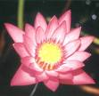
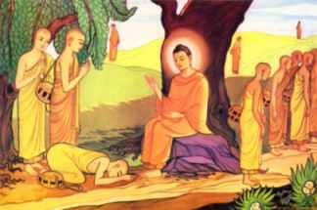
Introduction
In Buddhism there is one person whose life and teaching helps people to understand more about life. Buddhists believe he was the wisest teacher of all. His name was Siddharta Gautama but he is known by his special title; the Buddha.

Slide 9
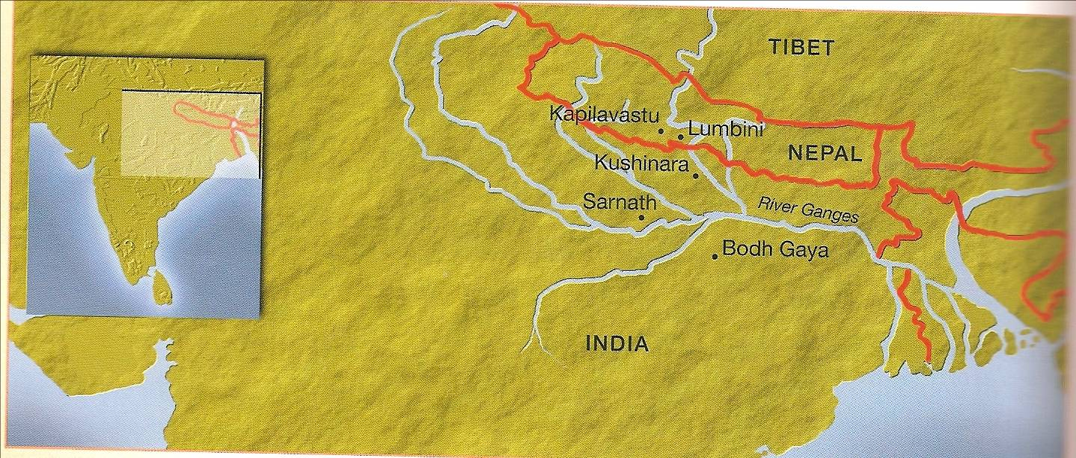
The Life of Buddha – Before Birth
The Buddha was born Siddhartha Gotama in a town called Lumbini, in India, near Nepal about 2500 years ago

Slide 10
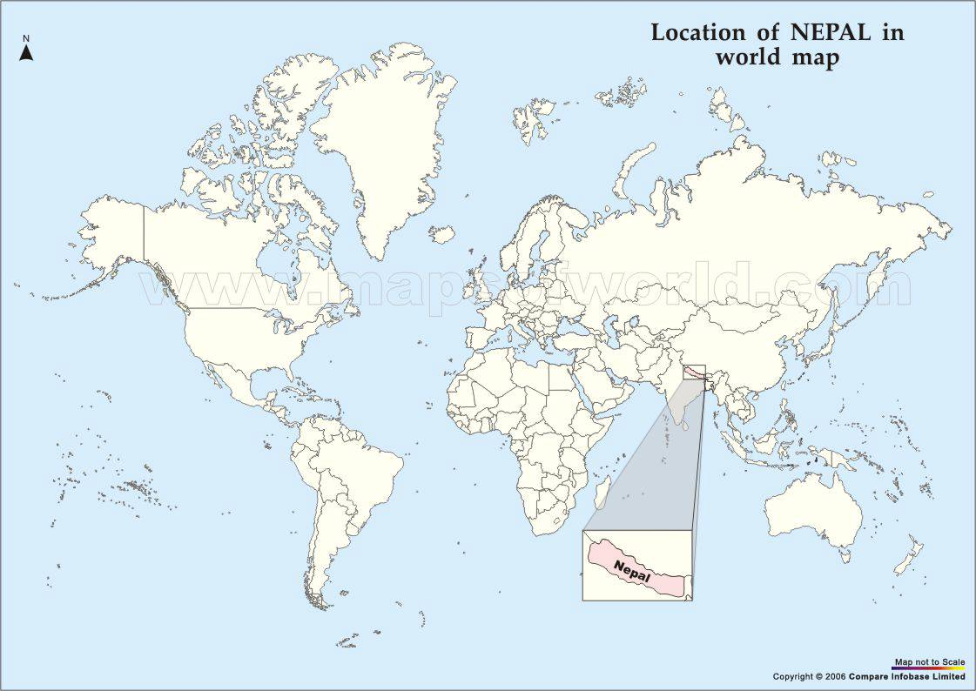

Slide 11
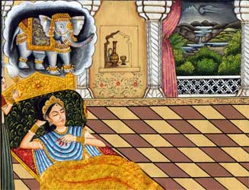
The Life of Buddha – Special Signs
Before and after his birth there were signs that the child would be important.
His Mother Queen Maya had a dream a special dream which meant the Buddha was going to be important.

Slide 12
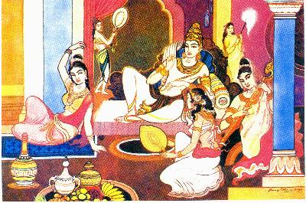
The Life of Buddha – Life at The Palace
The King did not want his son to see suffering so he decided Siddartha should live a life of luxury sheltered from the realities of the world.
He had everything he could ever want and at an early age married a beautiful princess Yasodhara.

Slide 13
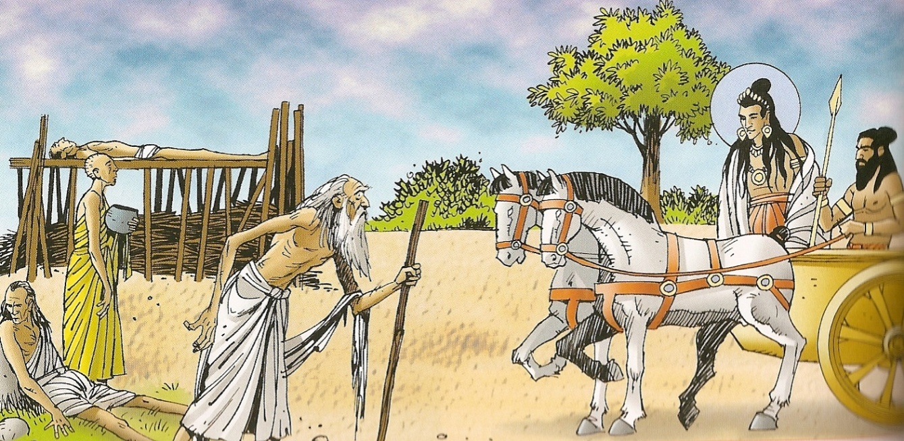
The life of Buddha – The Four Sights
The King attempted to protect Siddartha from the realities of the world but Siddartha was not happy living like a prisoner.
One day he went out hunting and he saw four sights:
  Old age
  Sickness
  Death
  A holy man

Slide 14
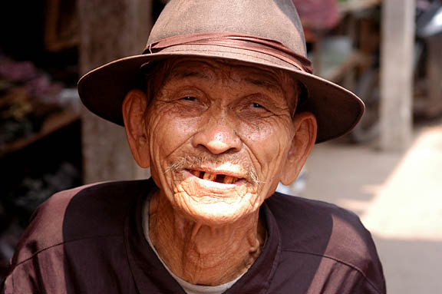
Old

Slide 15
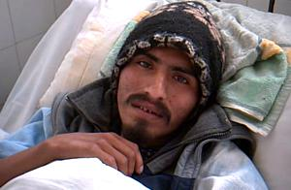
Sick

Slide 16
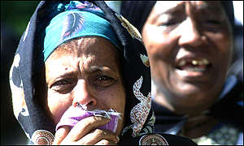
Mourning

Slide 17
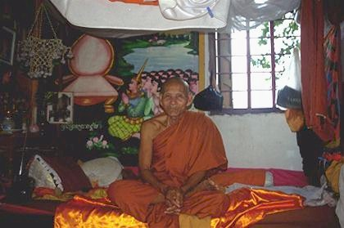
Happy Holy Man

Slide 18
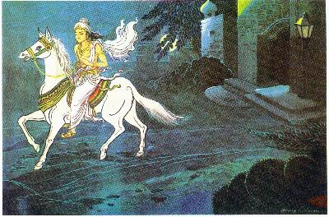
The life of Buddha
Each of the four sights made Siddartha sad and this made him think about life.
The day after his son Rahula was born, Siddartha decided that he must leave home in a quest for enlightenment. It was tough for him to leave his family but he thought he was doing it for the best and as soon as he reached enlightenment he would return.

Slide 19
His Holy Life
He spent six years travelling around India searching for enlightenment. He starved himself, he worked with teachers and monks but he did not find it. He then went and sat under the BODHI tree (meaning tree of wisdom) and it was there he gained enlightenment.

Slide 20
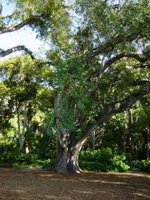

Slide 21
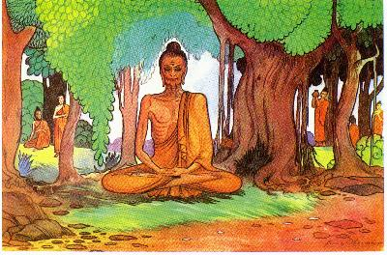
Life of Buddha
Siddhartha then lived as a Holy man. He had no money, clothes or luxury. He ate very little and was near to death when he realised this was not the answer.
He gave it up and decided a middle way was better between extreme luxury and extreme poverty

Slide 22
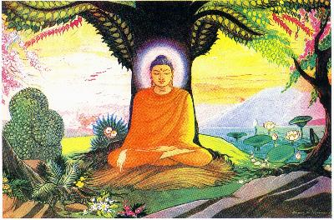
The Life of Buddha - Enlightenment
Siddhartha did not give up his search. Instead he sat himself under a Bodhi tree and meditated, determined to find the truth.
Whilst under the tree he was faced with many temptations sent by Mara – the force of evil.
Then gradually as morning came he saw things in a new way, he became enlightened and the supreme Buddha.

Slide 23
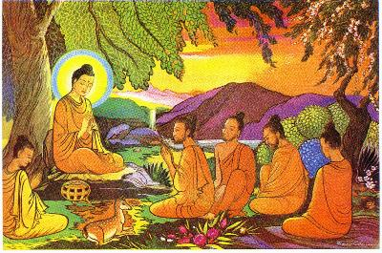
The Life of Buddha – His First Teachings
Siddartha was now the enlightened one -The Buddha- and had reached enlightenment.
He decided to share his teachings and ideas.
The Buddha then went and taught his first sermon in the Deer Park at Sarnath.

Slide 24

What Would You Do?
If you were Siddhartha, would you want to see life outside the palace, or would you prefer to stay inside and enjoy yourself? Why?

Slide 25
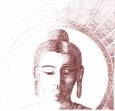
TTYP
Why do you think Siddhartha’s father tried to hide all suffering and death from him?
Do you think that his father’s actions had anything to do with the fact that his son was a prince? Why?

Slide 26
Let’s Think
What forms of suffering did Siddhartha experience when he journeyed outside the palace?
What thoughts might have gone through his mind when he saw these sights?

Slide 27
Task
Create a timeline of Buddha’s life using captions and pictures.
Write a paragraph explaining how this might affect how a Buddhist lives their life.

Slide 28

Extension
“Siddhartha Gautama should have stayed at home and looked after his family.”
Do you agree? Explain the reasons for your answer. Try to use persuasive language.

Slide 29
Plenary
Self-assess against the S.C.

