Slide 1
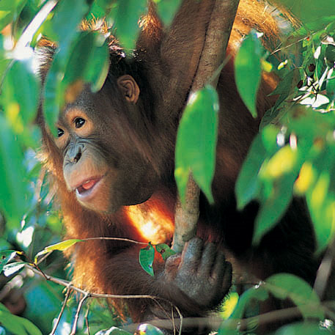
The Orangutan Quiz!!!!!

Slide 2
There is only one specie of Orangutans.
TRUE
FALSE
FALSE
There are two!
The Pongo abelii,
and the Pongo pygmaeus.
Where does the Pongo Abelii live?

Slide 3
The Orangutans are the only apes in the world from Asia.
TRUE
TRUE
They are the only great ape from Asia and they are found in tropical rainforests in northern Sumatra, Indonesia and in the swamps of Borneo
FALSE
Why do the Orangutans enjoy the tropical rainforests?

Slide 4
Orangutans sleep in tree logs on the ground.
TRUE
FALSE
FALSE
Orangutans build nests high in the trees at night and sometimes even make a roof of twigs!!!

Slide 5
An orangutan arms can have a reach of more than 8 feet.
TRUE
FALSE
TRUE
Orangutans usually move by swinging from one branch to another; this is called brachiating.

Slide 6
Orangutans are not an endangered species.
TRUE
FALSE
FALSE Baby Orangutans are caught and sold as pets and the numbers of Orangutans are decreasing as they lose their habitat to people.

Slide 7
Orangutans diets mainly consist of fruit.
TRUE
TRUE
They eat forest fruits, including durians, jackfruits, leeches, mangos, and figs, and also small animals, tree bark, soils rich in minerals, leaves and shoots.
FALSE

Slide 8
Orangutans travel in large family groups.
TRUE
FALSE
FALSE Orangutans do not live in large social or
family groups. They are semi-solitary animals. Adult males are usually found alone
and adult females are usually accompanied by one or two offspring.

Slide 9
Orangutans have lost 80% of their habitat in the last 20 years!
TRUE
TRUE
Tropical rainforests are being cut
down for timber and the land cleared for mining and
palm oil plantations.
FALSE

Slide 10
The Orangutans’ reproductive rate is quite fast.
TRUE
FALSE
FALSE In the wild, orangutans have only one infant every six to nine years, making orangutans particularly vulnerable to extinction.

Slide 11
Orangutans are highly intelligent and use tools to find food.
TRUE
TRUE
They will poke twigs into holes to catch insects, chew up leaves and use them as sponges and use branches and sticks to test the depth of water before entering it.
FALSE

