Slide 1
The titanic – what happened?
A research project exploring WHY the Titanic sank and WHO was to blame

Slide 2
The titanic – watch the video, taking notes of key facts & useful info…

Slide 3
Your challenge – week 1
after watching the video, decide whom you hold responsible for the sinking of the titanic.
Make a wanted poster for your chosen individual – this could be on Microsoft word or a similar drawing app if you are up for the challenge, or it could be on paper.
think about the presentation and language you use in it. Will you make it look dated? What reasons do you have for your choice? Were there more than one to choose from? If so, why?
Bonus task - Upload your finished designs on classroom dojo for your teachers to enjoy!

Slide 4
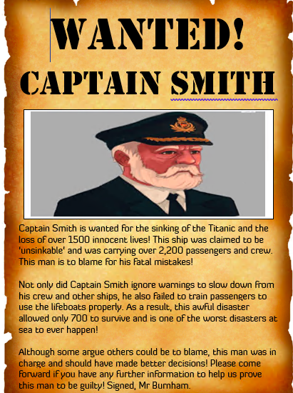
My example – I know you can do better!

