Slide 1
Orchards Home learning
A Science session in 3 easy steps! (Just follow the PowerPoint!)
Read, share and discuss this PowerPoint
Take some time to go online for additional research
Complete the task/challenge!
Easy! Everyone can do this…and we look forward to seeing your completed work!

Slide 2
Science - Year 4
Living Things & their Habitats
LOOK OUT FOR KEY WORDS ALONG THE WAY…THEY MAY HELP YOU WITH YOUR TASK!
.

Slide 3
Before you start reading the PowerPoint…
Watch this clip…
https://www.bbc.co.uk/bitesize/clips/ztbw2p3

Slide 4
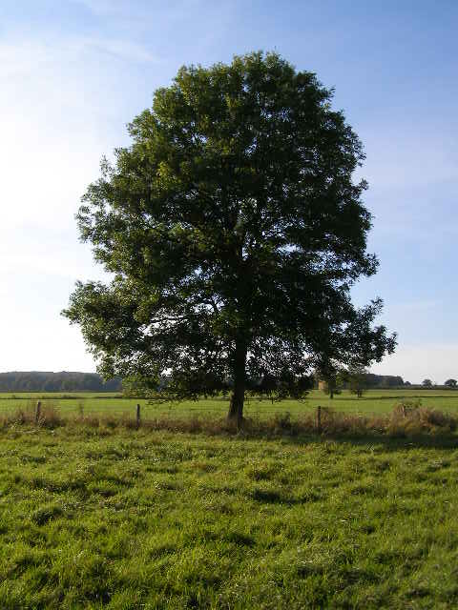
What makes a living thing? Discuss this with someone at home.
If everyone is busy, then just write your thoughts down on a bit of paper!!

Slide 5
Although all living things look different to each other even if they are the same species, there are 7 things that all living things do.
These 7 things are called life processes.
A thing is only living if it does all 7 of these life processes.

Slide 6
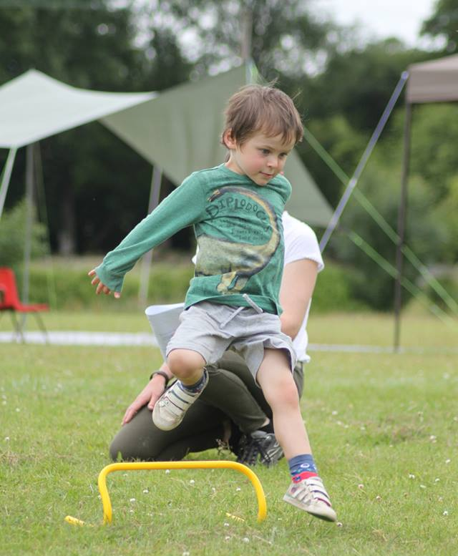
All living things move.
Animals move their body. From big movements like a jump, to small movements like a wink.
Plants turn, or grow, towards the light.

Slide 7
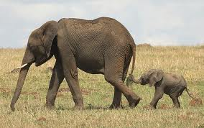
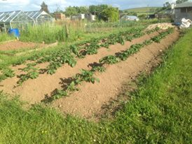
All living things reproduce.
Animals have babies.
New plants grow from seeds.

Slide 8
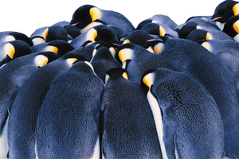
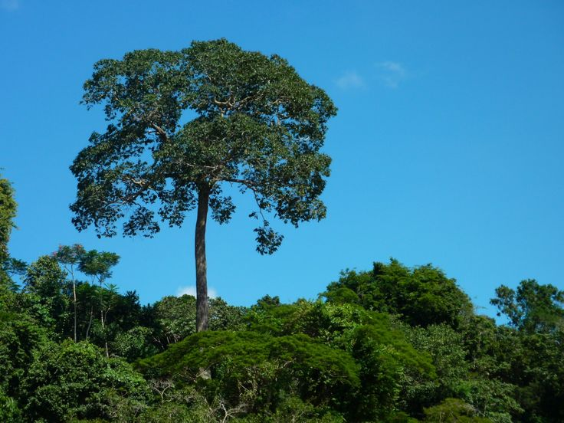
All living things are sensitive.
Living things are sensitive to their surroundings.
Animals react to changes in the temperature around them.
Plants grow towards sunlight and send their roots deeper if they need to find more water.

Slide 9
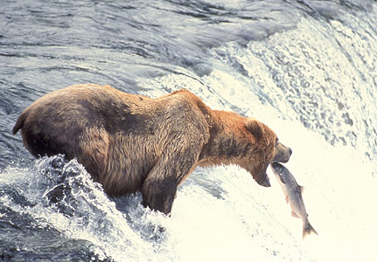
All living things need nutrition.
Living things need food for energy.
Plants make their own food using energy from the sun.
Animals eat plants and/or
other animals.

Slide 10
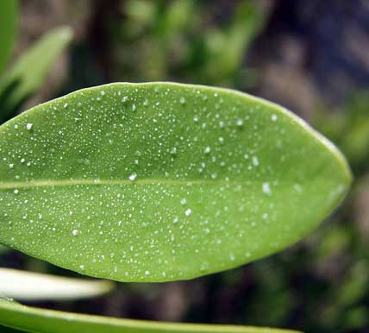
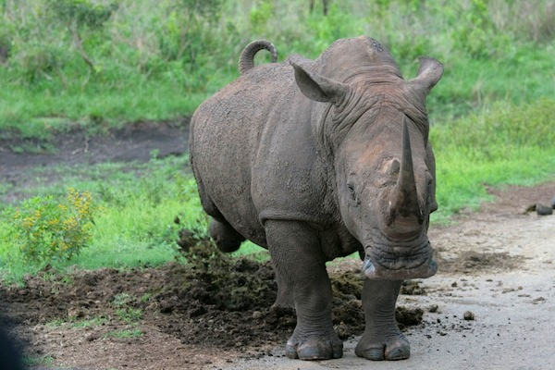
All living things excrete.
Plants and animals both need to get rid of waste gas and water.
Animals also need to get rid of other waste products.

Slide 11
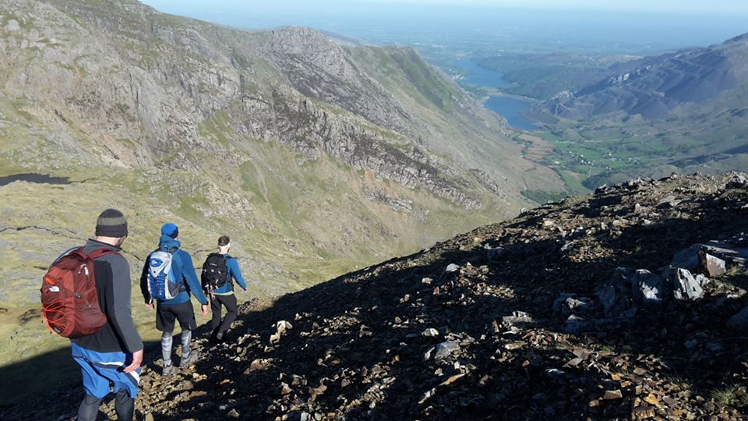
All living things respire.
What will you use your energy for today? Could you and the people you live with go for a walk or some exercise today?
Plants and animals use oxygen in the air to turn food into energy.

Slide 12
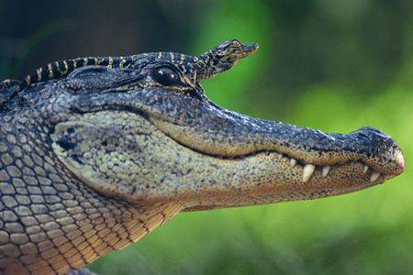
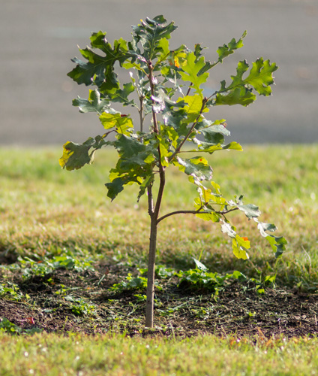
All living things grow.
Young animals grow into adults and plant seedlings grown in to mature plants.

Slide 13
Read these key words…can you memorise them?!
M – movement
R – reproduction
S – sensitivity
N – nutrition
E – excretion
R – respiration
G - growth

Slide 14
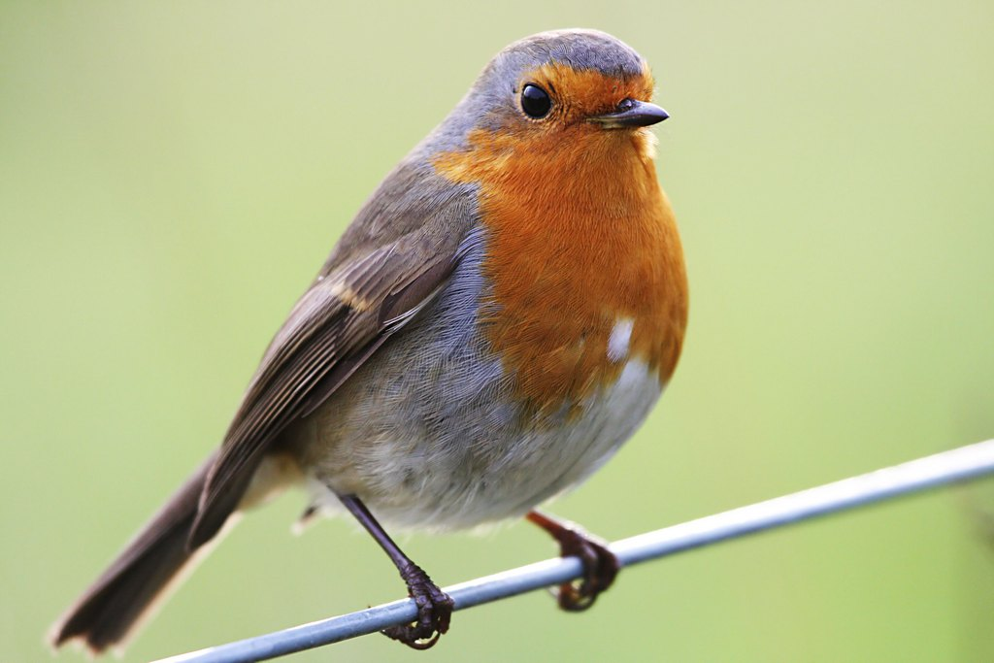
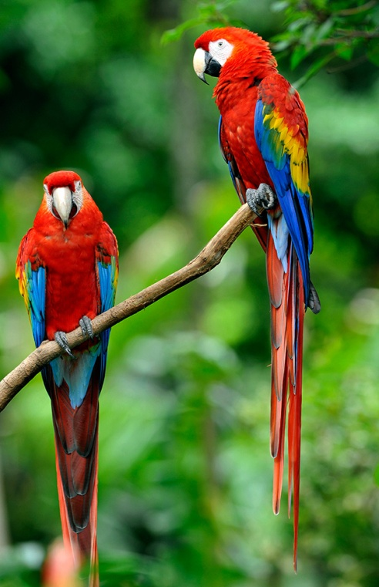
Name some living things we will find living in the wild in our local environment.
List some living things we will definitely not find locally.
Remember to think of some plants and animals.

Slide 15
Your Activity… Challenge yourself to create a poster or information page/booklet, to explain the seven characteristics of living things to younger children. Go back through the PowerPoint to help you.
On your work you should try to have an animal and plant example (this could be a drawing, or printed and stuck on!).
Spend some time discussing your ideas, before planning your work.
You may wish to go online to do some further research. Make sure you check spellings before you write anything! (key words are on this PowerPoint) Make your work bright and eye-catching, as well as informative. Perhaps add a border?
We cant wait to see your finished work!!!!

