Slide 1
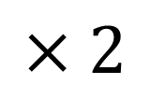
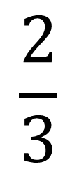
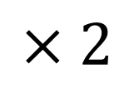
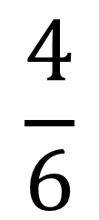
$$×2$$
$$\frac{4}{6}$$
$$\frac{2}{3}$$
$$\frac{?}{?}$$
$$=$$
$$×2$$

Slide 2
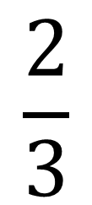
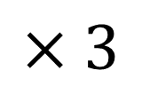
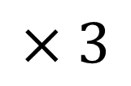
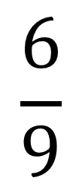
$$×3$$
$$\frac{2}{3}$$
$$\frac{?}{?}$$
$$\frac{6}{9}$$
$$=$$
$$×3$$

Slide 3
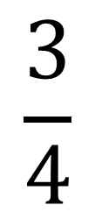
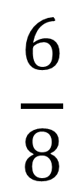
$$×2$$
$$\frac{?}{?}$$
$$\frac{3}{4}$$
$$\frac{6}{8}$$
$$=$$
$$×2$$

Slide 4

$$×3$$
$$\frac{3}{4}$$
$$\frac{9}{12}$$
$$\frac{?}{?}$$
$$=$$
$$×3$$

Slide 5

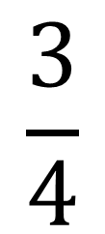
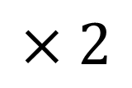
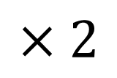
What is the missing number in this equivalent fraction?
$$×2$$
$$\frac{3}{4}$$
$$\frac{6}{?}$$
$$\frac{?}{?}$$
$$=$$
$$8$$
$$×2$$

Slide 6

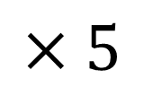
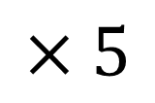

What is the missing number in this equivalent fraction?
$$×5$$
$$\frac{3}{4}$$
$$\frac{15}{?}$$
$$\frac{?}{?}$$
$$=$$
$$20$$
$$×5$$

Slide 7

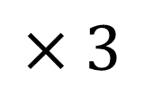
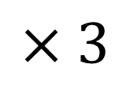

What is the missing number in this equivalent fraction?
$$×3$$
$$\frac{3}{4}$$
$$9$$
$$\frac{?}{12}$$
$$\frac{?}{?}$$
$$=$$
$$×3$$

Slide 8

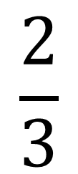
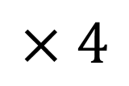
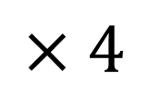
What is the missing number in this equivalent fraction?
$$×4$$
$$\frac{2}{3}$$
$$\frac{8}{?}$$
$$\frac{?}{?}$$
$$=$$
$$12$$
$$×4$$

Slide 9
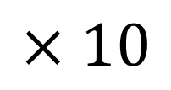
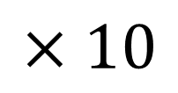

What is the missing number in this equivalent fraction?
$$×10$$
$$\frac{2}{3}$$
$$20$$
$$\frac{?}{30}$$
$$\frac{?}{?}$$
$$=$$
$$×10$$

