Slide 1

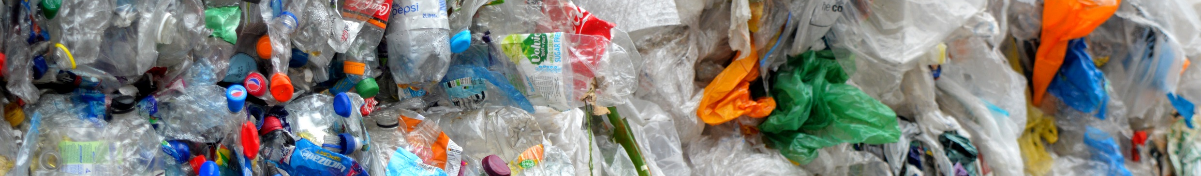
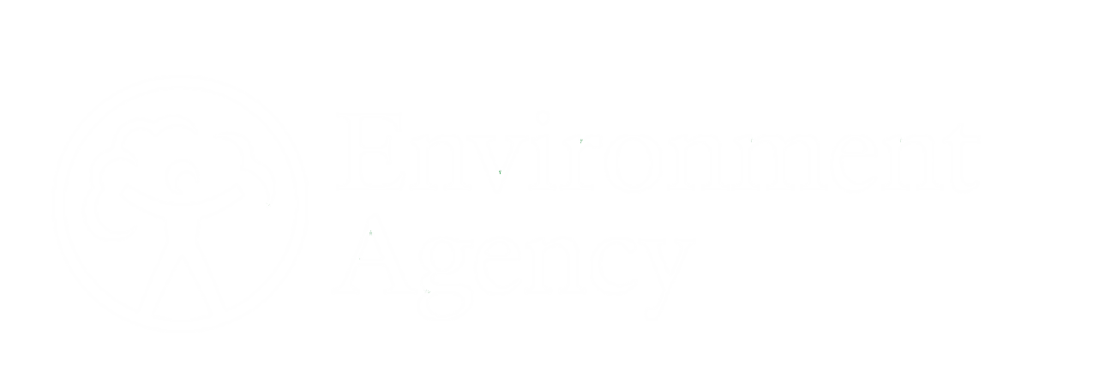
Together, we can make plastic pollution a thing of the past.

Slide 2
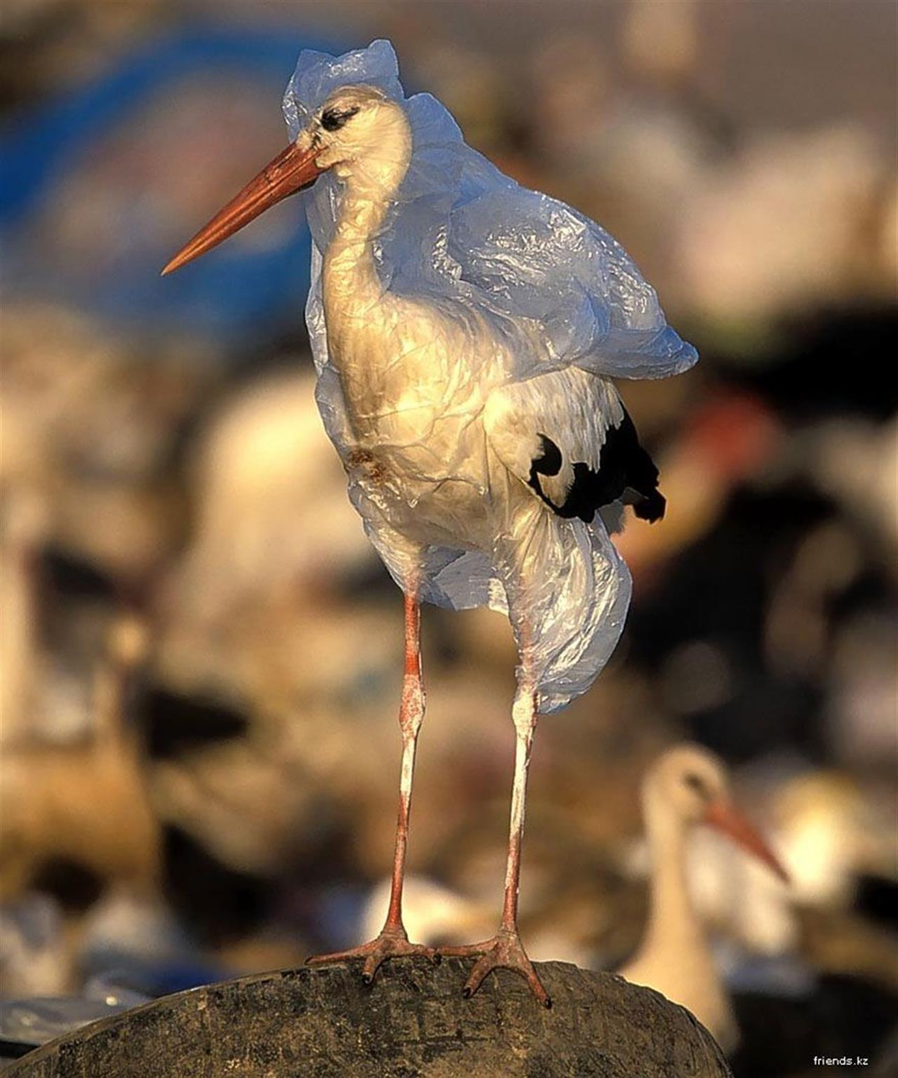

What is happening in this picture?
Why might this have happened?
Although there are bad things happening in the environment there are people who are encouraging others to make a difference, such as David Attenborough.
Notes:
Hand out white boards of the class to write their answers on. Questions for the class: What is happening in this picture? Why might this have happened? What could happen to the animals? Write some of the most popular/best answers on the board.
Lead onto the next slide: Although there are bad things happening in the environment there a people who are encouraging others to make a difference such as David Attenborough. Ask is anyone knows who David Attenborough is and what he does.

Slide 3
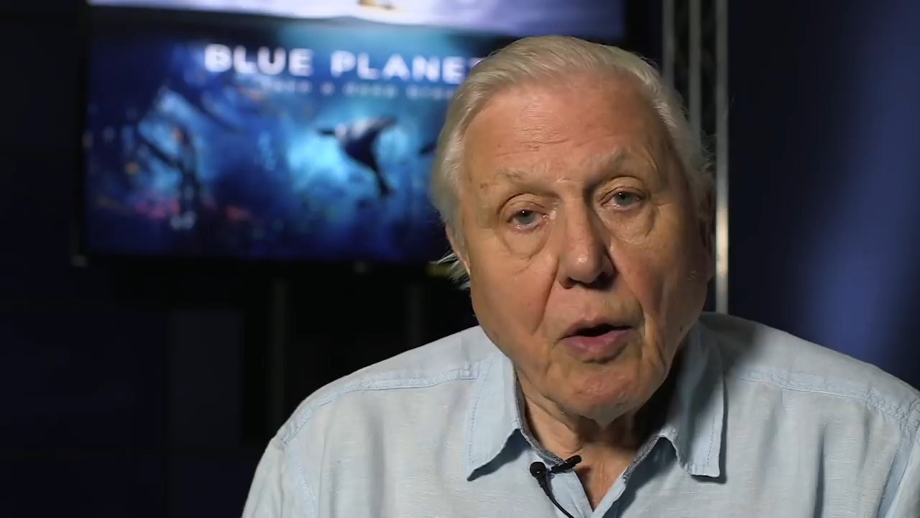
©BBC
Notes:
Play the video clip. After the video explain that naturalists such as David Attenborough are very important for getting people’s attention when it comes to important issues such as plastic.

Slide 4
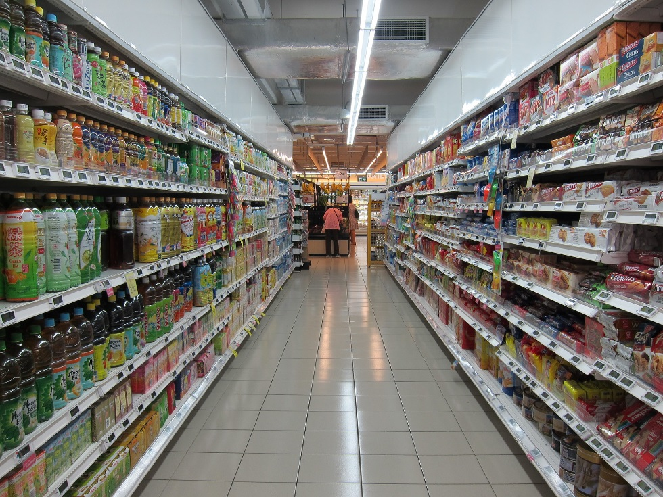
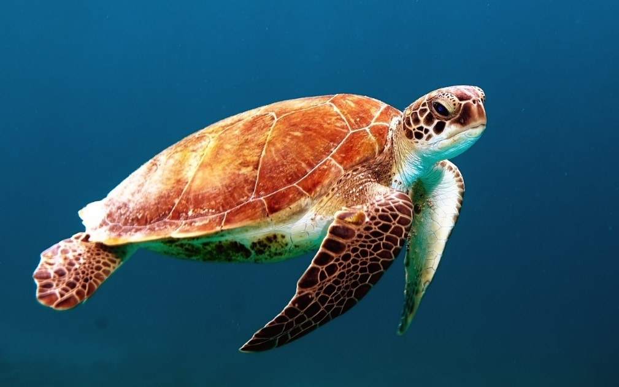
What’s the connection?
Notes:
This question is aimed at getting the class engaged and thinking. Give them a few minutes to put up their hand and suggest what they think the connection could be. Answers on the next slide.

Slide 5

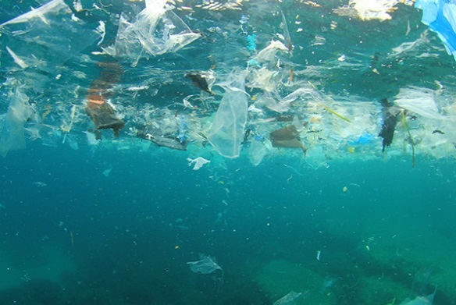
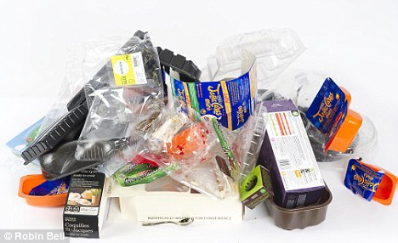
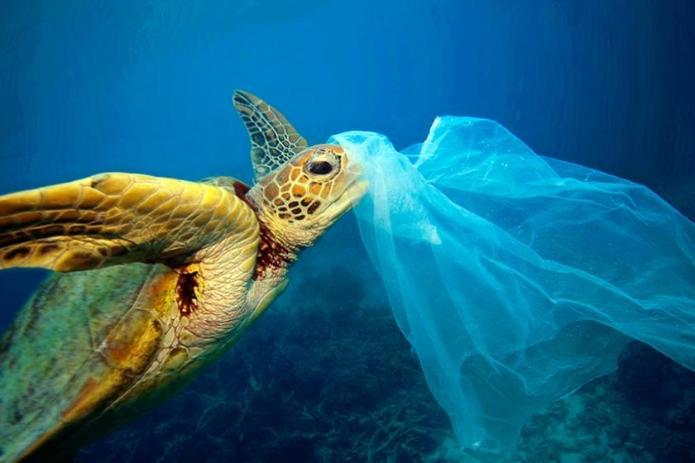

What’s the connection?
Notes:
Answer for the question will appear one step at a time. If the class haven’t guess the connection try and get them to continue guessing as each stage appears. From the supermarket people by food which is wrapped in plastic packaging. This can end up in the ocean which is were turtles live. Turtles can get confused and think that plastic is food. They can eat it which makes them ill.

Slide 6
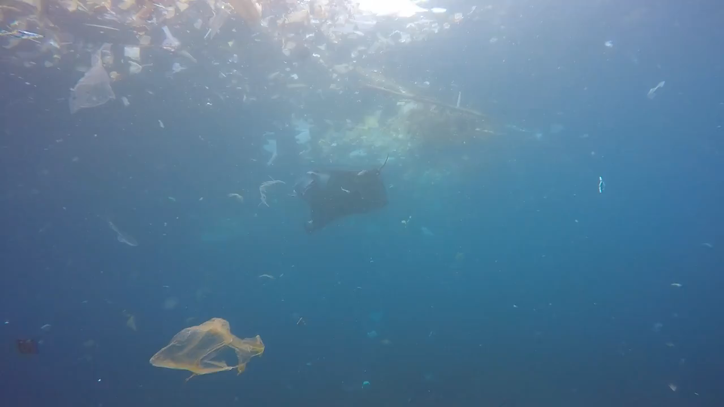
How does it make you feel?
Notes:
After watching the video ask the class to write on their white boards: first how it makes them feel, second how the manta ray might feel.

Slide 7
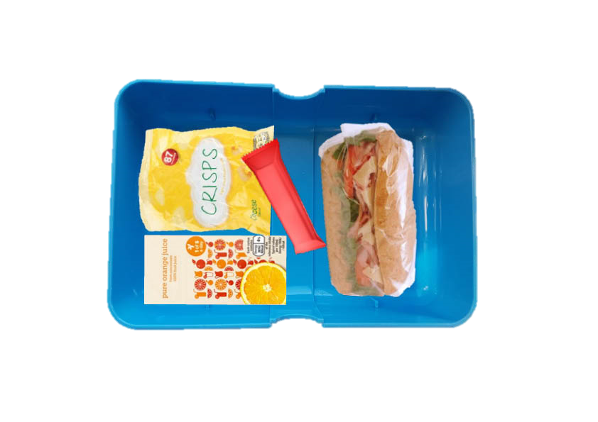
What’s in your lunchbox?
Notes:
This activity follows on from the lunchbox challenge shown in the previous video clip. Explain to the class that they are going to be looking at their lunchboxes (or thinking about what was in their lunchbox) to see how much plastic was used. Ask everyone to get their lunch and have a look at what is in there.

Slide 8
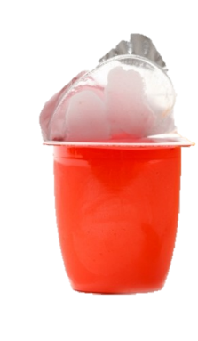
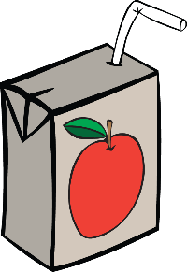
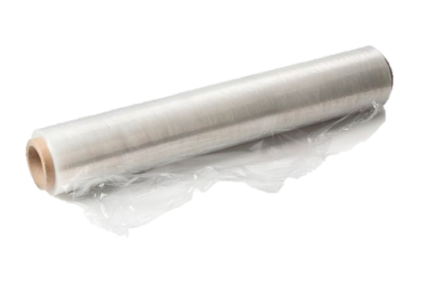
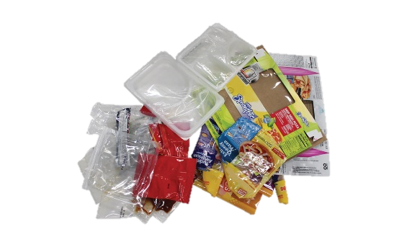
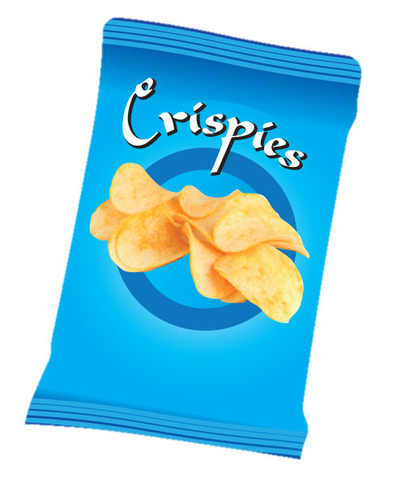
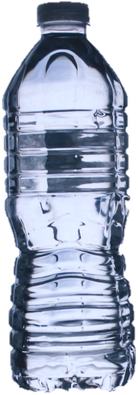
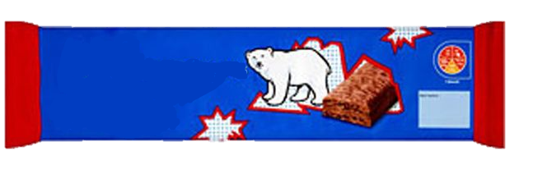
What’s in your lunchbox?
Clingfilm
Yoghurt pot
Drink carton
Other
Snack bar
Drink bottle
Crisp packet
Notes:
For each category get the children to put their hand up if it is/was in their lunchbox. Make a note of the numbers for each category for use in the next part of the activity.

Slide 9
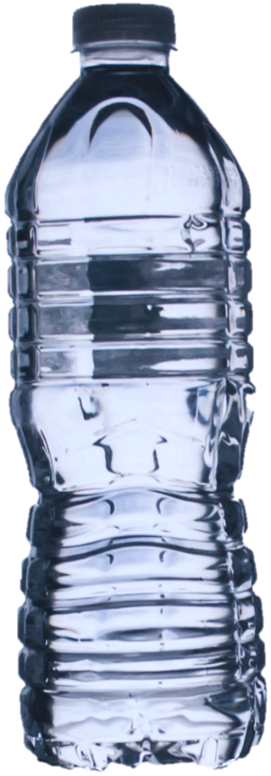
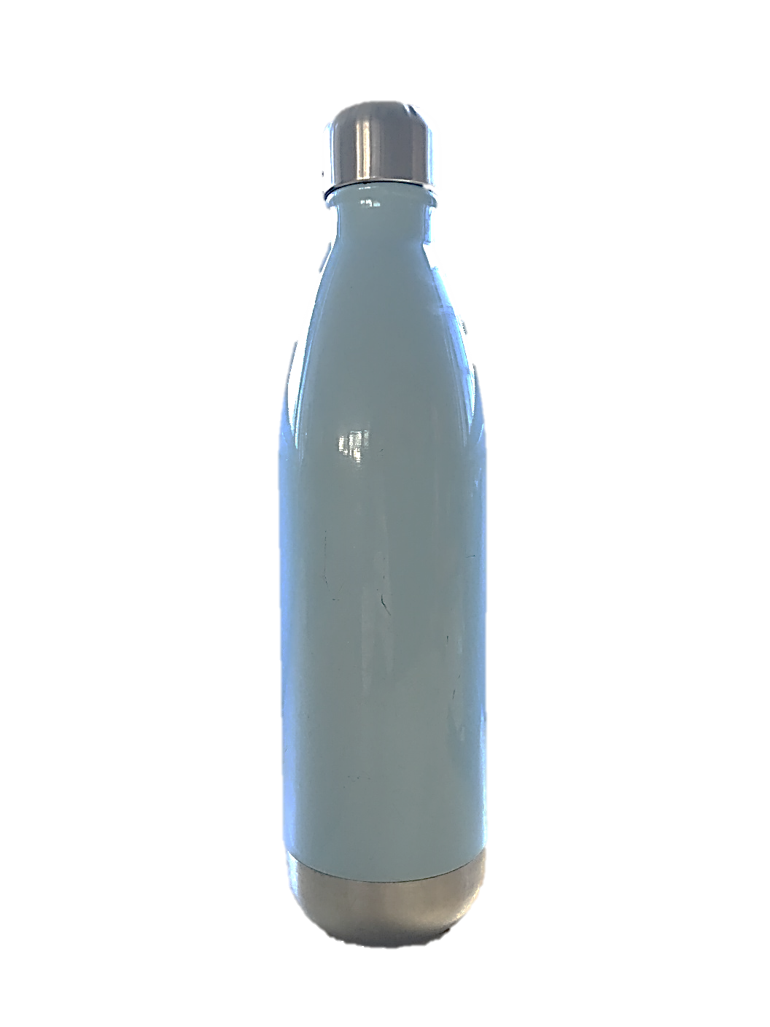
What could you use instead?
Notes:
To help reduce the amount of plastic in lunchboxes the next slides show some simple swaps. When each plastic item is shown ask the class to suggest what could be used instead before showing our suggestion. Remember that just because their answer is different to ours it doesn’t mean that it is wrong.
Instead of a single use drinks bottle or carton a resusble bottle could be used.

Slide 10
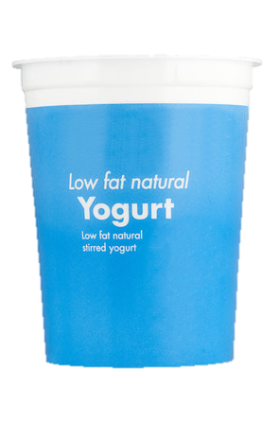
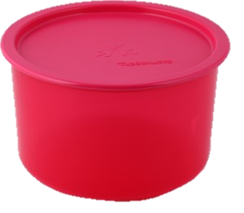
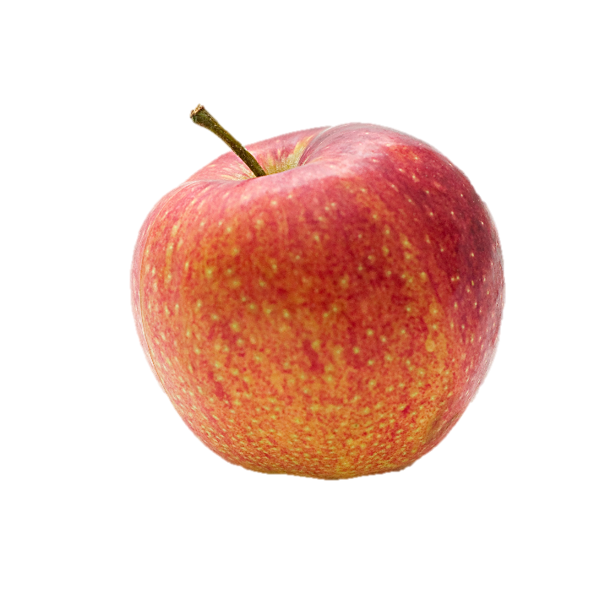
What could you use instead?
Notes:
Instead of a single use yoghurt pot choose fruit that isn’t wrapped in plastic or buy one big yoghurt pot and put a portion in a small tub.

Slide 11
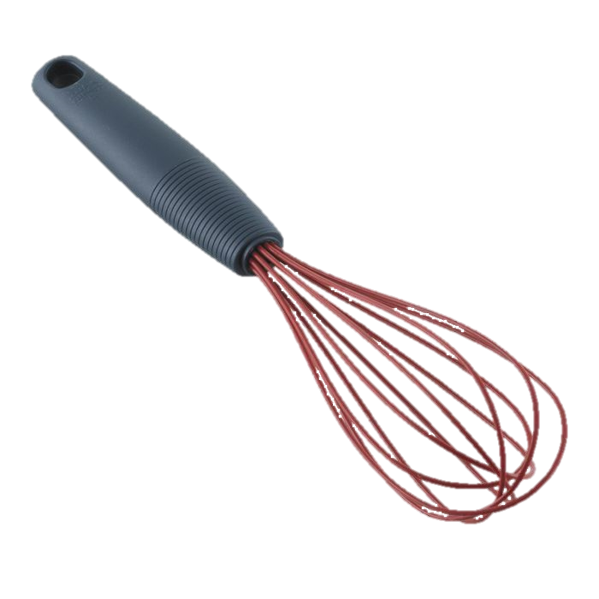
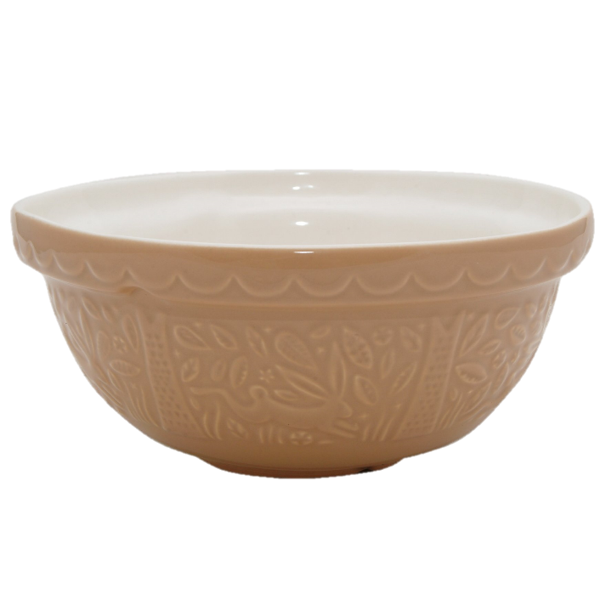
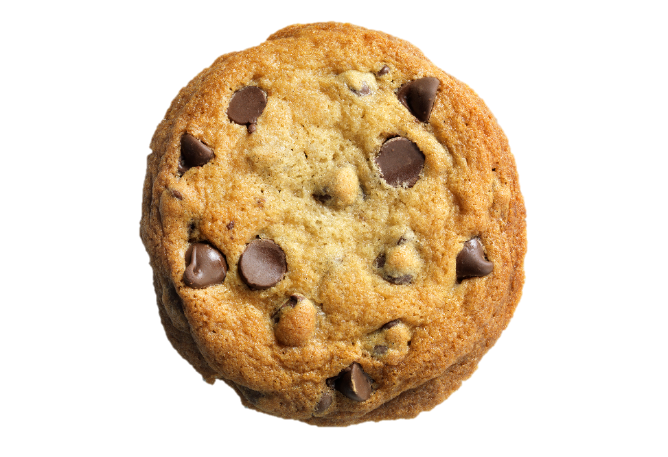
What could you use instead?
Notes:
Instead of buying snack bars wrapped in plastic you could make your own treats to take to school.

Slide 12
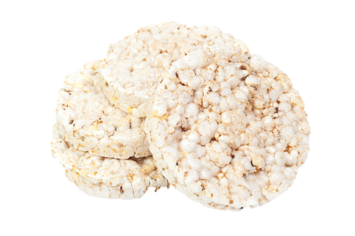
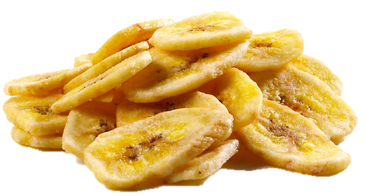
What could you use instead?
Notes:
Even though they don’t look like other plastics crisp packets are made from plastic. You could try bringing rice cakes loose in your lunchbox or dried fruit like banana chips.

Slide 13
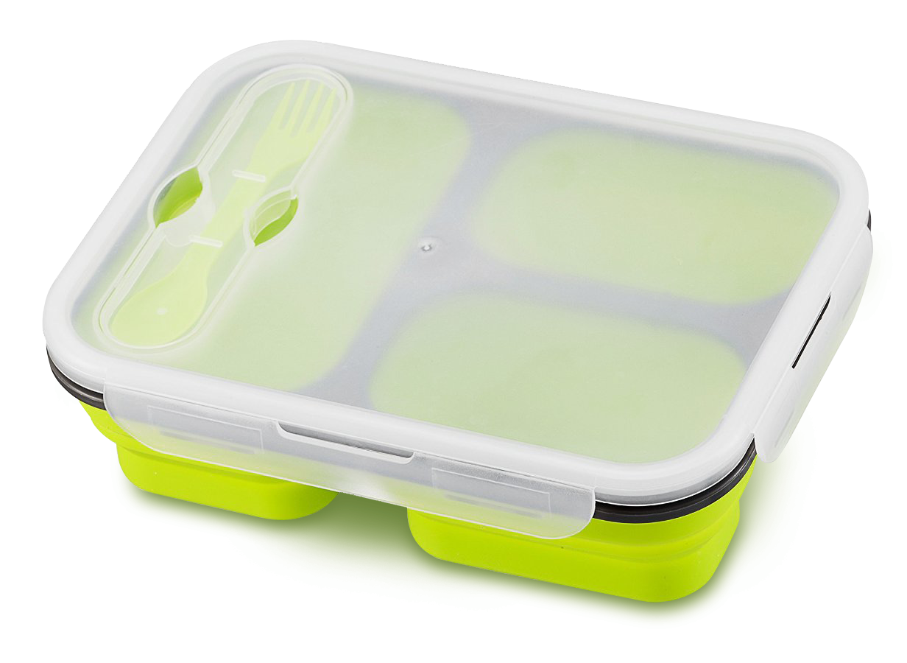
What could you use instead?
Notes:
Instead of wrapping things and putting them in a lunchbox or loose in your bag you can get a lunchbox with compartments and leave everything loose.

Slide 14
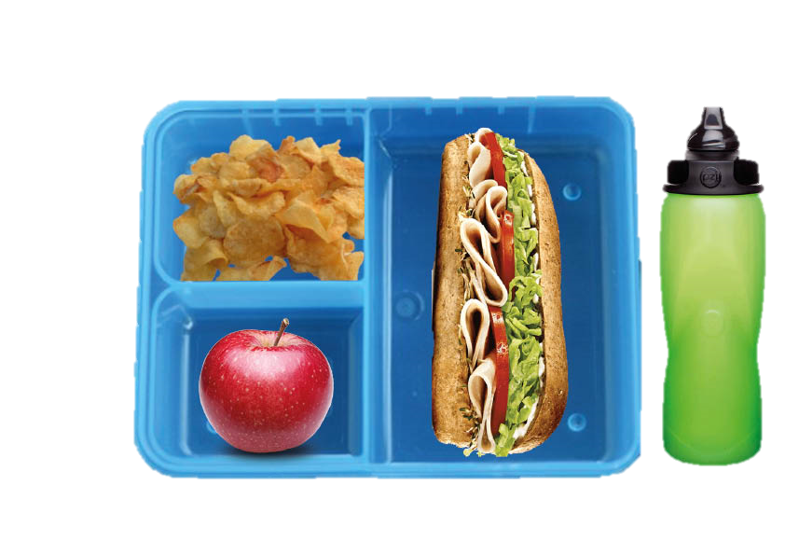
What’s in your lunchbox?
Notes:
Here’s an example of what you could have for your lunch. Quick discussion within the class what will you do/ ask your parent or carer to change in your lunchbox?

Slide 15

What is microplastic?
Microplastic are small pieces of plastic (0.5cm). They can be made by big pieces of plastic breaking up into small pieces, or plastic that are made to be small like beads. These tiny pieces of plastic can be dangerous because animals can eat them which makes them sick. Has anyone ever seen microplastic?

Slide 16
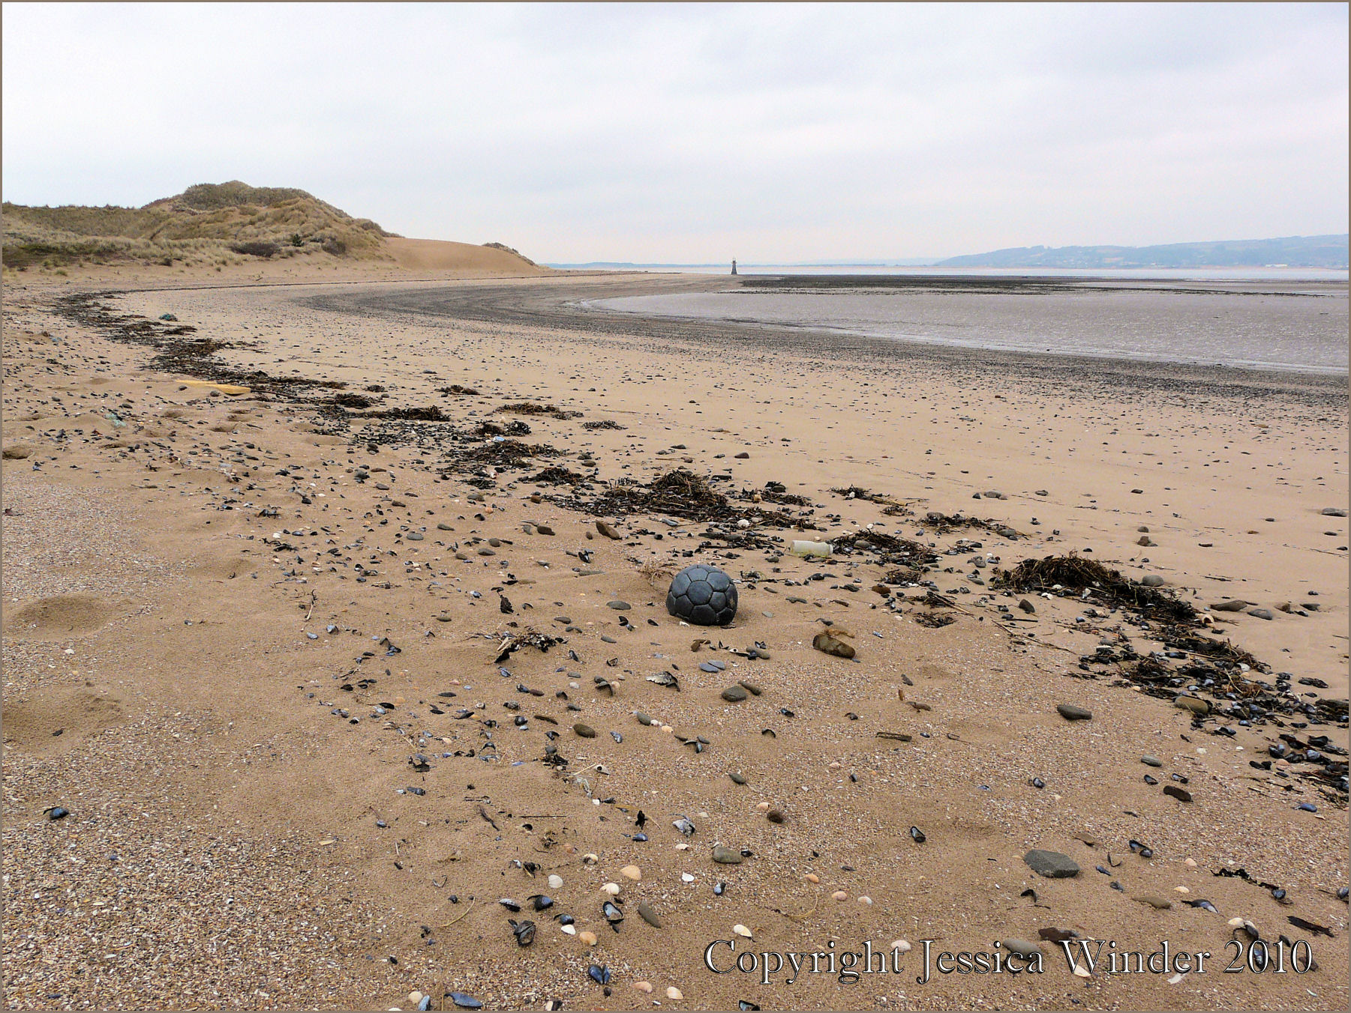
Microplastic Survey
5m
Notes:
Carrying out a survey is a way that scientists can estimate how much plastic in on a beach. A 1mx1m quadrat is used (make sure to explain what a quadrat is) it is placed on the sand along the strandline to mark out the survey area. The strandline is the place on a beach where the sea deposits most of things it is carrying, it can be spotted by looking for a line of seaweed along the beach. This is also where most plastic is usually found. Once the quadrat has been placed on the sand a small quadrat that is 10cmx10cm is used to take smaller samples, five small samples are taken inside the big quadrat. Then five metres is measured out, the big quadrat put down and this is repeated five times. The class is going to help analyse the results.

Slide 17
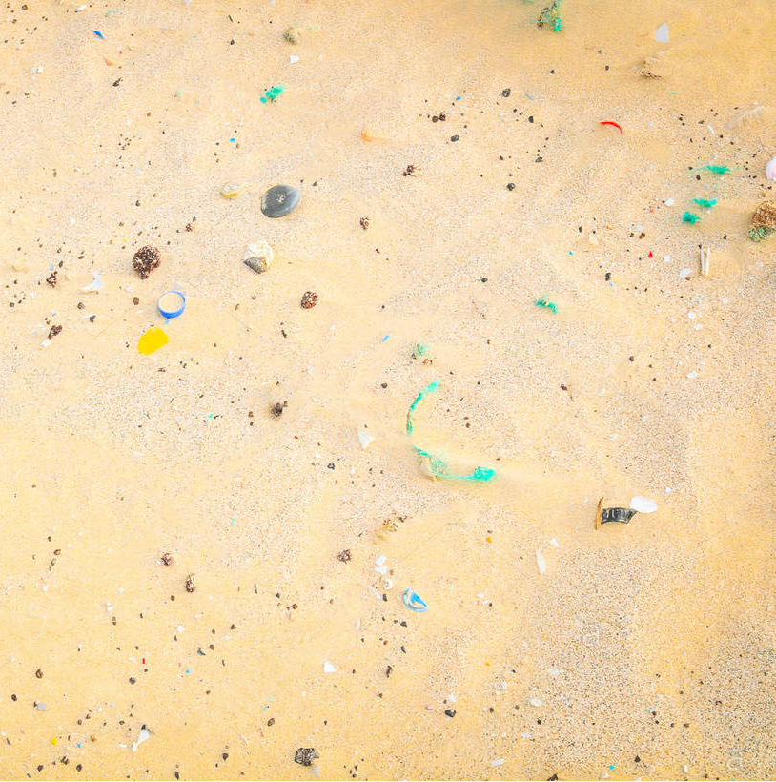
Microplastic Survey
Notes:
This is an example of the five smaller quadrats inside the big one. These are all 10cm² and let scientists work out the mean amount of plastic in 1m² which they can then use to work out the mean amount of plastic on the beach.

Slide 18
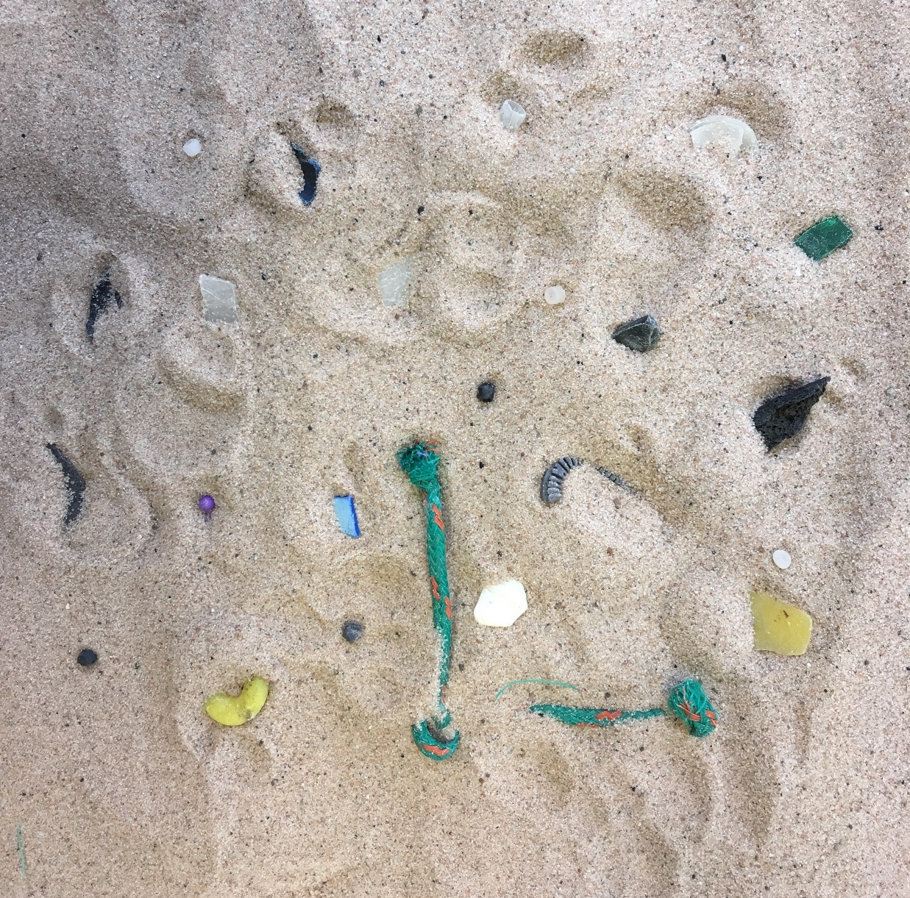
Microplastic Survey
Notes:
Each table in the room represents a 1m2 quadrat and on each table are 5 sheets which represent the 10cm2 quadrats. What you need to do is go around each quadrat and count how many pieces of microplastic there are in each quadrat and then write it on your sheet. Once you have been around to all of the quadrat there are some maths questions so that you can work out the mean amount of plastic on the beach.

Slide 19
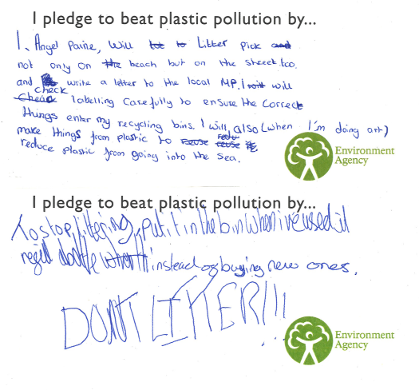
What can you do?
Notes:
Ask all the children to think of something that they could do at home, school or in a club. Here are some examples of pledges we have received (you can change these for some of your own) read these out to the class to give them ideas. They can then write this on a pledge card, tell them to keep hold of it as they will need it in a minute.

Slide 20
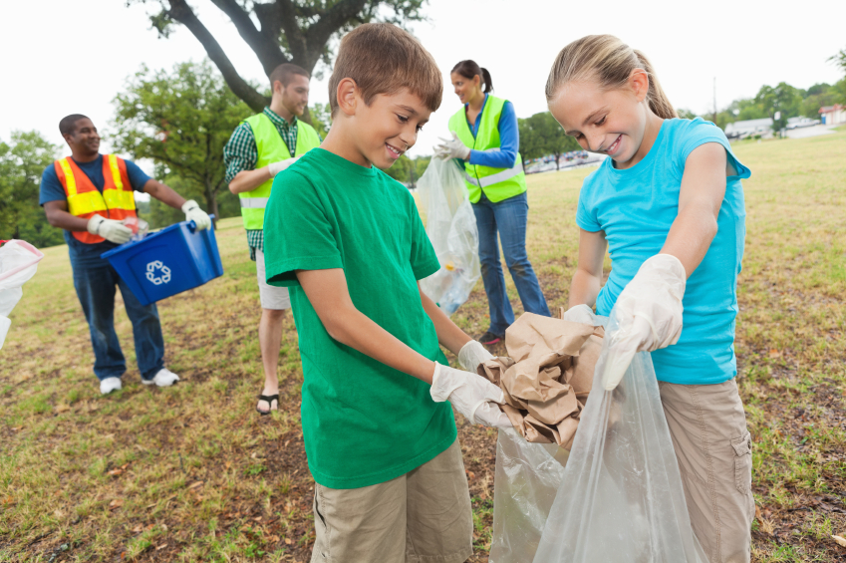
Life Cycle of a single use plastic bottle
What can you do?
© OneToughJob
Notes:
One of the easiest things you can do is to use reusable items rather than single-use ones. For example you could use a reusable water bottle, you can even ask in restaurants and cafes if they will fill it up with water for you.
You can also pick up litter in the street , on beaches or around rivers. How about organising a litter pick around your school?

Slide 21
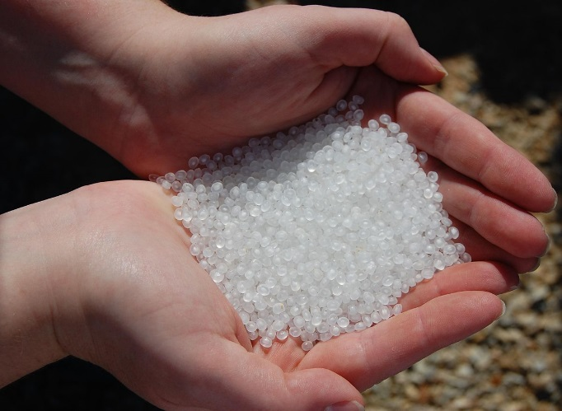
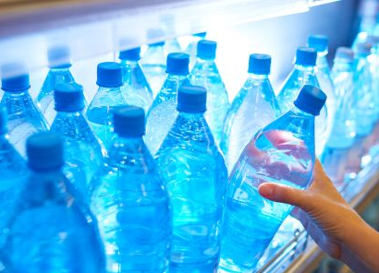
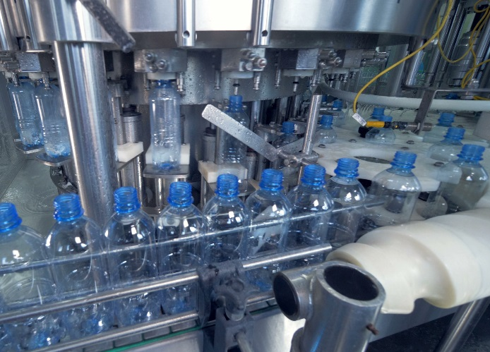
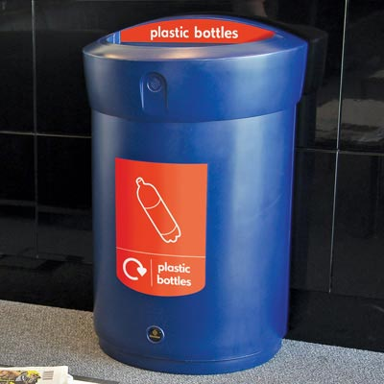
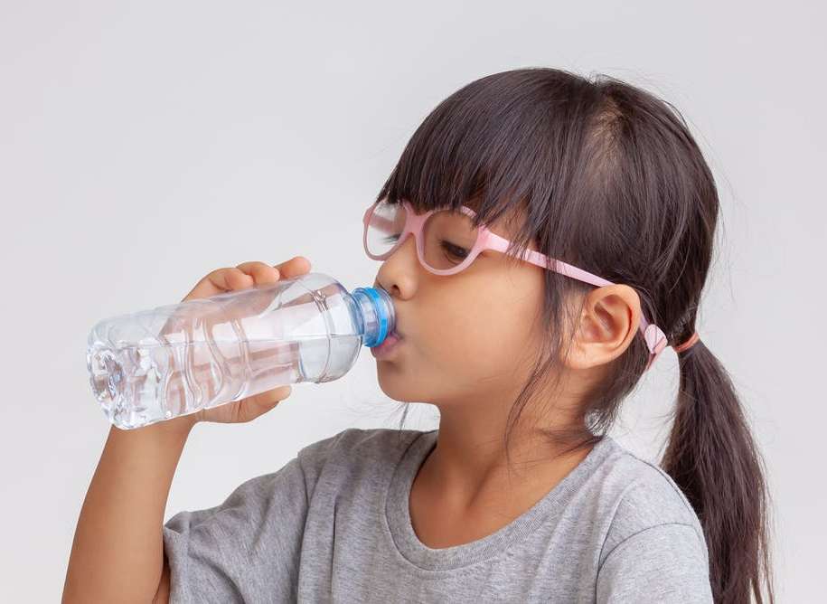
Life Cycle of a single use plastic bottle
Put the images and arrows in the correct order
Nurdles – Plastic production pellets
Plastic bottles in the supermarket
Purchasing
Transportation
Shipping
© Paul Nettles
© John Jewell
Plastic bottle factory
Plastic recycling bin
Using the plastic bottle
Disposal
Recycling
© SVTeam
© Envoy
© BigKhem
Notes:
For this activity split the class into groups of 4 or 5. This activity is going to look at the life cycle of a single-use plastic bottle. A life cycle can be used to for things that aren’t living as well as those that are., for example a single- use plastic bottle. Hand out the blue arrows and cards and ask the class to put together the life cycle. Hint: This life cycle will start with nurdles, these are pellets which are melted down to make into plastic items. Only use the blue arrows and pictures for this part of the activity (Next slide contains the answers).

Slide 22
Plastic recycling bin
Nurdles – Plastic production pellets
Nurdles – Plastic production pellets
Disposal
Recycling
Using the plastic bottle
Shipping
Plastic bottles in the supermarket
Plastic bottle factory
Purchasing
Transportation
Notes:
Here is the correct life cycle of a plastic bottle (shipping and transportation could be swapped around). For each stage ask the class what they think comes next before revealing it.

Slide 23
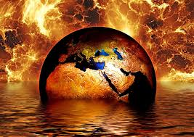
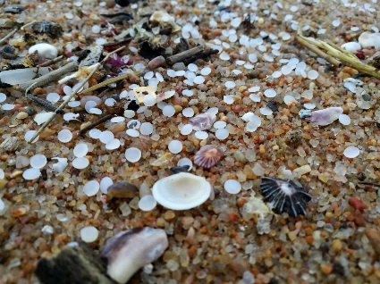
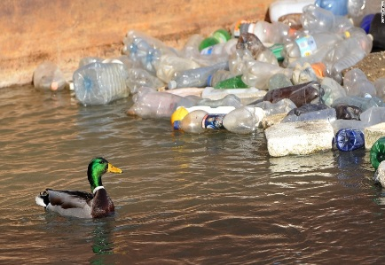
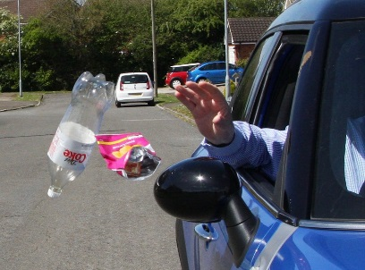
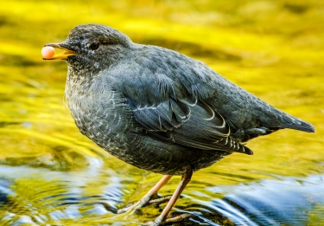
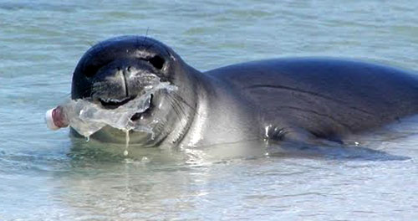
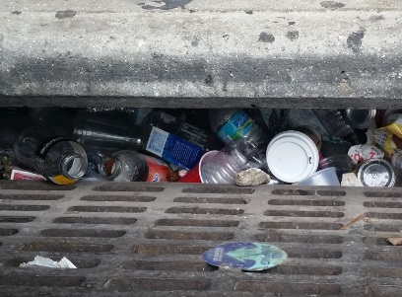
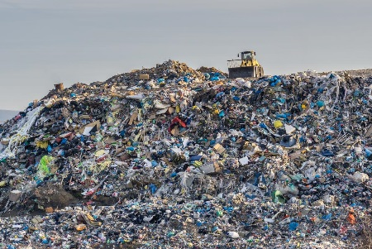
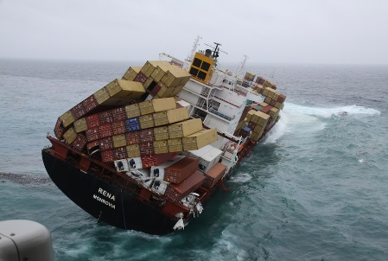
Life Cycle of a single use plastic bottle
Where can plastic enter the environment?
Nurdles spill
Sea becomes rough
© CC0PublicDomain
© Hanno Langenhoven
© AFP/Getty
Cause danger to marine life
Rain or wind
Littering
Washed into the river
© PevenseyBayLife
© Tavish Campbell
© GoesFoundation
Travel to the ocean
Release greenhouse gases
© Roshan Nebhrajani
© AsaseAfrica
© ABCau
Contaminated recycling
Notes:
The next part of the activity uses the red arrows and cards. For shipping, disposal and recycling the way that plastic can enter and damage the environment need to be identified. Add these arrows and pictures to the life cycle you have already made. The next slide shows an example to go through with the class.

Slide 24
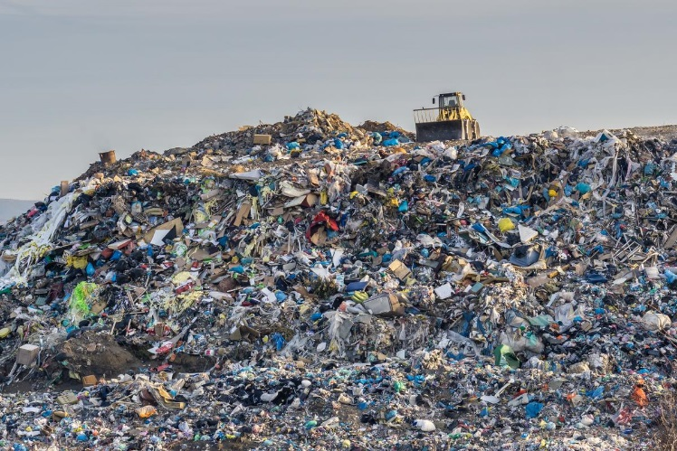
Release greenhouse gases
Contaminated recycling
Recycling
Notes:
Use this as an example before getting the class to do the others. Questions to ask: Do they know which recycling items should go in which bin at home? At school? The following slides shoe the answers.

Slide 25



Nurdles spill
Sea becomes rough
Shipping
Cause danger to marine life
Notes:
As with the life cycle ask the class what comes next before revealing the answers. Questions to ask: What might happen to animals that eat plastic? Has anyone ever seen a nurdle on the beach?

Slide 26



Rain or wind
Littering
Disposal
Washed into the river
Travel to the ocean
Notes:
As with the life cycle ask the class what comes next before revealing the answers. Questions to ask: Why do people litter? Have they ever littered, it could be an accident or on purpose? What might happen to the seal?

Slide 27

Thank you for helping to make plastic pollution a thing of the past!
Notes:
Thank all the children for listening and doing so well. Ask if there are any more questions.
Then get the children to come up to the front to hand in their pledge.

