Slide 1
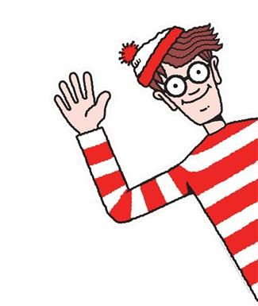
Where’s Wally
The Fantastic Journey
Wally wants you to find him...and the answers to his questions! What can you find amongst the pages…?

Slide 2
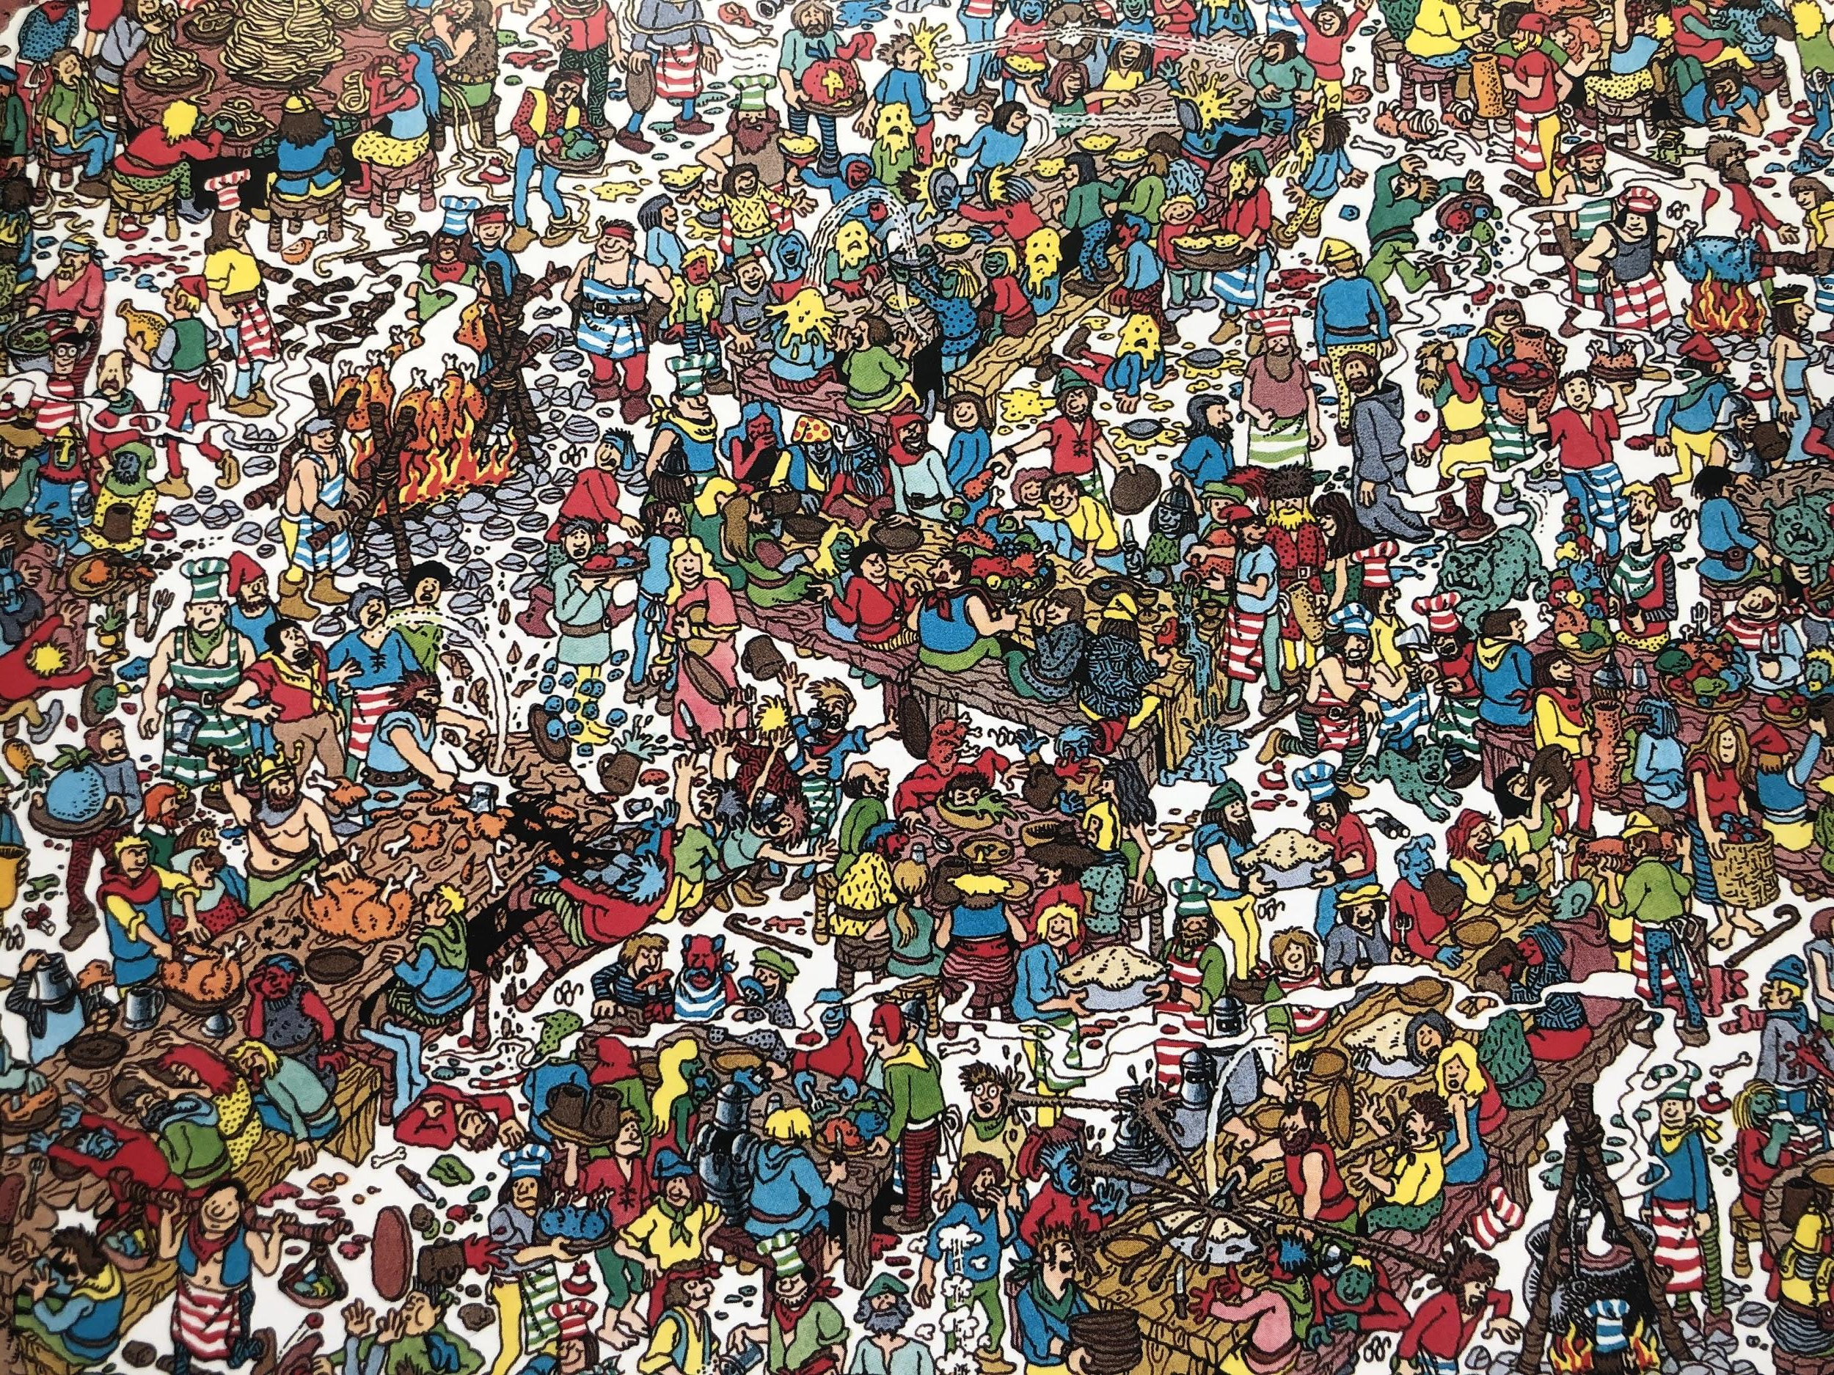
The Gobbling Gluttons

Slide 3
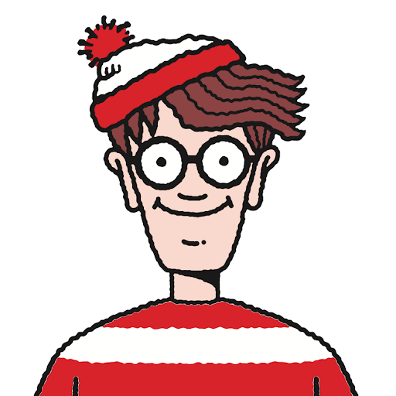
The Gobbling Gluttons
What animal might be cooking above the fire? How do you know?
Looking at the era this is set. Do you think they’d have spaghetti? Why?
Which table is having the most fun? How can you tell?
One table has a fish pool on it. Can you find it?
How many blue creatures can you find?
FIND WALLY

Slide 4
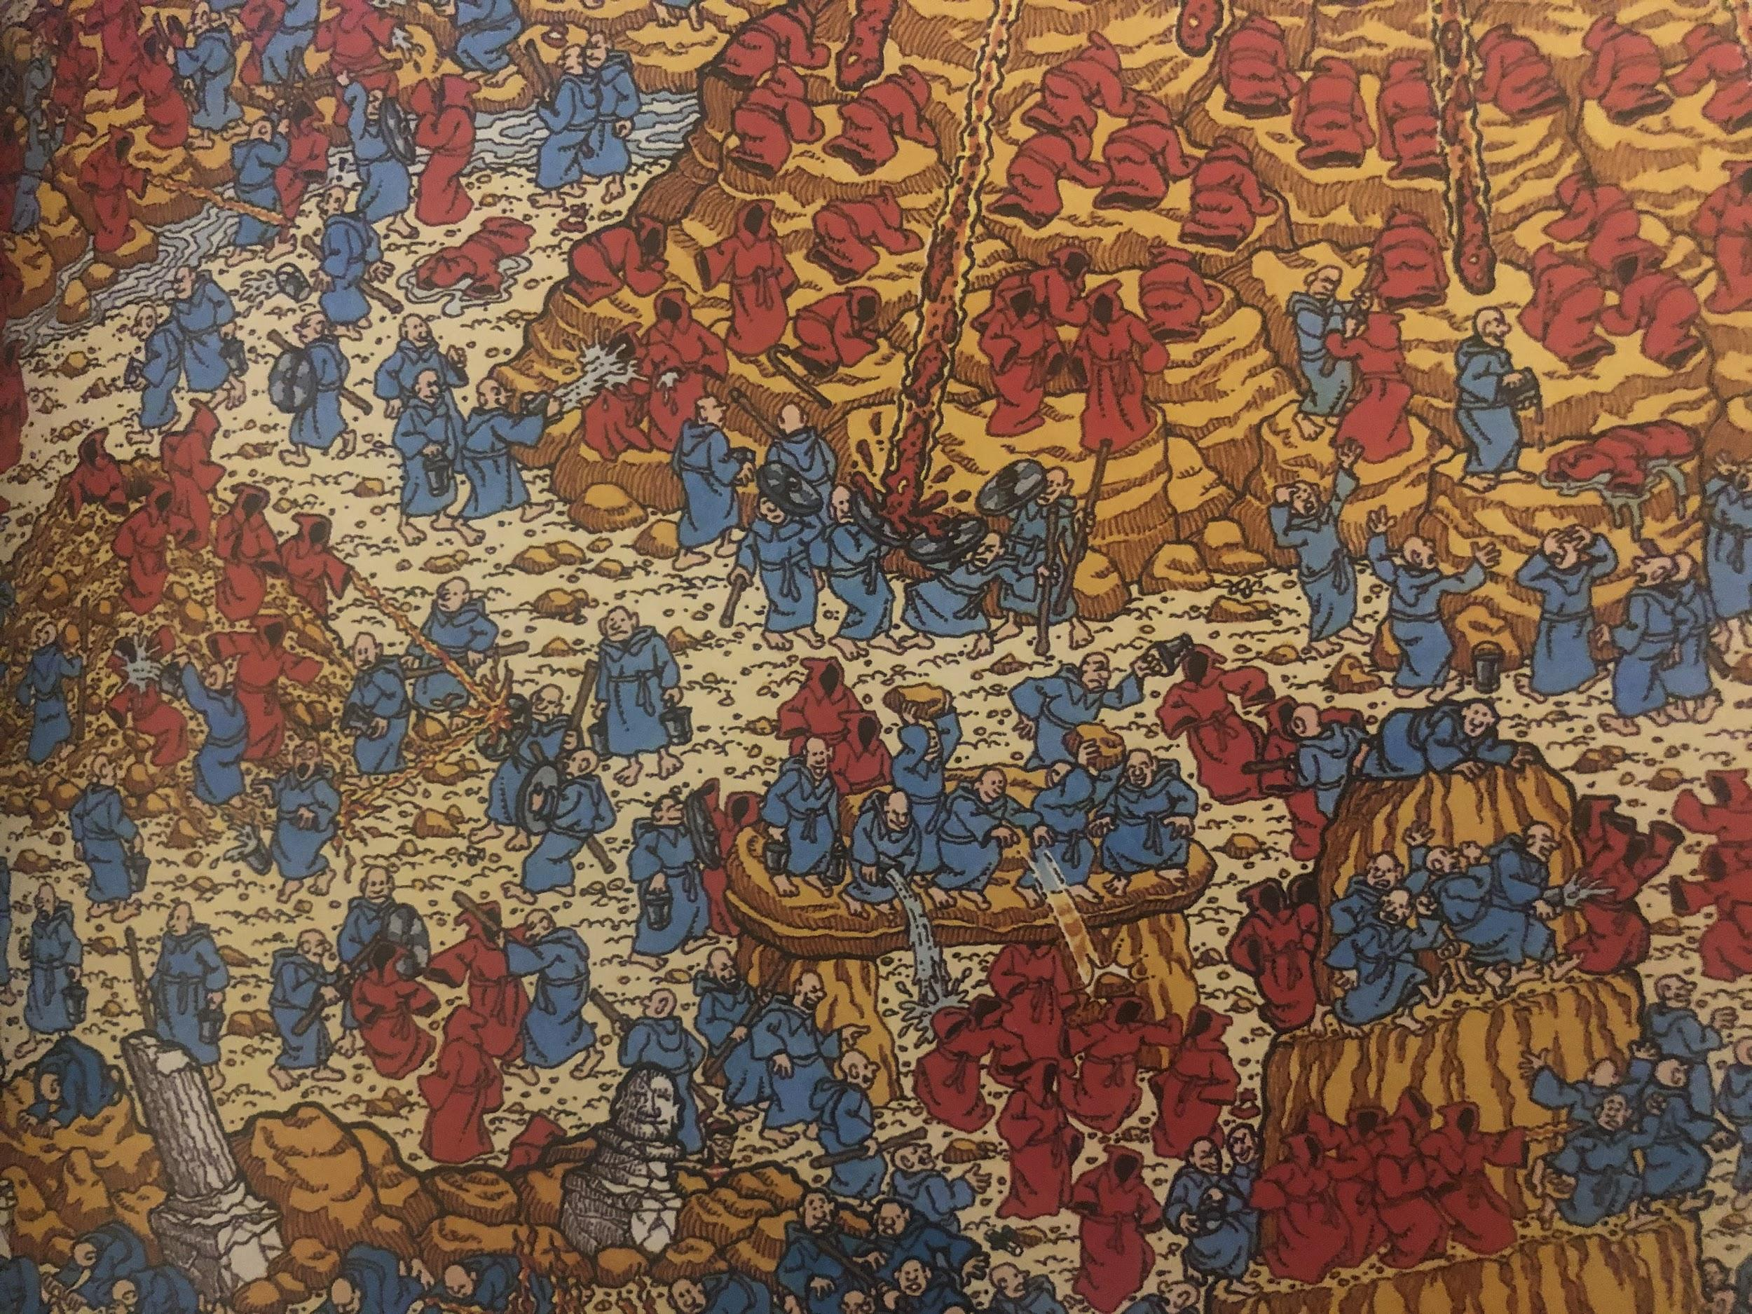
The Battling Monks

Slide 5
The Battling Monks
Without counting (!) are there more blue or red monks?
What destroy the red monks?
Find 3 monks holding sticks.
Why are the volcanoes important in this picture?
What are the monks fighting over?
FIND WALLY

Slide 6
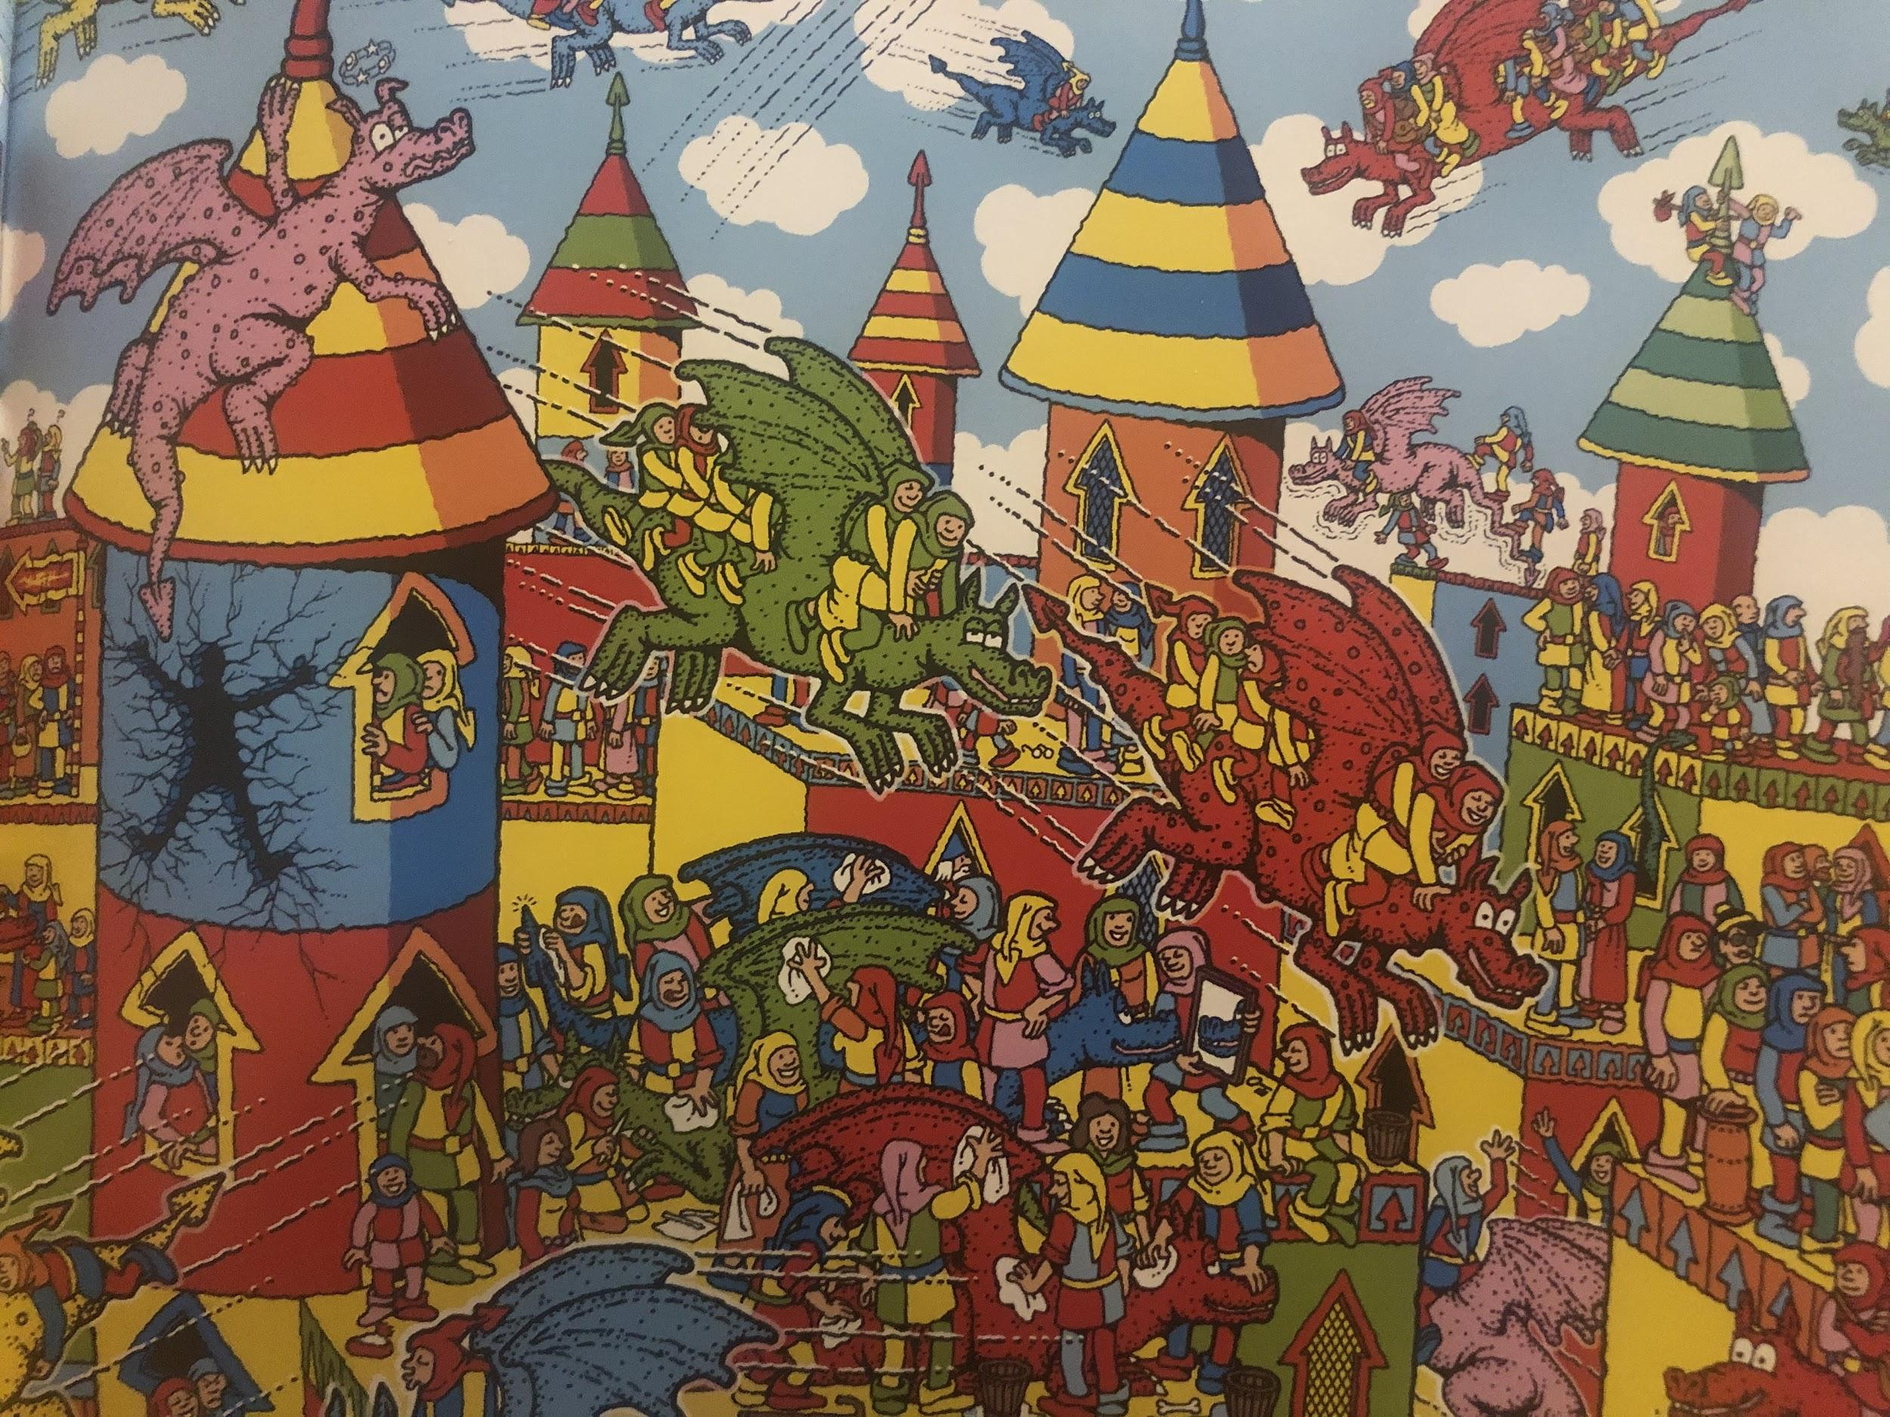
The Dragon Flyers

Slide 7
The Dragon Flyers
What shape are the windows?
What unusual thing can you see flying with the dragons?
Why is there a human-shaped hole in the tower? What’s happened?
Which dragon is the least dangerous? Why?
What modern day things can you see in the picture?
FIND WALLY

Slide 8
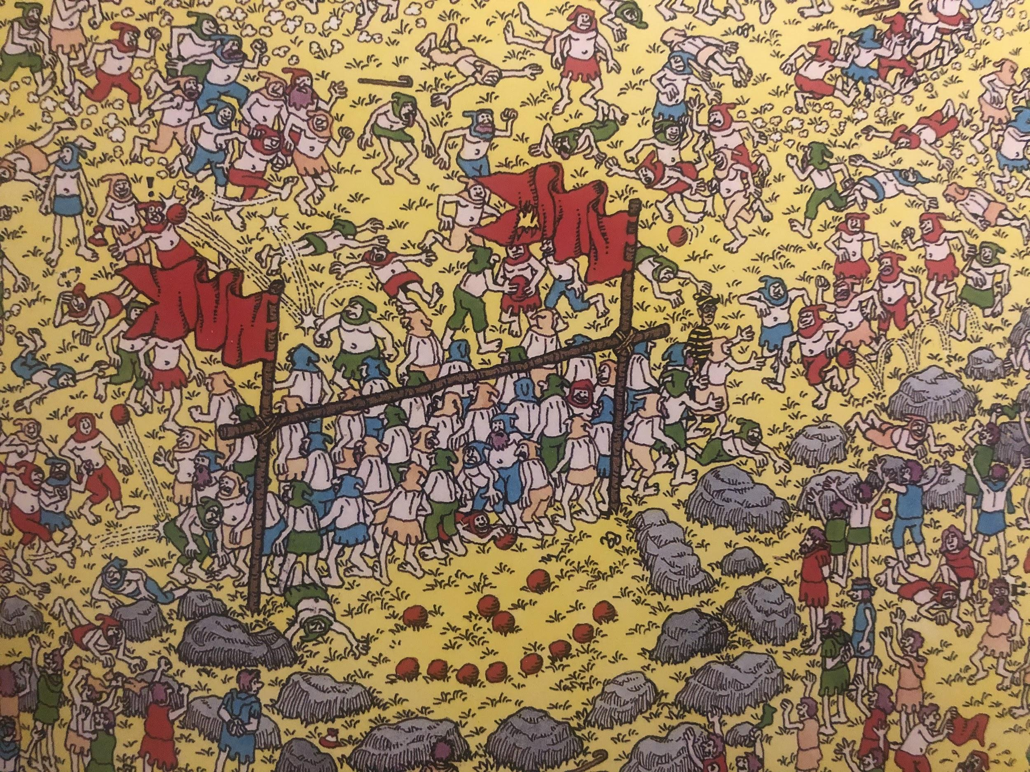
The Great Ball-Game Players

Slide 9
The Great Ball-Game Players
How does Wally know 4 teams are playing?
What is the aim of the game?
Which team is winning? Explain your answer.
Find the players who are singing.
Where are the broken posts?
FIND WALLY

Slide 10
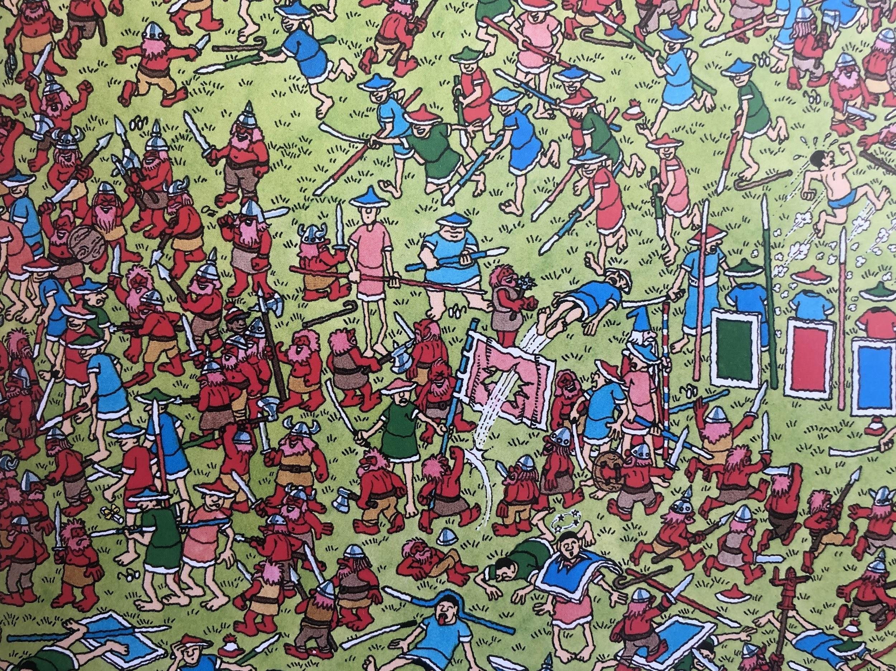
The Ferocious Red Dwarves

Slide 11
The Ferocious Red Dwarves
What havoc can you see being caused in the picture?
Find the soldier who went through a shield!
Which is the most ferocious warrior? How do you know?
Which side is winning? Because...
How are the characters feeling?
FIND WALLY

Slide 12
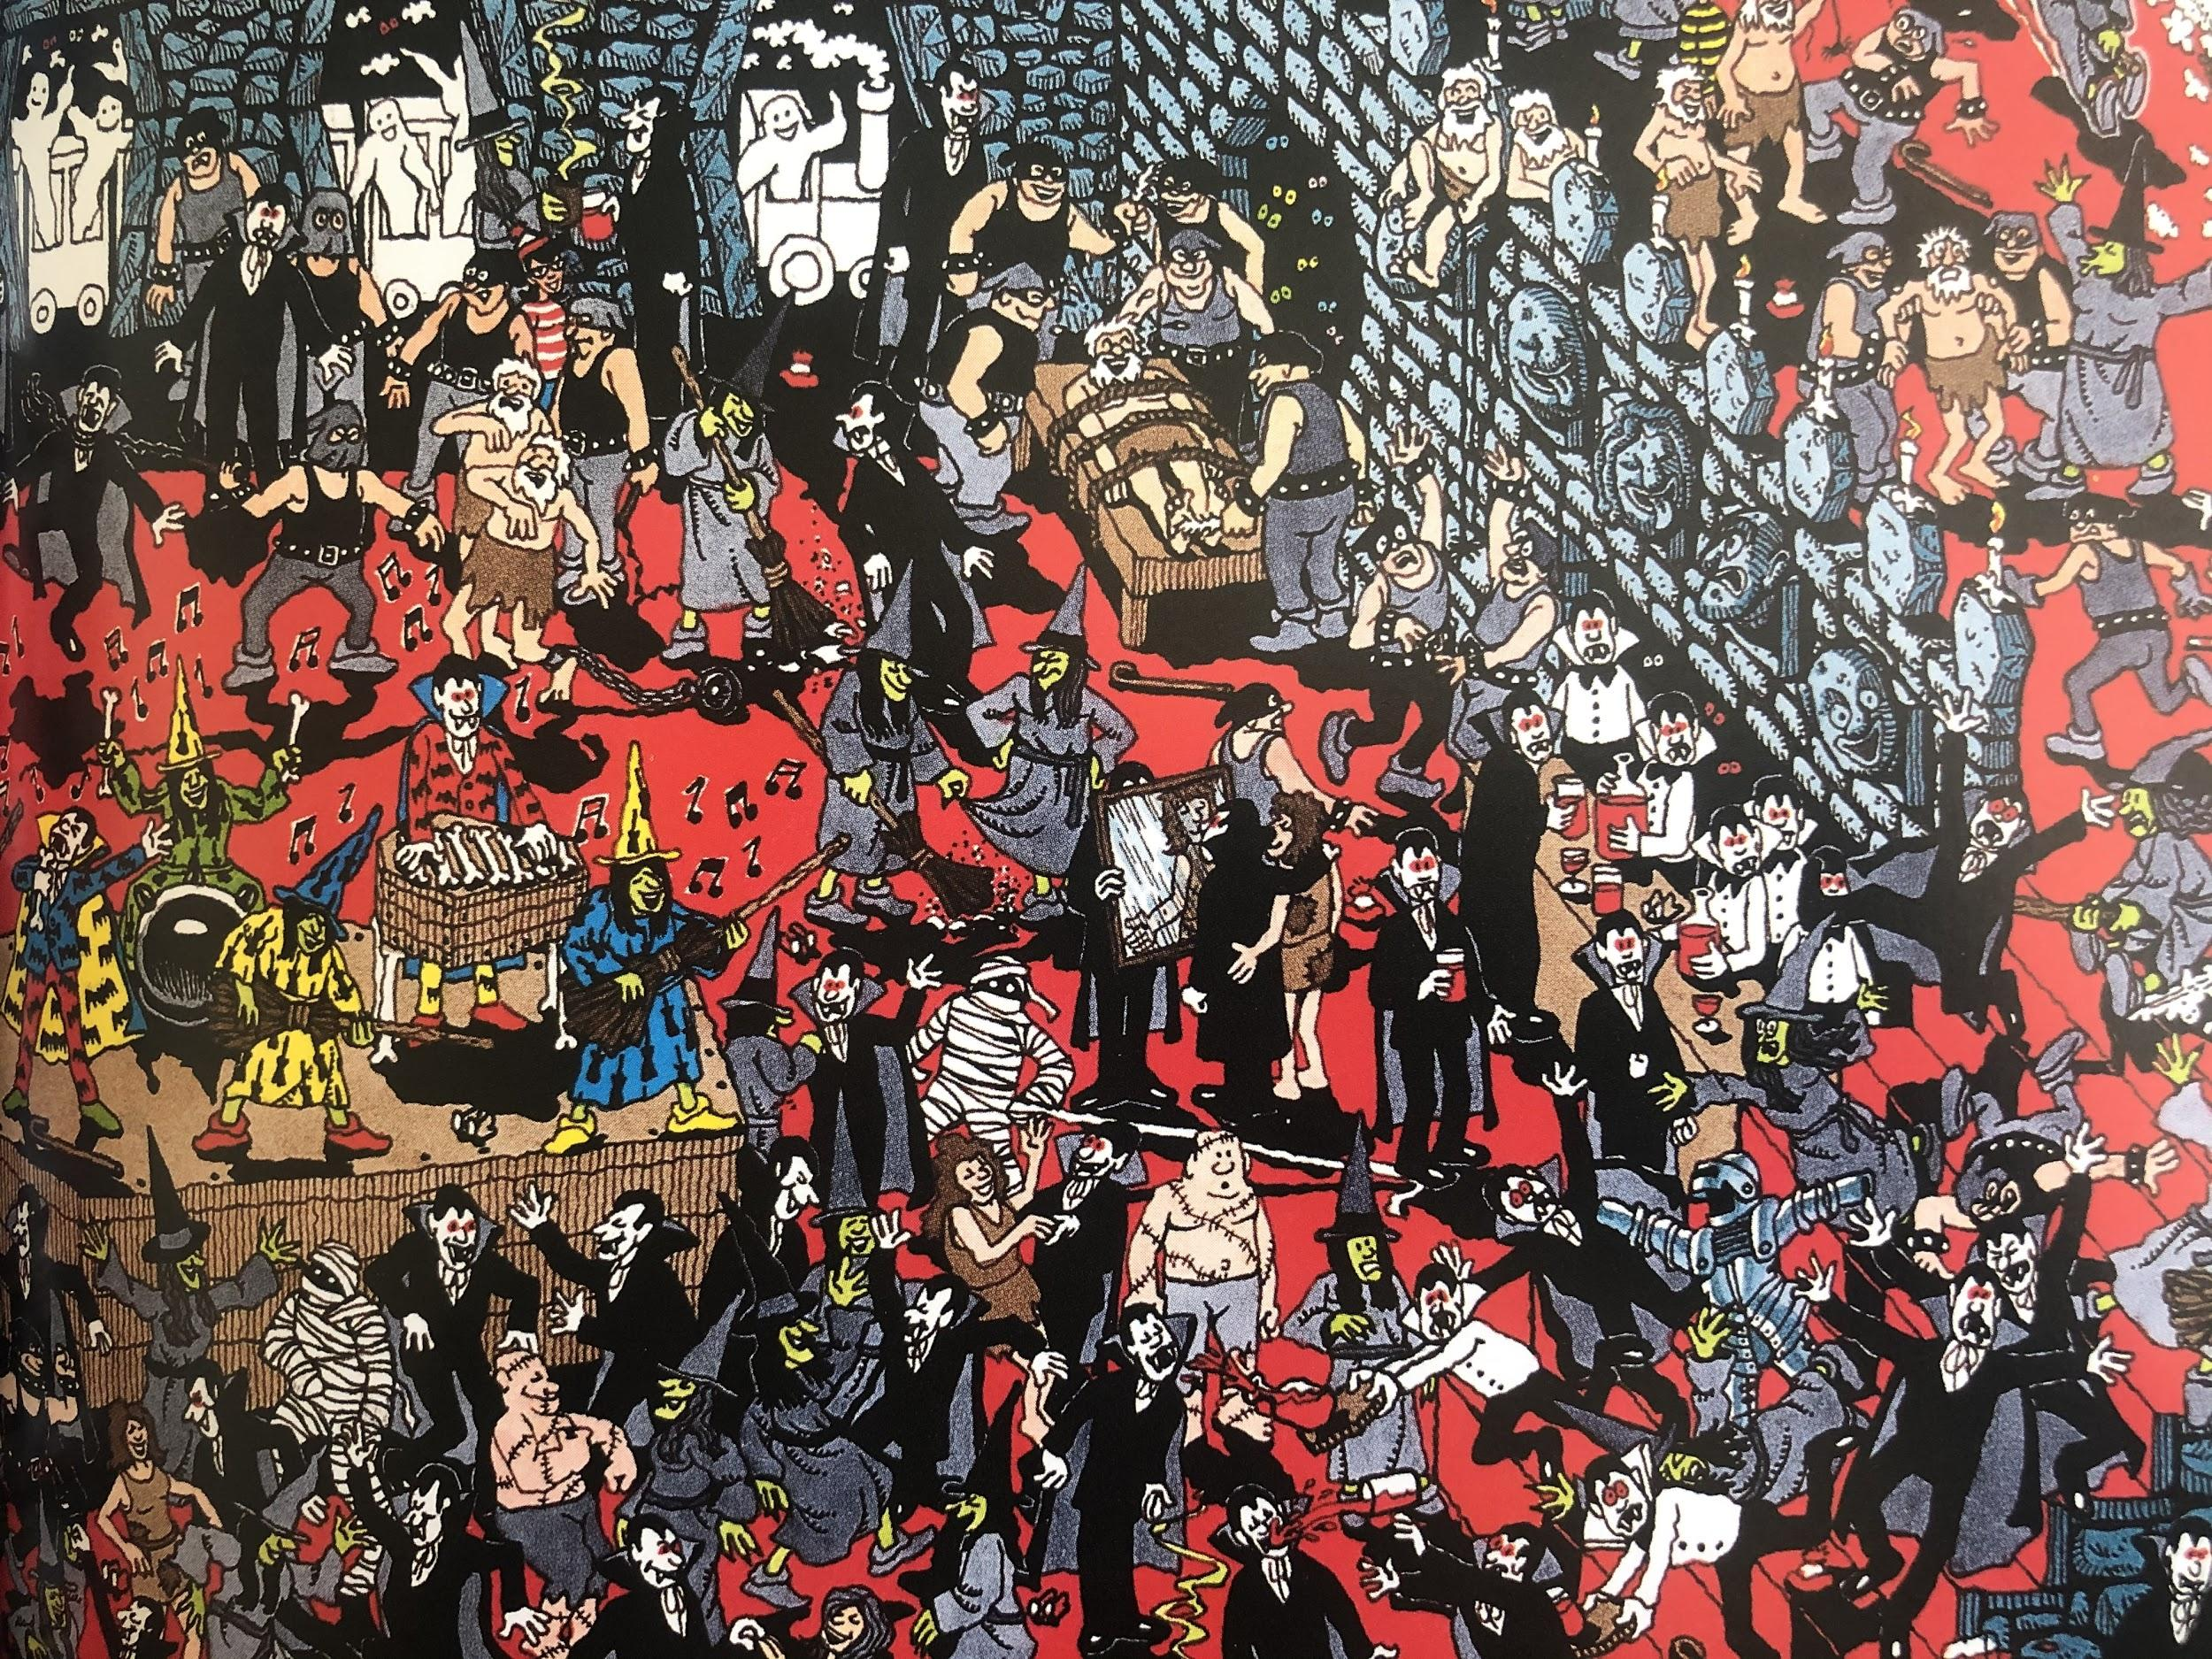
The Nasty Nasties

Slide 13
The Nasty Nasties
What different creatures can you see in this scene?
What is in the vampires cup?
What is significant about the shape of the skittles, the stage or the benches?
Why might the dogs be dangerous in this scene?
Find the witch who has lost her broom!
FIND WALLY

Slide 14
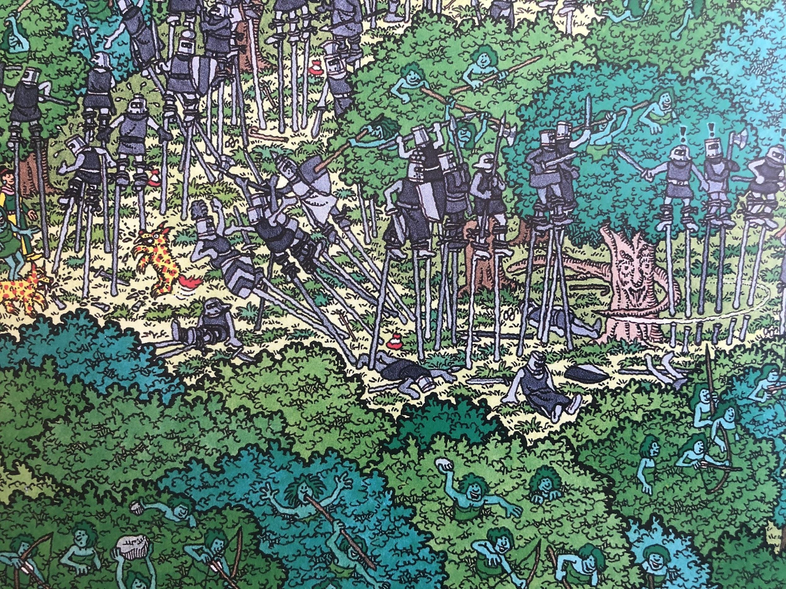
The Fighting Foresters

Slide 15
The Fighting Foresters
Where have the brown creatures come from?
Why are the foresters having to fight?
Why are the soldiers grey?
How do the trees feel about the fight?
Show me a unicorn.
FIND WALLY

Slide 16
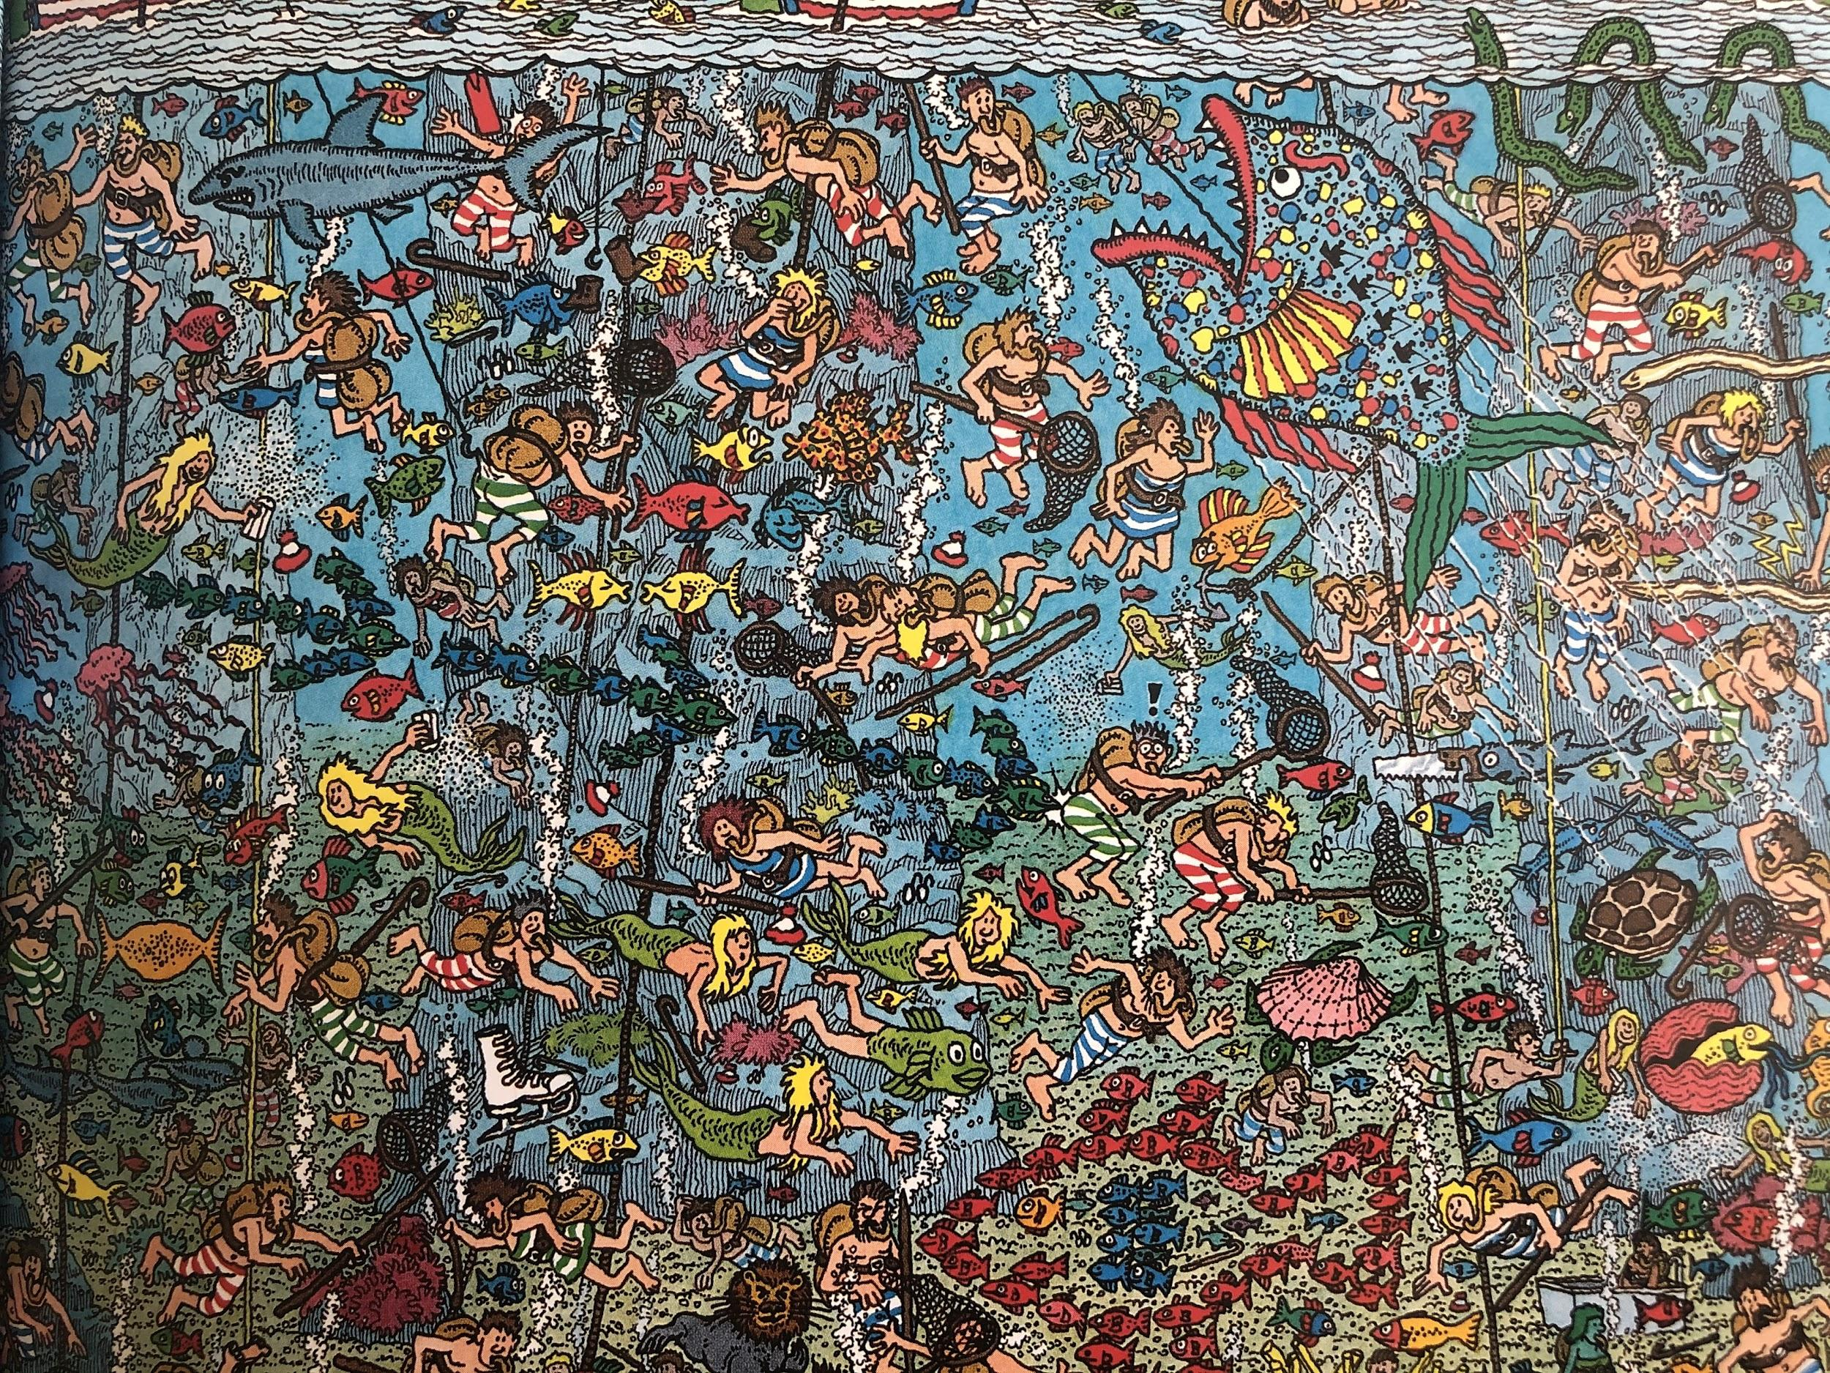
The Deep Sea Divers

Slide 17
The Deep Sea Divers
Find a fish made from fish!
Why does one creature have a lions head? (Bottom right!)
Why are there so many people fishing?
Find me some puns!
How does it feel to see the sea so full?
FIND WALLY

Slide 18
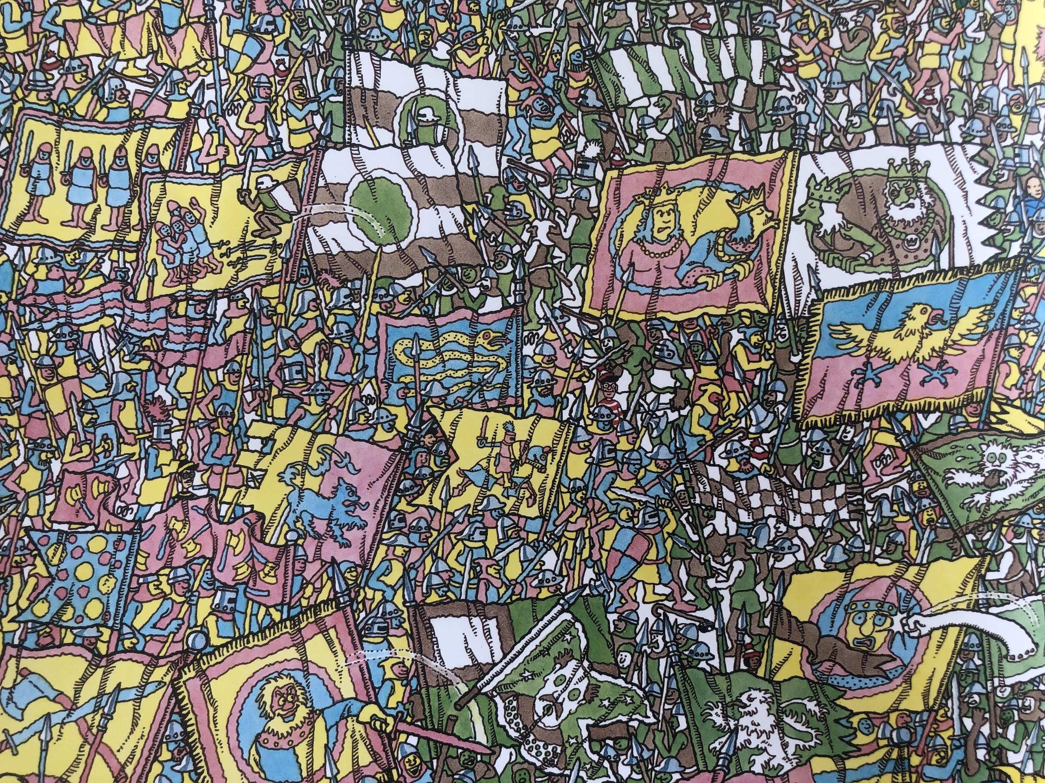
The Knights of the Magic Flag

Slide 19
The Knights of the Magic Flag
Find a cross king.
What different animals are featured on the flags?
Which flag is the most interesting? Why?
How do you know they’re fighting?
What’s funny about the flags interacting with each other?
FIND WALLY

Slide 20
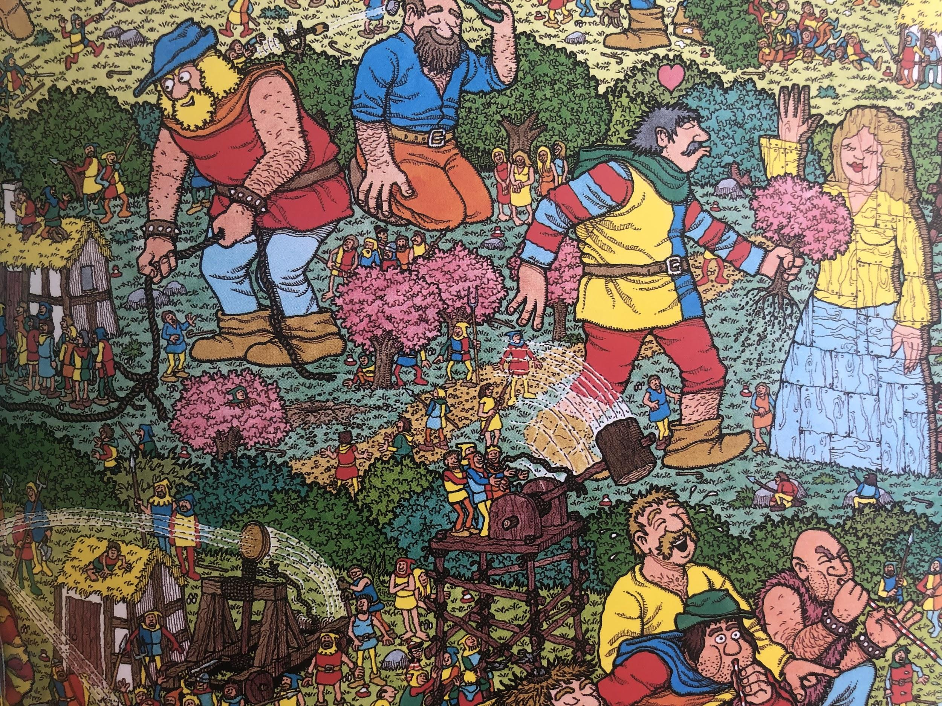
The Unfriendly Giants

Slide 21
The Unfriendly Giants
Which giant is going to be very disappointed?
What are the giants playing chess with?
Can the humans beat the giants?
Which giant in the kindest? Explain your answer.
Would you want to live in this village?
FIND WALLY

Slide 22
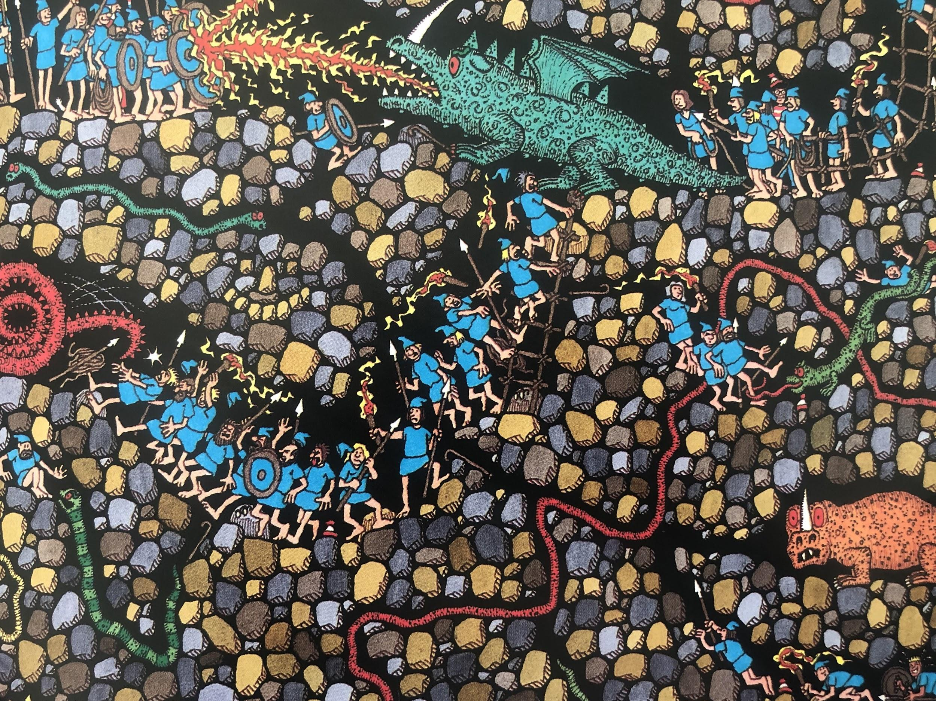
The Underground Hunters

Slide 23
The Underground Hunters
What is the purpose of the hunting?
Malevolent means what?
Which is the scariest monster? Why?
Find the biggest monster.
Should they be hunting?
FIND WALLY

Slide 24
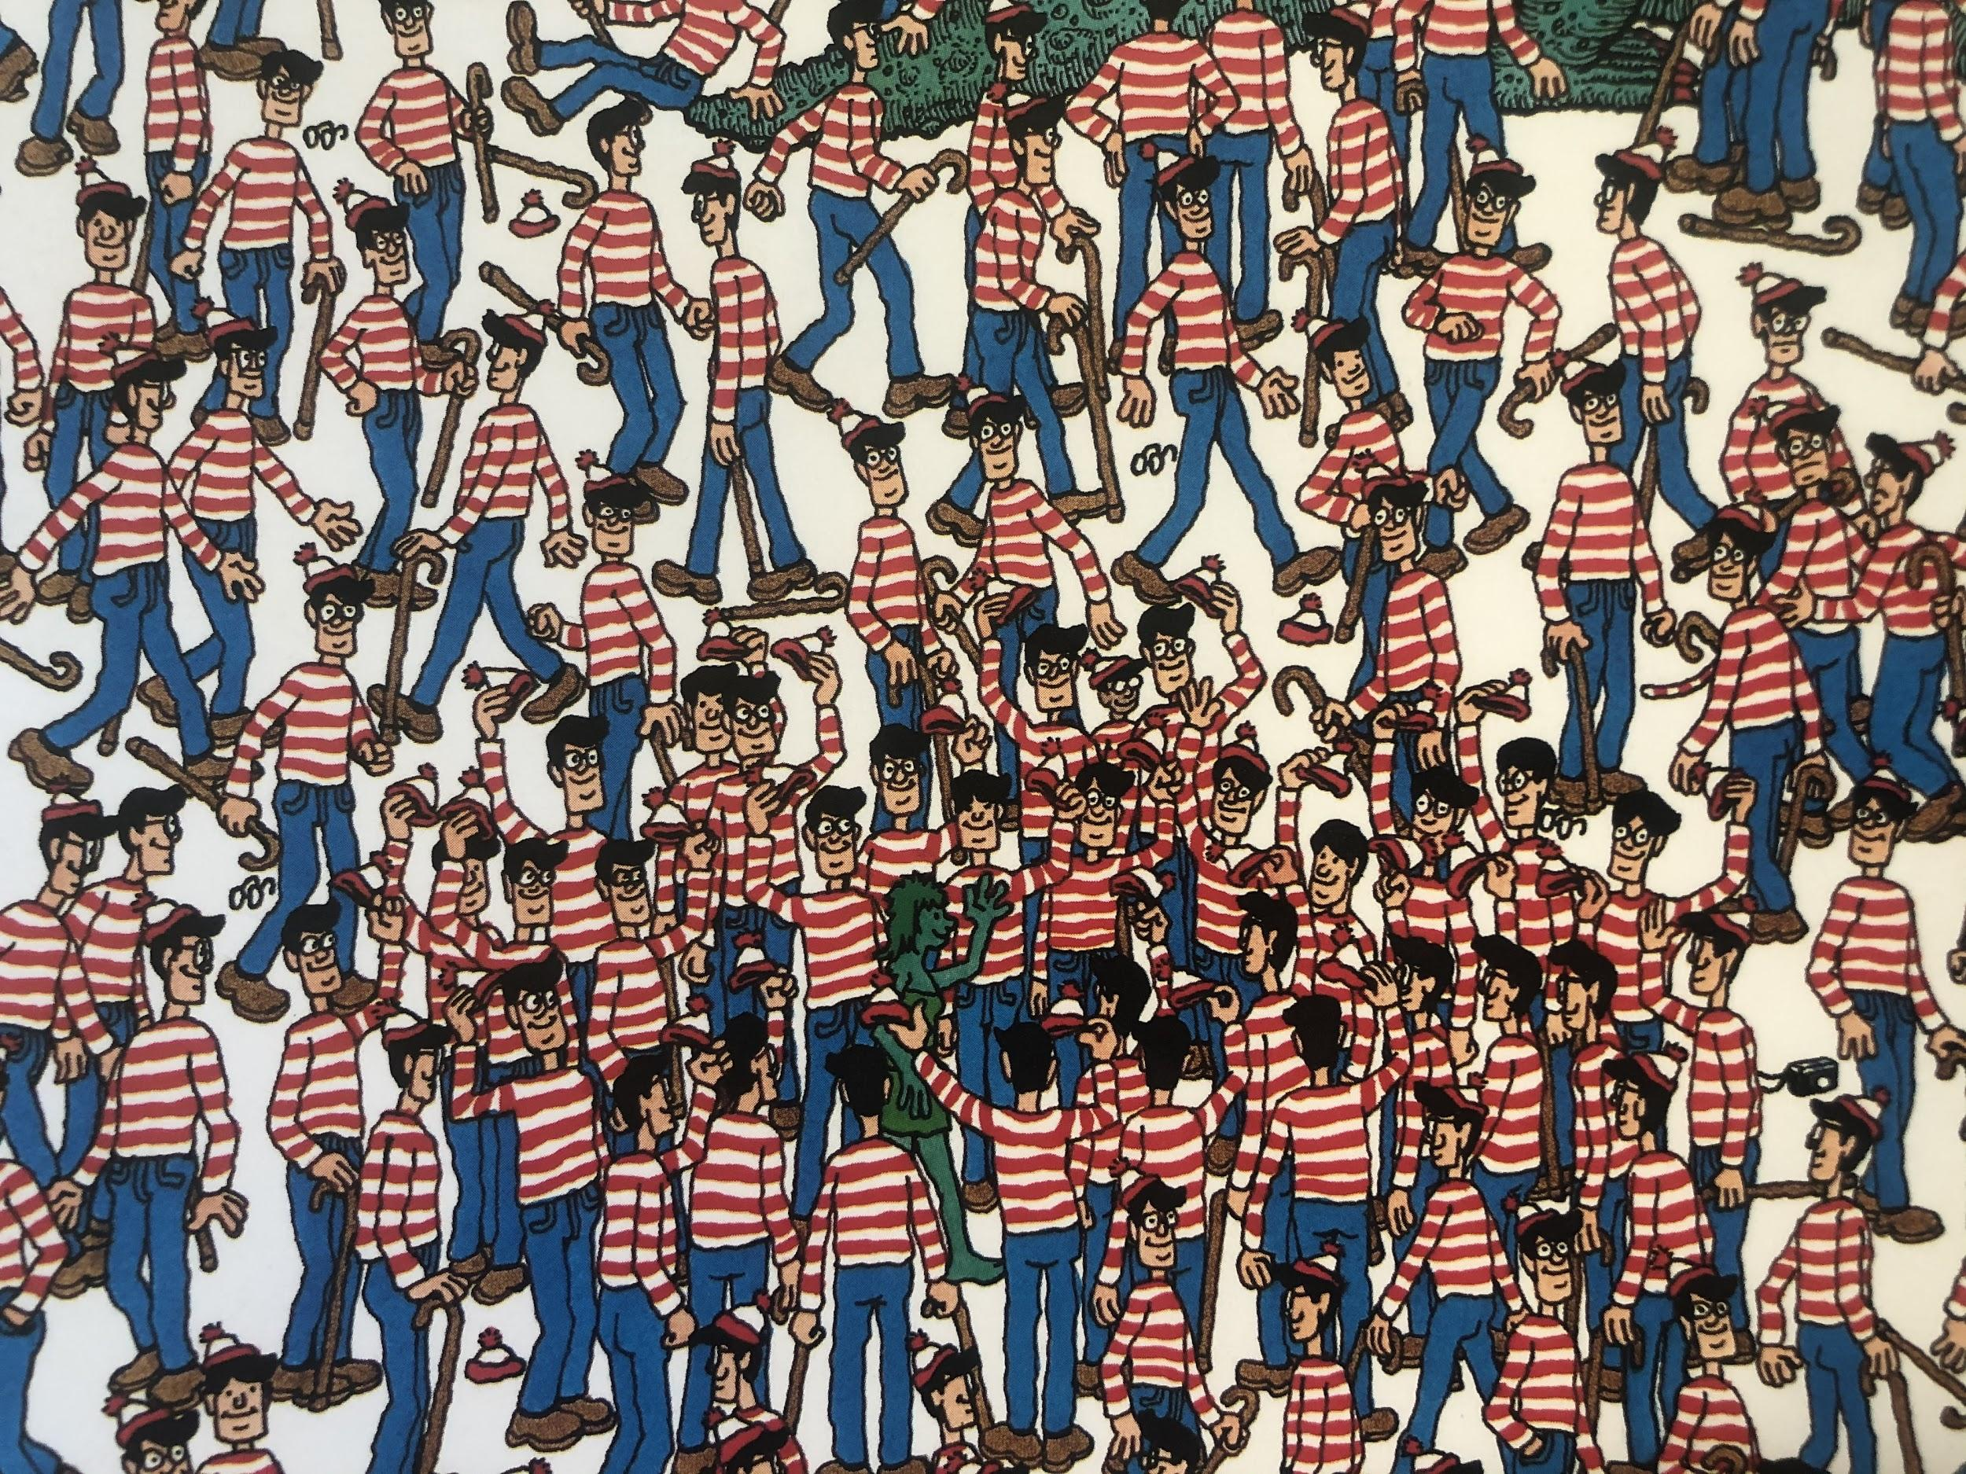
The Land of Wallies

Slide 25
The Land of Wallies
Where do you recognise each of the characters from?
How do we know which Wally is the ‘real’ one?
Why is this scene last in the book?
Find 5 Wallies that have lost something different.
Who us the giant hiding from? Can they find him?
FIND WALLY

