Slide 1
Orchards Ski Italy 2020 21st – 28th March
INFORMATION EVENING

Slide 3
Packing List…try to use a soft bag if possible (1 per person)

Slide 4
Christmas gift kit or borrow kit from friends
Aldi ski sale
Sports direct
Muddy puddles
What you don’t need!
SKIs, ski boots, poles, helmet are all included

Slide 5
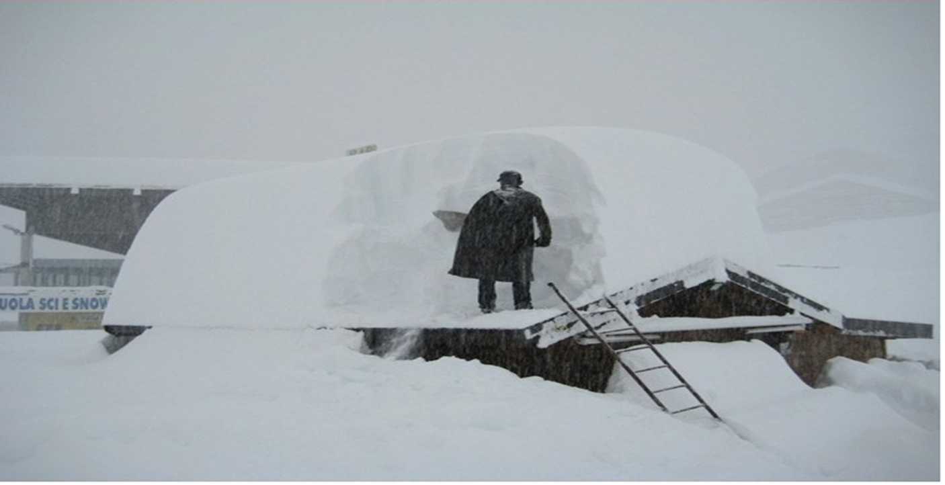
Prepare for the worst conditions and you will be ready for anything!
2019 inspection visit in march people were skiing in t shirts
March 2018 below!

Slide 6
Extras to start thinking about
Hoodies
Everyone will receive a free ski Orchards hoodie to follow
(sizes to be confirmed)
50 euros spend (sweets, refreshments, souvenirs) Bank of Dr jones will store
EHIC card (get one ordered)
We also have complete winter sports travel insurance
Passport (all passengers will need an individual passport)
Entertainment for the journey (I pads, audio books, kindles, drawing, diary, sleep!) Make sure any downloads/games are suitable for all children
u or Pg rating only (devices will be taken with anything above this)

Slide 7
Key times and dates for Travel
Saturday 21st March 2020 arrive at school from 16.45
Coach arrives 17.00 Leave school 17.30
Departure for Folkestone (Tunnel Crossing) Departure approx. 21.20 hopefully before
Arrival in resort Approx. 15.00 (Bags to rooms and visit shop for ski fit)
Evening meal on Sunday 18.30
Friday 27th March 2020 leave the hotel after hot Dinner 19.45
Saturday 28th March departure Calais (Tunnel Crossing) 13.20
Return to school 15.30
Food for the journey
Bring a packed dinner for the journey out (snacks and sweets for the week)
We will provide breakfast and lunch on the way over (Sunday 22nd MArch)
On return pupils will be given a packed breakfast/lunch (Saturday 28th March)
We wont go hungry!

Slide 8
Worthing coaches/lucketts coaches
2 drivers with us for the trip duration
Limit of 4 hours driving then swap
Stopping at rest areas along the journey (always stay as a group)
Toilet on the coach
Dvd service on the coach
Hopefully usb charging points on the coach (portable power bank?)
Long journey think comfort!

Slide 9
Daily skiing routine (4 hours of professional lessons per day) 20 hours in total
7.30 breakfast
Lessons from 9.00-11.00 approx.
11.30 hot lunch
Lessons 13.00 – 15.00 approx.
6.30 pm evening meal
7.30 evening activities
Bedtime TBC!

Slide 10
Its ok and natural to worry a little bit about being away from home
Lovely staff going so talk to us and make new friends!
Mr Christie, Dr Jones, MR Chilvers, Mr Cave
Mrs Jones, Miss Martin, Mrs Holme, Miss Chilvers
Rooms to be sorted in January 2,3,4 to a room and you will be with friends!
5 ski groups with at least one member of staff skiing with your group at all times
10 pupils per ski group
Approx. ratio of 1 staff adult to 6 pupils on the trip
Loads of fun extra activities we will be doing
No mobile phones
Emergency contact details will be provided

Slide 11
Instagram (Please follow request) parents/carers only as pupils shouldn’t have Instagram at junior school age
@Sparkleski
Private account
commenting to be limited but please like!
Please let me know if you don’t want your child to appear in this forum

Slide 12
Evening activities
Board games
Mr Cave’s disco night
Snow tubing night in the neighbouring resort (Prato Nevoso)
Sledging and hot chocolate night
Pizza and film night (amazing pizza oven in the hotel)
Ongoing arts and craft activities with Mrs Holme
Daily evening sports activities outside the front of the hotel (football, cricket)
Play park area

Slide 13
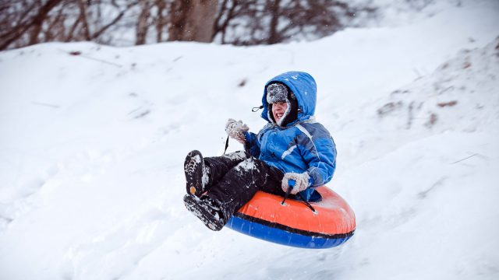

Slide 14
Any questions just ask
Feel free to ask any questions tonight
gchristie@orchardsjunior.school

